Slide 1
How I Started

Slide 2
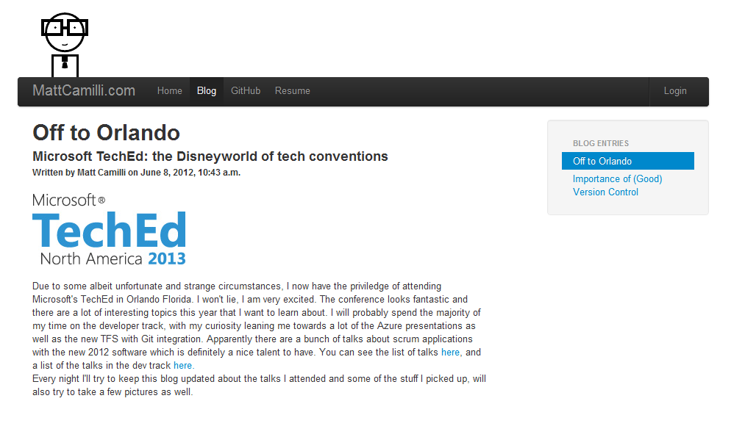
The first project

Slide 3
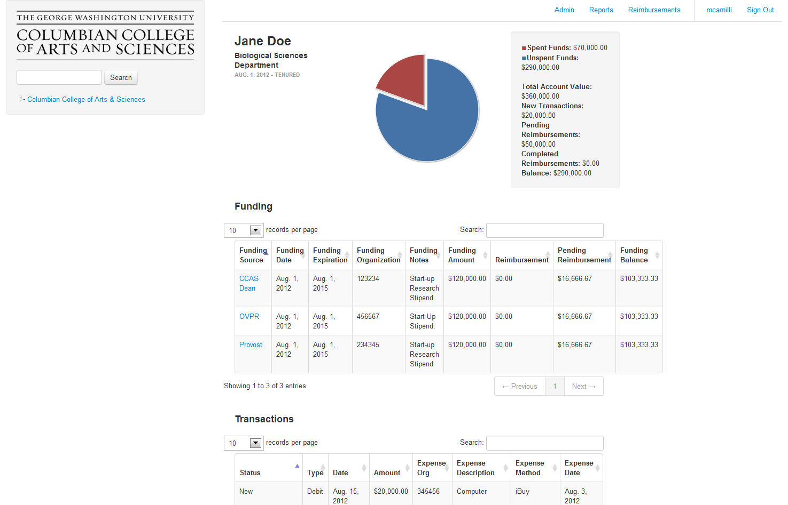
GW Prototype
How I Started

Slide 4
Where do you go from here?

Slide 5
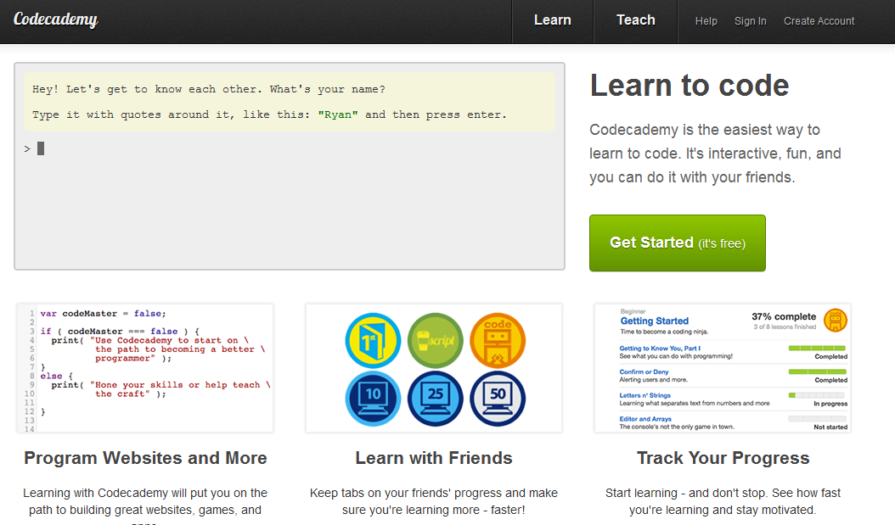
Code Academy

Slide 6
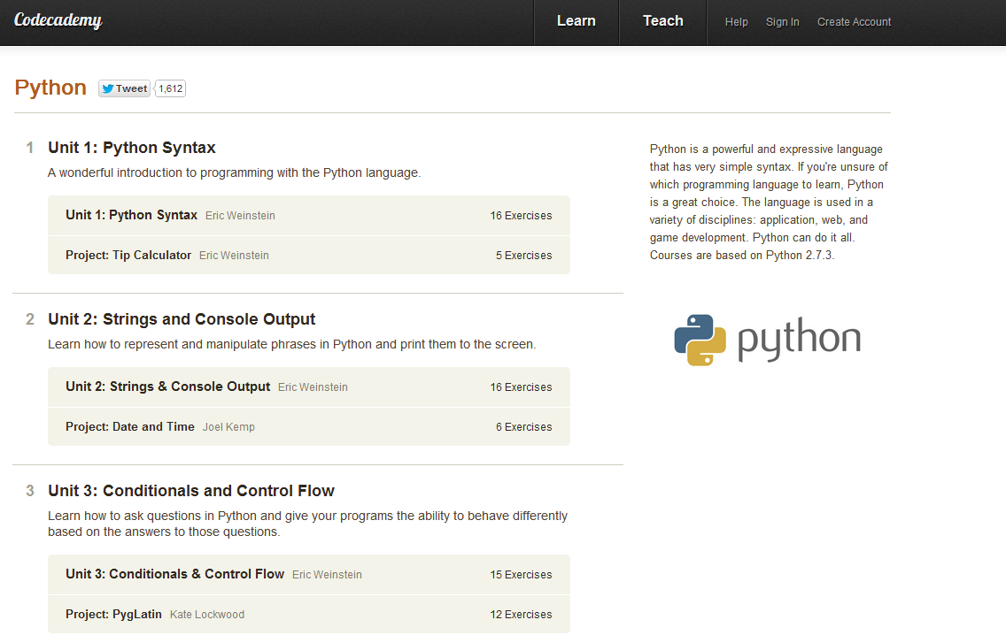
Python Lessons

Slide 7
Don’t want to download software?

Slide 8
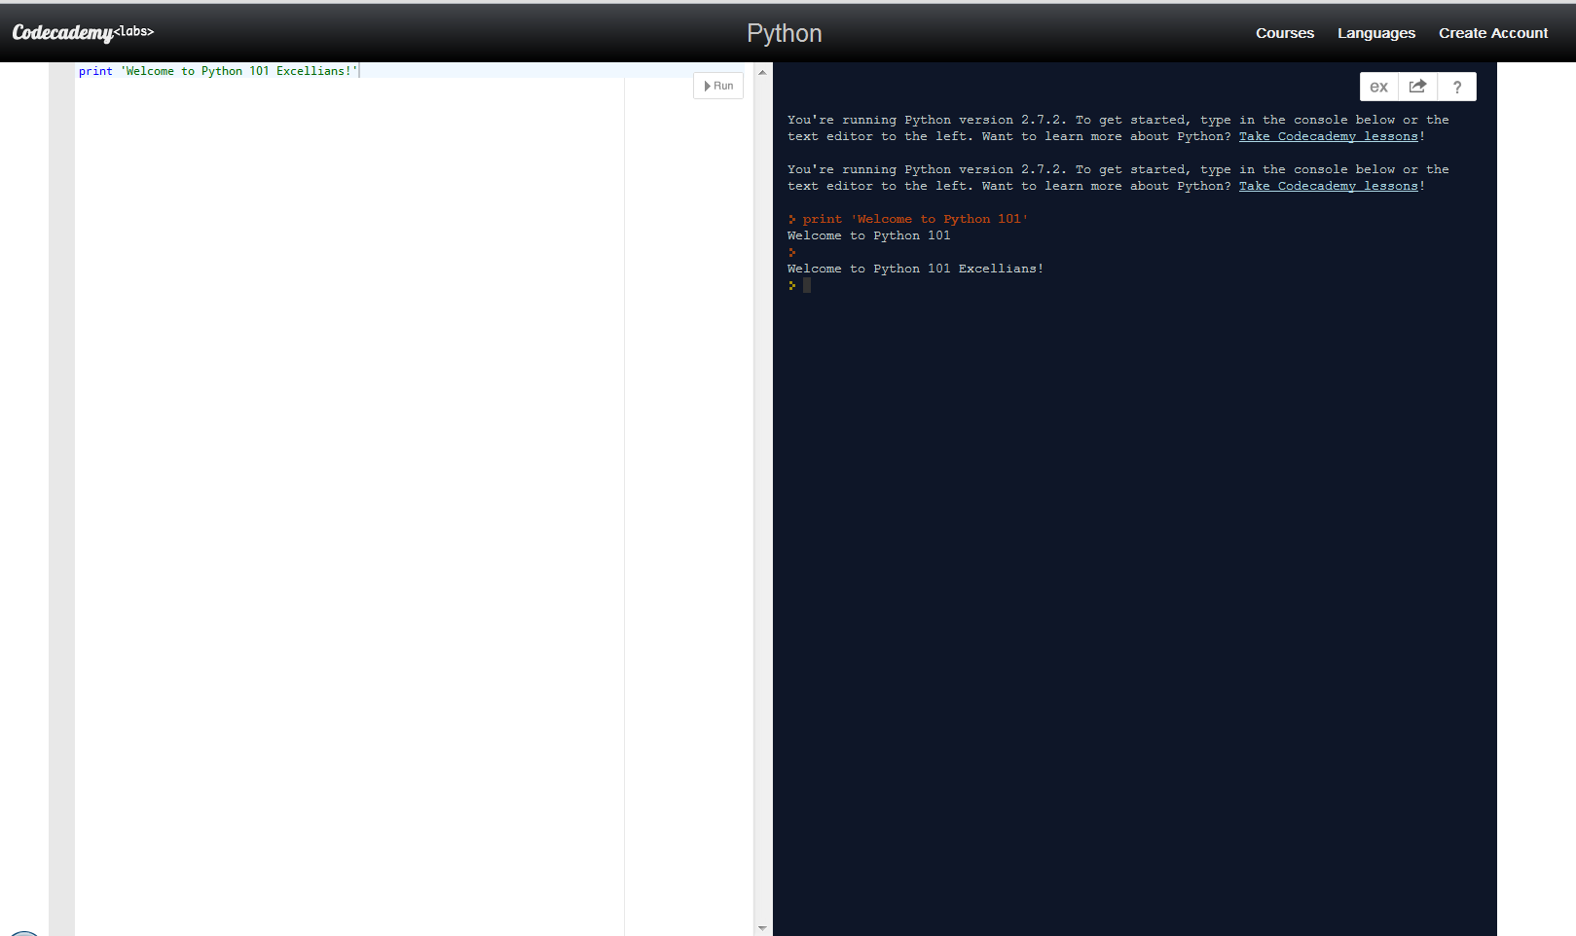
No Problem!

Slide 9
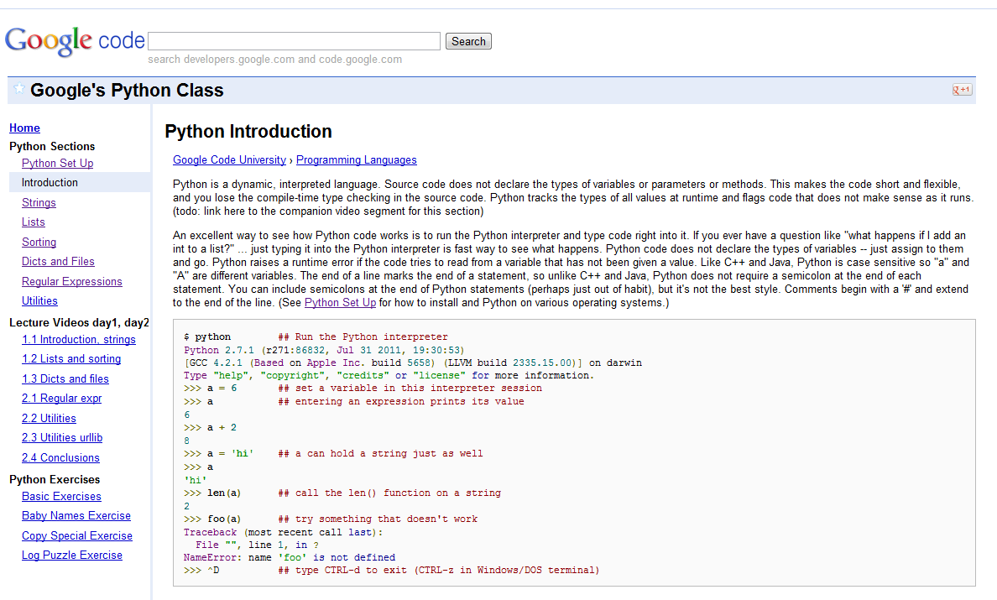
PyQuick by Google

Slide 10
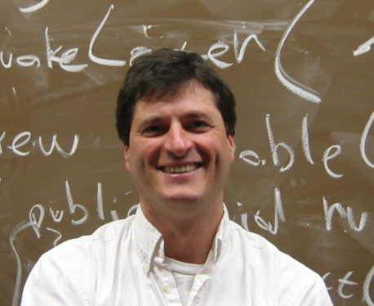
Nick Parlante

Slide 11
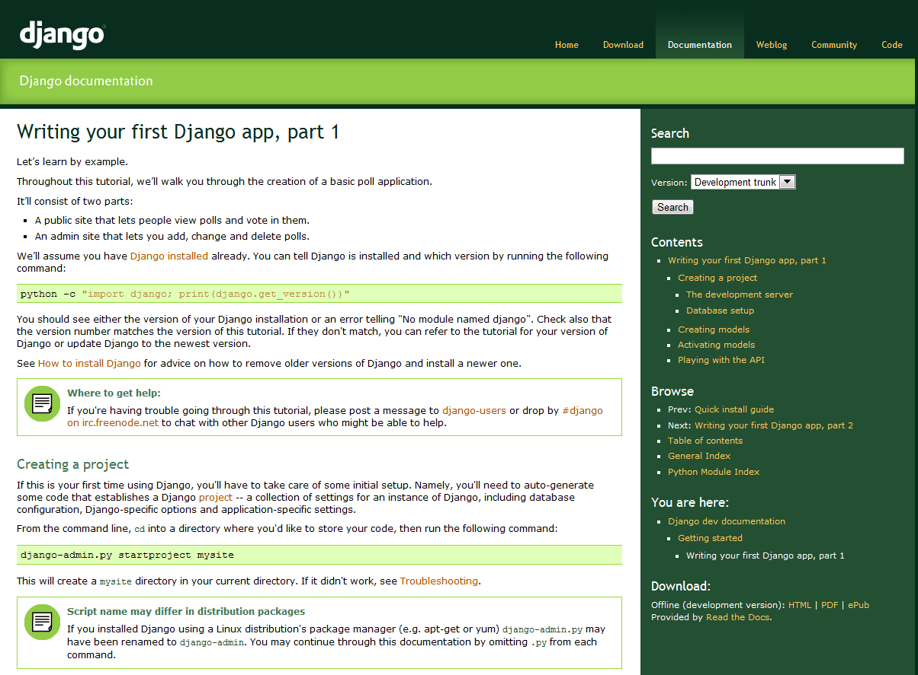
Learning Django

Slide 12
Questions?

