Slide 1
Meteorite Database
By: MaKayla Sokoloski

Slide 2
Agenda
What is a meteorite?
Database tables
Meteorite_landings
Meteorite_classifications
Regions
Database Design
Deleting Records
Views
Queries
References
Questions

Slide 3
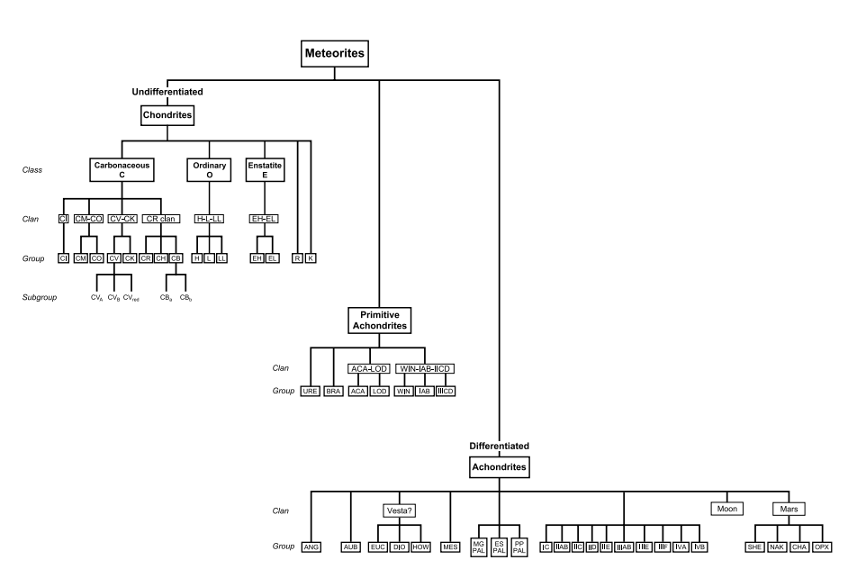
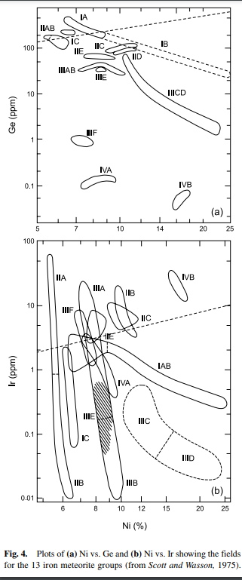
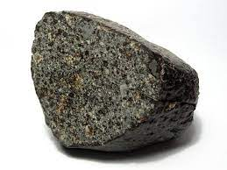
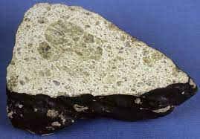
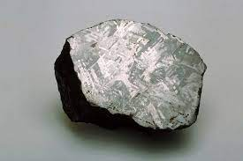
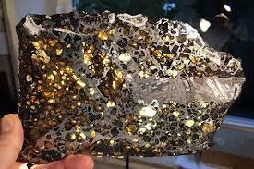
Meteorites
A meteorite is a solid piece of debris from an object, such as a comet, asteroid, or meteoroid, that originates in outer space and survives its passage through the atmosphere to reach the surface of a planet or moon.
Classifications
Chondrites
Melted minerals into chondrules/a rock
Oldest in Solar System
82% of Meteorites
Achondrites
Originated from Moon or Mars
Stony without chondrules
7.8% of Meteorites
Irons
Resemble the outer core of Earth
4.8% of Meteorites
Crystalline iron-nickel alloy
Stony Irons
Iron-nickel alloys and non-metallic matter
Theorized to be like Earth core/mantle
1.2% of Meteorites

Slide 4
Database Tables
Meteorite_landings
Meteorite_id
Name
Nametype
Mass_g
Fall
Year
Geolocation
Region_id
Classification_id
Meteorite_classifications
Classification_id
Recclass
Category
Regions
Region_id
Region_name
Min_latitude
Max_latitude
Min_longitude
Max_longitude

Slide 5

Meteorite_landings
Imported NASA data as a .csv
Correct for NULL values
PRIMARY KEY – meteorite_id
Included in the .csv
Clean/Manipulate data
To maintain referential integrity
Used for development of related tables

Slide 6
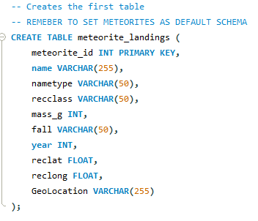
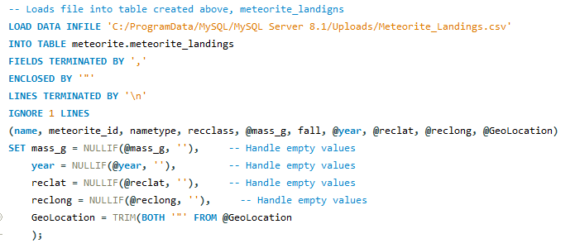
SQL for Meteorite_landings

Slide 7

Meteorite_classification
Created table meteorite_classifications
Ran SQL Statement to get all recclass values from meteorite_landings
Updated .csv to include category values
Imported .csv into meteorite_classifications
Created a foreign key (classification_id) and inserted it back into meteorite_landings according to recclass value
Meteorite_classification.classification_id = meteorite_landings.classification_id
Removed recclass from meteorite_landings

Slide 8
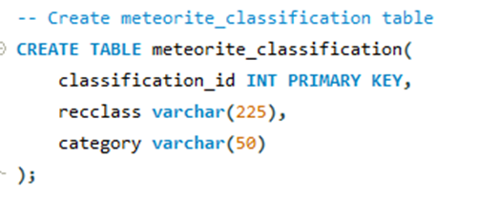
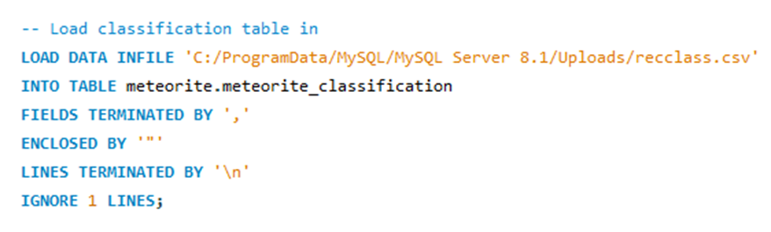
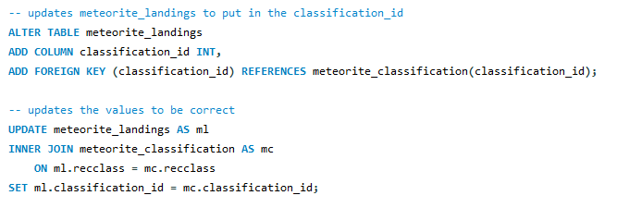
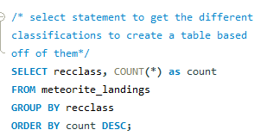

SQL for meteorite_classification

Slide 9
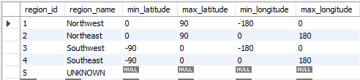
Regions
Created table Regions
Inserted values for Regions on globe
Northeast
Northwest
Southeast
Southwest
Inserted Min/Max Longitude/latitude for each region
Created a foreign key (region_id) and inserted it back into meteorite_landings according to lat/long coordinates
Regions.region_id = meteorite_landings.region_id
Removed reclat and reclong from meteorite_landings

Slide 10
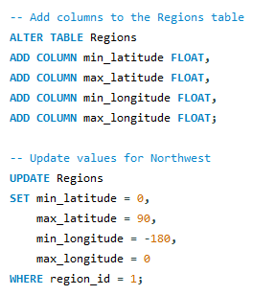
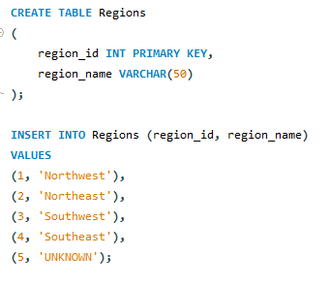
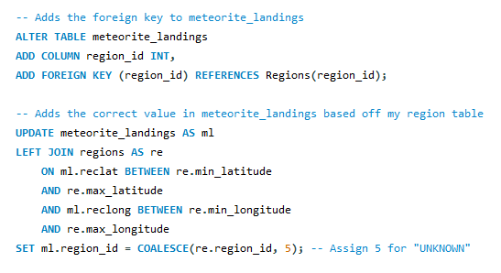

SQL for Regions

Slide 11
Deleting Records
Scenario Involving Meteorite_landings and Meteorite_classifications:
Foreign Key Relationship:
Meteorite_landings.classification_id = Meteorite_classifications.meteorite_classification_id
Records in meteorite_classifications has relationships to records in the meteorite_landings table
The database would not allow for deletion to maintain referential integrity
Scenario Involving Meteorite_landings and Regions:
Foreign Key Relationship:
Meteorite_landings.region_id = Regions.region_id
There are associated records in the Meteorite_landings table that reference the record being deleted in the Regions table.
The database prevents the deletion to maintain referential integrity.

Slide 12
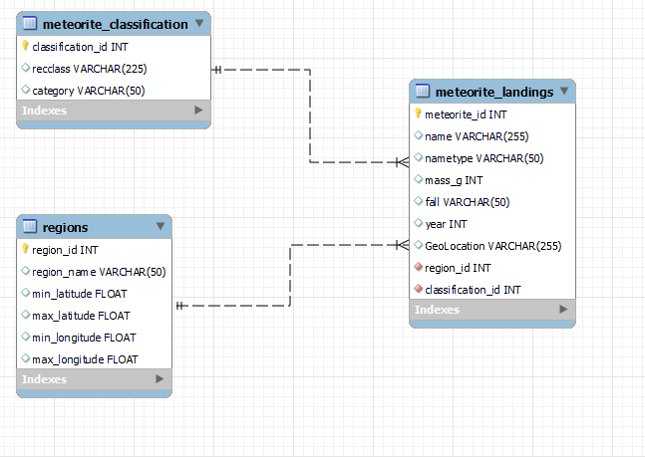
Design
Primary key – meteorite_id
Foreign Key – Classification_id
Foreign Key – Region_id

Slide 13
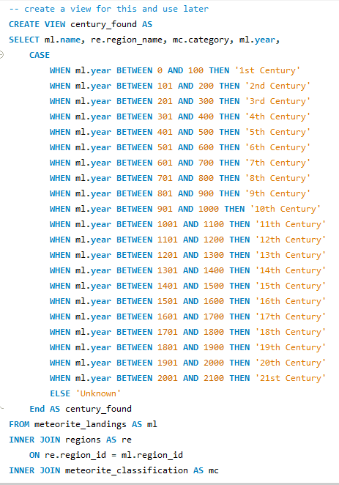
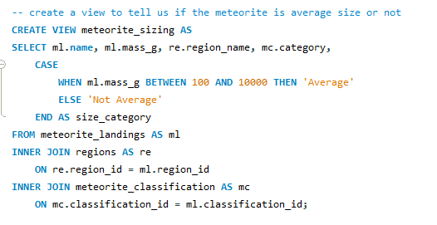
Views
To classifiy if a meteorite is average (100-10,000 grams)
What century the meteorite was found/fell

Slide 14
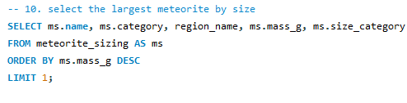

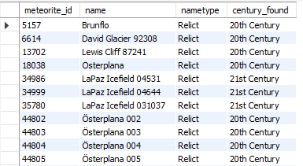
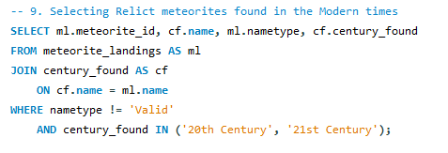

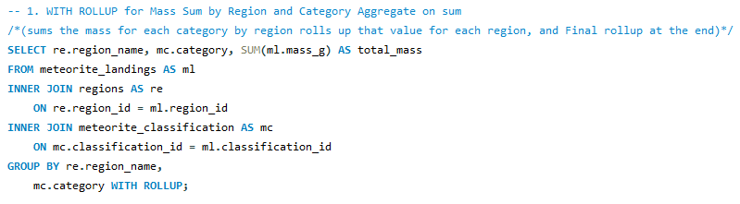
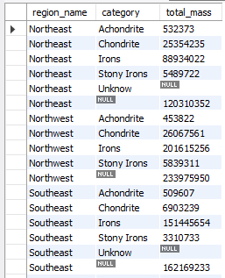


Queries

Slide 15
References
Meteorite Landings Data – https://catalog.data.gov/dataset/meteorite-landings
Meteorite Types - https://www.meteoritemarket.com/type.htm
Meteorite Sizes - https://meteorites.ucla.edu/faq/
Regions Based on Longs and Lats - https://gisgeography.com/latitude-longitude-coordinates/
Centuries Timeline - https://diamond-tutoring.com/blogs/f/chronology-a-timeline-of-historical-events

Slide 16

Thank you! Questions?

