Slide 1
Residential Solar Forecast & Financial analytics
(probably more than you wanted to know)
Bay Area useR group
December 9, 2019
Gautam Makani
https://www.linkedin.com/in/gautammakani/

Slide 2
Project analysis slide 2
Agenda
Quick intro to Solar NEM (Net Energy Metering)
How good are the self-service analytics at pge.com
Analysis approach, packages and environment
Findings – generation models, forecast, $$ savings, sensitivity

Slide 3
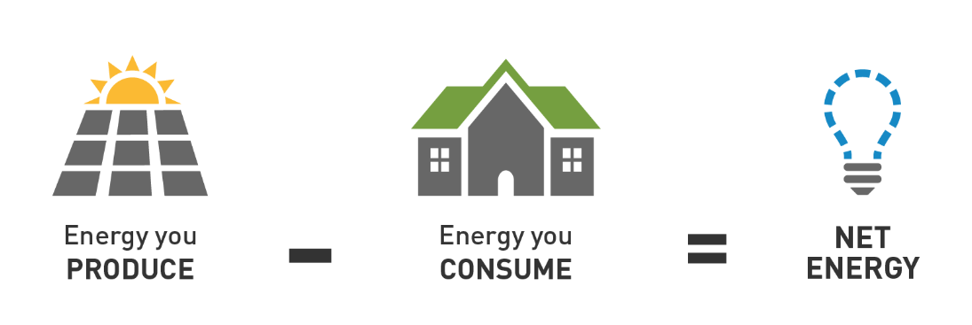
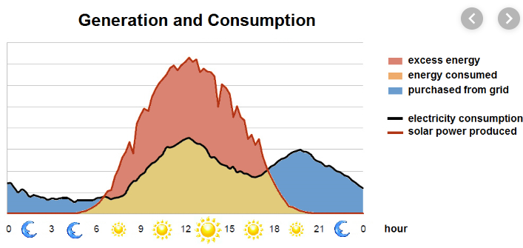
Project analysis slide 2
Solar NEM
PG&E credit for energy fed back into the grid at retail TOU (time of usage) rates
12 month True-Up billing cycle
Under threat (especially with PG&E Bankruptcy)
  Michigan changed NEM policy making it less profitable
  No NEM states: Arizona, Georgia, Hawaii, Indiana, Nevada, Maine and Mississippi ..
Critical for solar profitability

Slide 4
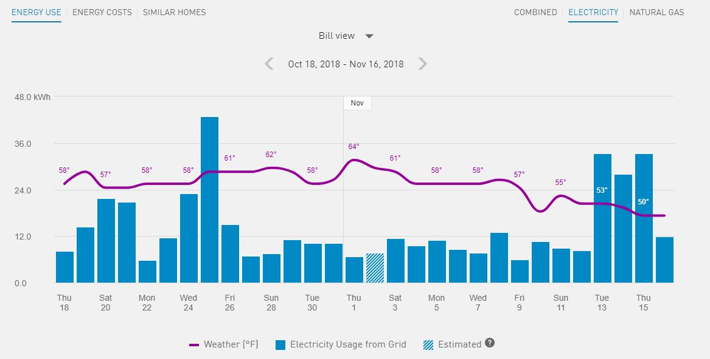
Project analysis slide 2
PG&E’s online analytics
Can’t use online PG&E Opower analytics to answer:
What is my actual usage profile (i.e. not NEM) ?
How is my electricity usage trending on a year on year basis ?
What is the consumption forecast ?
Is Solar saving me money ?

Slide 5
Project analysis slide 2
R based analysis
Compare time series models with seasonality
ARIMA
GLM with weather attributes
GLM without weather attributes
Hourly/daily NEM usage from PG&E
Clean
Add missing values
Aggregate
ARIMA Forecast daily generation out for 25 year lifetime
Solar production data from vendor portal (Enphase)
NOAA Daily Weather data
Sensitivity analysis and Financial calculations
ROI
IRR
Payback
Complex TOU calculations
PG&E TOU pricing – varies 4 times a day, and summer vs winter months
Production value per day based on 5 min generation profile
Model sensitivity scenarios of future electricity prices

Slide 6
Project analysis slide 2
R packages and resources
Resources and reference
Hadley’s R for Data Science book
Rob J Hyndman blog and book on forecasting
StackOverflow
StackExchange.
Key Packages
library(tidyverse)
library(forecast)
library(plotly)
library(FinCal) => financial calcs
library(data.table)
library(lubridate)
library(TSstudio)
Environment:
RStudio
Charts hosted on Rpubs
Plotly visualization
Github repo:
https://github.com/makanig/solarHomeEnergyAnalytics

Slide 7
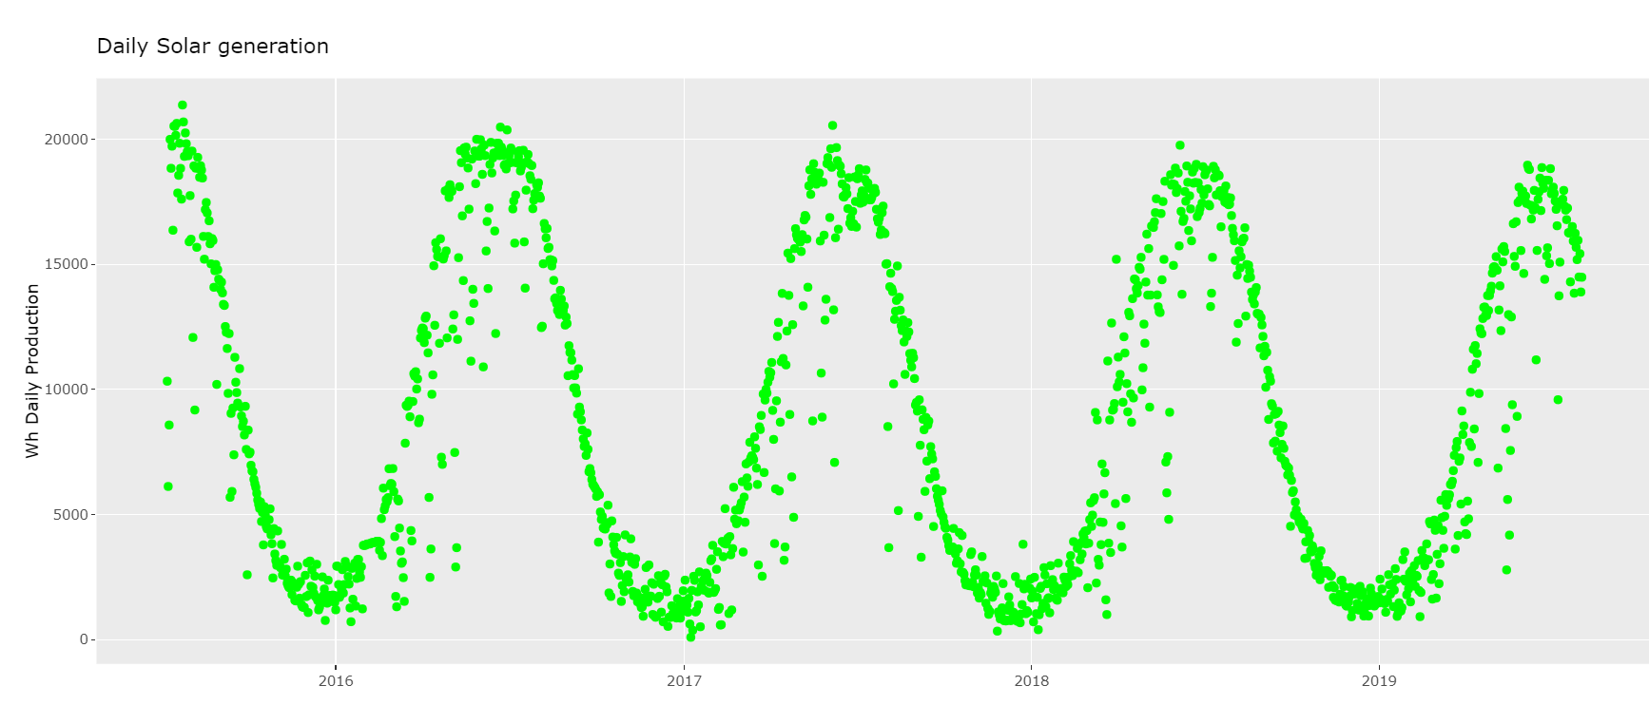
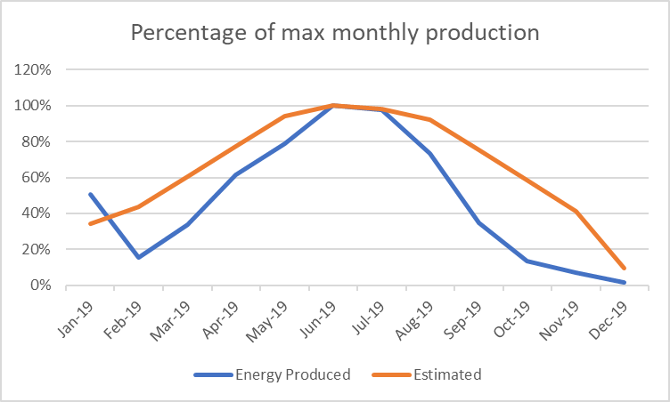
Project analysis slide 2
Findings – Generation varies more than expected
I saw more production variation than expected
Note slight downward trend
For new installs, future NEM policy is key to profitability

Slide 8
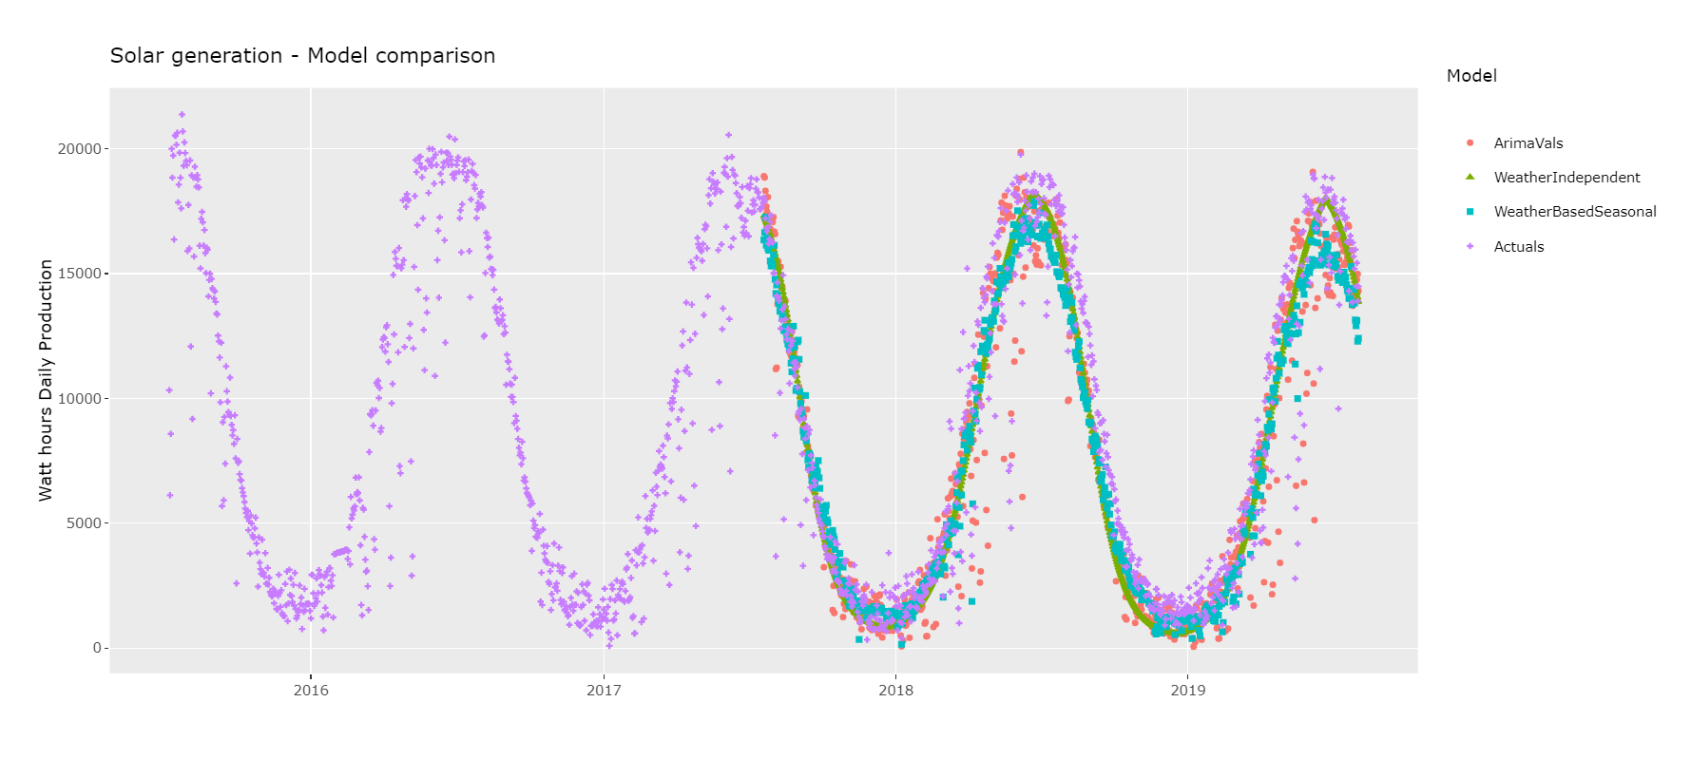
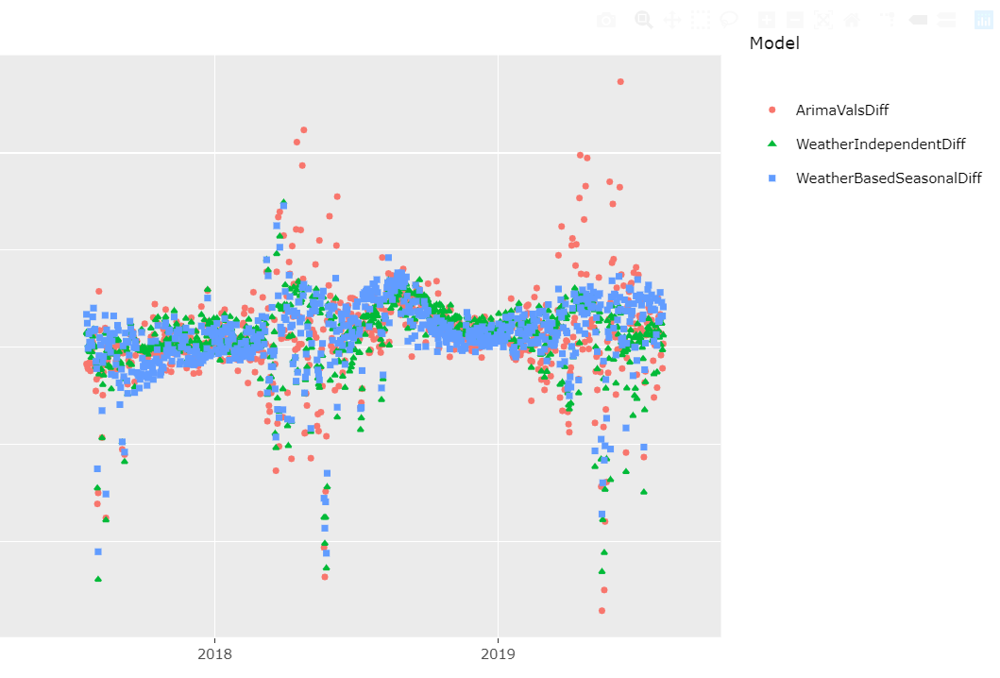
Project analysis slide 2
Findings – Model comparison
Weather based GLM model best performance
  RMSE: 0.44
  Pearson residual variance: 0.19
  GOF: 0.91

Slide 9
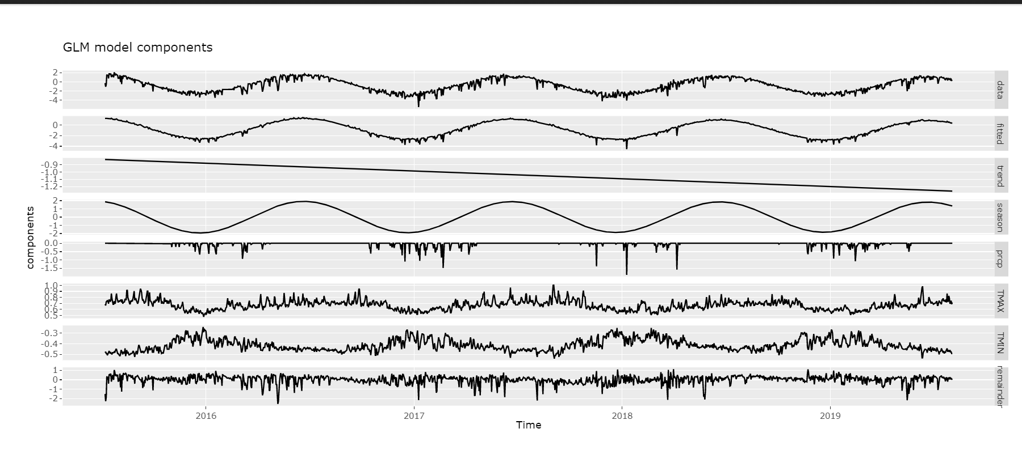
Project analysis slide 2
Findings – GLM weather model components
# Use this to fit a seasonal/sinusoidal pattern
solarDf$xc<-cos(2*pi*solarDf$DATE_Numeric/365)
solarDf$xs<-sin(2*pi*solarDf$DATE_Numeric/365)
glm(energyProducedWhLog ~ xc+PRCP +DATE_Numeric*xc +TMAX + TMIN, data=solarDf)

Slide 10
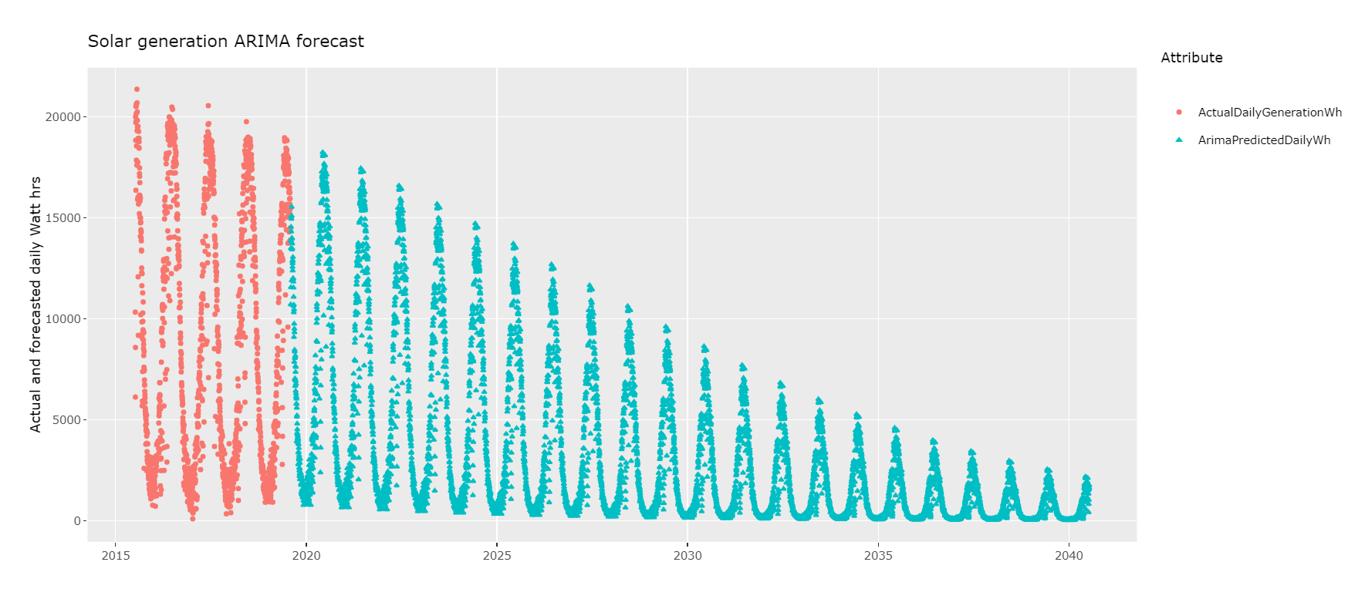
Project analysis slide 2
Findings – ARIMA daily generation forecast
Degradation at ~2% is overestimated

Slide 11
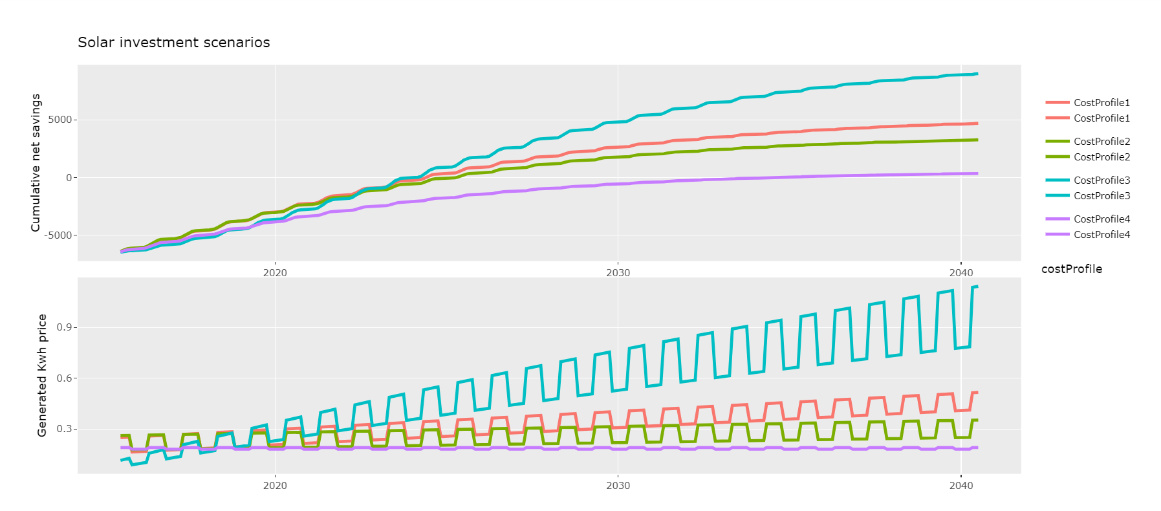
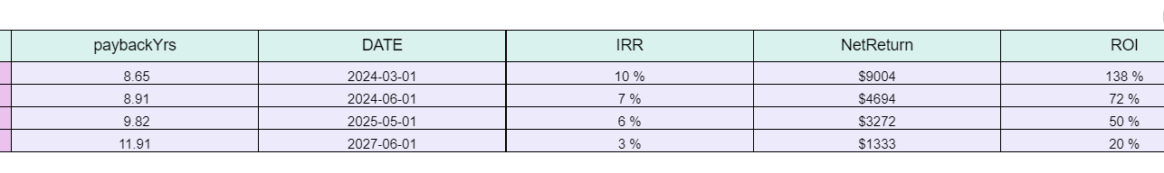
Solar investment is profitable
Net investment: $6516 (after 30% tax credit)
ROI: 130% - 20%
Net return - $9000 - $1300

