Slide 1
JointJS

Slide 2
What is JointJS?
JointJS Core
what can be done with it?
dive into library
Graph
Paper
Element
Link
ElementView&LinkView
Rappid

Slide 3
What is JointJS?
JointJS is a library that focuses on creating diagrams and interacting with them. Based on jQuery, Underscore/Lodash, Backbone and SVG.
Also uses:
Vectorizer (V) is tiny lightweight SVG library
Geometry (g) is another lightweight library for geometry operations
Supported browsers (those that support SVG):
latest Google Chrome (including mobile)
latest Firefox
Safari (including mobile)
IE 9+
Performance:
0 - 200 (no performance issue)
200 - 500 (performance issue)
500+ (a significant drop in performance)
in next release v1.0 optional async rendering of all views

Slide 4
JointJS Core
It is open source library (under the Mozilla Public License v2.0). Defines the joint namespace that contains all the objects that you use to build up your diagrams.
Features:
custom shapes via SVG or programmatically rendered
customizable links, their arrowheads and labels
connecting diagram elements with links
interactive elements and links
magnets/ports
serialization/deserialization JSON
highly event driven
touch support
animations
plugin system
nodejs support
MVC architecture

Slide 5
JointJS Core
What can be done with it?
A simple static diagram which shows elements and links between them can be created without any effort.
If you need more functionality you can easily develop new modules and then build fully interactive diagramming and application builders.
See examples below:

Slide 6
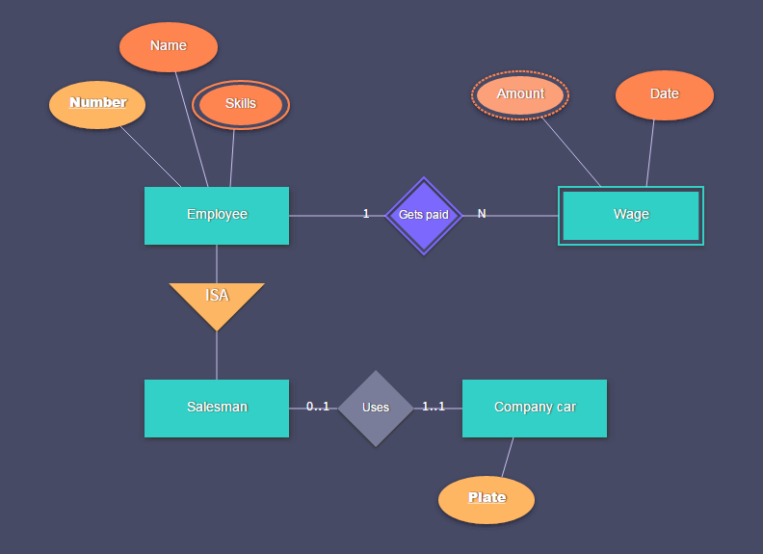
What can be done with it?
ER diagrams

Slide 7
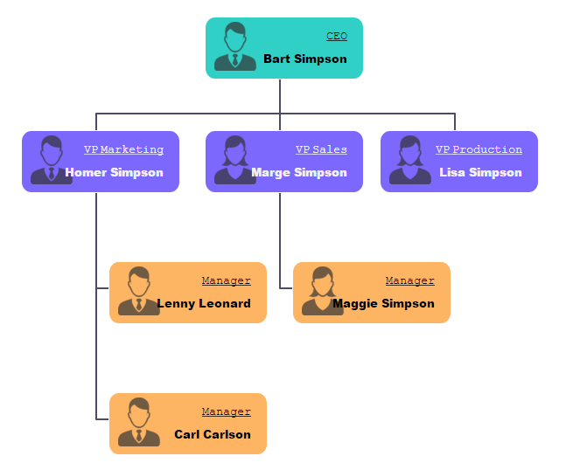
What can be done with it?
Organizational charts

Slide 8
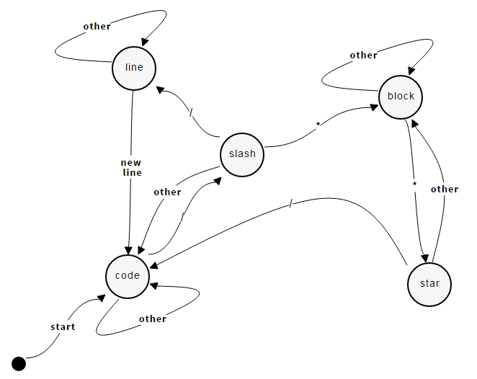
What can be done with it?
Finite state machines

Slide 9
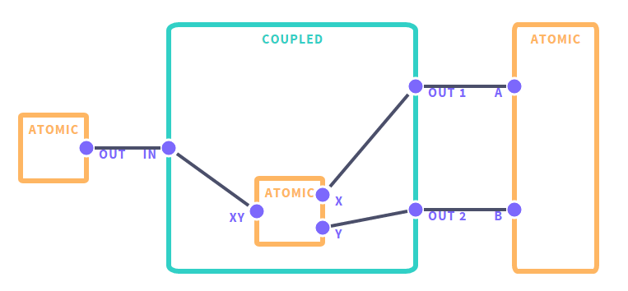
What can be done with it?
Work with ports

Slide 10
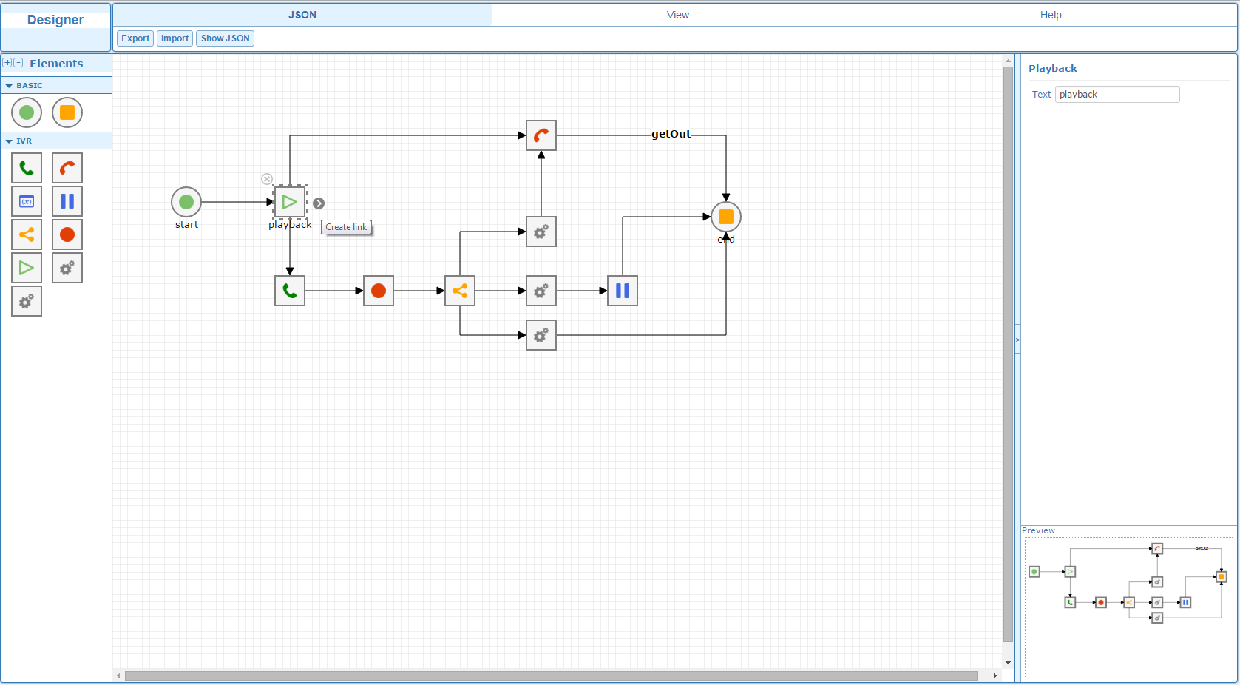

Slide 11
JointJS Core
Dive into library
Responsible for:
rendering shapes onto the screen
shapes transformations
JSON import/export
basic interactions and glues everything together via MVC & Event driven architectures (models hold geometrical and presentation attributes of diagram elements and links, while views are responsible for rendering and handling interaction)
The basic blocks are:
joint.dia.Element - a model representing a JointJS element (a.k.a node) shape.
joint.dia.Link - a model representing a JointJS link (a.k.a edge) shape.
joint.dia.Graph - a model representing the whole diagram that consists of elements and links.
joint.dia.Paper - a view representing the whole diagram. It listens for changes on the associated joint.dia.Graph model.
joint.dia.ElementView - a view representing a JointJS element. It listens for changes on the associated joint.dia.Element model.
joint.dia.LinkView - a view representing a JointJS link. It listens for changes on the associated joint.dia.Link model.
g - a library providing lots of useful geometry math functions.
Vectorizer - a lightweight and fast SVG library.
Utility functions - various helper functions.

Slide 12
Dive into the JointJS
Graph
It is a simple model (Backbone.Model) that holding all the cells of the diagram.
Some of methods:
get/add/clone/reset - Cell(s)
work with Subgraph
dfs/bfs (algorithms for traversing the graphs)
search/findBy(point, area)
toJSON/formJSON
list of triggered events (add/remove/change)

Slide 13
Dive into the JointJS
Paper
It is the view (Backbone.View) for the Graph model. It also makes sure that all the cells added to the Graph are automatically rendered.
Some of methods:
findBy(Model/Point/Area)
events handlers
manipulation of the workplace

Slide 14
Dive into the JointJS
Element
It is the basic model (Backbone.Model) for diagram elements.
All properties can be put into three groups:
geometry (coordinates, angle, size)
presentation (defines an SVG markup)
nesting (parent, embeds)

Slide 15
Dive into the JointJS
Link
It is the basic model for diagrams links.
All properties can be put into next groups:
connections (source, target)
presentation (vertices, connector, router, styling)

Slide 16
Dive into the JointJS
ElementView & LinkView
It is the view for the Element/Link model or any of its inheritants.
Responsible for rendering an Element/Link with properties defined in its model into the paper.
Takes care of handling pointer events.

Slide 17
Rappid
It is the complete HTML5 diagramming UI framework that is built on the strong foundation of JointJS.
Pros:
a complete toolkit for building advanced applications
a set of more than 40 UI components
compatible with: meteorjs, nodejs, angular, react, backbone, jQuery
three applications for quick start
Cons:
a commercial license

Slide 18
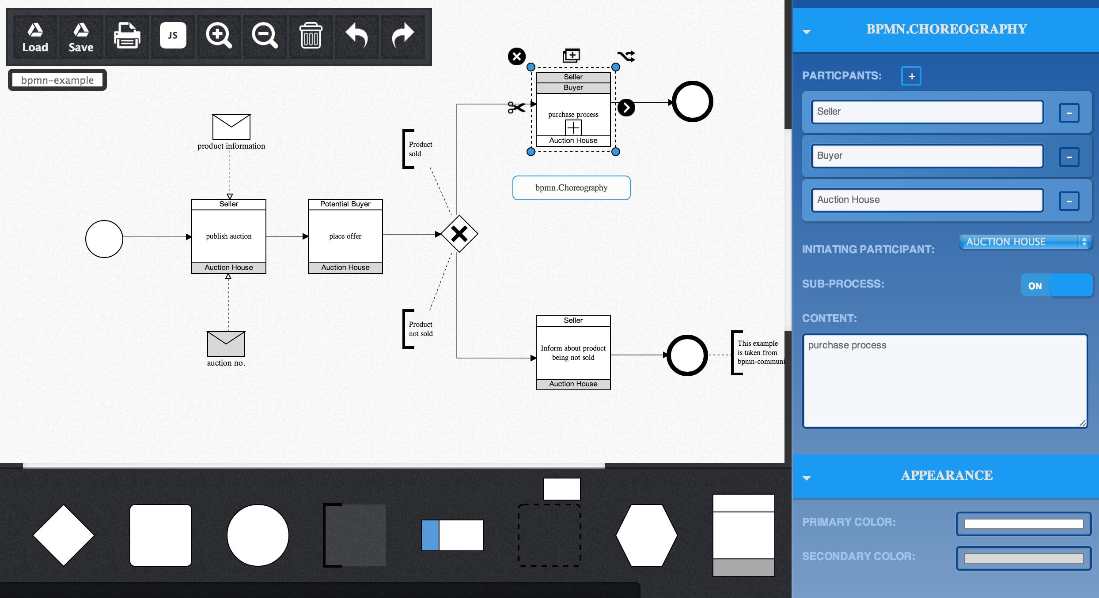

Slide 19
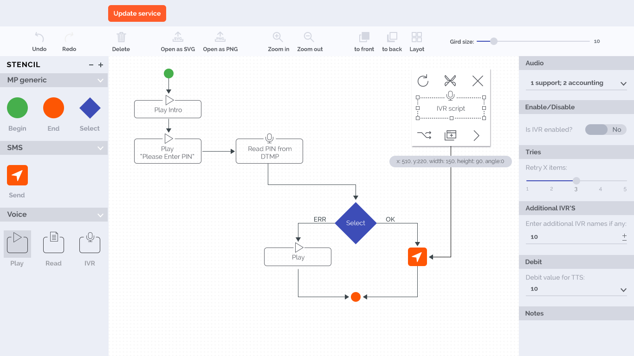

Slide 20
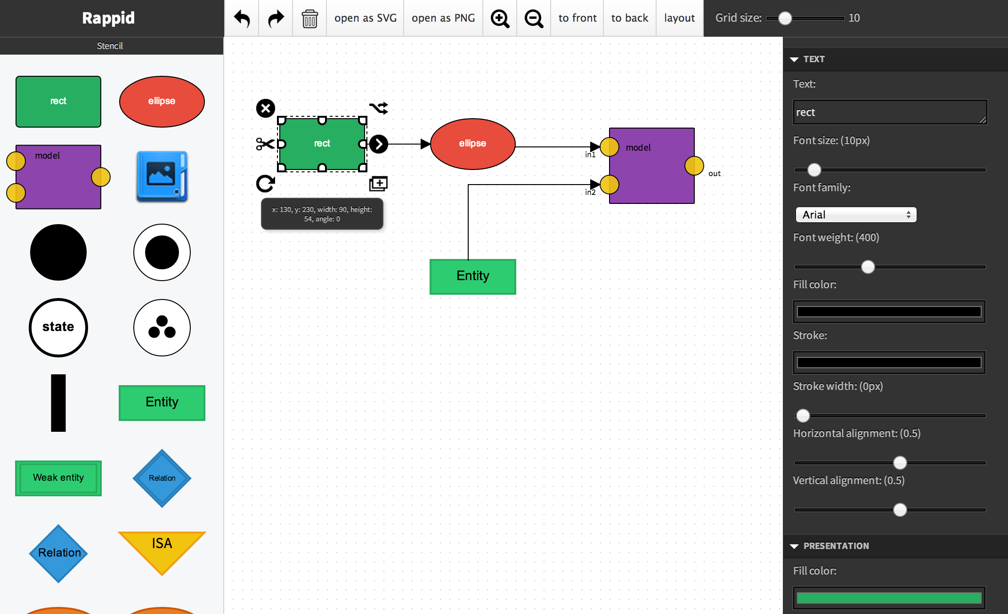

Slide 21
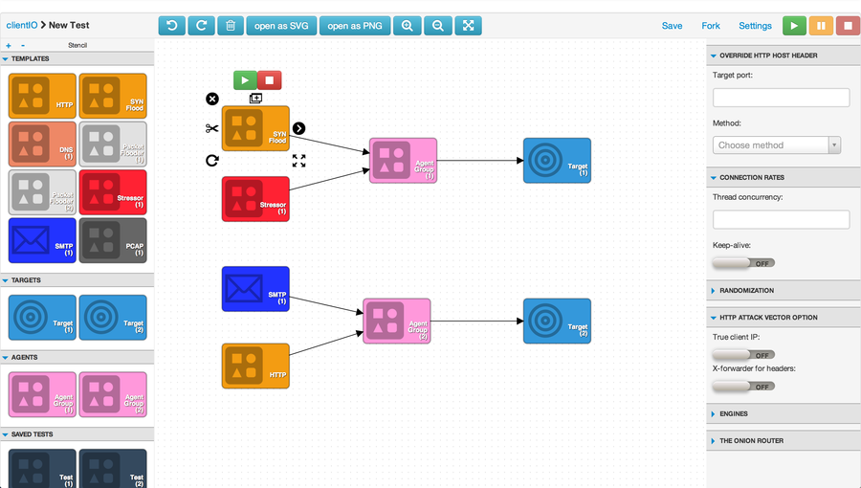

Slide 22
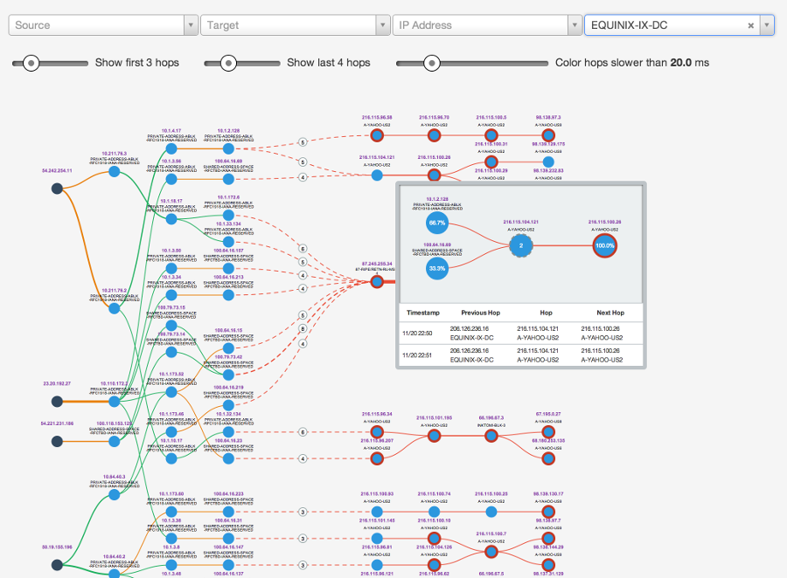

Slide 23
Any questions?

