Slide 1
AVIATION ANALYSIS
A Non-Technical Overview of the Aviation Analysis Insights

Slide 2
OVERVIEW
This analysis seeks to study aviation data collected over the past years to provide insights into future trends and key aspects to keep in mind when getting into the aviation industry.

Slide 3
Business Understanding
Investors who are considering investments in the aviation industry need a clear understanding of various factors, including safety trends, risk factors, and the reliability of equipment. The aviation sector is capital-intensive, meaning that identifying and analyzing risks is crucial for informed decision-making. Investors must carefully evaluate aspects such as:
Aircraft manufacturers to invest in.
Engine models and makes with proven safety records
Accident prone areas
Types of flights

Slide 4
DATA UNDERSTANDING
The dataset contains data from the National Transport Safety Board that is comprised of aviation accident data from 1962 u to 2023 in the United States and International Waters.
The data contains records such as engine types, engine models, makes, weather conditions leading into the accidents listed. We aim to use this data to visualize the effect these different factors have on the accident rates.
The data contains a lot of missing values that we tried to replace where deemed necessary. The formatting however was consistent and there was no need to work on it.

Slide 5
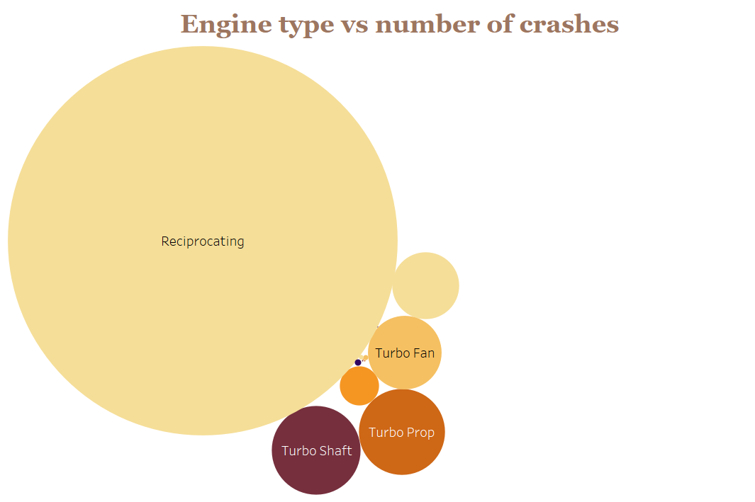
Data analysis
After filling in the missing values, the next task was visualizing the data using various graphs to uncover any insights that could help in decision making. Engine type was one of the factors we were investigating and plotted a bubble plot as shown:

Slide 6
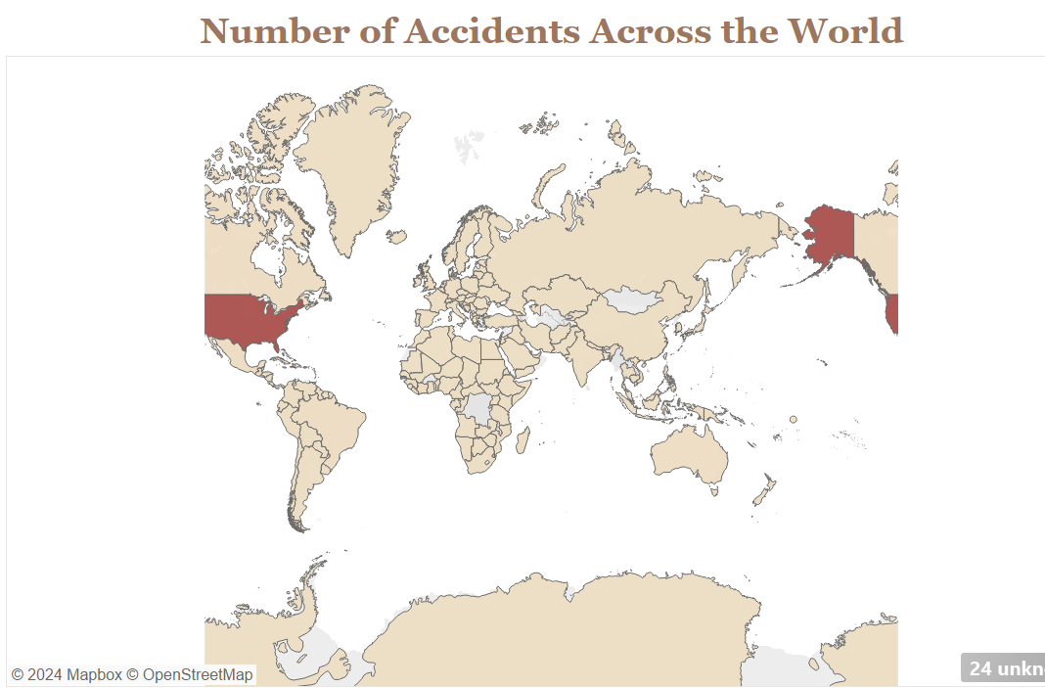
As per the plot, reciprocating engines had high accident rates followed not closely by Turbo Shaft and Turbo Prop engines.
A region plot to uncover high risk locations provided insight into U.S.A. being a high-risk aviation area as per the high number of accidents recorded there.

Slide 7
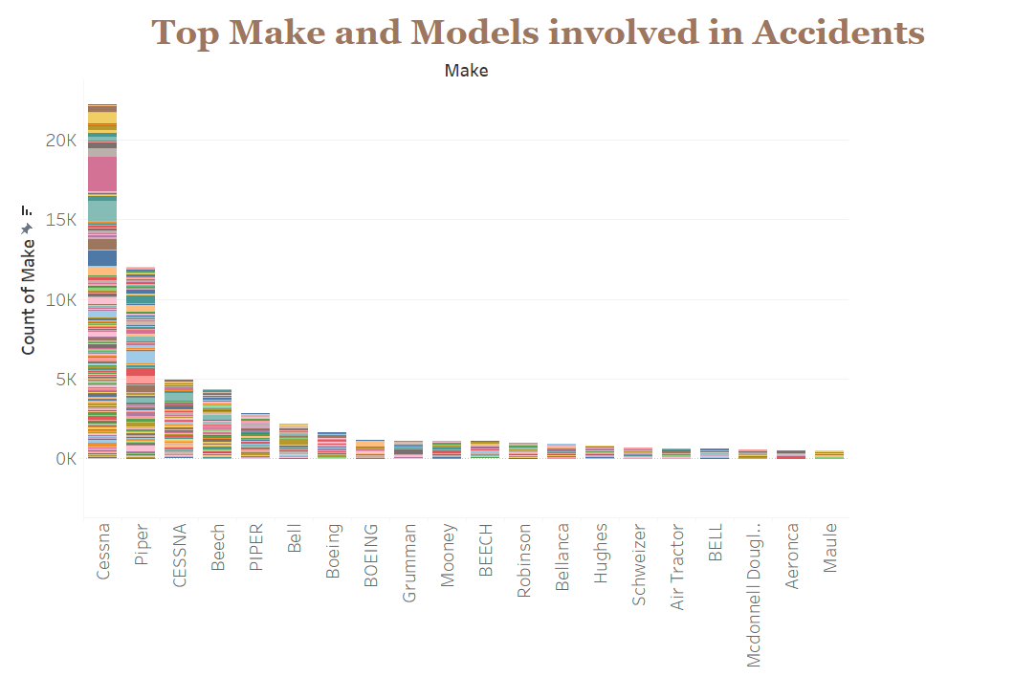
A peek into the effect of engine make and model have on the accident rates revealed that Cessna engines, especially the 152, had a high failure rate making it advisable to avoid and go for other brands that have proven safer.

Slide 8
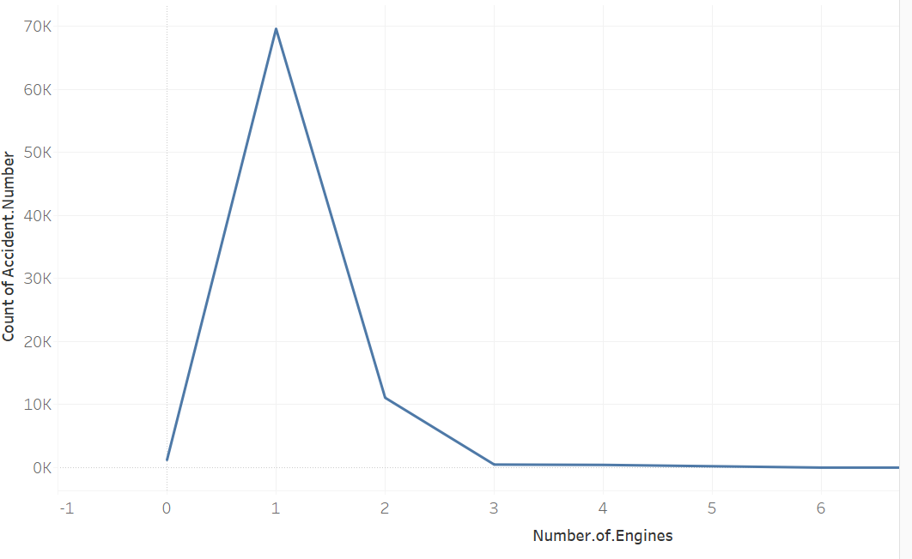
Studying the number of engines in the aircraft also unearthed the detail of multiple engine aircraft being more efficient than their single engine counterparts.

Slide 9
RECOMMENDATIONS
Investment into engine manufacturers with lower accident rates such as Maule and BELL instead of ones with higher rates e.g. Piper, Bell and Cessna.
Invest in other areas in the world apart from USA which has a very high accident occurrence rate.
Invest in multi engine aircraft which have a lower accident rates compared to single engine aircraft.
Invest in engine types with a lower crash rate such as the electric engine, the turbofan and the geared turbofan engine

Slide 10
NEXT STEPS
Look into financial details of the various recommendations provided to come up with a good investment model which couldn’t be done with the presently available data

Slide 11

THANK YOU

Slide 12
Evans Makau
Github: https://github.com/makau99

