Slide 1
AVIATION ANALYSIS
A Non-Technical Overview of the Aviation Analysis Insights

Slide 2
OVERVIEW
This analysis seeks to study aviation data collected over the past years to provide insights into future trends and key aspects to keep in mind when getting into the aviation industry.

Slide 3
Business Understanding
We aim to figure out:
Aircraft manufacturers to invest in.
Engine models and makes with proven safety records
Less accident-prone areas
Types of flights e.g. instructional, public flights to invest in.

Slide 4
Data Understanding
The dataset contains data from the National Transport Safety Board that is comprised of aviation accident data from 1962 to 2023 in the United States and International Waters.
The data contains records such as engine types, engine models, makes, weather conditions leading into the accidents listed. We aim to use this data to visualize the effect these different factors have on the accident rates.

Slide 5
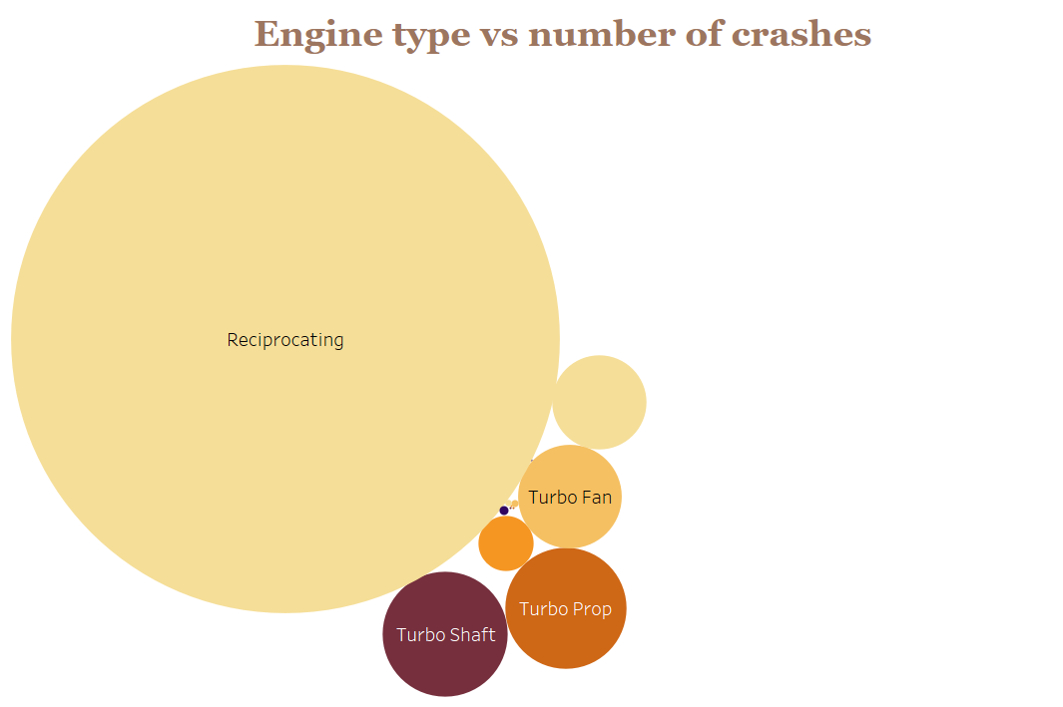
Results And Conclusions
Reciprocating engines have high accident rates

Slide 6
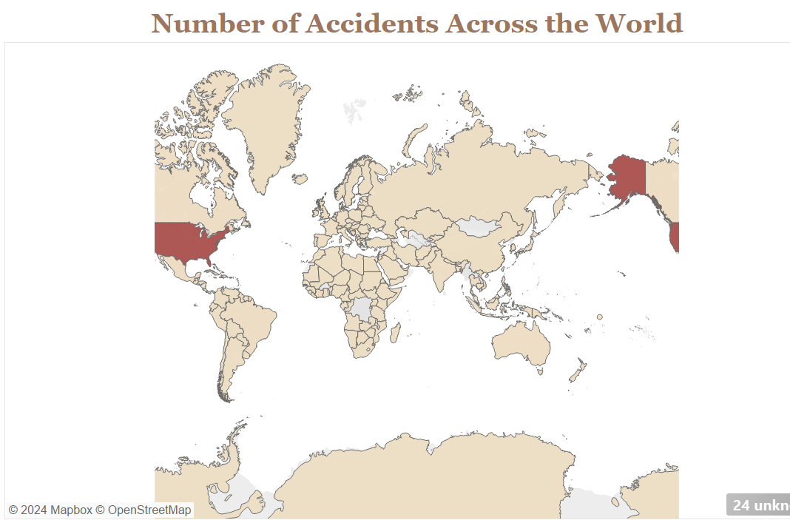
Results And Conclusions
U.S.A. is a high-risk aviation area as per the high number of accidents recorded there.

Slide 7
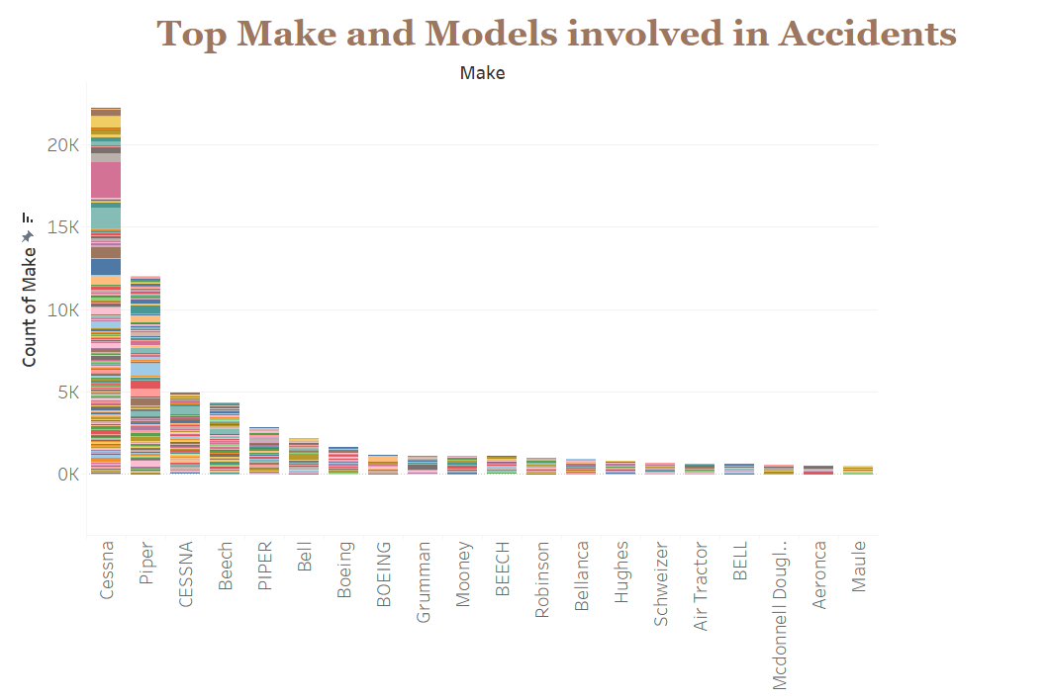
Results And Conclusions
CESSNA and piper engines have very high failure rates.

Slide 8
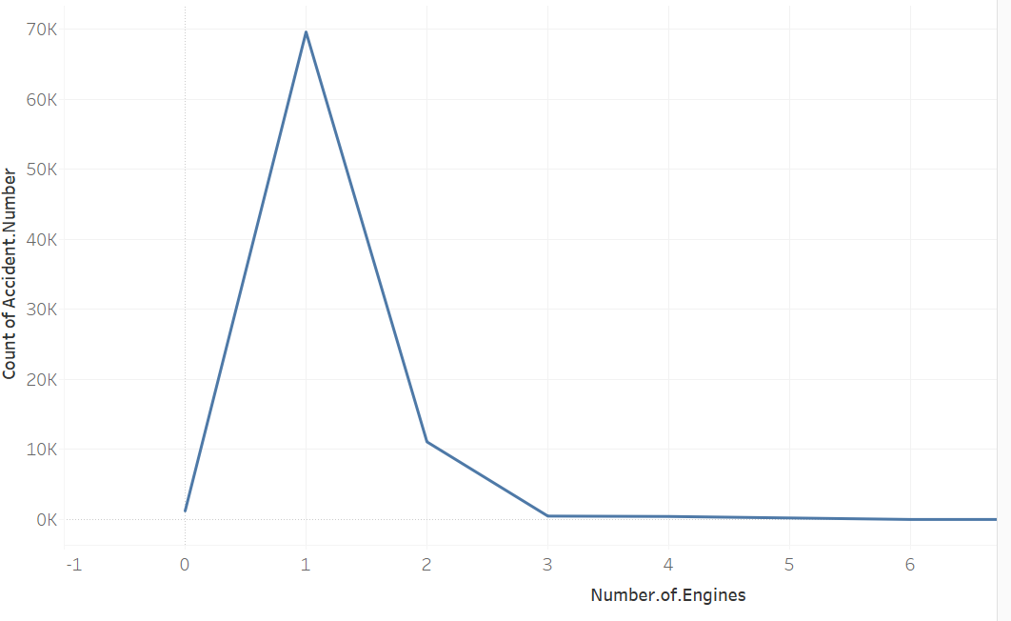
Results And Conclusions
Multiple engine aircraft are more efficient than their single engine counterparts.

Slide 9
Recommendations
Investment into engine manufacturers with lower accident rates such as Maule and BELL instead of ones with higher rates e.g. Piper, Bell and Cessna.
Invest in other areas in the world apart from USA which has very high accident rates.
Invest in multi engine aircraft which have a lower accident rates compared to single engine aircraft.
Invest in engine types with a lower crash rate such as the electric engine, the turbofan and the geared turbofan engine

Slide 10
Next Steps
Including financial details of the various recommendations provided to come up with a good investment model.
Predict low risk areas with good profits.

Slide 11


Slide 12
THANK YOU!
Evans Makau
Github: https://github.com/makau99
Email: makauevans01@gmail.com

