Slide 1
MOVIE INDUSTRY ANALYSIS
GROUP 10
January 24, 2025

Slide 2
OUTLINE
Project goal
Business Understanding
Data and Methods
Data analysis
Conclusions

Slide 3
Project goal
Descriptive analysis of movie performance data and production insights to highlight investment niches in the industry to exploit:
Genres that require the lowest budget to produce with good revenue returns
Genres that produce blockbuster hits often
Genres with a good rating average and a significant vote number, both indicators of positive audience feedback.

Slide 4
BUSINESS Understanding
Key Objectives:
Identify successful box office hit genres
Identify genres with low budget requirements
Identify genres with good profit margins

Slide 5
BUSINESS Understanding
Key Questions:
What genres require the highest budget?
What genres have the longest runtime?
What genres raked in the highest revenue?
What is the relationship between votes, popularity, and revenue?
Can we prove several statistical concepts based on our data?

Slide 6
DATA AND METHODS
IMDB data obtained from a SQL database file for over 140,000 movies for which we use the title basics table
TMDB data obtained by scraping the website using API calls. Contains over 26,000 titles.
Data includes: movie titles, genres, runtime, popularity, budget, revenue, vote average and vote count

Slide 7
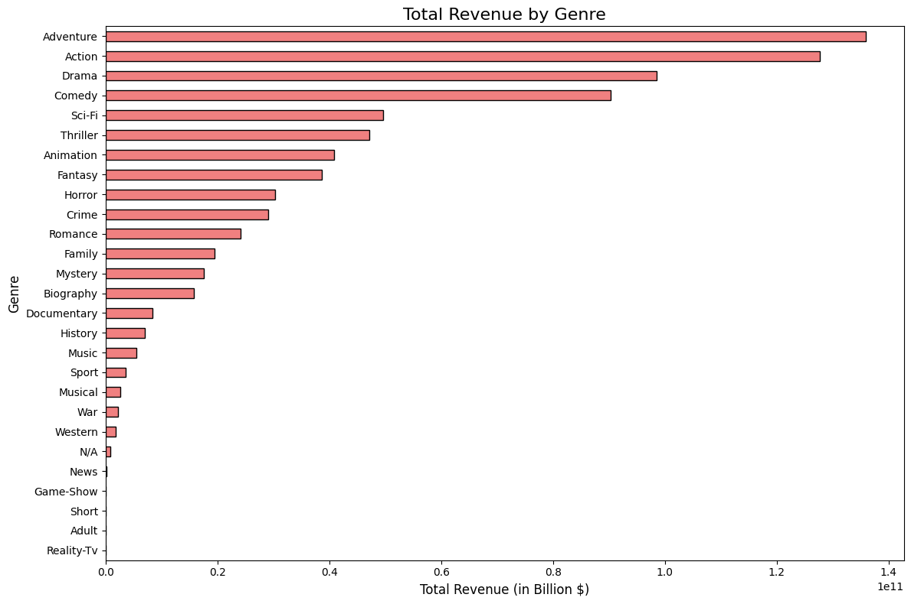
Data ANALYSIS
Genres such as Adventure, Action, and Comedy had the highest revenue returns.

Slide 8
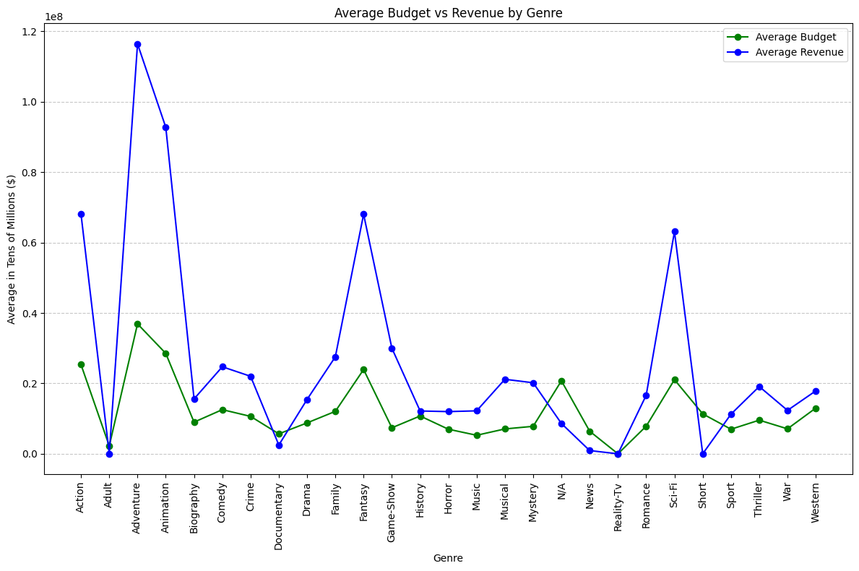
Data ANALYSIS
Genres such as Adventure, Action, and Fantasy and Animation had the highest returns on input.

Slide 9
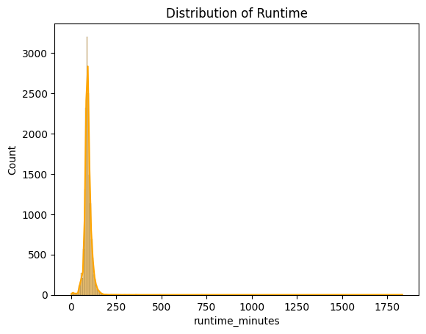
Data ANALYSIS
Most titles align with a 90–120-minute preference.

Slide 10
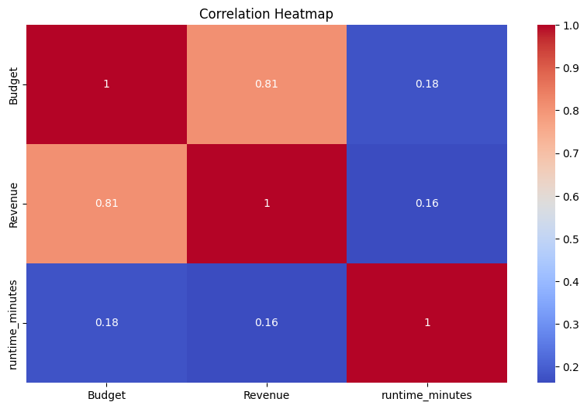
Data ANALYSIS
Budget and Revenue have a high positive correlation, meaning that a high budget movie has a higher chance of raking in high revenue.

Slide 11
Conclusions
High Revenue Genres: Adventure, Fantasy, and Sci-Fi generate higher revenues.
Steady Performers: Drama, Comedy, and Thriller offer consistent returns.
Budget vs. Return: Adventure, Sci-Fi and Animation need higher budgets but yield big returns.
Cost-Effective: Drama and Documentaries balance lower budgets with steady engagement.

Slide 12
Recommendations
Focus on Genres: Invest in Adventure, Fantasy, and Drama, with Documentaries as a niche.
Partner with Directors: Collaborate with top directors for consistency and success.
Optimize Runtime: Align with the 90–120-minute preference.
Balanced Investment: Prioritize high-revenue genres while diversifying with niche options.

Slide 13
Next steps
Better predict highly profitable sub-genres e.g. action-animation.
Build model to analyze movies and recommend related titles.

Slide 14


Slide 15
THANK YOU !!
Job Cheruiyot
Eric Mriti
Lydia Mangoa
Evans Makau
Wambui Kariuki
Susan Mworia
GitHub Repo: https://github.com/makau99/Movie-Data-Analysis.git

