Slide 1
STEVE MAKAU KENNEDY 123037 ICS 4C A DIABETES PREDICTION MODEL BASED ON KNN Supervisor name: DR. Dickson Owuor

Slide 2
Background & Problem Statement
Diabetes is a long-term disease that affects people of all ages. Diabetes occurs when the pancreas is not able to produce enough insulin or when the body cannot effectively use the produced insulin.
There are different types of Diabetes. Type 1 is caused by low insulin production, Type 2 is caused by excess body weight and lack of sufficient activity. Gestational diabetes affects expectant mothers.
Majority of patients who get tested for diabetes are diagnosed once they start developing symptoms. Doctors check if their patients have symptoms for the disease, if there was anyone in the family who previously had the disease, and allergies.The idea of blood tests help in observing the levels of glucose in the blood

Slide 3
Description of Dataset
The system used the Pima Indians Diabetes dataset from the National Institute of Diabetes and Kidney Diseases which was obtained from Kaggle. The objective of the dataset is to diagnostically predict whether or not a patient has diabetes, based on certain diagnostic measurements included in the dataset., which includes attributes like pregnancies, glucose levels, blood pressure, skin thickness, BMI, diabetes percentage, and age. The outcome confirmed if a patient had diabetes, with 1 being a Yes and 0 being a No.

Slide 4
Motivation
Patients with diabetes may find it difficult to predict their condition, so having a system that can assist with prediction can be beneficial for both long-term planning and psychological support.
The model can assist physicians in the future when deciding how best to care for their patients and in monitoring the patient's diagnosis trend.

Slide 5
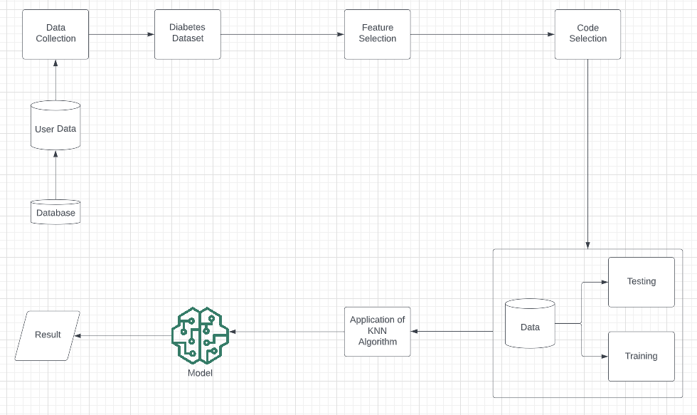
Solution demonstration

