Slide 1

Model Context Protocol (MCP)
The universal standard for connecting AI applications to external systems — think USB-C for AI integrations.

Slide 2

What MCP Enables in the Real World
Intelligent Agents
Creative Workflows
AI assistants accessing calendars, Notion databases, and enterprise tools seamlessly through standardised connections.
Claude Code building functional applications directly from Figma designs, bridging design and development.
Enterprise Integration
Physical Workflows
Chatbots querying multiple data sources simultaneously, providing unified answers from disparate systems.
AI interacting with design tools like Blender and hardware systems including 3D printers for end-to-end production.

Slide 3



Why MCP Matters
For Developers
For AI Applications
For End Users
Faster integrations with standardised interfaces
Access to shared ecosystem of tools
More capable AI experiences
Reduced complexity through shared protocols
Expanded resource availability
Actionable insights from connected data
Reusable components across projects
Interoperability across platforms
Seamless workflow automation
Lower maintenance overhead
Community-driven innovation
Enhanced productivity tools

Slide 4
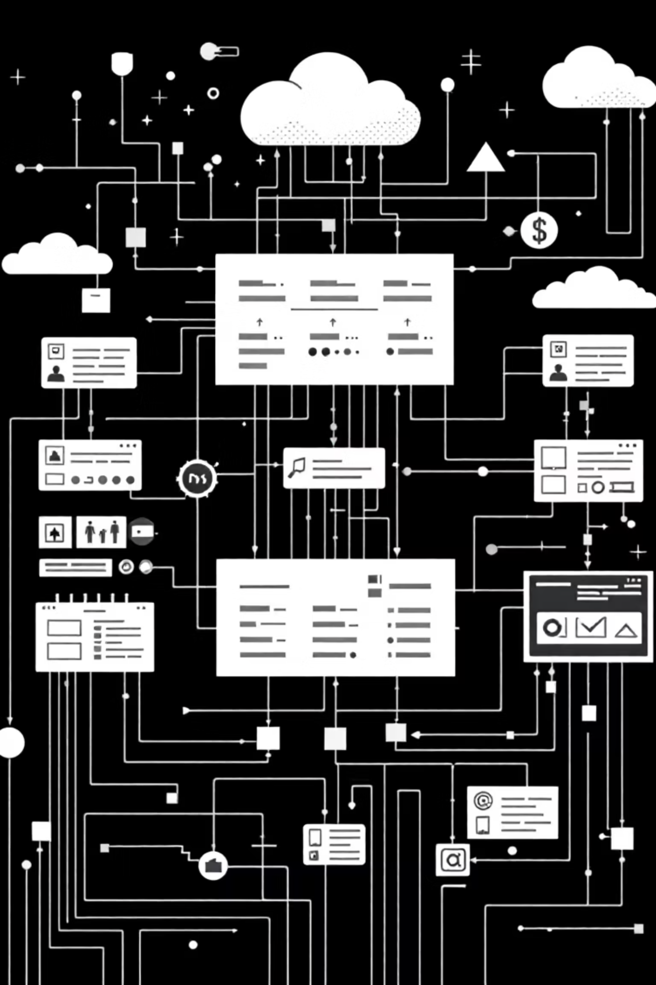




MCP Architecture: Client-Server Model
MCP Host
The AI application (e.g., Claude Desktop) that orchestrates interactions and maintains the primary user interface.
MCP Client
Embedded within the host, manages protocol communication and handles requests to MCP servers.
MCP Server
Exposes resources, tools, and prompts. Can run locally via STDIO or remotely via Streamable HTTP.
Key Concept: MCP servers can run locally for file system access or remotely for cloud-based services, providing flexibility in deployment architecture.

Slide 5
Understanding MCP's Two Layers
Data Layer
Transport Layer
Defines the core protocol using JSON-RPC for structured communication. Manages lifecycle events, capability negotiation, and primitives like tools, resources, and prompts.
Handles physical communication and authentication between components. Supports multiple transport mechanisms including STDIO for local processes and HTTP for remote services.
Protocol specification and primitives
Communication protocols
Lifecycle management
Authentication mechanisms
Request-response patterns
Connection management
This architectural separation enables MCP to remain transport-agnostic whilst maintaining consistent protocol semantics across different deployment scenarios.

Slide 6






Data Layer: Core Primitives
Tools
Resources
Executable actions that AI can invoke, such as querying databases, sending emails, or manipulating files. Each tool defines parameters and expected outputs.
Contextual data sources that provide information to AI, including file contents, database records, or API responses. Resources are read-only by default.
Prompts
Sampling
Reusable interaction templates that structure AI conversations. Define workflows, questioning patterns, and response formats for consistent experiences.
Enables servers to request AI completions through the client, maintaining human oversight whilst allowing complex multi-step reasoning.
Elicitation
Logging
Structured requests for user input, allowing servers to gather necessary information through standardised prompts and validation.
Centralised event tracking and debugging capability, enabling servers to emit structured logs that clients can capture and display.

Slide 7
Lifecycle & Tool Interaction Flow
Initialisation
1
Client and server establish connection, exchange protocol versions, and negotiate supported capabilities through the initialize handshake.
2
Tool Discovery
Client sends tools/list request. Server responds with available tools, their parameters, descriptions, and JSON schemas for validation.
Tool Execution
3
AI decides to use a tool. Client sends tools/call with tool name and arguments. Server validates parameters and executes the requested action.
4
Response Handling
Server returns structured content including results, errors, or additional context. Client processes response and integrates into conversation flow.
Dynamic Updates
5
Server emits notifications when capabilities change. Client receives tools/list_changed, re-queries available tools, and updates AI's awareness.

Slide 8

Real-Time Updates: Event-Driven Architecture
Why Notifications Matter
Traditional polling creates latency and wastes resources. MCP's notification system enables servers to push updates immediately when their state changes.
Dynamic Capabilities
Efficient Communication
Tools and resources can appear or disappear based on runtime conditions, user permissions, or external state changes.
Event-driven updates eliminate polling overhead, reducing network traffic and improving responsiveness in AI workflows.
Contextual Awareness
AI maintains accurate understanding of available capabilities, preventing errors from attempting to use unavailable tools.

Slide 9




Client-Side Features: Advanced Capabilities
Elicitation
Roots
Servers request structured input from users through standardised forms. Supports validation, type checking, and conditional fields for complex data gathering.
Define filesystem scope and boundaries for resource access. Acts as coordination mechanism, helping servers understand their operational context without enforcing security.
Sampling
Enables servers to request AI completions via the client, maintaining human-in-the-loop oversight. Critical for multi-step reasoning whilst preserving user control over model behaviour.

Slide 10


Design Philosophy & Security Model
Core Principles
Coordination Over Enforcement
Roots provide guidance about filesystem scope but don't enforce access control. Clients maintain ultimate security decisions.
Client Authority
MCP hosts retain complete control over permissions, model selection, and execution decisions. Servers make requests; clients authorise.
Human Oversight
Sampling workflows require human supervision, ensuring AI actions remain transparent and controllable throughout execution chains.
Security First: MCP is designed with defence-in-depth principles. Servers expose capabilities, but clients enforce policies and users maintain final control.

Slide 11

?

