Slide 1

Model Context Protocol (MCP)
The universal standard for connecting AI applications to external systems — think USB-C for AI integrations.

Slide 2
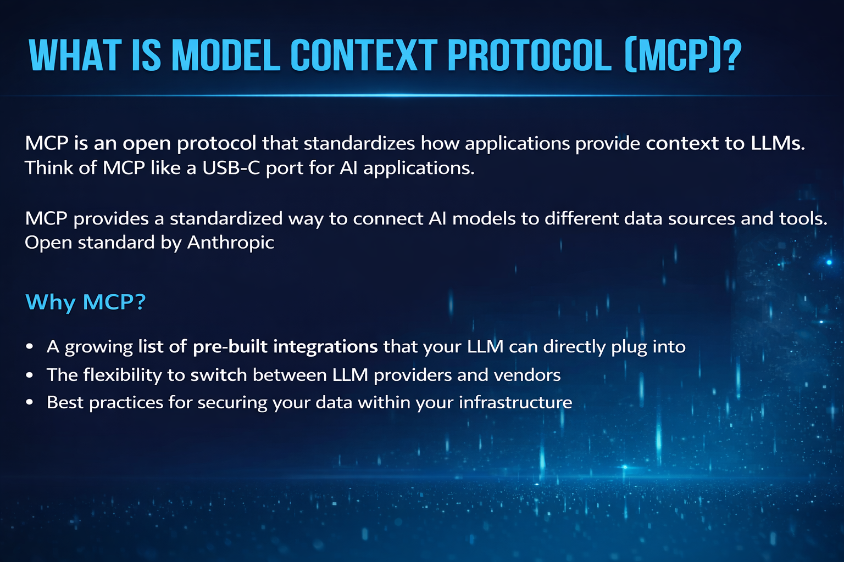

Slide 3
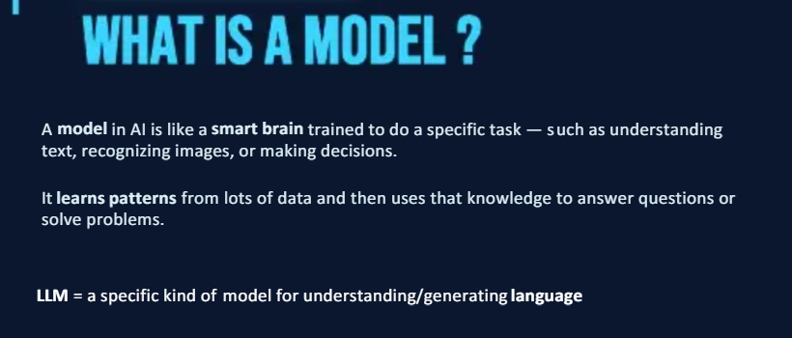
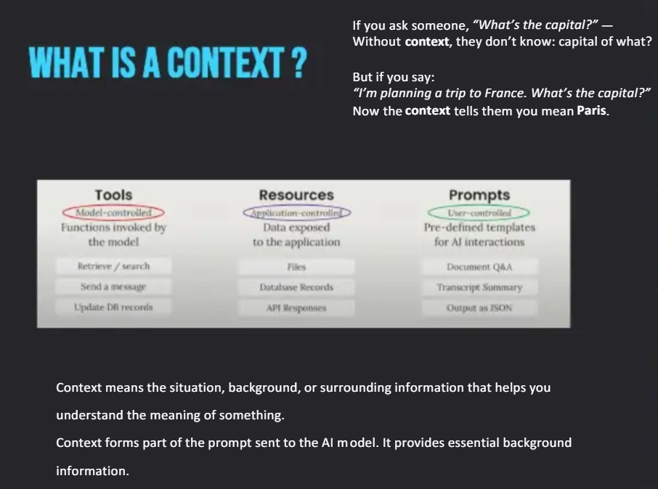
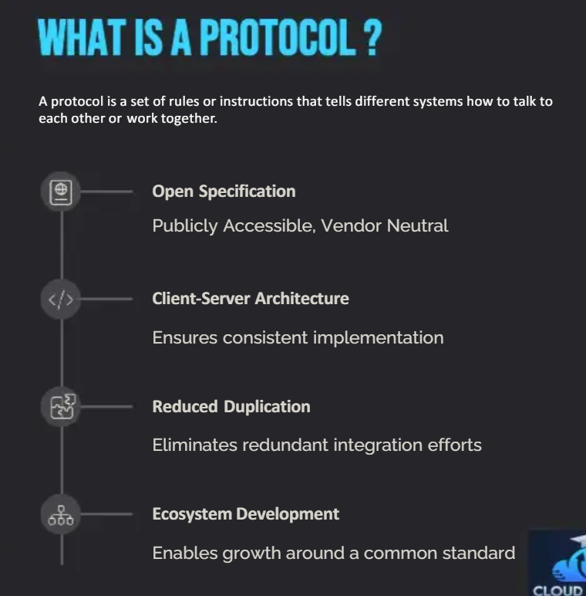

Slide 4
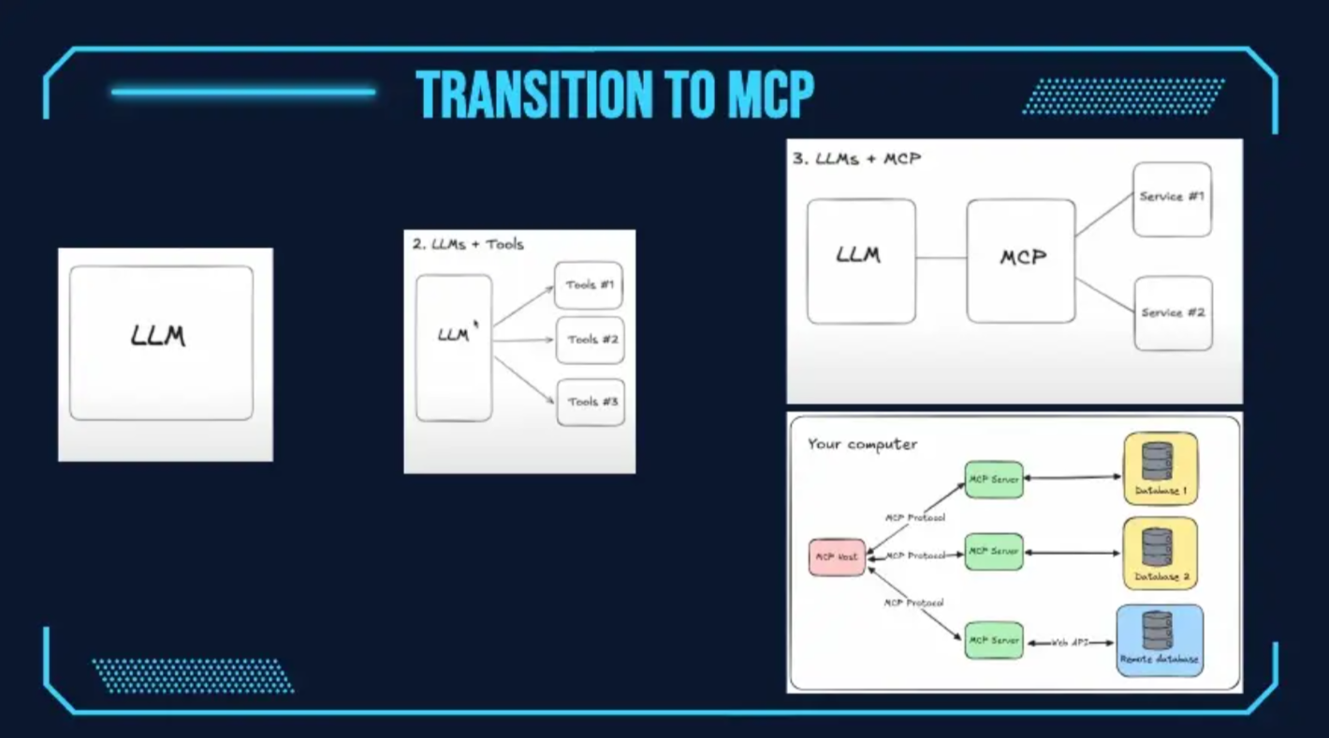

Slide 5
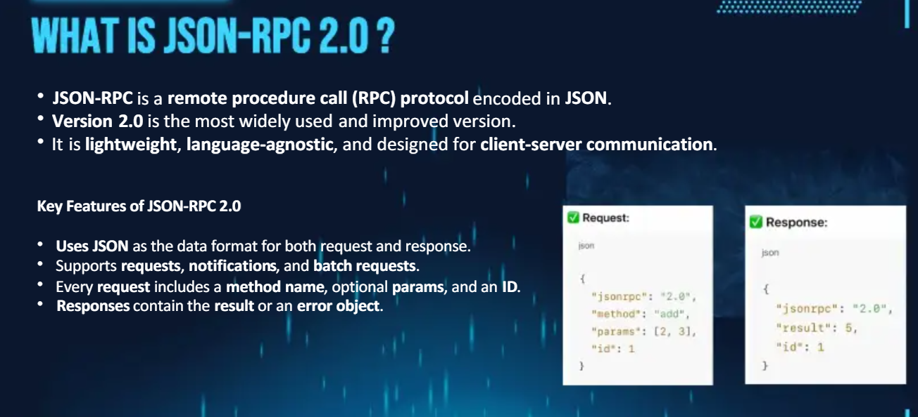

Slide 6
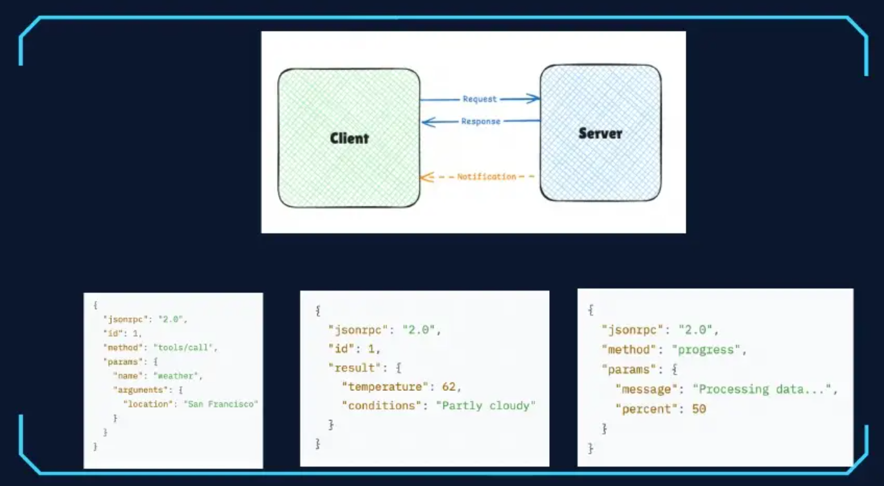

Slide 7

What MCP Enables in the Real World
Intelligent Agents
Creative Workflows
AI assistants accessing calendars, Notion databases, and enterprise tools seamlessly through standardised connections.
Claude Code building functional applications directly from Figma designs, bridging design and development.
Enterprise Integration
Physical Workflows
Chatbots querying multiple data sources simultaneously, providing unified answers from disparate systems.
AI interacting with design tools like Blender and hardware systems including 3D printers for end-to-end production.

Slide 8
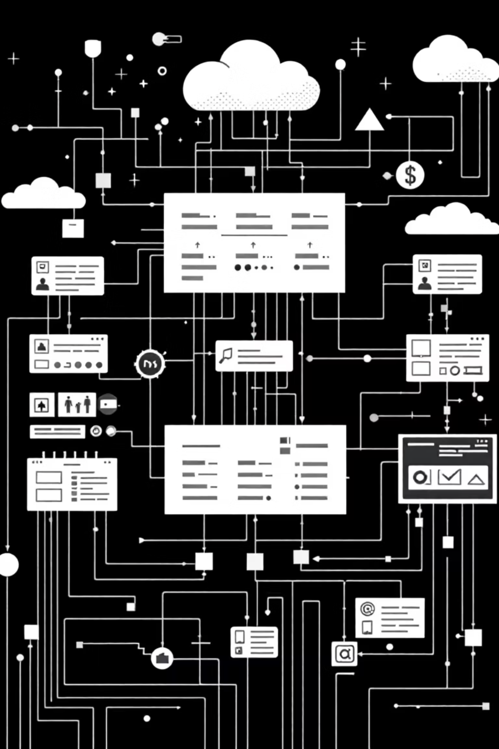




MCP Architecture: Client-Server Model
MCP Host
The AI application (e.g., Claude Desktop) that orchestrates interactions and maintains the primary user interface.
MCP Client
Embedded within the host, manages protocol communication and handles requests to MCP servers.
MCP Server
Exposes resources, tools, and prompts. Can run locally via STDIO or remotely via Streamable HTTP.
Key Concept: MCP servers can run locally for file system access or remotely for cloud-based services, providing flexibility in deployment architecture.

Slide 9
Understanding MCP's Two Layers
Data Layer
Transport Layer
Defines the core protocol using JSON-RPC for structured communication. Manages lifecycle events, capability negotiation, and primitives like tools, resources, and prompts.
Handles physical communication and authentication between components. Supports multiple transport mechanisms including STDIO for local processes and HTTP for remote services.
Protocol specification and primitives
Communication protocols
Lifecycle management
Authentication mechanisms
Request-response patterns
Connection management
This architectural separation enables MCP to remain transport-agnostic whilst maintaining consistent protocol semantics across different deployment scenarios.

Slide 10
✅ API ENDPOINT FOR AI AGENTS INSTEAD OF A WEBSITE
NOT NEW !!!!!!!
EVRYTHING IS API BUT REPACKAGED IN A DIFFERENT WAY FOR AI AGENTS SPECIFICALLY
MCP SERVERS ARE APIS BUT FOR AGENTS

Slide 12
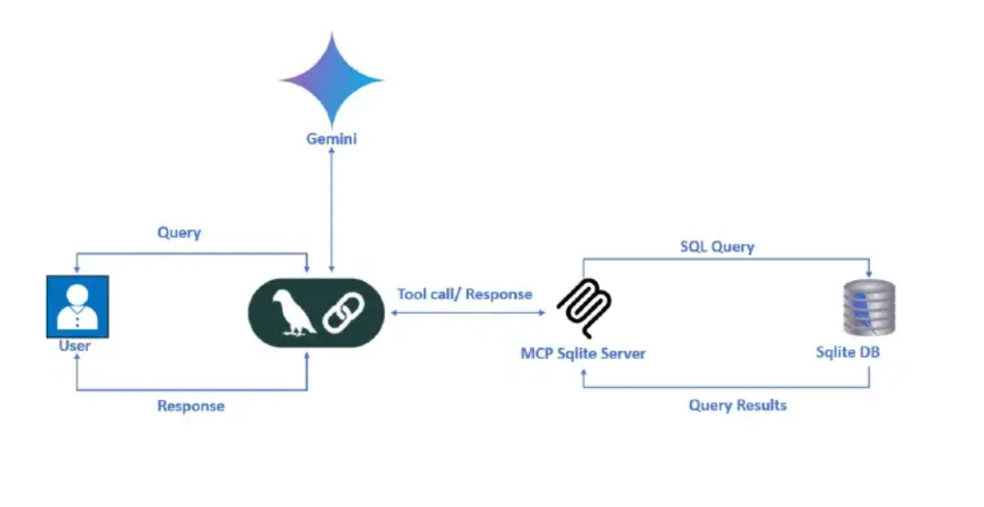

Slide 13
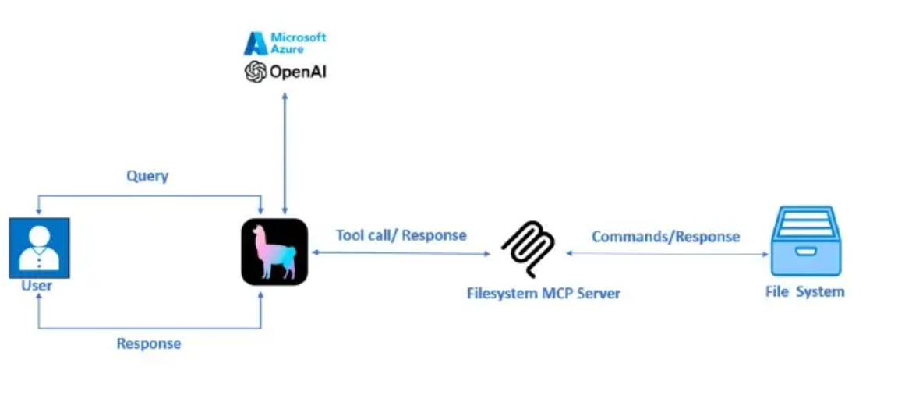

Slide 14
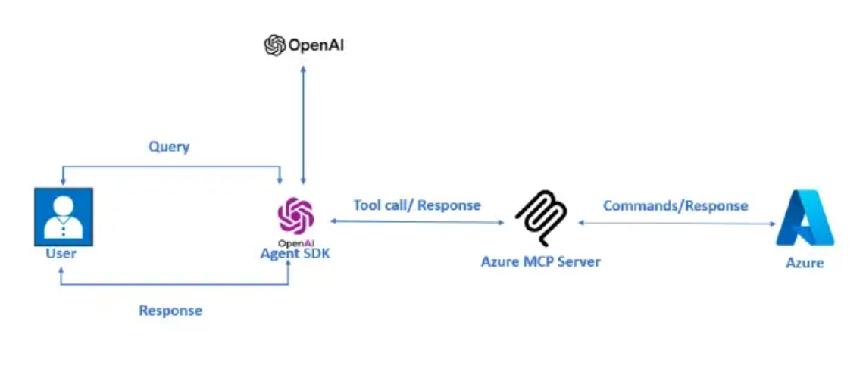

Slide 15
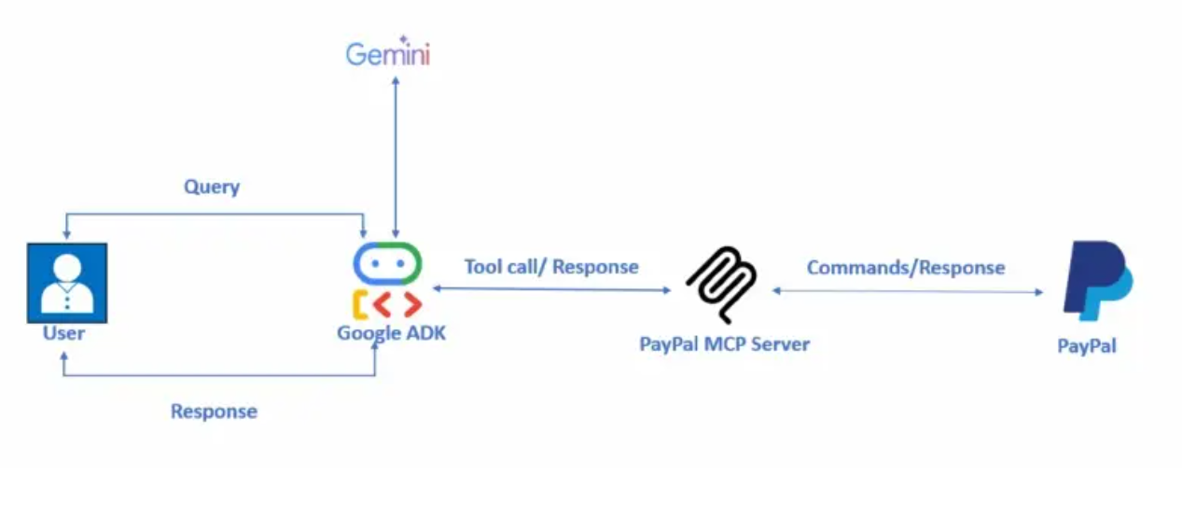

Slide 16






Data Layer: Core Primitives
Tools
Resources
Executable actions that AI can invoke, such as querying databases, sending emails, or manipulating files. Each tool defines parameters and expected outputs.
Contextual data sources that provide information to AI, including file contents, database records, or API responses. Resources are read-only by default.
Prompts
Sampling
Reusable interaction templates that structure AI conversations. Define workflows, questioning patterns, and response formats for consistent experiences.
Enables servers to request AI completions through the client, maintaining human oversight whilst allowing complex multi-step reasoning.
Elicitation
Logging
Structured requests for user input, allowing servers to gather necessary information through standardised prompts and validation.
Centralised event tracking and debugging capability, enabling servers to emit structured logs that clients can capture and display.

Slide 17
Lifecycle & Tool Interaction Flow
Initialisation
1
Client and server establish connection, exchange protocol versions, and negotiate supported capabilities through the initialize handshake.
2
Tool Discovery
Client sends tools/list request. Server responds with available tools, their parameters, descriptions, and JSON schemas for validation.
Tool Execution
3
AI decides to use a tool. Client sends tools/call with tool name and arguments. Server validates parameters and executes the requested action.
4
Response Handling
Server returns structured content including results, errors, or additional context. Client processes response and integrates into conversation flow.
Dynamic Updates
5
Server emits notifications when capabilities change. Client receives tools/list_changed, re-queries available tools, and updates AI's awareness.

Slide 18
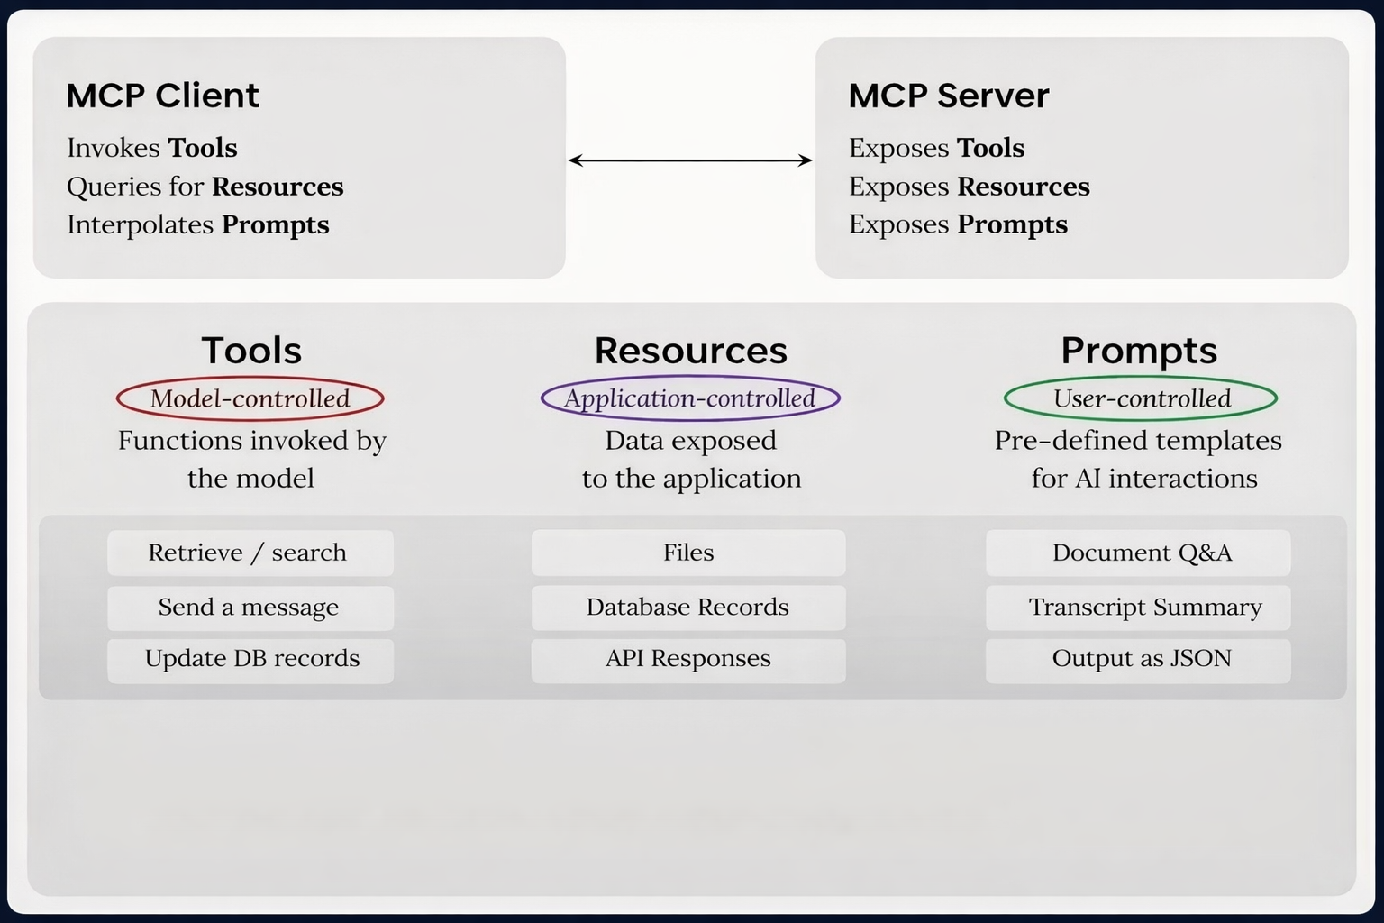

Slide 19
Advantages
Universal Integration: MCP simplifies connecting AI models to diverse tools (e.g., GitHub, Slack, Google Drive) with a single protocol, reducing the need for custom integrations.
Real-Time Data Access: Enables dynamic, two-way communication for up-to-date responses, perfect for workflows like code analysis or CRM automation.
Scalability & Modularity: Supports multiple transport methods (e.g., WebSockets, HTTP SSE) and modular server designs for flexible, reusable components.
Open-Source Ecosystem: Backed by a growing community with 250+ pre-built servers, fostering collaboration and rapid development.
Security: Built-in OAuth 2.0 and isolated connections enhance data protection during integrations.

Slide 20
Disadvantages
Learning Curve: Developers need to understand JSON-RPC and server setup, which can be challenging for beginners.
Early-Stage Limitations: As a young protocol, MCP lacks a standardized authentication mechanism and has limited long-term performance data.
Security Risks: Potential vulnerabilities like prompt injection or tool permission issues require careful implementation.
Fragmentation Risk: Without a centralized registry, finding reliable MCP servers can be time-consuming.

Slide 21

?

