Slide 1
Novel Corona Virus 2019 Class Project 1 – Group 5
Team Members:
Julio Montano
Ishan Chakrabarty
Morteza Akbari
Revathi Subramanian Lakshmanan
Clay Swisher

Slide 2
Novel Corona Virus 2019
Project Summary/Objectives
The team objectives are to identify significant trends of the global Covid-19 outbreak from January 2020 through April 2021. In addition, the team will look at trends of the Covid-19 outbreak in relationship to World Population, GDP, and available vaccinations.
Pandas data queries, Matplotlib data visualization charts, and GMaps will be used for analysis.
Questions asked by the Team
Where did the first Covid-19 cases get reported?
Availability vaccinations by manufacturer and country?
Does GDP and population have any impact or influence on the covid 19 outbreak?
Which countries are impacted the most and least by the covid 19 outbreak?
Notes:
Julio

Slide 3
Novel Corona Virus 2019 – Cont’d
Team’s considerations:
Were the questions answered to the team's satisfaction?
The team was able to successfully locate the data sources for Covid 19 Cases, Covid 19 Vaccinations, World Population, and GDP it believed would to be reasonably sufficient toward answering the teams' questions.
During the team's analysis, the following were noted as deviations from what would normally be expected:
Mexico - unusually high percent relationship between deaths and the number of confirmed Covid 19 cases.
US - discontinuance of reporting Covid 19 recoveries in mid December 2020.
Global GDP published by the World Bank and World population numbers are available as of 2019 (vs. 2020).
Notes:
Julio

Slide 4
Novel Corona Virus 2019
Source Data used for answering team questions:
Primary Sources from www.Kaggle.com
World Bank GDP Ranking for 2019
https://www.kaggle.com/theworldbank/world-bank-gdp-ranking
World Population of each country for 2019
https://www.kaggle.com/vaishnavivenkatesan/world-population
World Vaccinations up to May 2021
https://www.kaggle.com/xholisilemantshongo/vaccination-progress
https://www.kaggle.com/deblina00/insights-on-eda-of-covid19-world-vaccination
World Health Organization tables
https://www.kaggle.com/sudalairajkumar/novel-corona-virus-2019-dataset
Global Time Series on covid -19 affected cases – 3 separate files: Confirmed, Deaths, Recovered
Optional data, not directly used in analysis:
Johns Hopkins University (GitHub Repository)

Slide 5
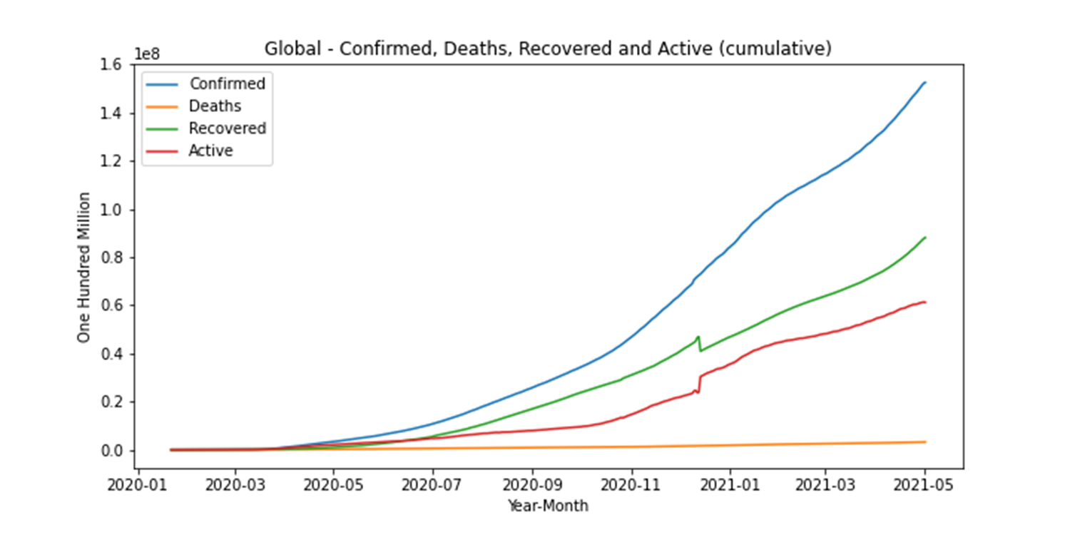

Covid-19 Cumulative Global Cases
Confirmed Cases = Active Cases + Recovered Cases + Deaths
0.502e8 = 0.16e8 + 0.33e8 + 0.012e8
50.3 M = 16 M + 33 M + 1.3 M
Note: Effective 12/14/2020, the US discontinued reporting the number of recoveries on a daily bases. This represents a 6.3M adjustment to cumulative recoveries. The US has continued to report "zero" recoveries since.

Slide 6
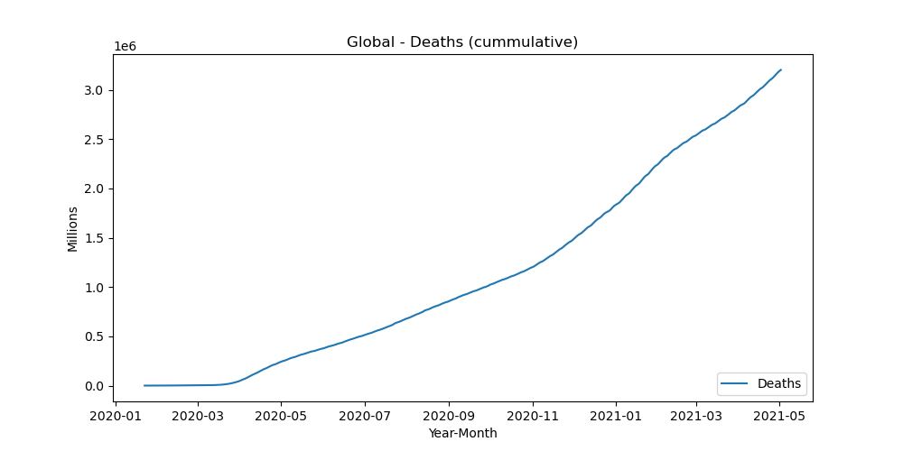
Covid-19 Cumulative Deaths
1.3 e6 = 0.012 e8

Slide 7
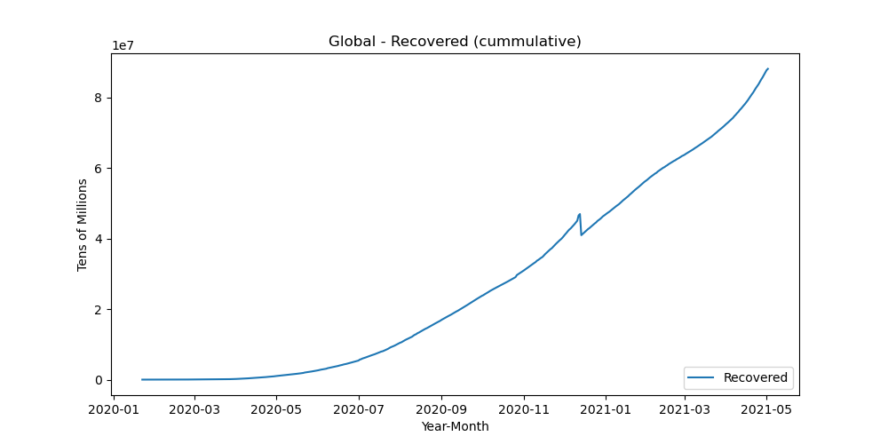
Covid-19 Cumulative Recoveries
Note: Effective 12/14/2020, the US discontinued reporting the number of recoveries on a daily bases. This represents a 6.3M adjustment to cumulative recoveries. The US has continued to report "zero" recoveries since.

Slide 8
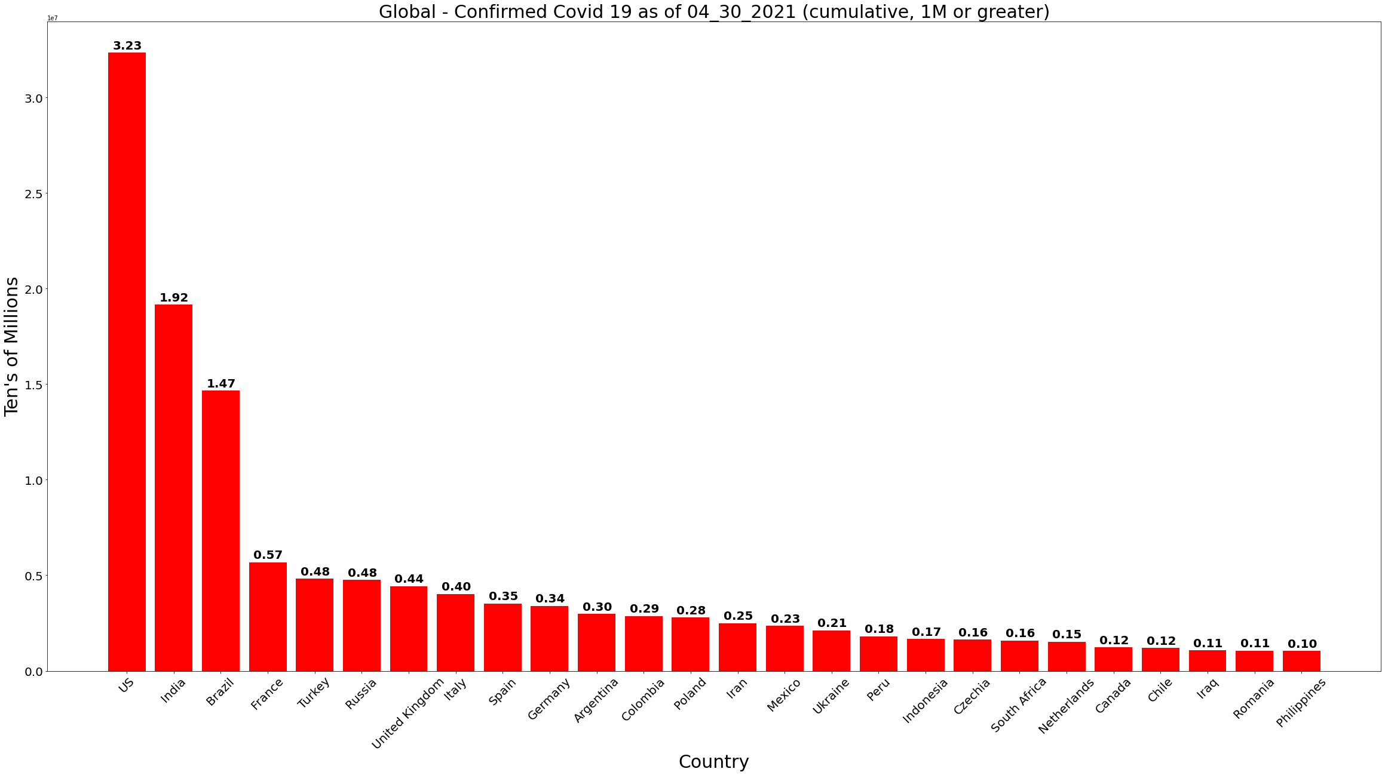
Covid-19 Confirmed - 1M or greater cases

Slide 9
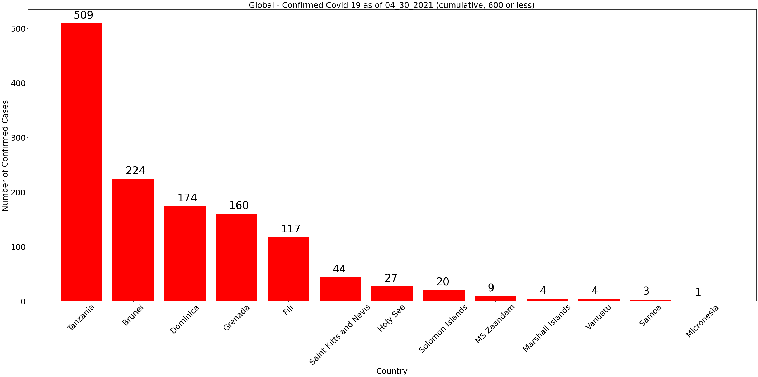
Covid-19 Confirmed (less than 600 cases reported)
Islands in the Pacific and Atlantic oceans, are likely benefiting by bordering only the sea. Strict travel policies may be responsible for low confirmed cases.

Slide 10
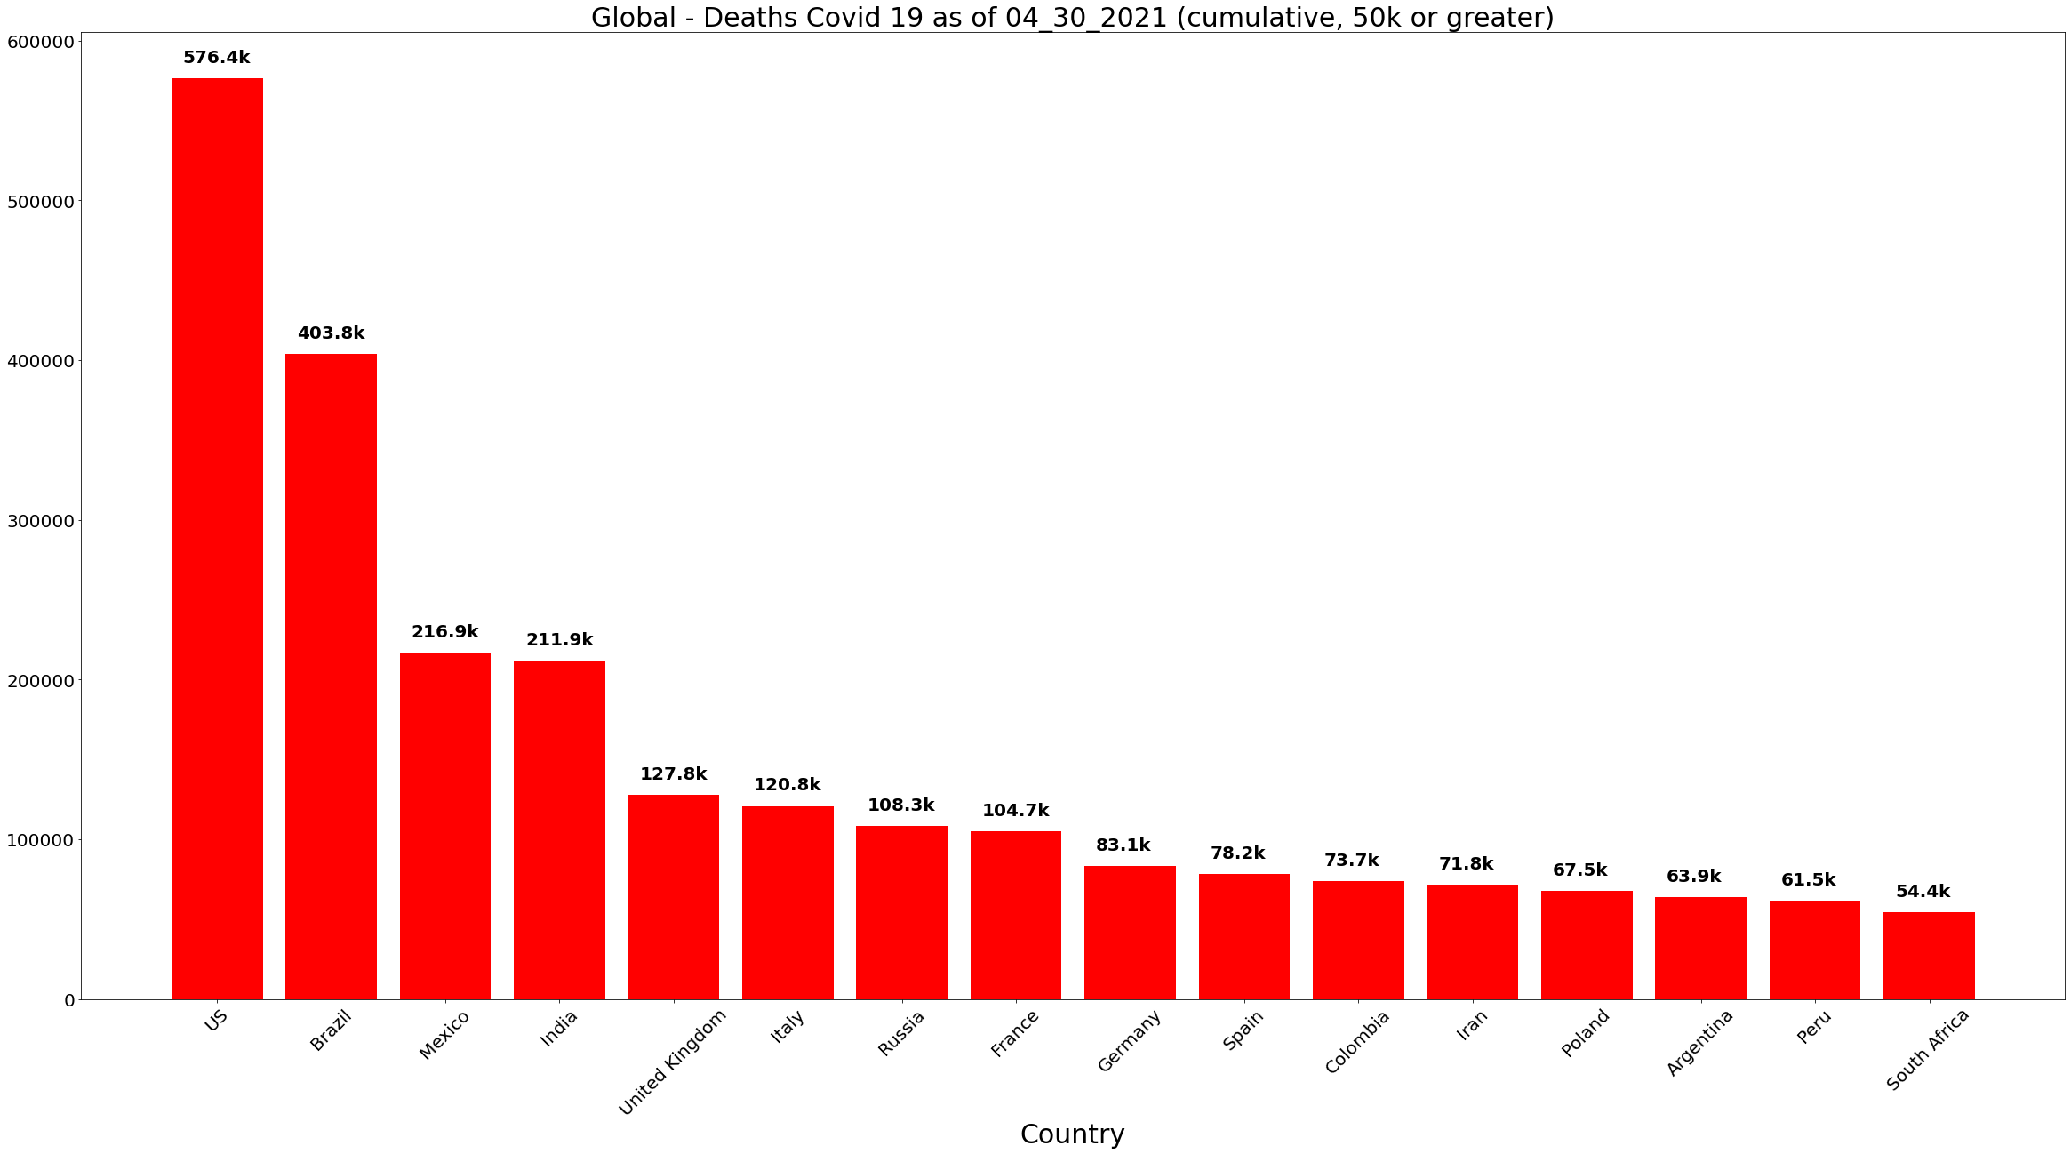
Covid-19 Deaths

Slide 11
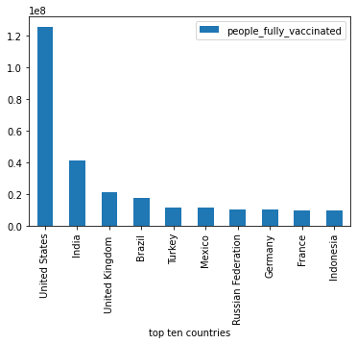
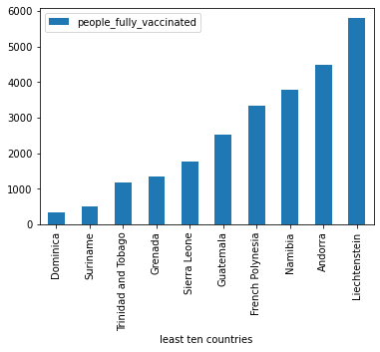
Covid-19 Fully Vaccinated (Top Ten and Least Ten Countries)

Slide 12
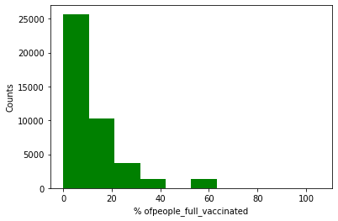
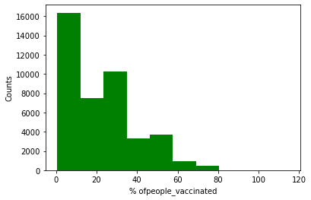
Covid-19 Vaccine Percentages
Full Vaccinations
Partial (Single Dose) Vaccinations

Slide 13
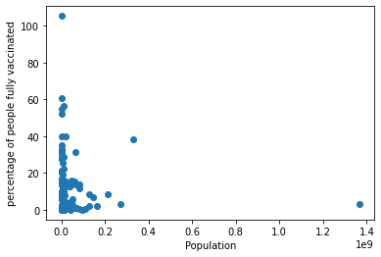
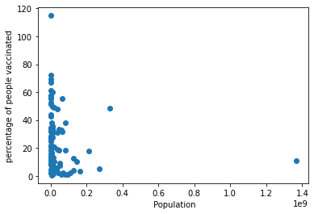
Covid-19 Vaccine Percentages
Full Vaccinations
Partial (Single Dose) Vaccinations

Slide 14
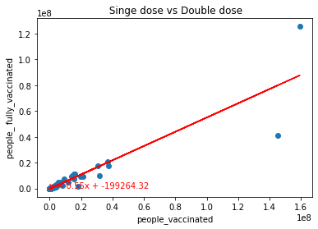
Covid-19 Vaccine Percentages

Slide 15
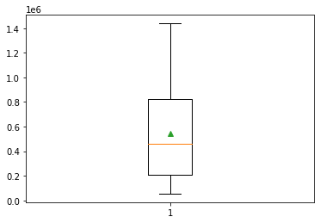
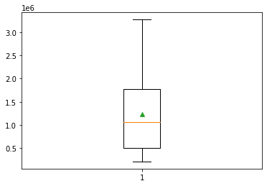
Covid-19 Vaccine Percentages
(Box plot excludes outliers)
Full Vaccinations
Partial (Single Dose) Vaccinations

Slide 16
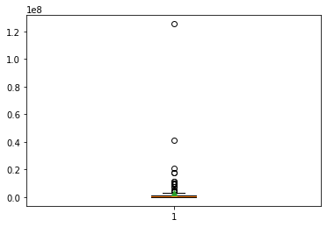
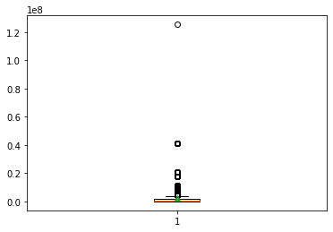
Covid-19 Vaccine Percentages
(Box plot with outliers)
Full Vaccinations
Partial (Single Dose) Vaccinations

Slide 17
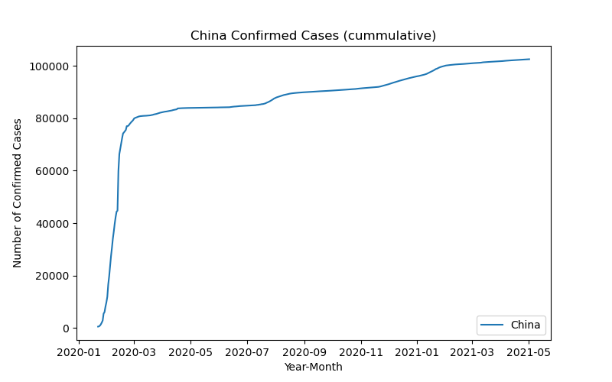
Covid-19 China Confirmed Cases
On 01/22/2020, China was the first Country to report 500+ covid 19 cases to the World Health Organization. As of 4/30/2020, the total confirmed cases in China was 102k.
Comment from the World Health Organization : On 31 December 2019, WHO was alerted to several cases of pneumonia in Wuhan City, Hubei Province of China.
Note: 2019 Novel Coronavirus (2019-nCoV) is a virus (more specifically, a coronavirus) identified as the cause of an outbreak of respiratory illness first detected in Wuhan, China.
Notes:
Despite being the first place to be hit by COVID-19, China was well-placed to tackle the disease. It has a centralized epidemic response system. Most Chinese adults remember SARS-CoV and the high mortality rate that was associated with it. Only 3% of China's elderly population live in care homes, whereas in several western countries, such facilities have been major sources of infection.

Slide 18
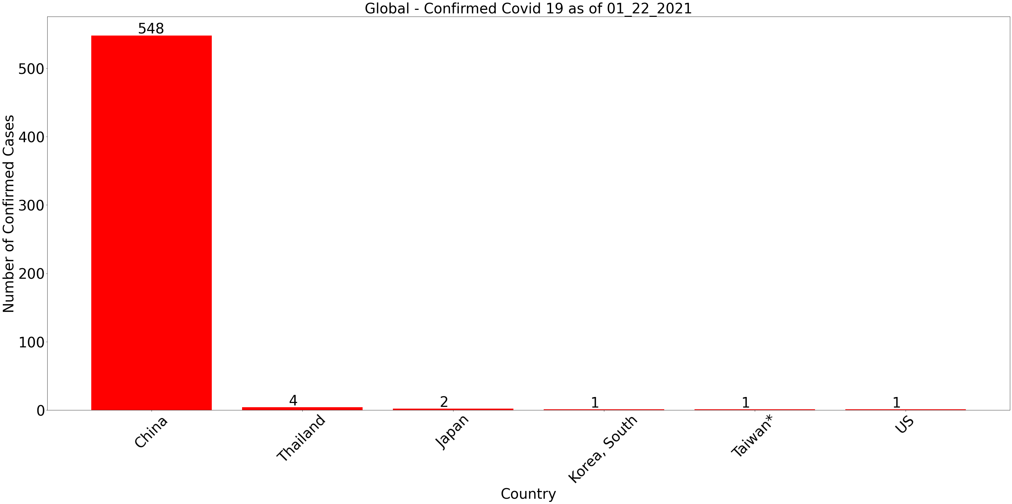
Where did the first Covid-19 cases get reported?
Note: China reported 17 deaths on January 22, 2020.
Notes:
Despite being the first place to be hit by COVID-19, China was well-placed to tackle the disease. It has a centralized epidemic response system. Most Chinese adults remember SARS-CoV and the high mortality rate that was associated with it. Only 3% of China's elderly population live in care homes, whereas in several western countries, such facilities have been major sources of infection. Comment from the World Health Organization : On 31 December 2019, WHO was alerted to several cases of pneumonia in Wuhan City, Hubei Province of China. Note: 2019 Novel Coronavirus (2019-nCoV) is a virus (more specifically, a coronavirus) identified as the cause of an outbreak of respiratory illness first detected in Wuhan, China.

Slide 19
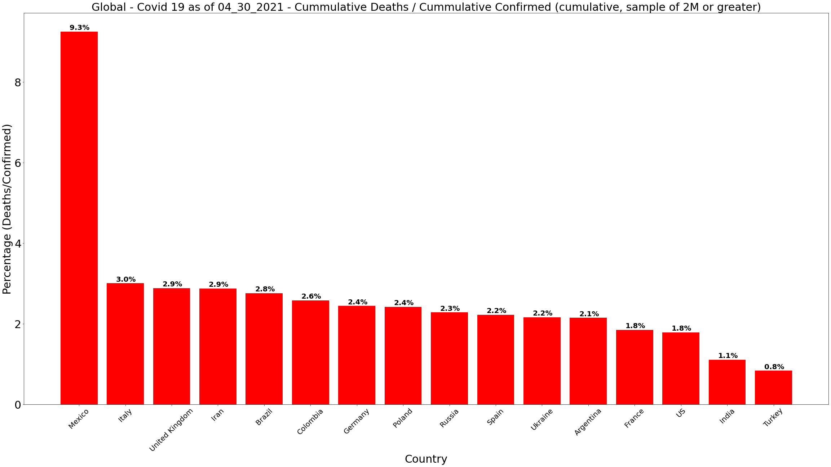
Covid-19 Deaths – Percent (Deaths/Confirmed) (Countries with 2M or greater confirmed cases)

Slide 20
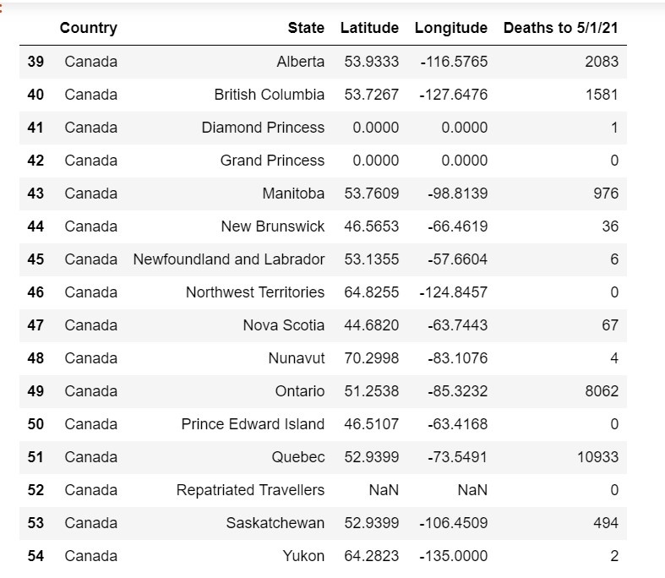
Data Set Anomalies and Inconsistencies
Anomalies
High variation in data ranges
Outlier influence
Inconsistencies
Not consistent reporting
Country names between data sources
Reporting granularity

Slide 21
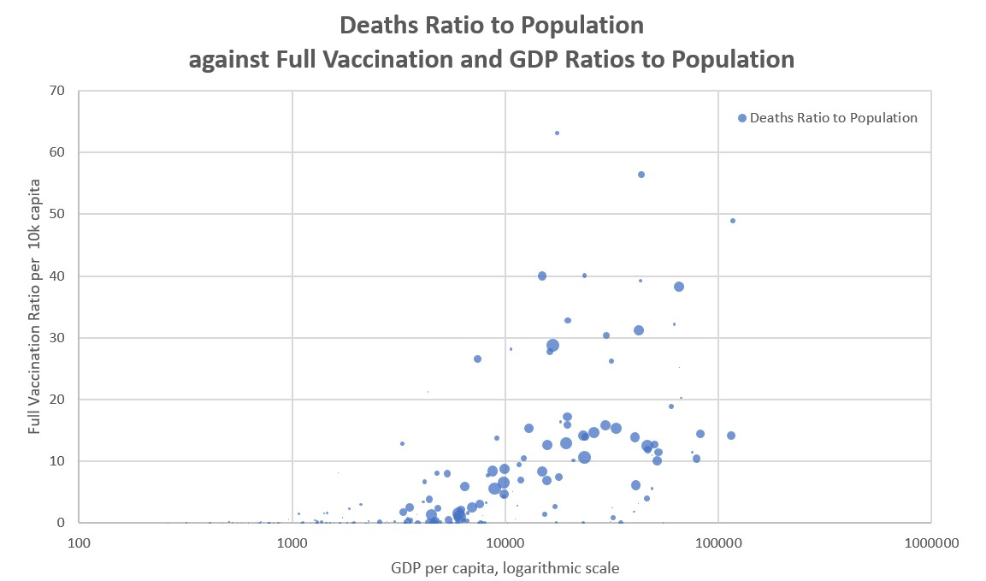
Novel Corona Virus 2019 Class Project 1 – Group 5

Slide 22
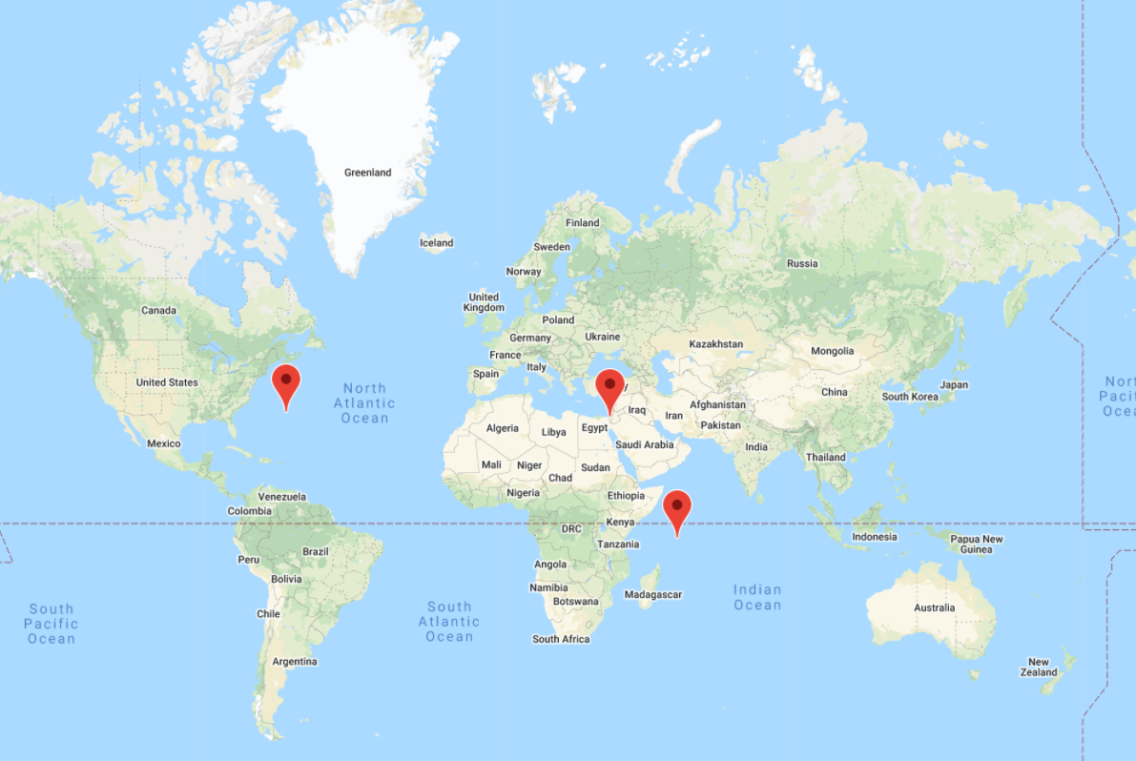
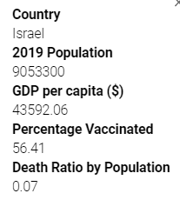
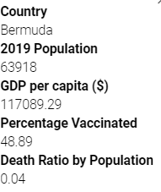
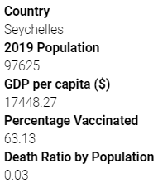
Covid-19 Countries: Bermuda, Israel, Seychelles
High GDP, High Vaccination Rate, and Low Death Rate by Population

Slide 23
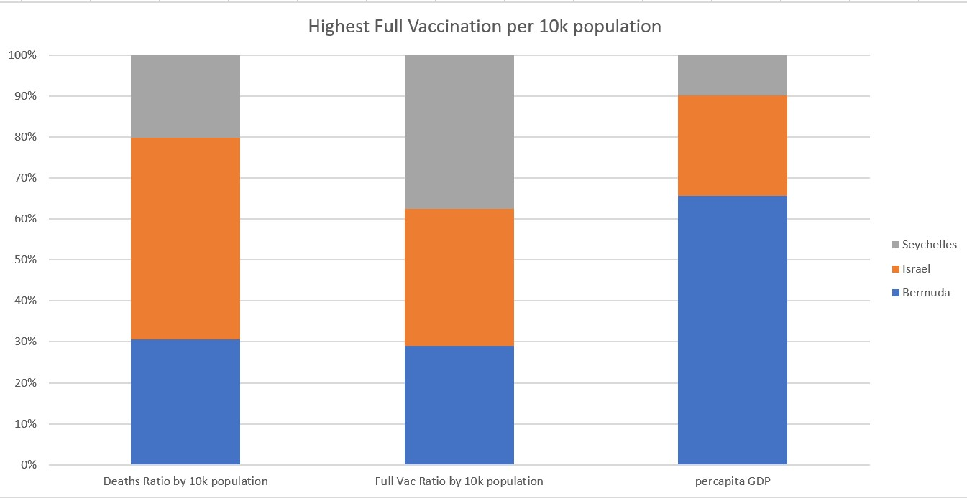
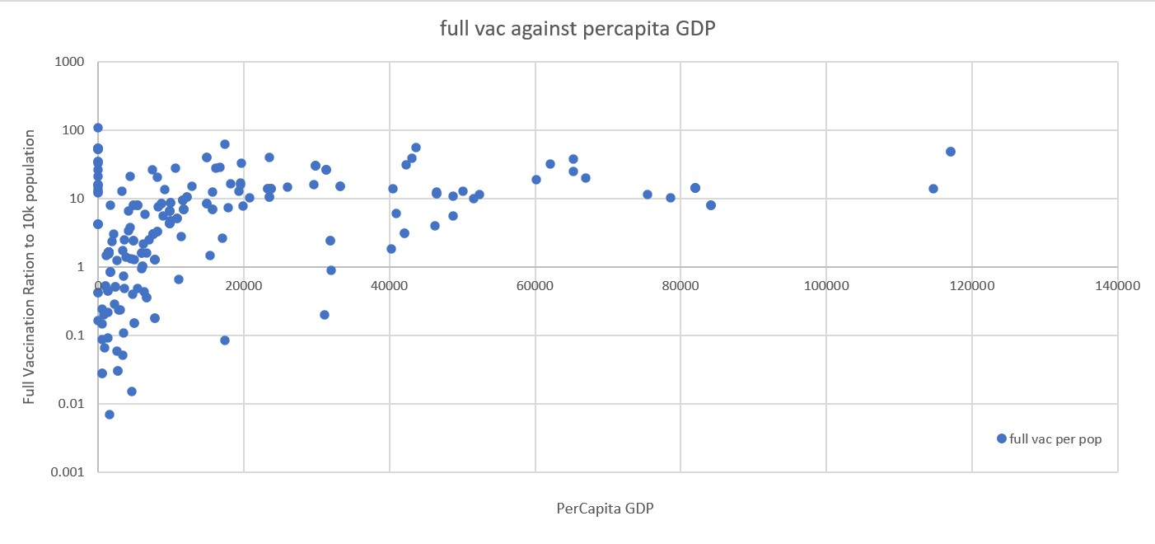
Novel Corona Virus 2019 Class Project 1 – Group 5

Slide 24
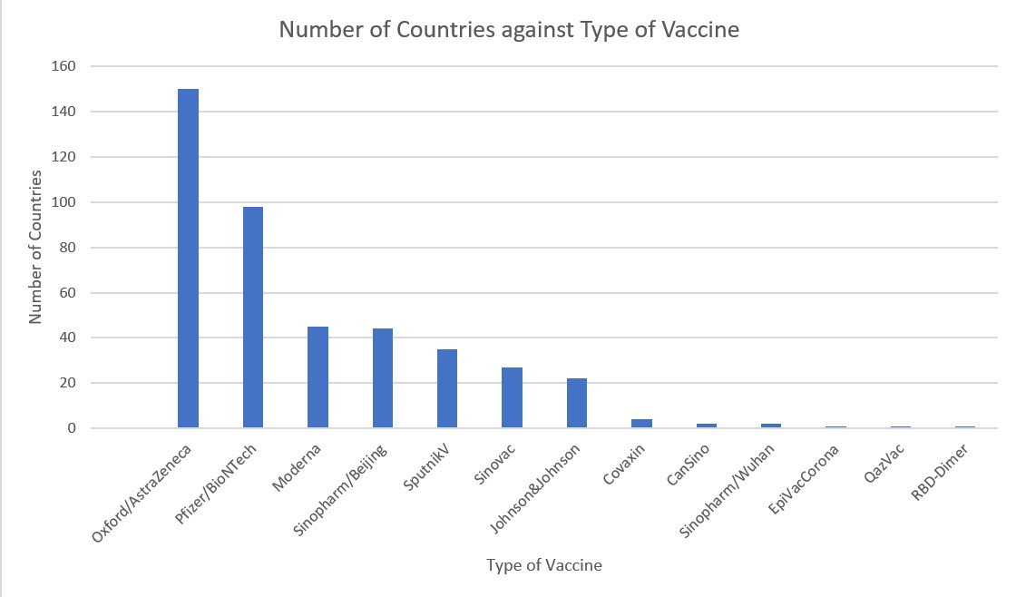
Novel Corona Virus 2019 Class Project 1 – Group 5

Slide 25
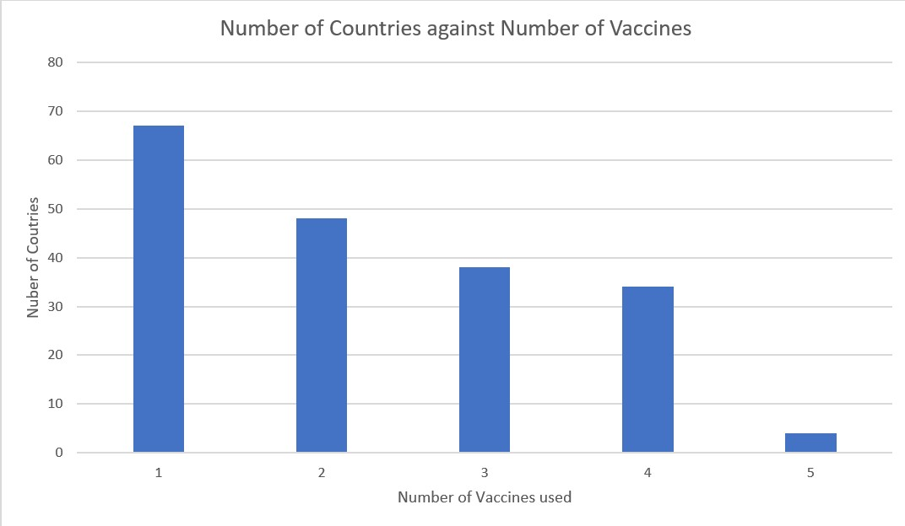
Novel Corona Virus 2019 Class Project 1 – Group 5

Slide 26
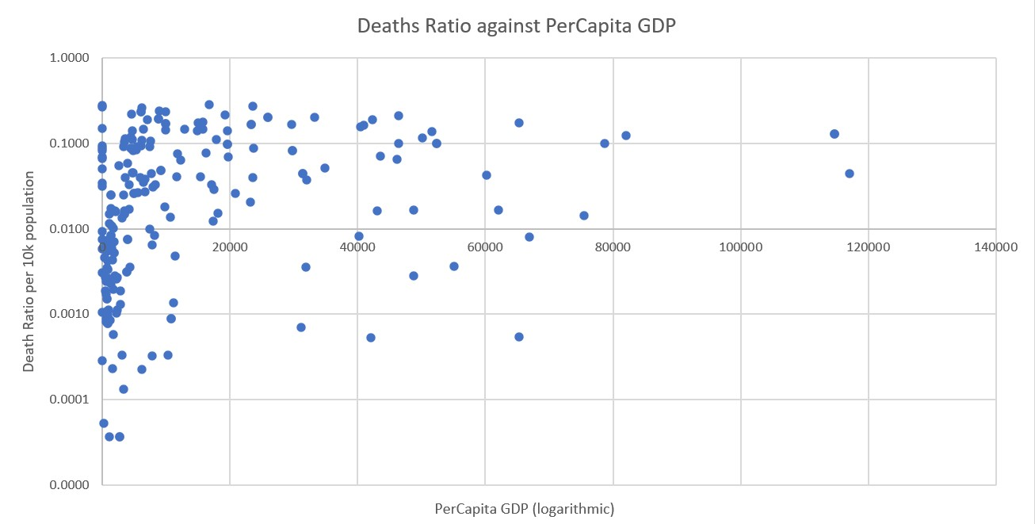
Novel Corona Virus 2019 Class Project 1 – Group 5

Slide 27
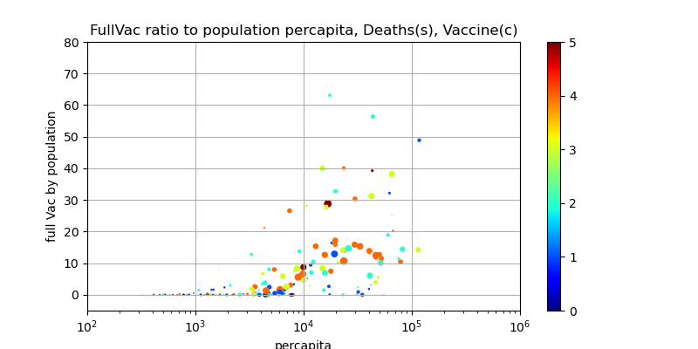
Novel Corona Virus 2019

Slide 28

Questions & Recommendations
Recommended Future Analysis
Use updated data reports
Further cleanup of country names
Segregate non-reporting or limited reporting countries

