Slide 1
Novel Corona Virus 2019 Class Project 1 – Group 5
Team Members:
Julio
Ishan Chakrabarty
Morteza Akbari
Revathi Subramanian Lakshmanan
Clay Swisher

Slide 2
Novel Corona Virus 2019
Project Summary/Objectives
The team objectives are to identify significant trends of the global Covid-19 outbreak from January 2020 through April 2021. In addition, the team will look at trends of the Covid-19 outbreak in relationship to World Population, GDP, and available vaccinations.
Pandas data queries and Matplotlib data visualization charts will be used for analysis.
Questions asked by the Team
Where did the Covid 19 outbreak originate?
Available vaccinations by manufacturer and country?
Does GDP and World population have any impact or influence on the covid 19 outbreak?
Which countries are impacted the most and least by the covid 19 outbreak?
Were the questions answered to the teams satisfaction?

Slide 3
Covid-19 Data Analytics
Source Data used for answering team questions:
World Bank GDP Ranking
https://www.kaggle.com/theworldbank/world-bank-gdp-ranking
World Population of each country
https://www.kaggle.com/vaishnavivenkatesan/world-population
World Vaccinations
https://www.kaggle.com/xholisilemantshongo/vaccination-progress
https://www.kaggle.com/deblina00/insights-on-eda-of-covid19-world-vaccination
Johns Hopkins University (GitHub Repository) - Global Time Series on covid -19 affected cases – 3 separate files: Confirmed, Deaths, Recovered
World Health Organization https://www.kaggle.com/sudalairajkumar/novel-corona-virus-2019-dataset. Data is extracted by Johns Hopkins University using google sheets and made available in Kaggle.com

Slide 4
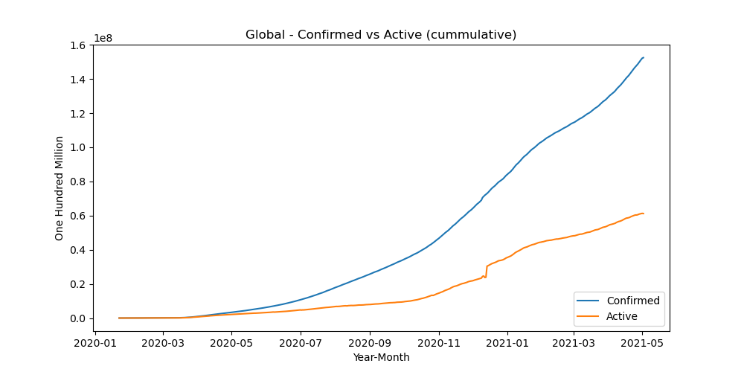
Covid-19 Confirmed

Slide 5
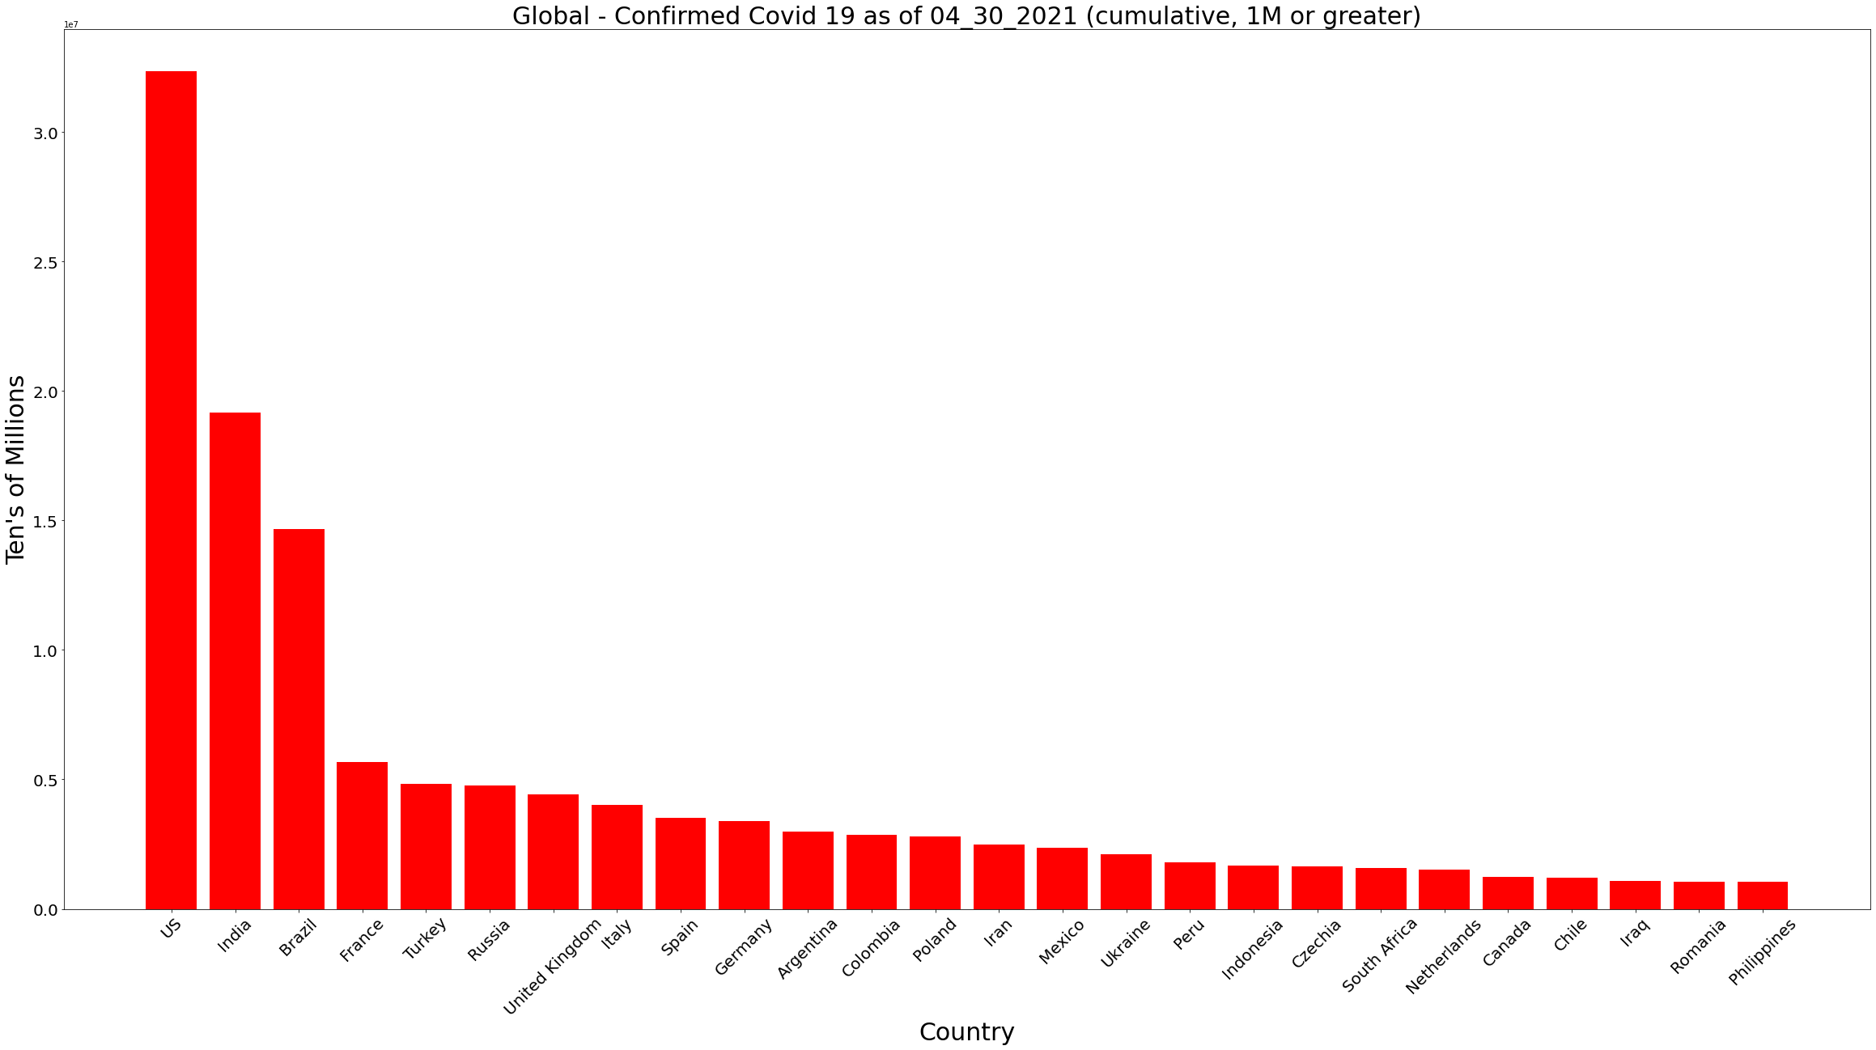
Covid-19 Confirmed

Slide 6
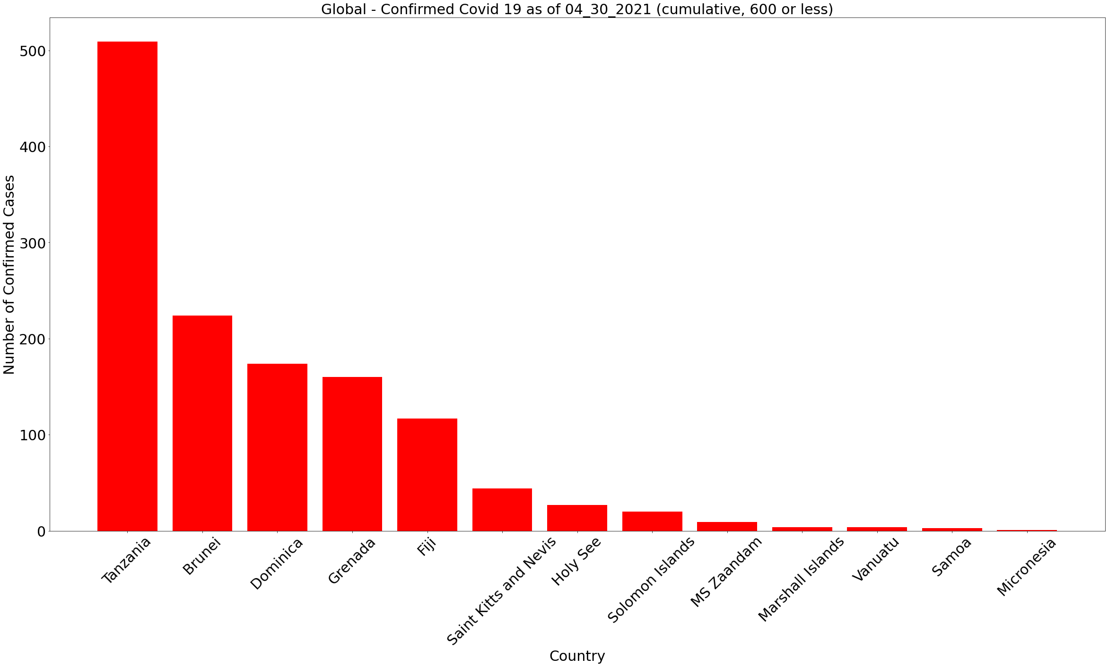
Covid-19 Confirmed
Islands in the Pacific and Atlantic oceans, and are likely benefiting by bordering only the sea. Strict travel policies may be responsible for low confirmed cases.

Slide 7
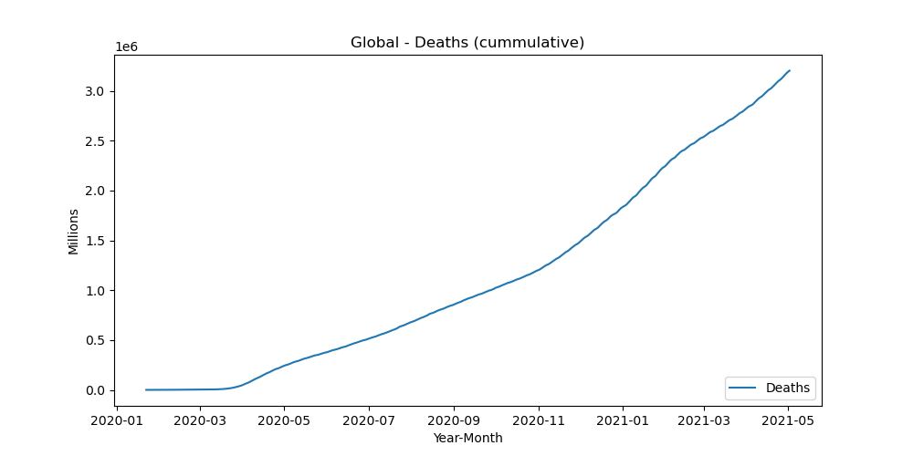
Covid-19 Deaths

Slide 8
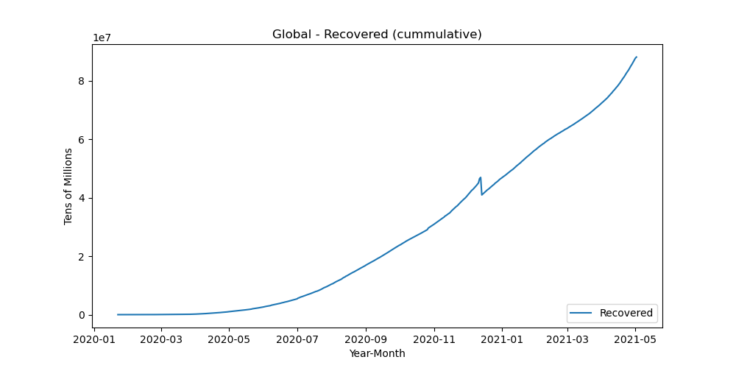
Covid-19 Recoveries
Note: Effective 12/14/2020, the US discontinued reporting the number of recoveries on a daily bases. This represents a 6.3M adjustment to cumulative recoveries. The US has continued to report "zero" recoveries since.

Slide 9
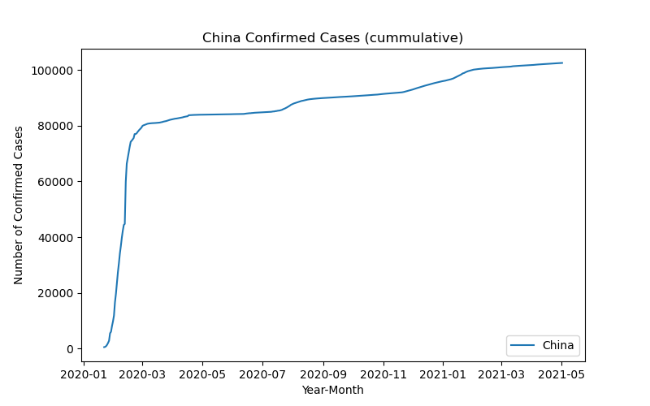
Covid-19 China Confirmed Cases
On 01/22/2020, China was the first Country to report 500+ covid 19 cases to the World Health Organization. As of 4/30/2020, the total confirmed cases in China was 102k
Comment from the World Health Organization : On 31 December 2019, WHO was alerted to several cases of pneumonia in Wuhan City, Hubei Province of China.
Note: 2019 Novel Coronavirus (2019-nCoV) is a virus (more specifically, a coronavirus) identified as the cause of an outbreak of respiratory illness first detected in Wuhan, China.

