Slide 1
Miles Per Gallon (MPG) Predictor
MAK

Slide 2
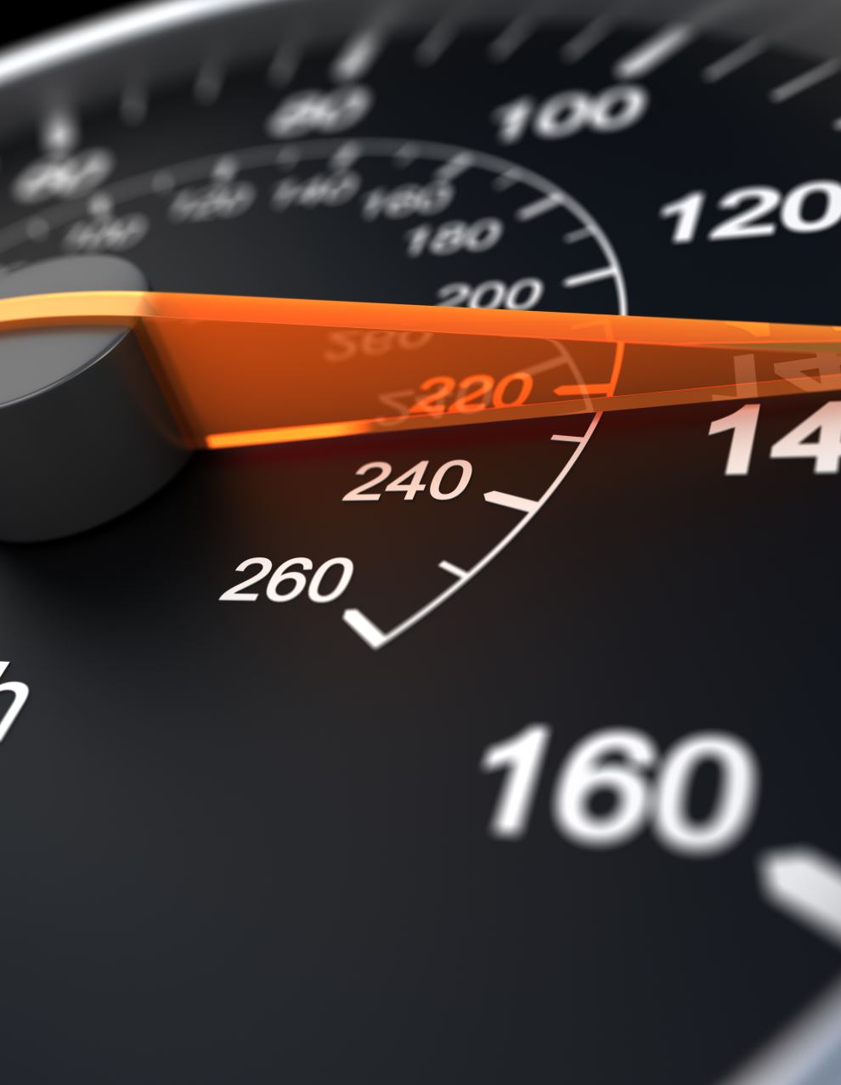
Slide 1: Introduction
Welcome to the MPG Predictor!
This Shiny app predicts a car’s fuel efficiency in terms of Miles Per Gallon (MPG) based on: - Horsepower (hp) - Number of cylinders (cyl)

Slide 3
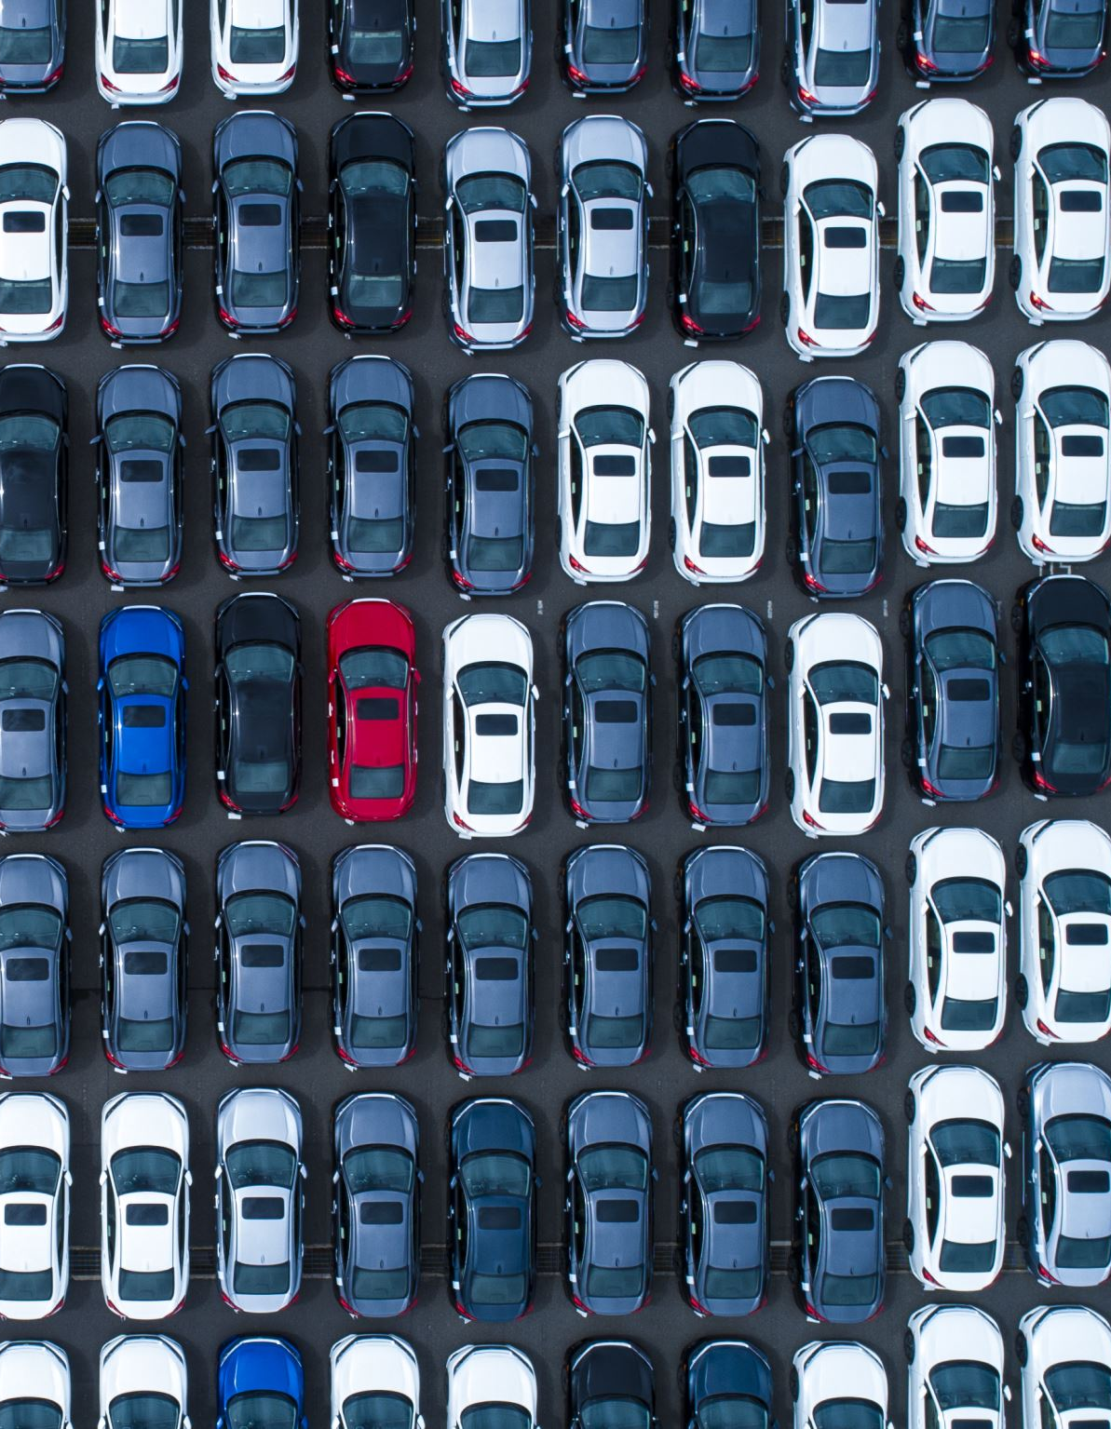
Slide 2: Problem Statement
Why is MPG important? - High MPG indicates better fuel efficiency, saving costs and reducing emissions. - Car buyers and manufacturers value fuel economy as a critical metric.

Slide 4

Slide 3: App Features
Key Features of the App 1. Dynamic User Inputs: - Select horsepower using a slider. - Choose the number of cylinders from a dropdown. 2. Real-time Predictions: - See MPG predictions instantly. 3. Interactive Visualization: - Explore relationships between horsepower and MPG.

Slide 5
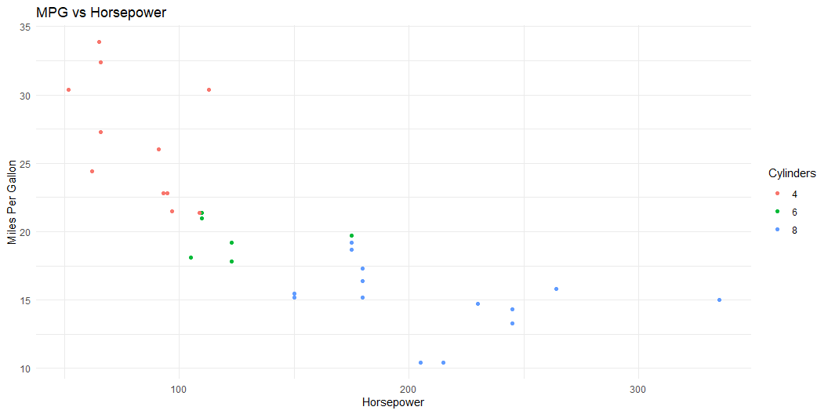
Slide 4: Demo

