Slide 1
Distributed sorting
Team White

Slide 2
Weekly progress
Week 1 → None, due to mideterm
Week 2 → Commit convention, planning
Week 3 → Flow, gRPC, gensort, merge algorithm, develop setting, Test case
Week 4 → Develop setting, discuss detailed implementation

Slide 3
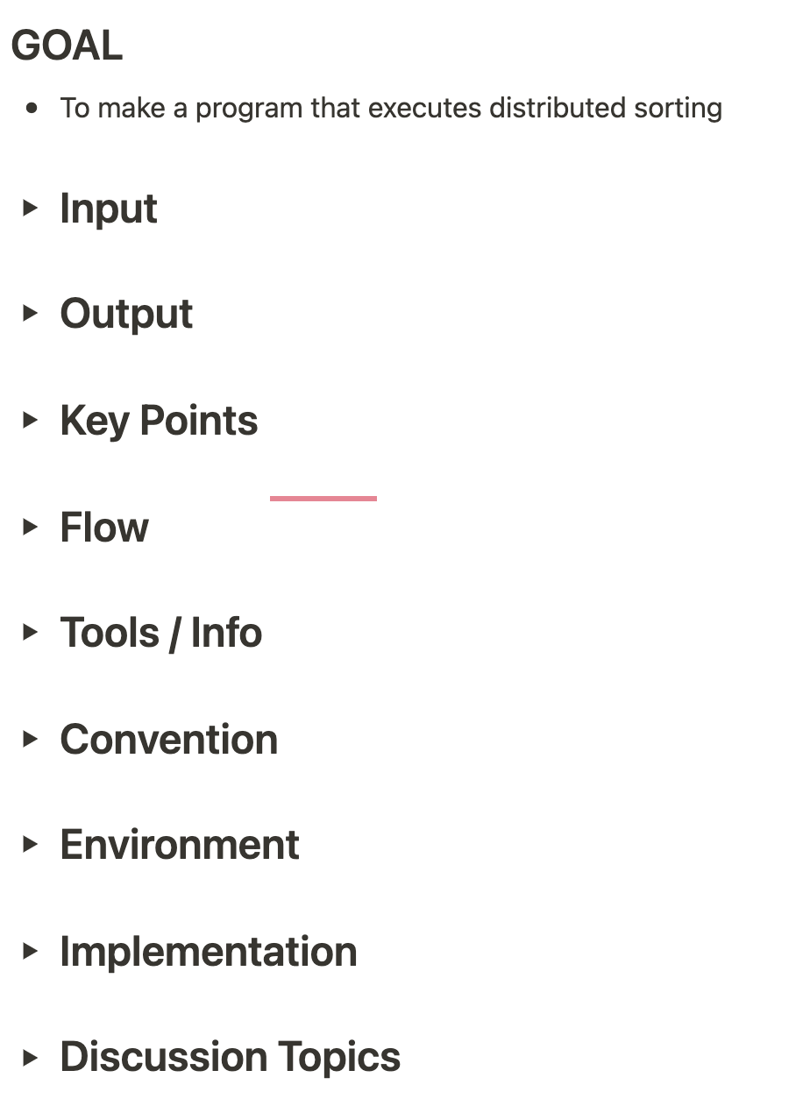
Logistic
Use notion to record our meetings / information
Weekly meeting for every Thursday, long time
Pop-up meeting when urgent → minimize
Record everything that needed
One leader, two followers

Slide 4
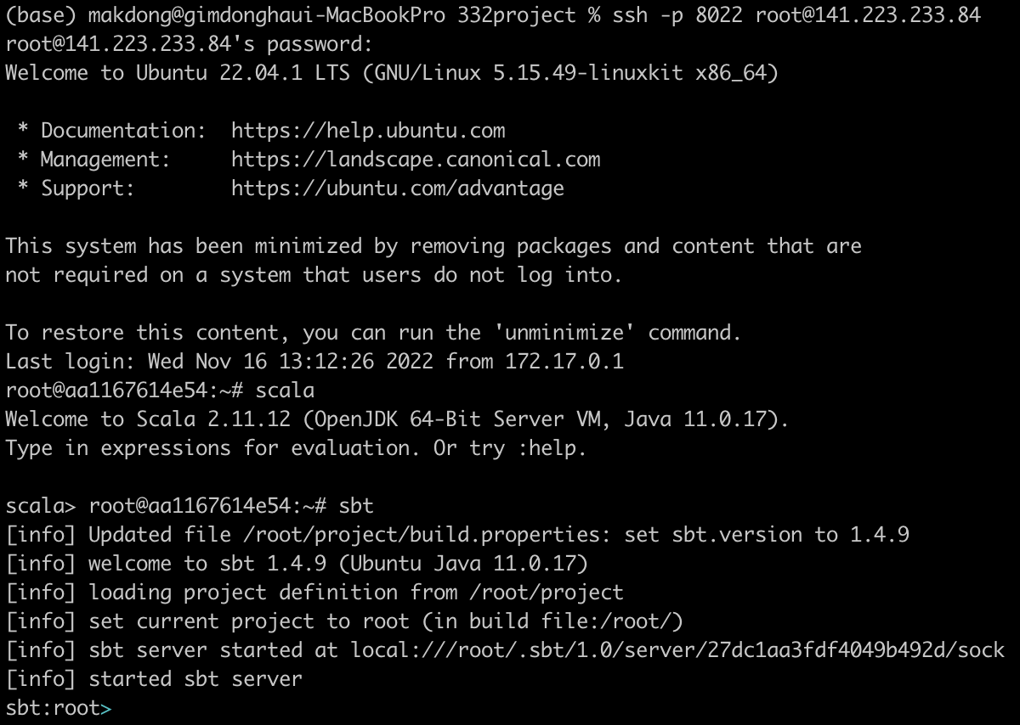
Details – server
Development settings
→ No cluster server, but local server
MacBook Pro (2019), Monterey 12.4
Mac mini (2021), Monterey 12.6
SBT 1.4.9
Scala 2.12.12
Java 11.0.17 (ubuntu Java)
ubuntu 22.04.1 (LTS)
docker

Slide 5
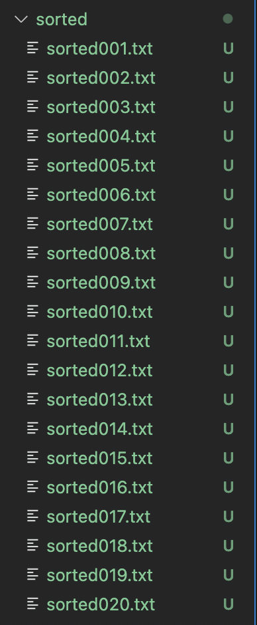
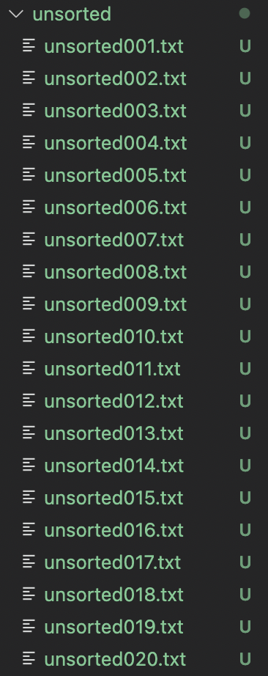
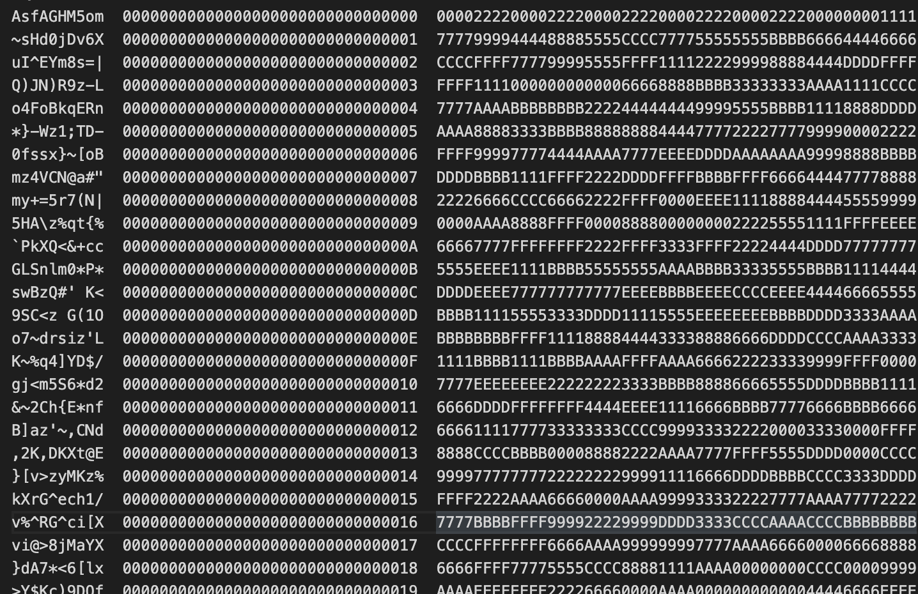
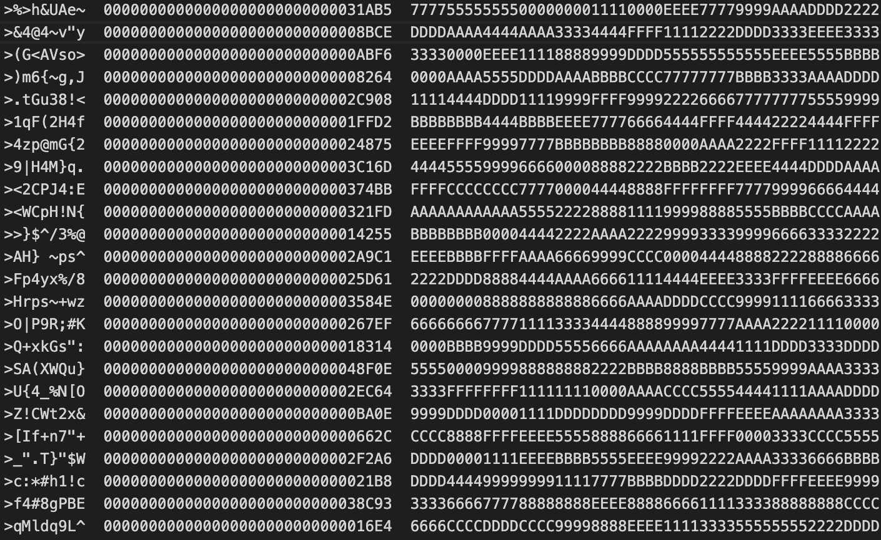
Details – library
Libraries → gRPC, log4j
Gensort for input data

Slide 6
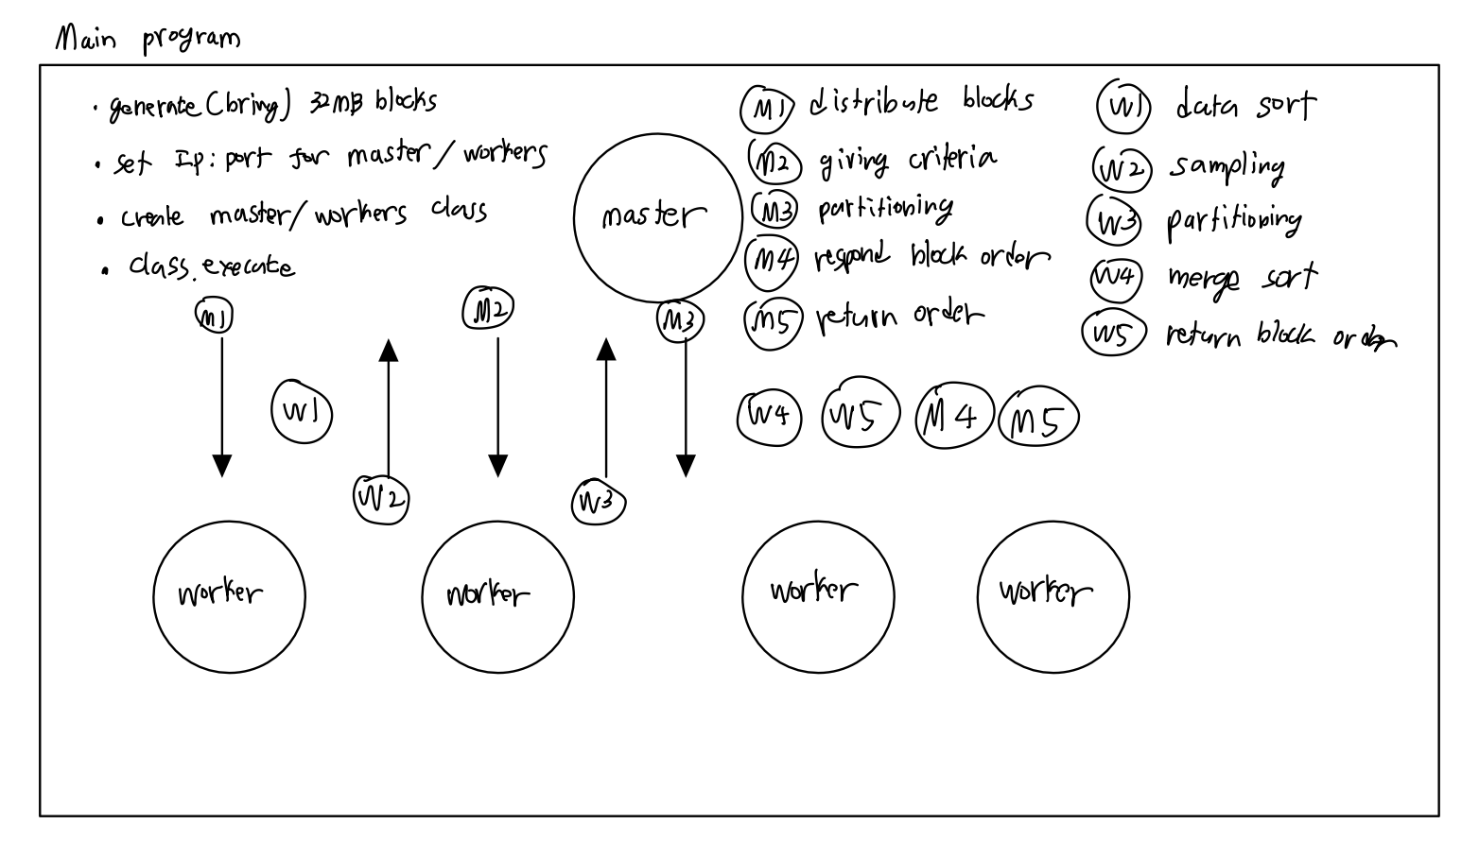
Overall design

Slide 7
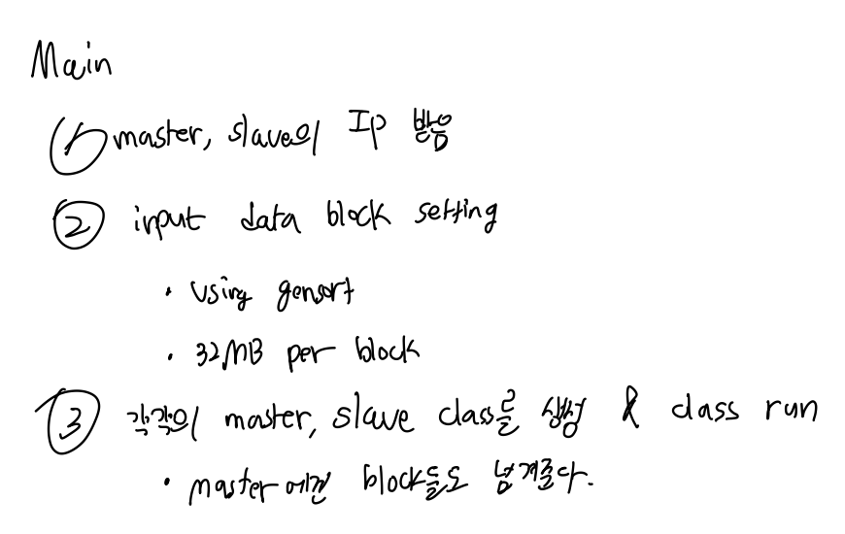
Design – main

Slide 8
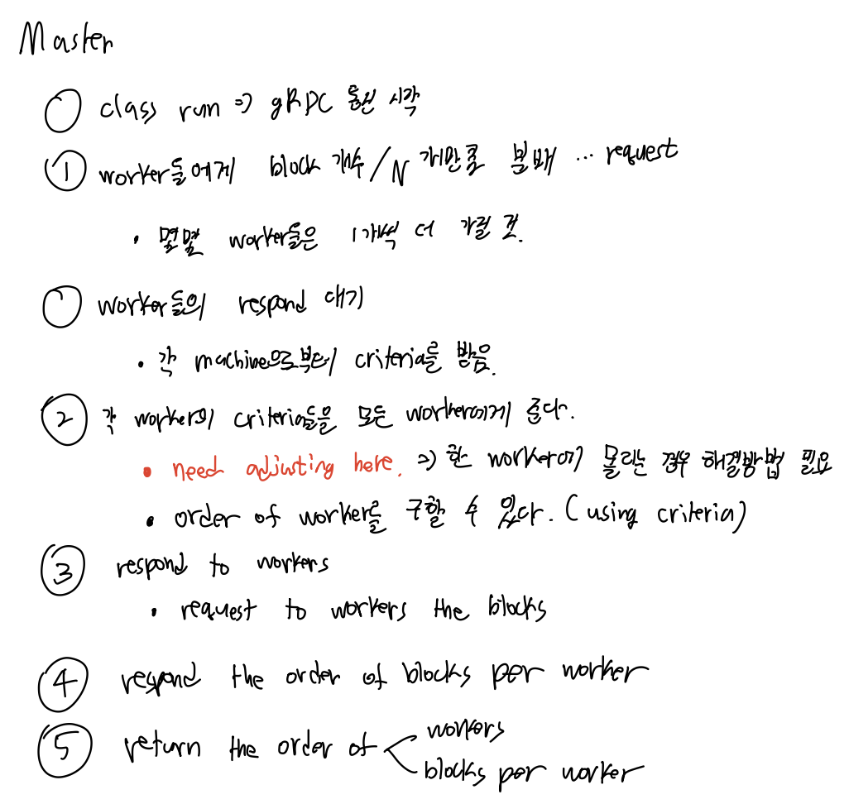
Design – master

Slide 9
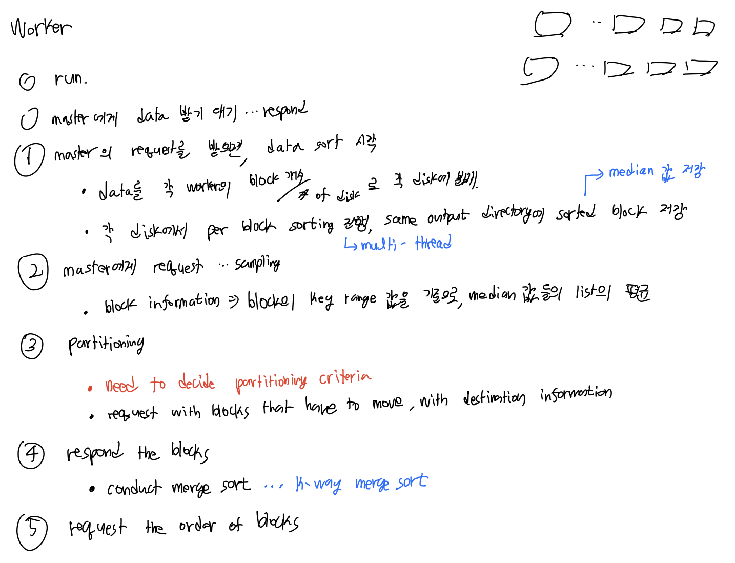
Design - worker

Slide 10
Key points
Multi-disk, multi-thread
Partitioning Criteria
Adjusting
Merge algorithm
Auto testing

Slide 11
Milestones
Conclude discussion about partitioning
Conclude discussion about adjusting
Conclude discussion about detailed implementation about service, message
Implement gRPC connection setting
Implement each service, message
Debug
Implement Auto-test

Slide 12
plans
Date | To-do | Note
until now | Detail planning | 1/3 planning
~ 11/27 | Implement project | 1/6 coding
~ 11/30 | Make auto-test, test | 1/4 early test
~ 12/9 | Debugging | 1/4 system test, debug

Slide 13
End
Thank you

