Slide 1
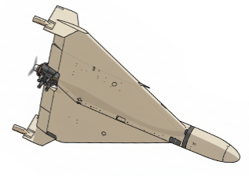
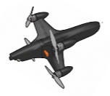
Possible
Intercept point
speed v
1. Solve for t where t>0
||r + v * t|| = s * t
Relative position
r
speed
s
2. calculate aim point target_pos + v * t
3. desired heading is
Aim point – interceptor pos

Slide 2
Potential Issues
Simulation Fidelity vs. Real Aerodynamics (wake turbulance, nonlinear aerodynamics)
Sensor Assumptions vs. Operational Reality
Target Behavior Modeling
Actuator and Control Constraints Ignored or Idealized
Transition Between Radar and Vision Guidance
Environmental Effects Not Modeled (wind shear, gusts…)

