Slide 1
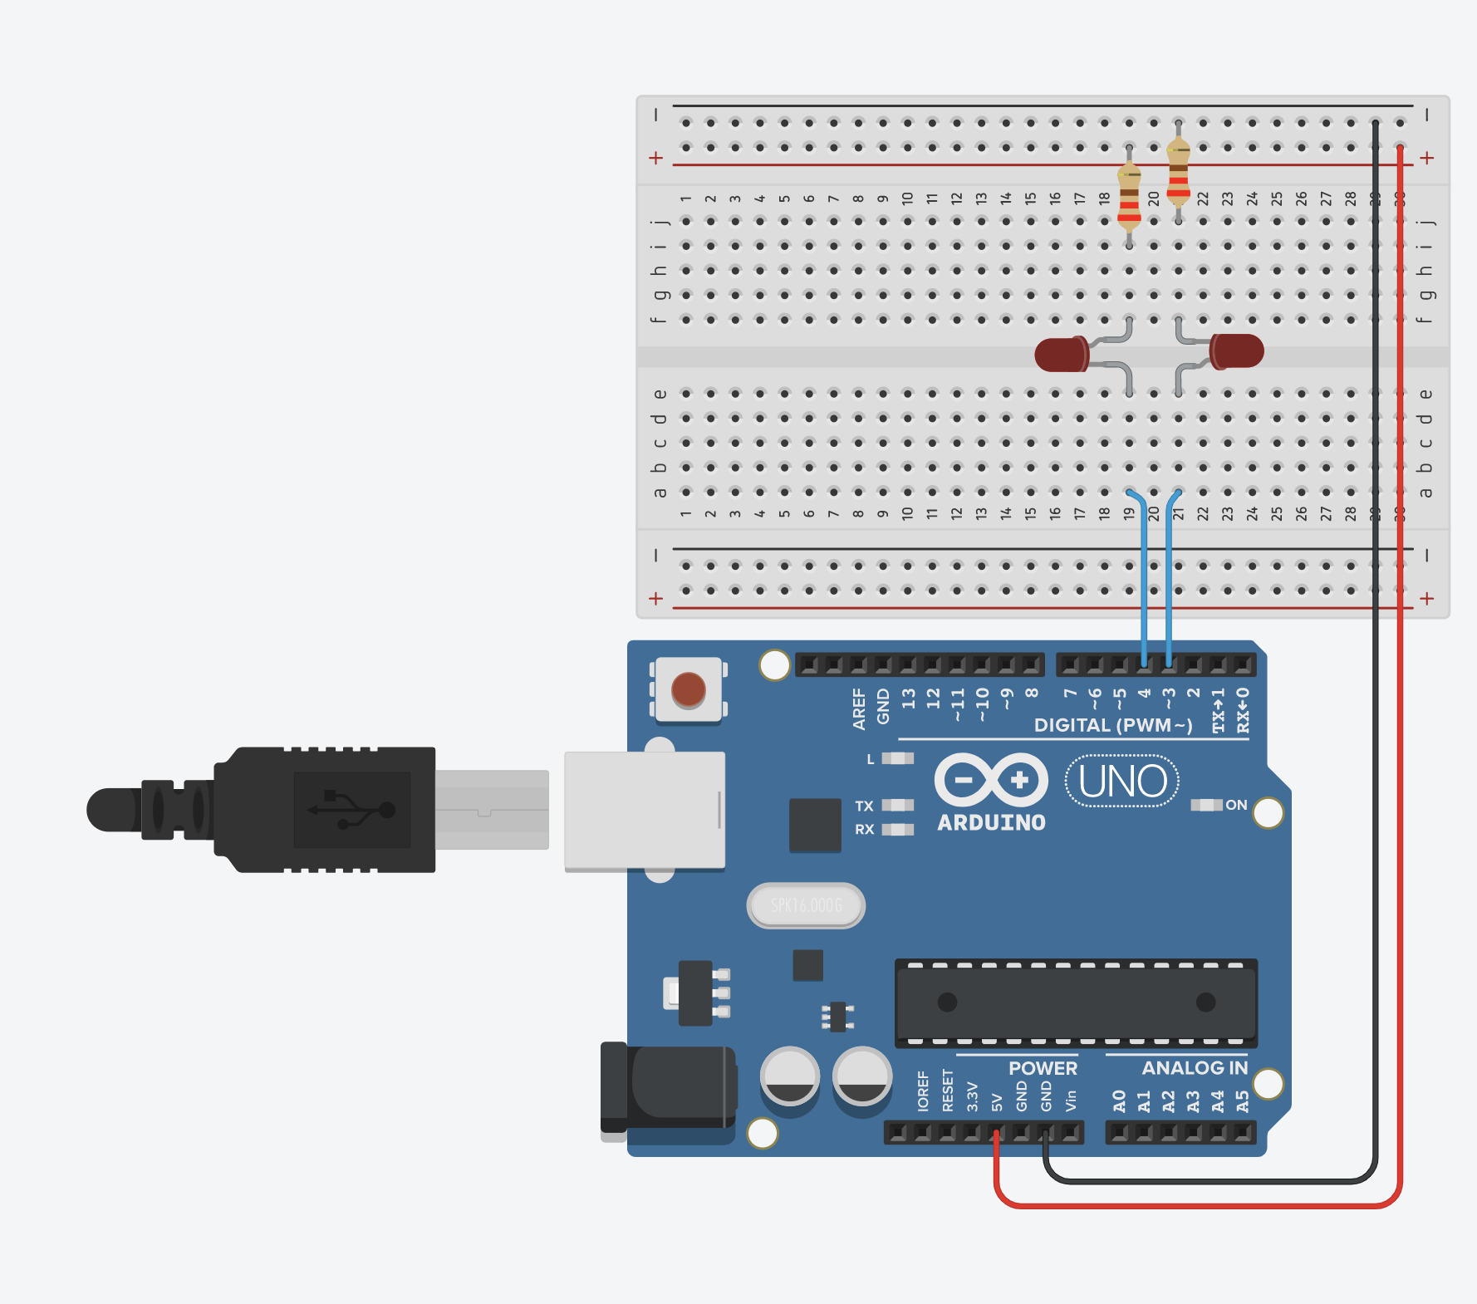
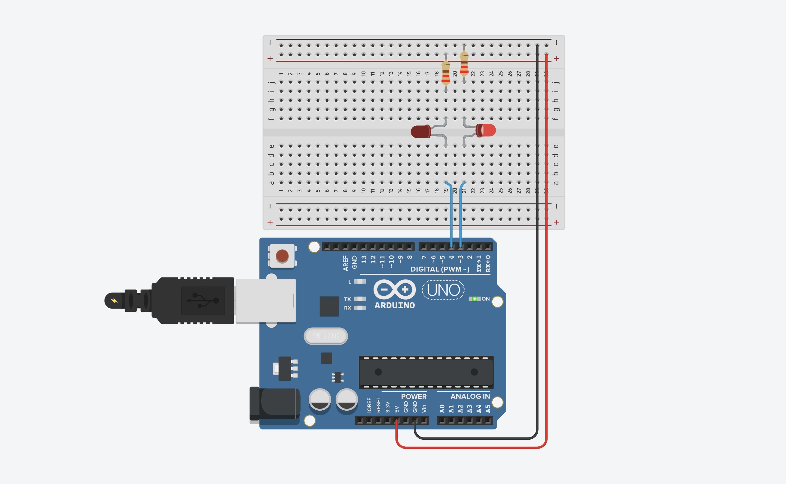
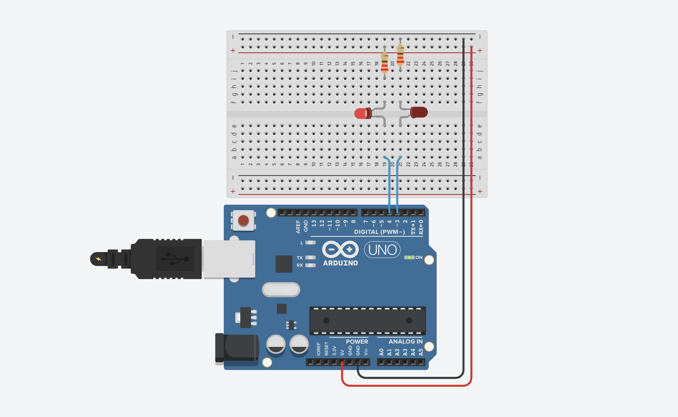
LED Circuit 2
LED Circuit 1
LED Cathode
LED Anode
Unplugged
The Arduino is off

Slide 2
LED Circuit 2
LED Circuit 1
digitalWrite(3, HIGH);
digitalWrite(4, HIGH);
LED Cathode
LED Anode

Slide 3
LED Circuit 2
LED Circuit 1
digitalWrite(3, LOW);
digitalWrite(4, LOW);
LED Cathode
LED Anode

