Slide 1
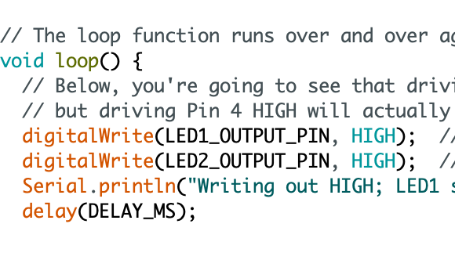
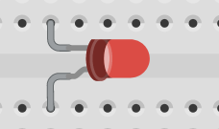
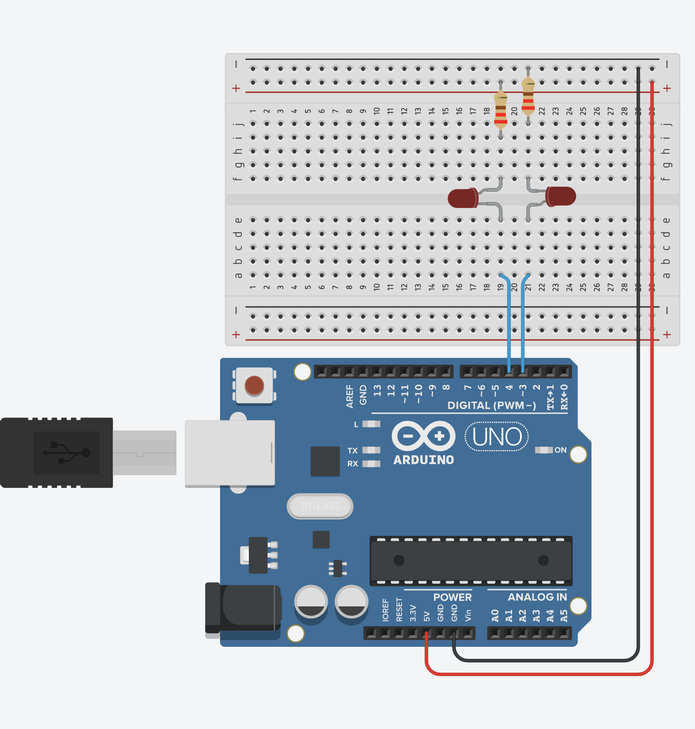
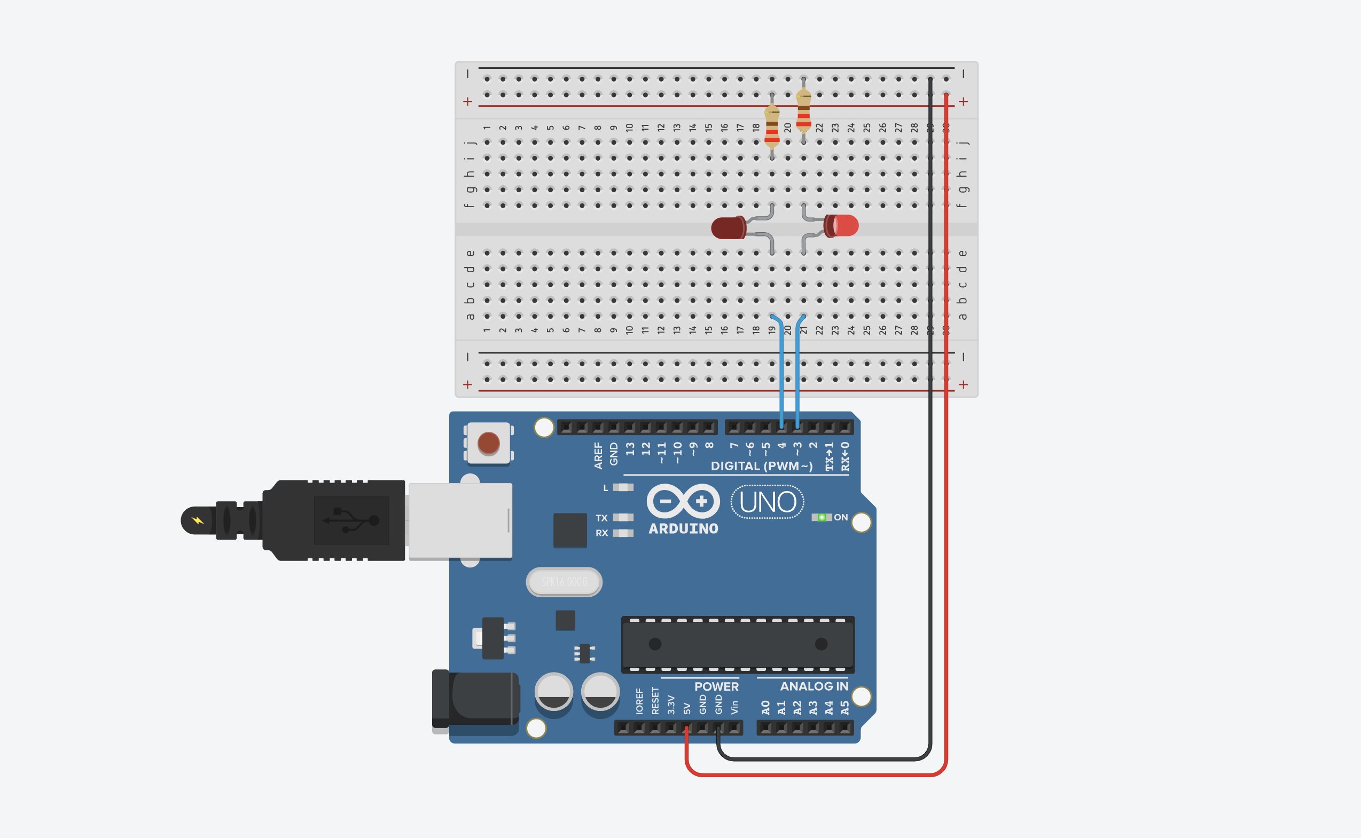
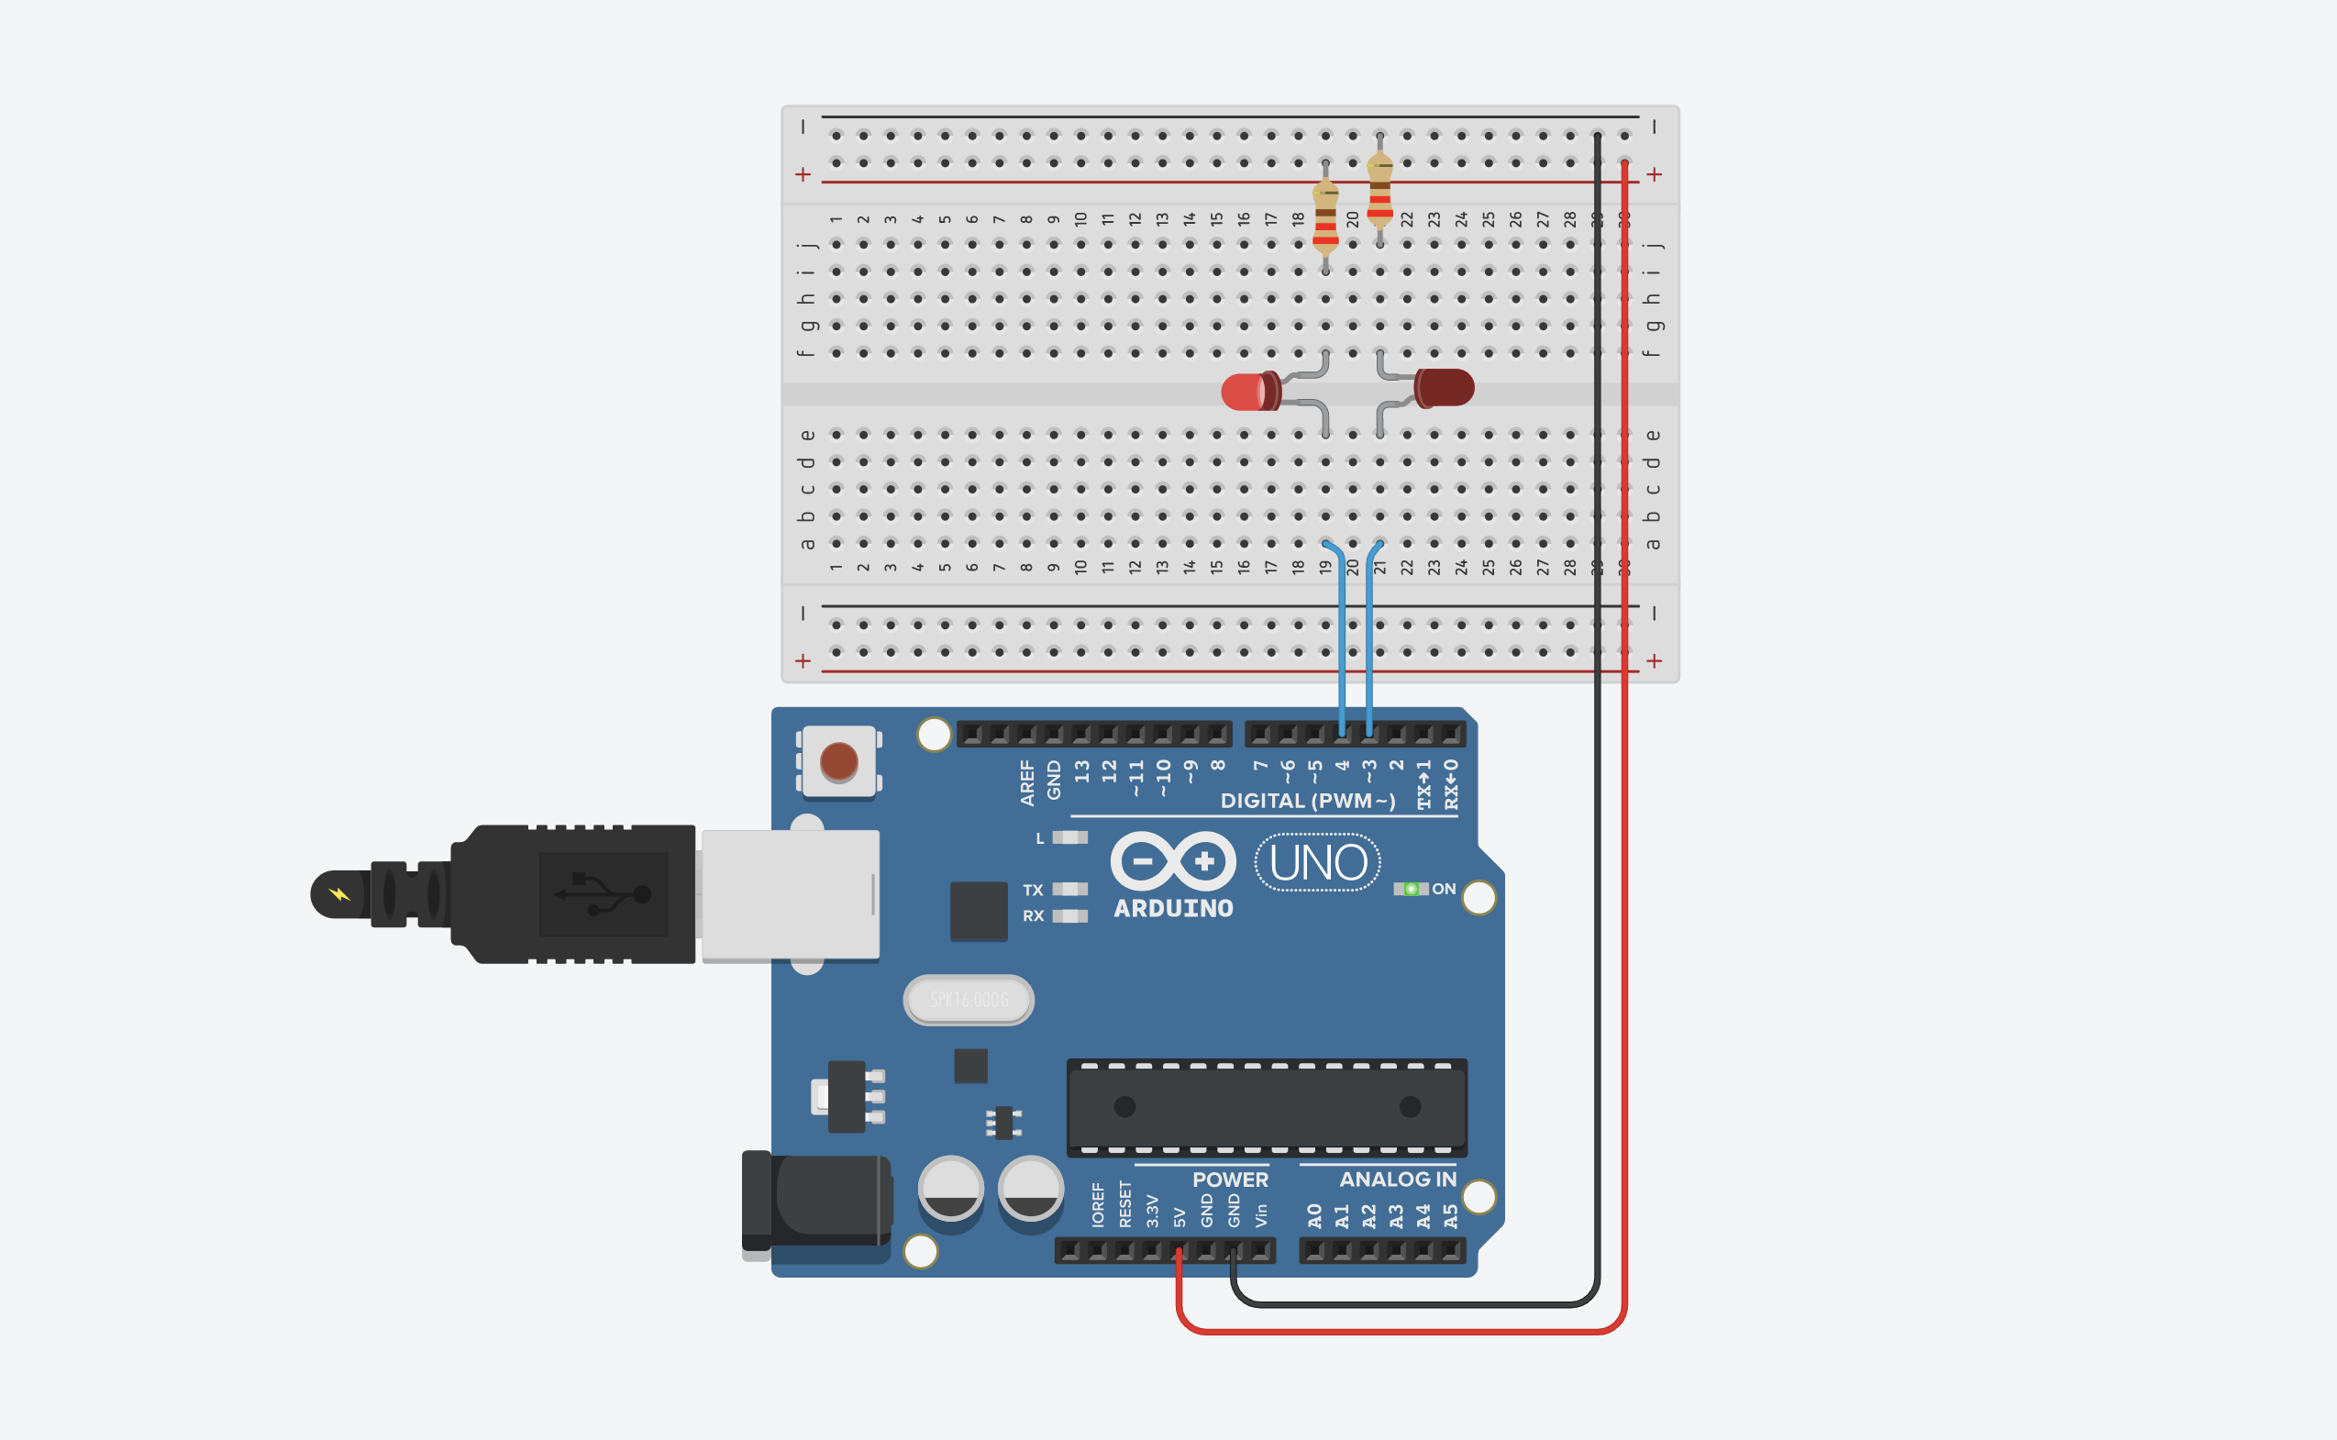
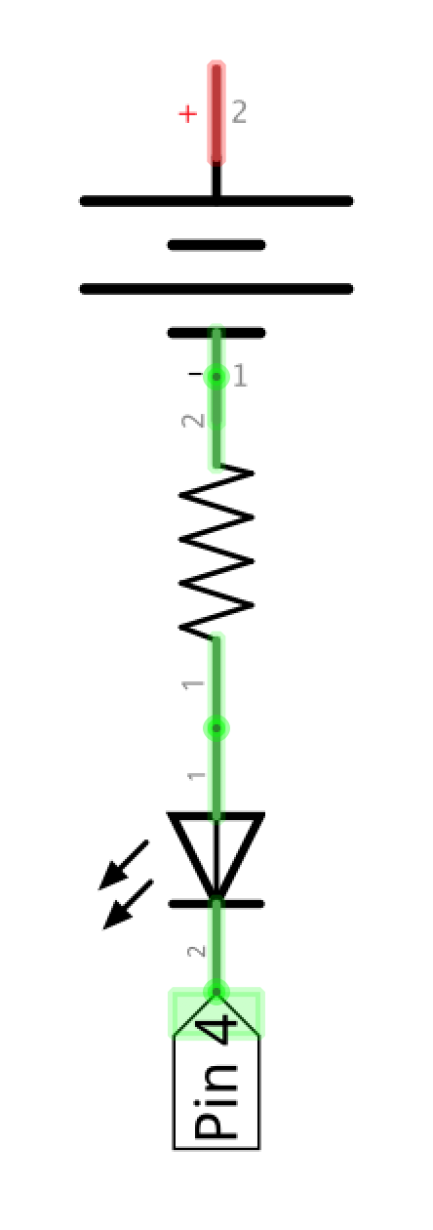
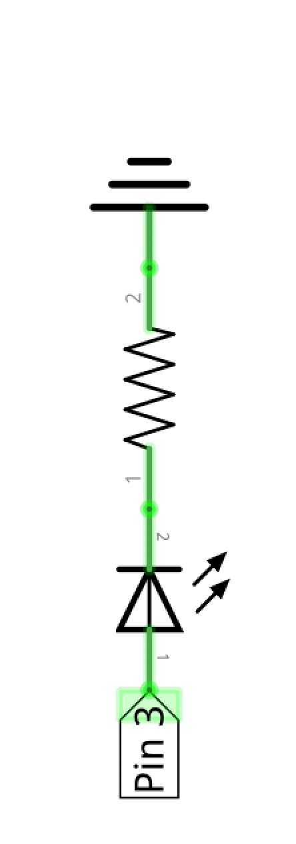
LED Circuit 2
LED Circuit 1
LED Circuit 2
LED Circuit 1
LED Cathode
LED Anode
5V
GND
5V
5V

Slide 2
LED Circuit 2
LED Circuit 1
digitalWrite(3, HIGH);
digitalWrite(4, HIGH);
LED Circuit 2
LED Circuit 1
LED Cathode
LED Anode
5V
GND
5V
5V

Slide 3
LED Circuit 2
LED Circuit 1
digitalWrite(3, LOW);
digitalWrite(4, LOW);
LED Circuit 2
LED Circuit 1
LED Cathode
LED Anode
5V
GND
0V
0V

Slide 4
LED Circuit 2
LED Circuit 1
digitalWrite(3, HIGH);
digitalWrite(4, HIGH);
LED Circuit 2
LED Circuit 1
LED Cathode
LED Anode
5V
GND
5V
5V

Slide 5
LED Circuit 2
LED Circuit 1
digitalWrite(3, LOW);
digitalWrite(4, LOW);
LED Circuit 2
LED Circuit 1
LED Cathode
LED Anode
5V
GND
0V
0V

Slide 6
LED Circuit 2
LED Circuit 1
digitalWrite(3, HIGH);
digitalWrite(4, HIGH);
LED Circuit 2
LED Circuit 1
LED Cathode
LED Anode
5V
GND
5V
5V

Slide 7
LED Circuit 2
LED Circuit 1
digitalWrite(3, LOW);
digitalWrite(4, LOW);
LED Circuit 2
LED Circuit 1
LED Cathode
LED Anode
5V
GND
0V
0V

