Slide 1
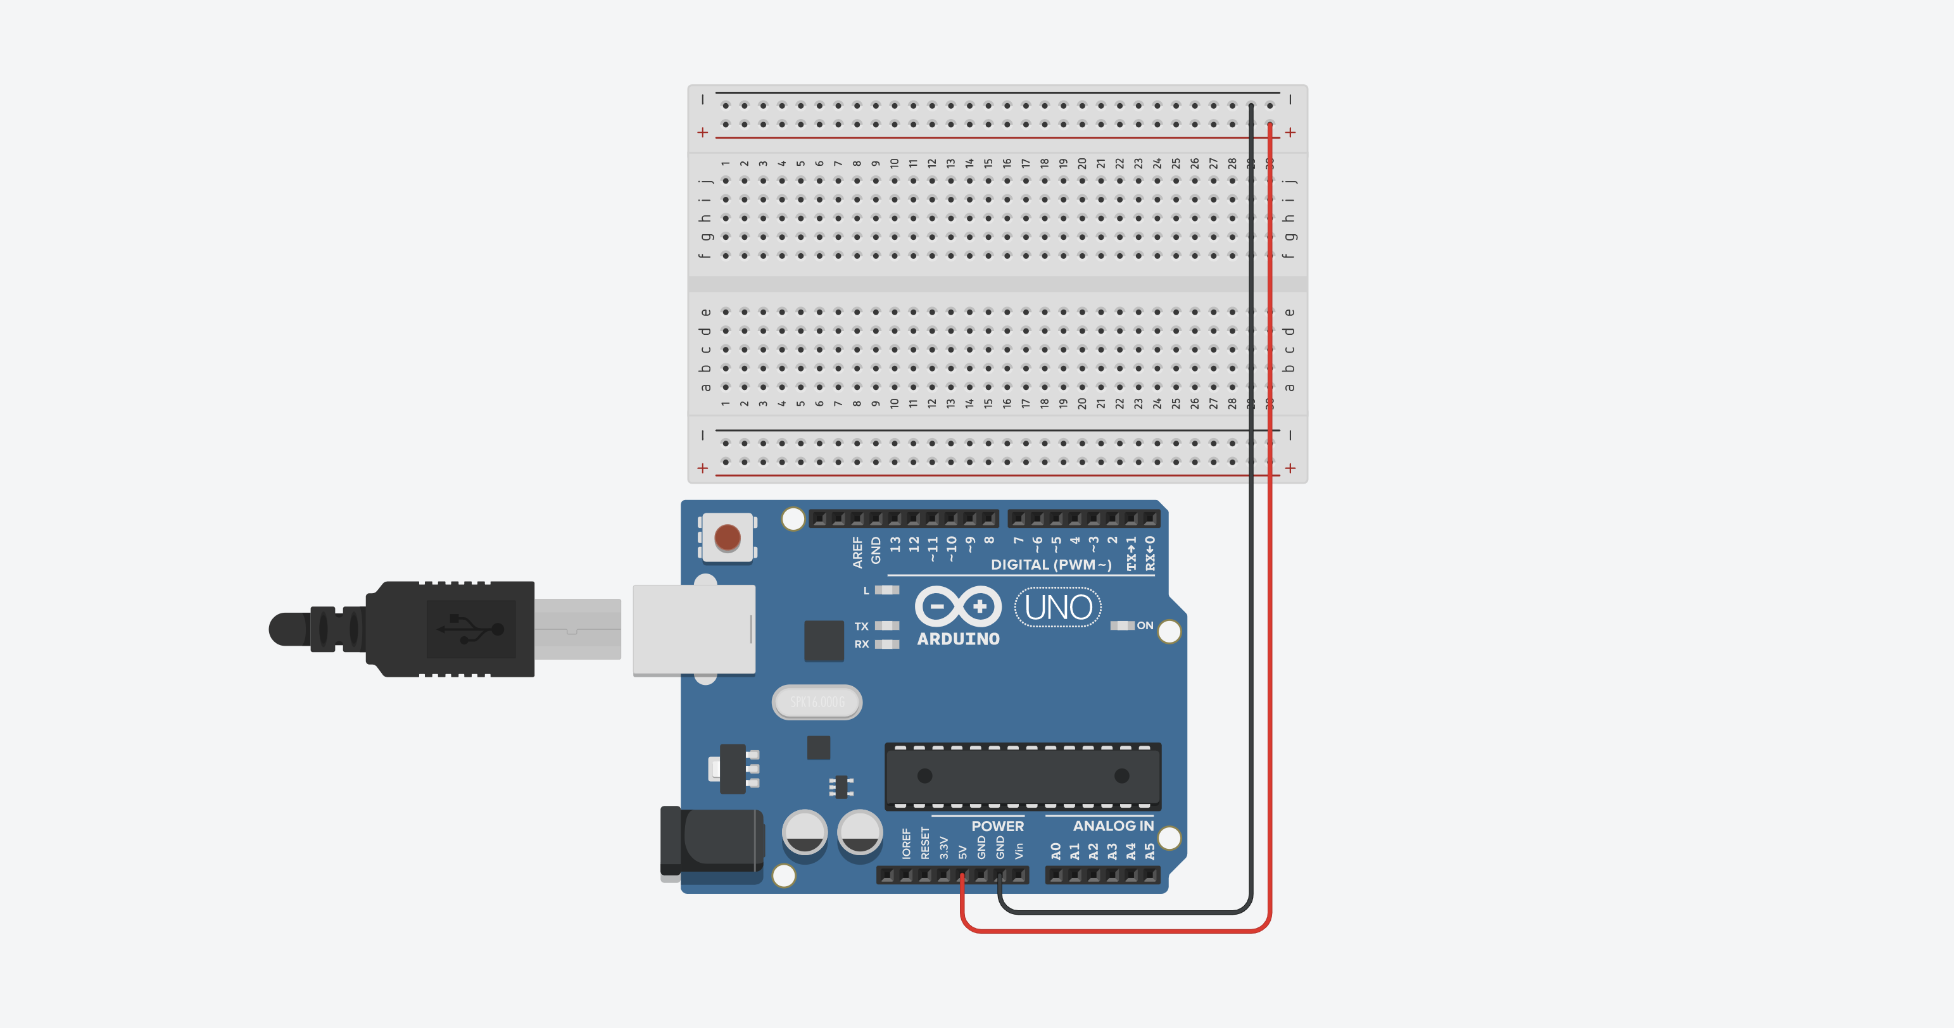

Slide 2
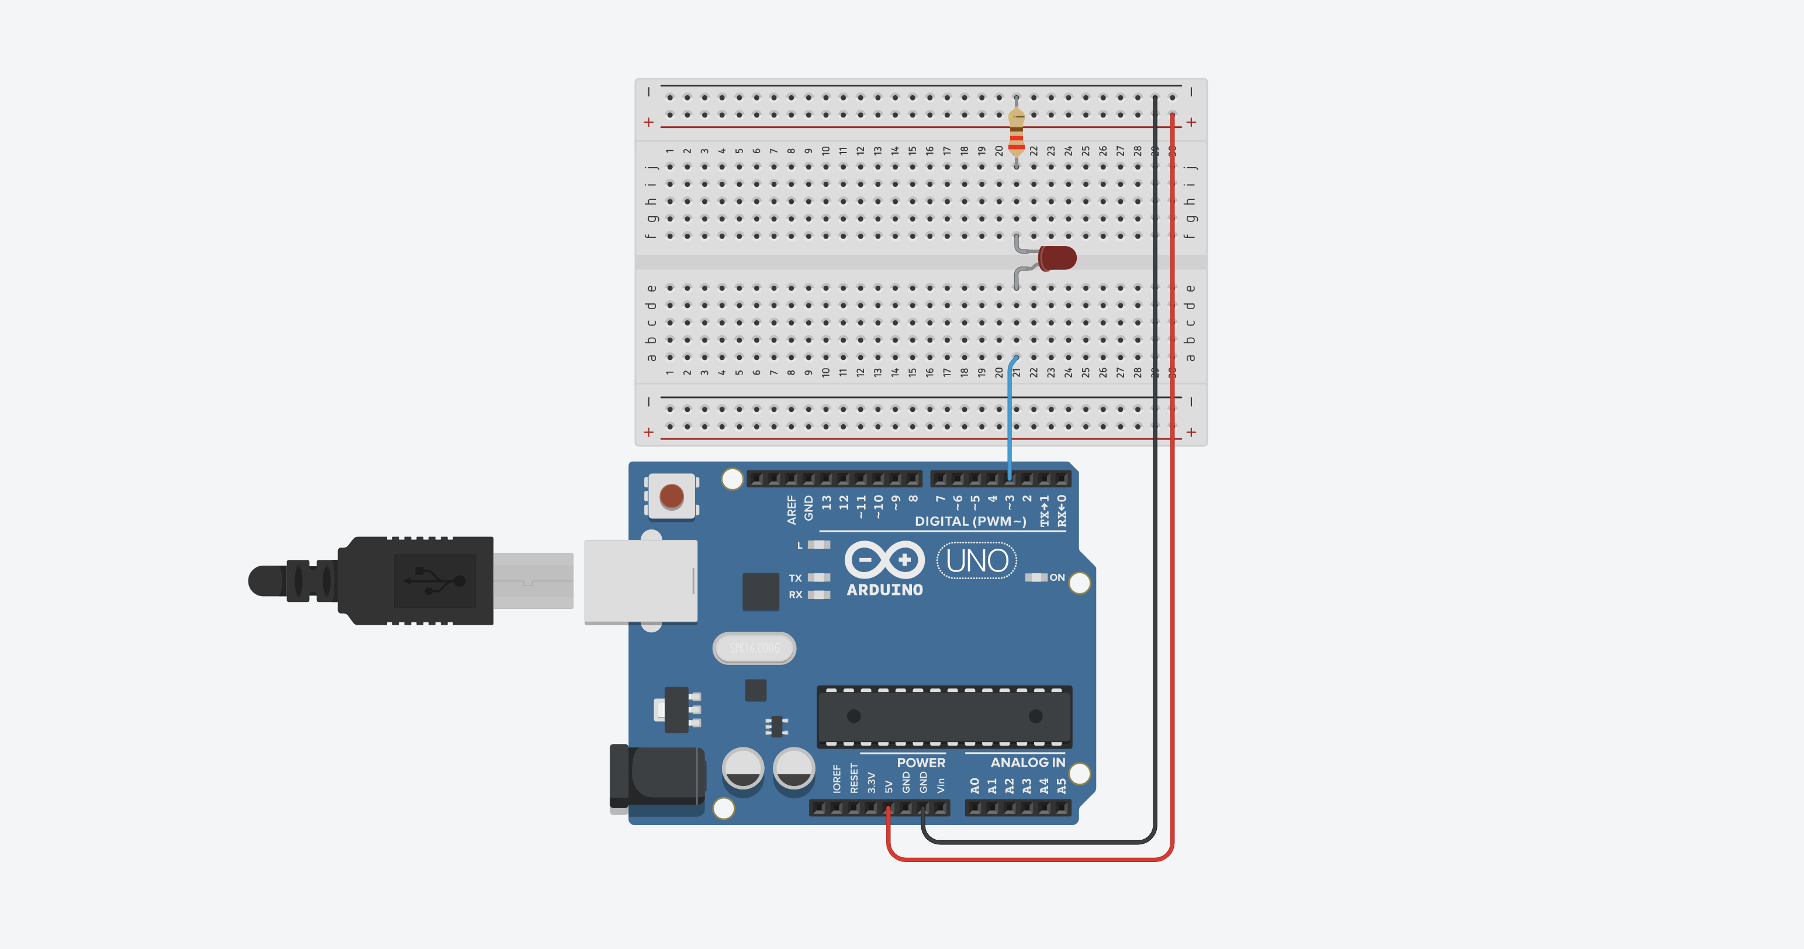
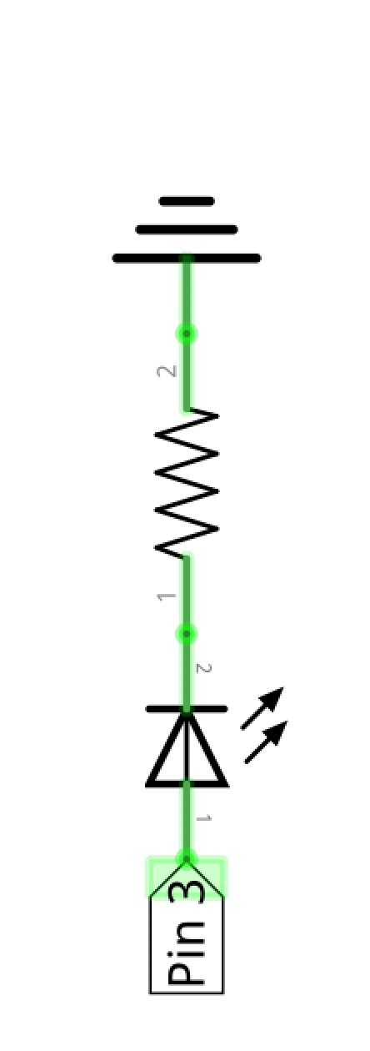
LED Circuit 1
LED Circuit 1
GND
LED Anode

Slide 3

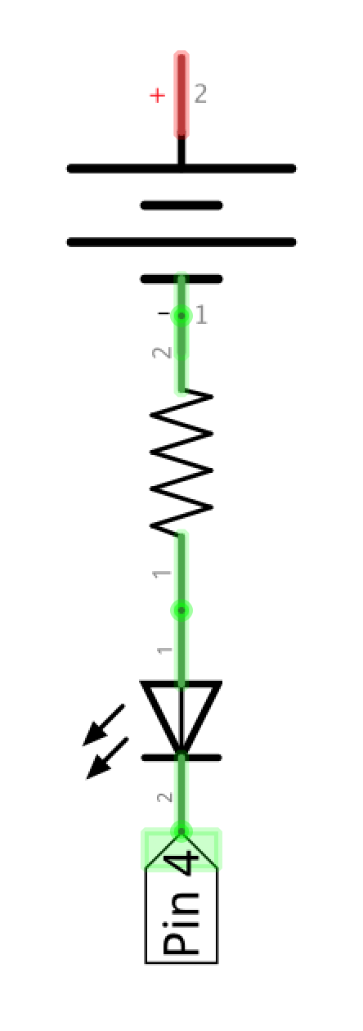
LED Circuit 2
LED Circuit 1
LED Circuit 2
LED Circuit 1
GND
5V
LED Cathode
LED Anode

Slide 4
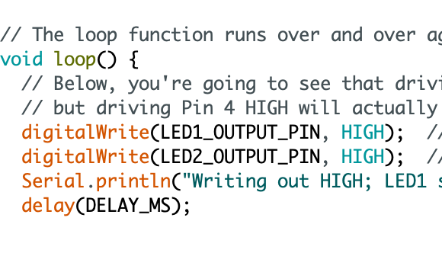
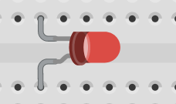
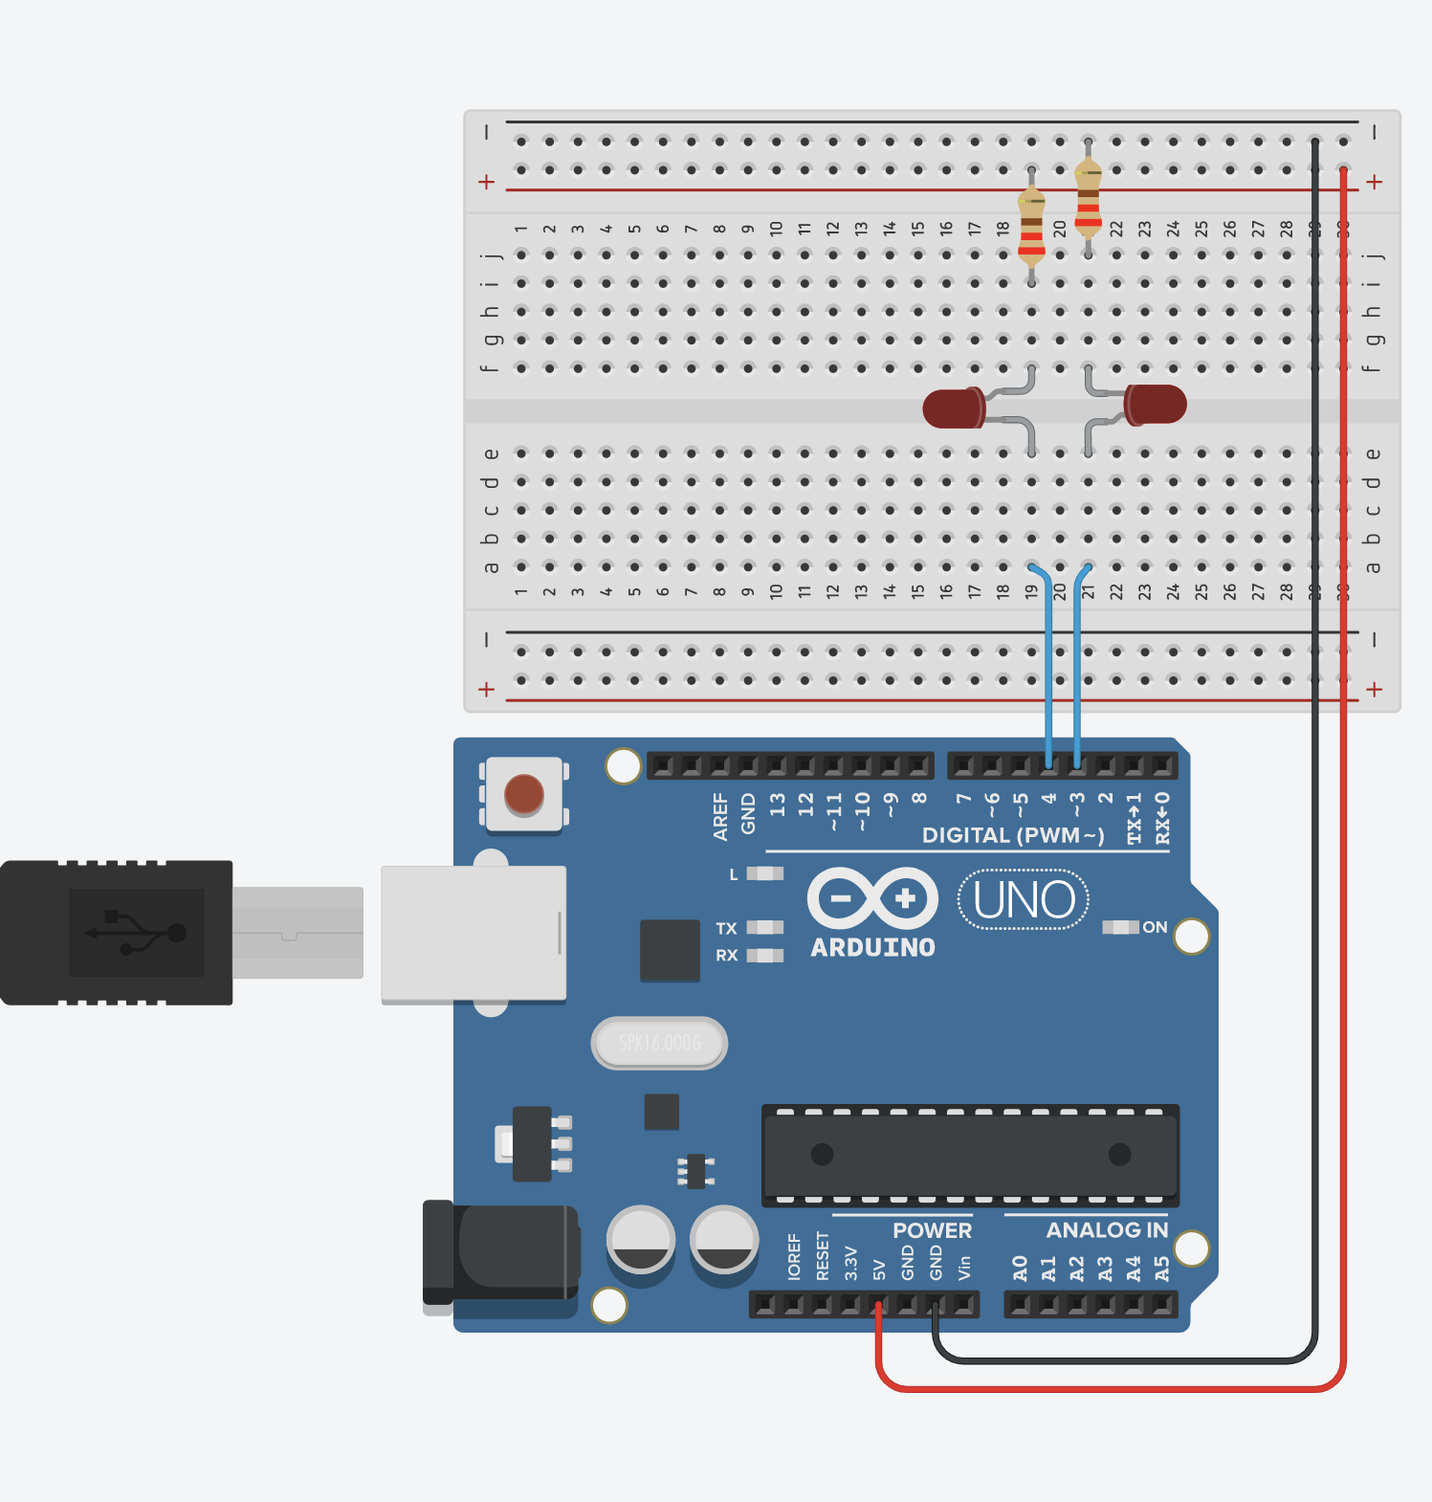
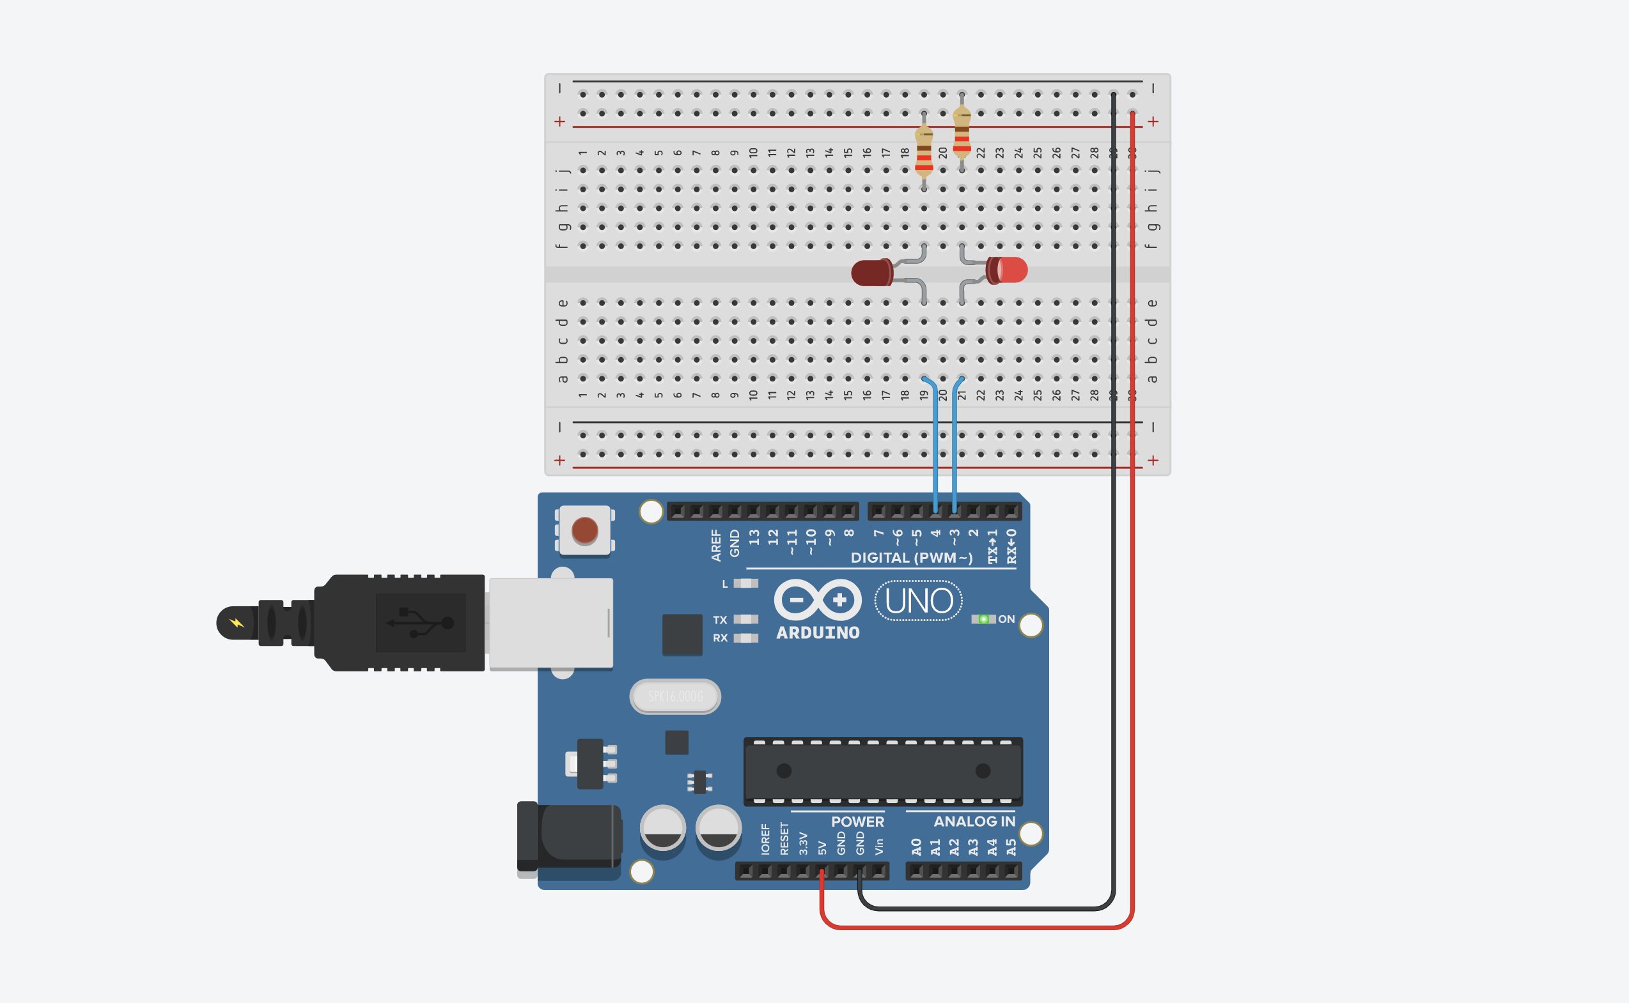
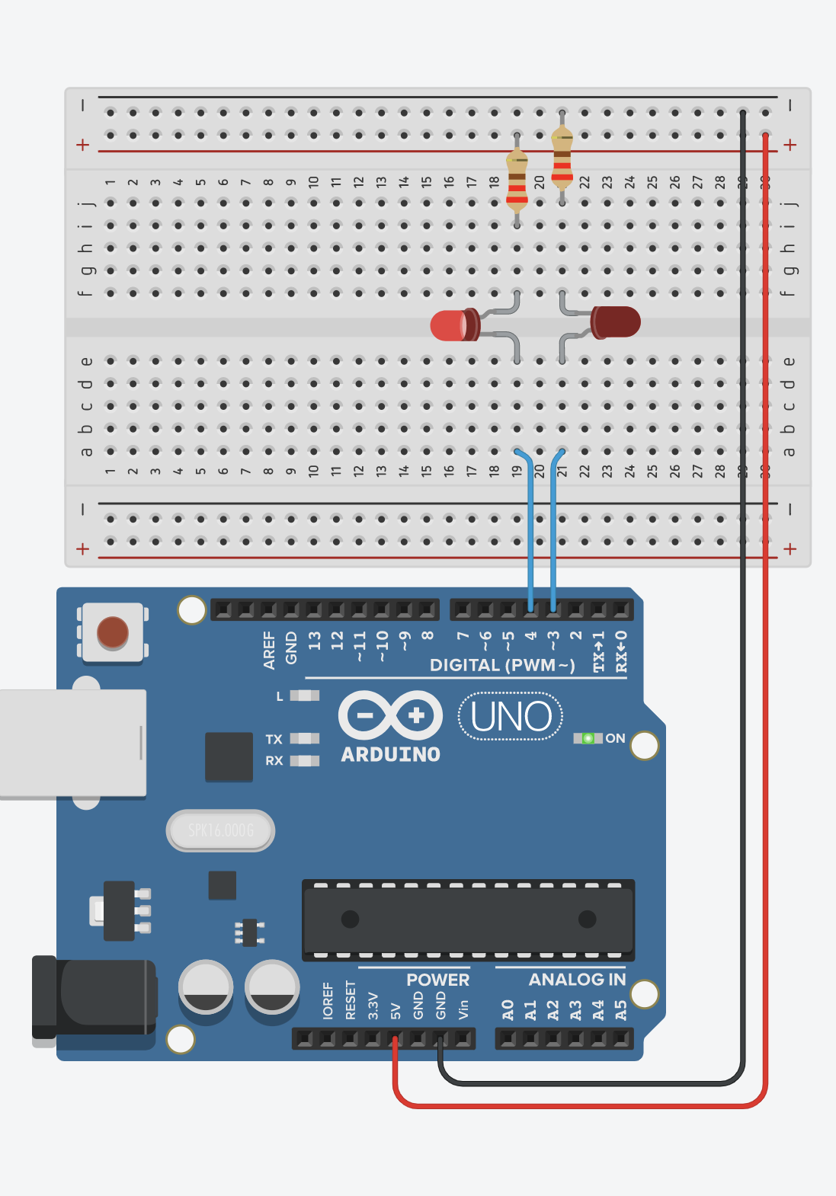
LED Circuit 2
LED Circuit 1
LED Circuit 2
LED Circuit 1
LED Cathode
LED Anode
5V
GND
5V
5V

Slide 5
LED Circuit 2
LED Circuit 1
digitalWrite(3, HIGH);
digitalWrite(4, HIGH);
LED Circuit 2
LED Circuit 1
LED Cathode
LED Anode
5V
GND
5V
5V

Slide 6
LED Circuit 2
LED Circuit 1
digitalWrite(3, LOW);
digitalWrite(4, LOW);
LED Circuit 2
LED Circuit 1
LED Cathode
LED Anode
5V
GND
0V
0V

