Slide 1
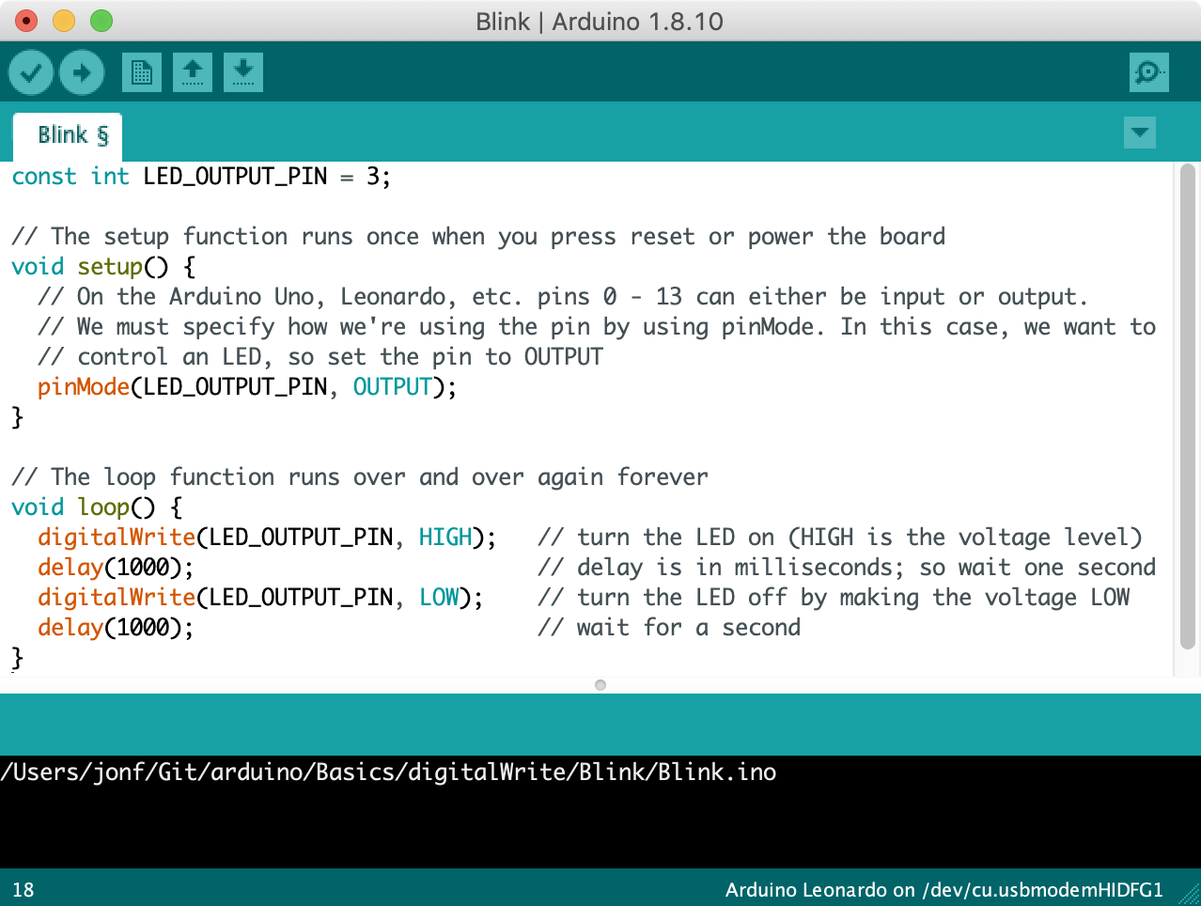
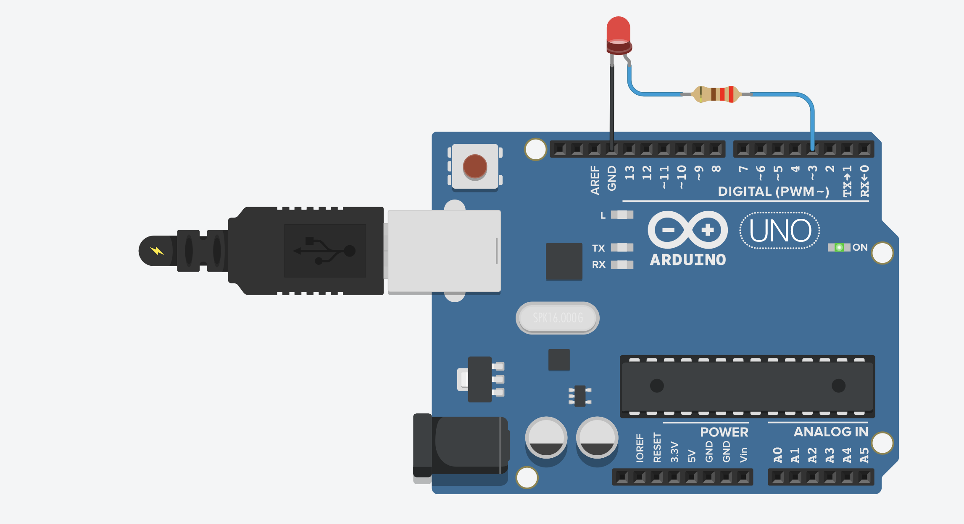
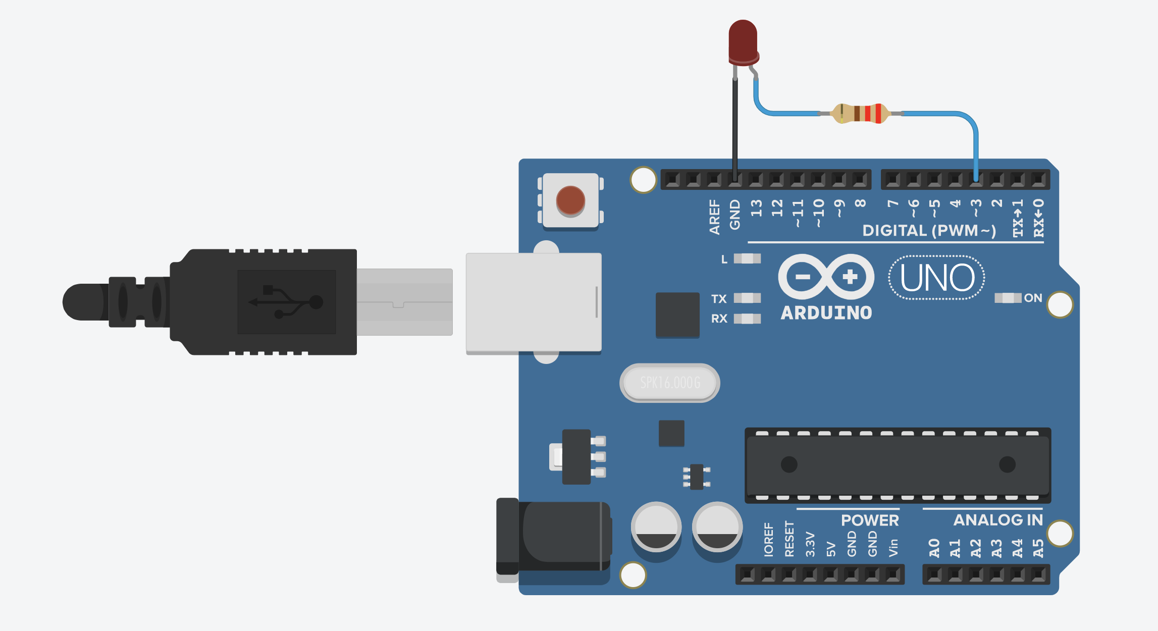
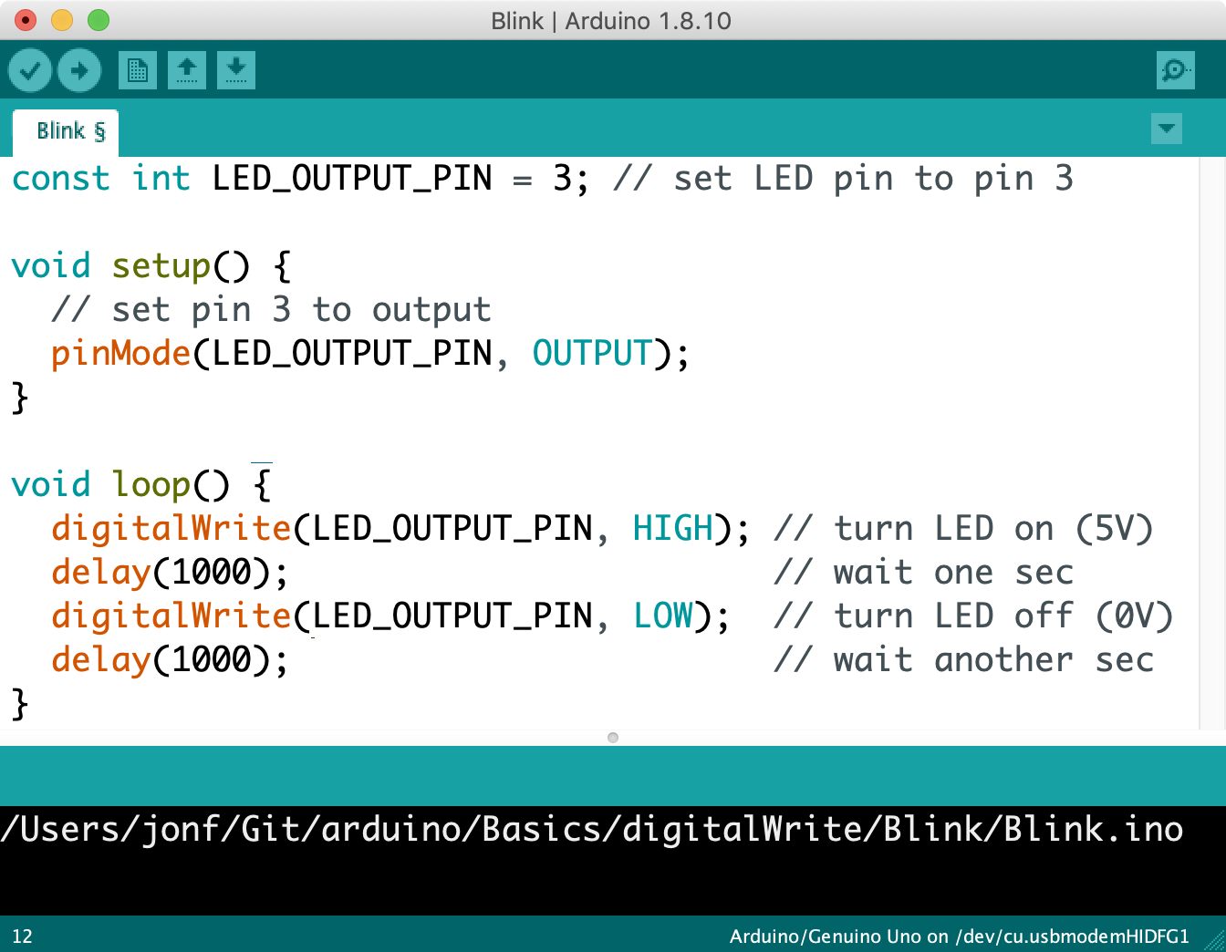
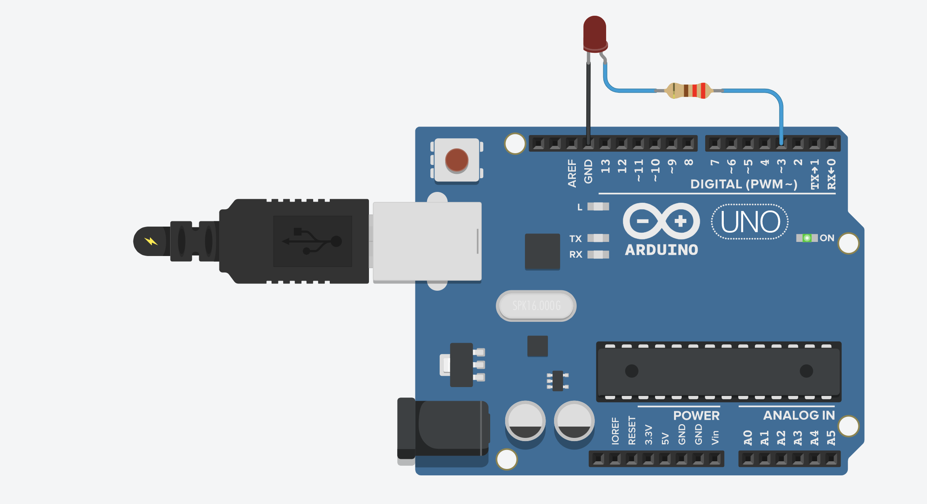
Arduino powered on
setup() is called immediately once and only once. Put your initialization code here.
Run initial setup() code
Pins 0 – 13 can be either input or output. Set Pin 3 to output to control the connected LED.
After setup(), loop() is called
After setup() completes, loop() is called automatically. When loop() ends, it is run again and again (until the Arduino is shut off or reprogrammed)
digitalWrite(3, HIGH)
Output a HIGH signal (5V) on Pin 3 and then wait for one second
digitalWrite(3, LOW)
Output a LOW signal (0V) on Pin 3 and then wait for one second
End of loop(), call loop() again
When loop() ends, it is called again automatically. This loop continues forever.
Notes:
The program running on the Arduino, which continuously alternates between outputting 5V on Pin 3 for one second and outputting 0V.

Slide 2
Notes:
The program running on the Arduino, which continuously alternates between outputting 5V on Pin 3 for one second and outputting 0V.

Slide 3
Arduino powered on
setup() is called immediately once and only once. Put your initialization code here.
Notes:
The program running on the Arduino, which continuously alternates between outputting 5V on Pin 3 for one second and outputting 0V.

Slide 4
Run initial setup() code
Pins 0 – 13 can be either input or output. Set Pin 3 to OUTPUT to control the connected LED.
Notes:
The program running on the Arduino, which continuously alternates between outputting 5V on Pin 3 for one second and outputting 0V.

Slide 5
After setup(), loop() is called
After setup() completes, loop() is called automatically. When loop() ends, it is run again and again (until the Arduino is shut off or reprogrammed)
Notes:
The program running on the Arduino, which continuously alternates between outputting 5V on Pin 3 for one second and outputting 0V.

Slide 6
digitalWrite(3, HIGH)
Output a HIGH signal (5V) on Pin 3 and then wait for one second
Notes:
The program running on the Arduino, which continuously alternates between outputting 5V on Pin 3 for one second and outputting 0V.

Slide 7
digitalWrite(3, LOW)
Output a LOW signal (0V) on Pin 3 and then wait for one second
Notes:
The program running on the Arduino, which continuously alternates between outputting 5V on Pin 3 for one second and outputting 0V.

Slide 8
End of loop(), loop() called again
When loop() ends, it is called again automatically. This loop continues forever.
Notes:
The program running on the Arduino, which continuously alternates between outputting 5V on Pin 3 for one second and outputting 0V.

Slide 9
loop() is called again
Execute loop() again
Notes:
The program running on the Arduino, which continuously alternates between outputting 5V on Pin 3 for one second and outputting 0V.

Slide 10
digitalWrite(3, HIGH)
Output a HIGH signal (5V) on Pin 3 and then wait for one second
Notes:
The program running on the Arduino, which continuously alternates between outputting 5V on Pin 3 for one second and outputting 0V.

Slide 11
digitalWrite(3, LOW)
Output a LOW signal (0V) on Pin 3 and then wait for one second
Notes:
The program running on the Arduino, which continuously alternates between outputting 5V on Pin 3 for one second and outputting 0V.

Slide 12
End of loop(), loop() called again
When loop() ends, it is called again automatically. This loop continues forever.
Notes:
The program running on the Arduino, which continuously alternates between outputting 5V on Pin 3 for one second and outputting 0V.

Slide 13
loop() is called again
Execute loop() again
Notes:
The program running on the Arduino, which continuously alternates between outputting 5V on Pin 3 for one second and outputting 0V.

Slide 14
digitalWrite(3, HIGH)
Output a HIGH signal (5V) on Pin 3 and then wait for one second
Notes:
The program running on the Arduino, which continuously alternates between outputting 5V on Pin 3 for one second and outputting 0V.

Slide 15
digitalWrite(3, LOW)
Output a LOW signal (0V) on Pin 3 and then wait for one second
Notes:
The program running on the Arduino, which continuously alternates between outputting 5V on Pin 3 for one second and outputting 0V.

Slide 16
End of loop(), loop() called again
When loop() ends, it is called again automatically. This loop continues forever.
Notes:
The program running on the Arduino, which continuously alternates between outputting 5V on Pin 3 for one second and outputting 0V.

Slide 17
loop() is called again
Execute loop() again
Notes:
The program running on the Arduino, which continuously alternates between outputting 5V on Pin 3 for one second and outputting 0V.

Slide 18
Arduino powered on
setup() is called immediately once and only once. Put your initialization code here.
Run initial setup() code
Pins 0 – 13 can be either input or output. Set Pin 3 to output to control the connected LED.
After setup(), loop() is called
After setup() completes, loop() is called automatically. When loop() ends, it is run again and again (until the Arduino is shut off or reprogrammed)
digitalWrite(3, HIGH)
Output a HIGH signal (5V) on Pin 3 and then wait for one second
digitalWrite(3, LOW)
Output a LOW signal (0V) on Pin 3 and then wait for one second
End of loop(), call loop() again
When loop() ends, it is called again automatically. This loop continues forever.
Notes:
The program running on the Arduino, which continuously alternates between outputting 5V on Pin 3 for one second and outputting 0V.

