Slide 1
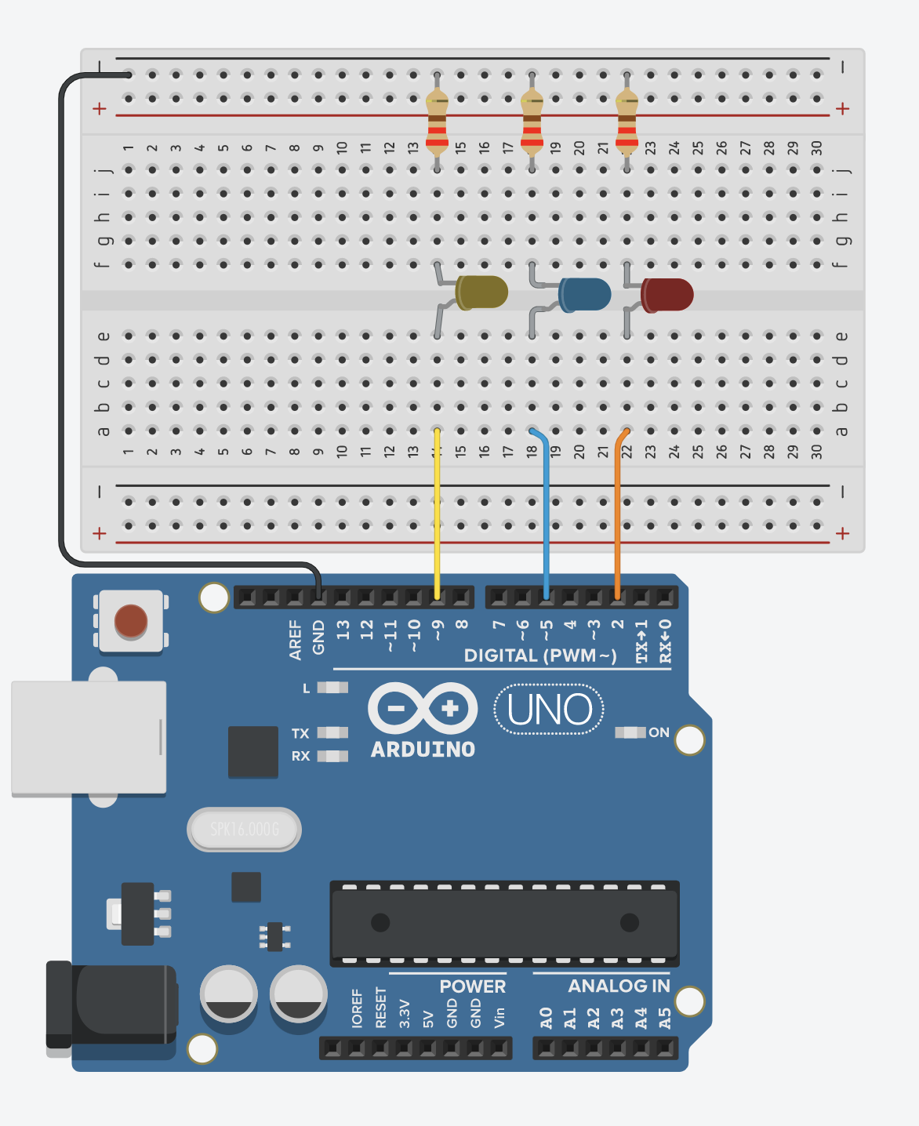
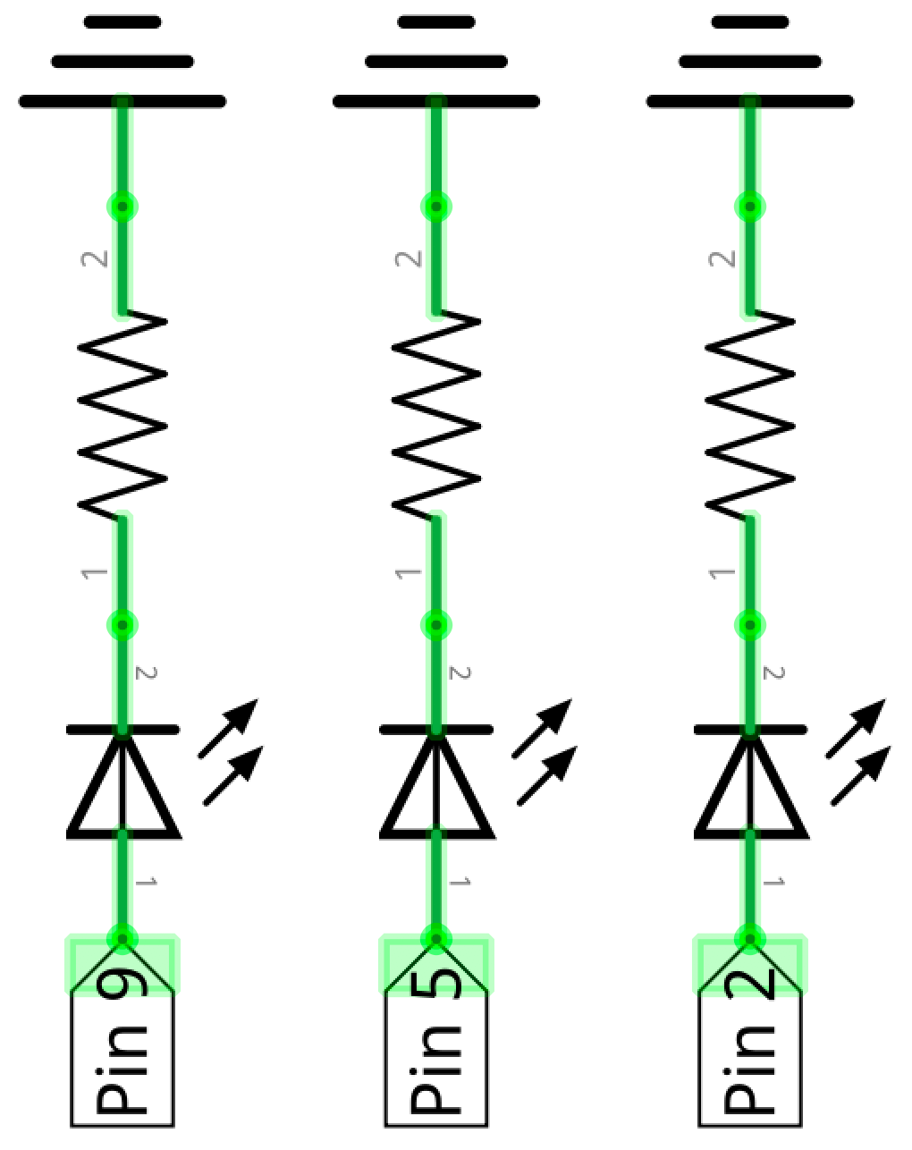
GND
All LED anodes (long legs) facing the I/O pins
Current
flow
Set pins HIGH to drive current (and turn on LEDs)

