Slide 1
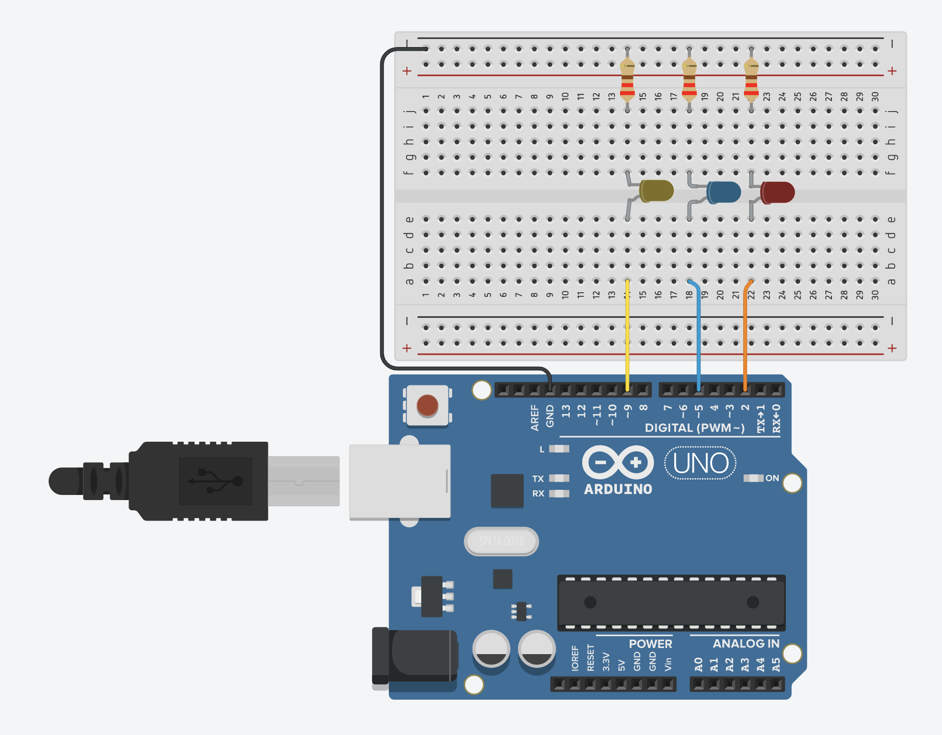
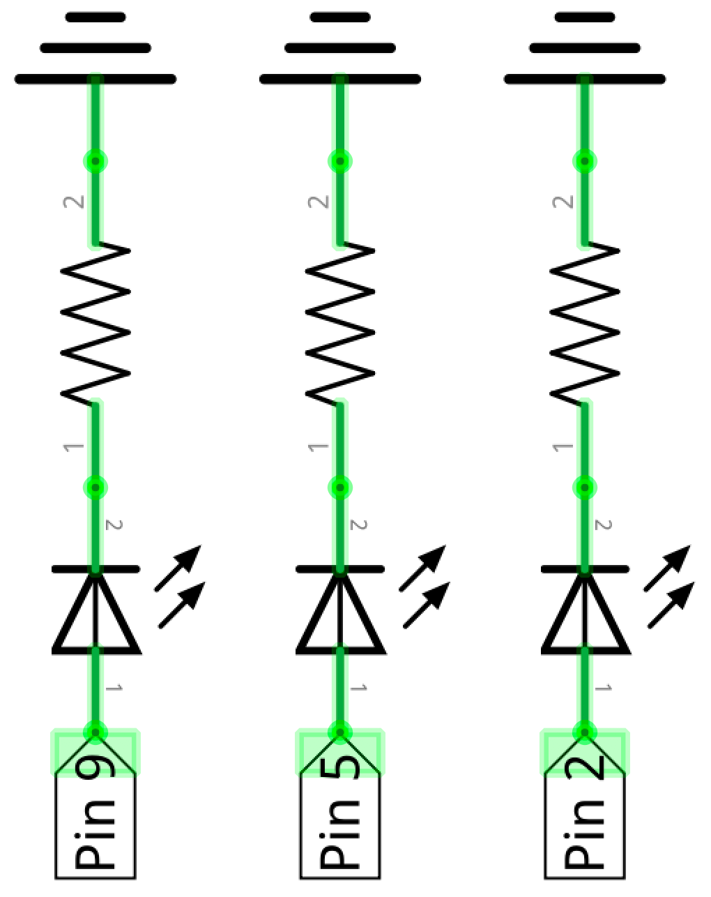
GND
All LED anodes (long legs) facing the I/O pins
Current
flow
Set pins HIGH to drive current (and turn on LEDs)

Slide 2
GND
Current
flow
All LED anodes (long legs) facing the I/O pins
Set pins HIGH to drive current (and turn on LEDs)

