Slide 1
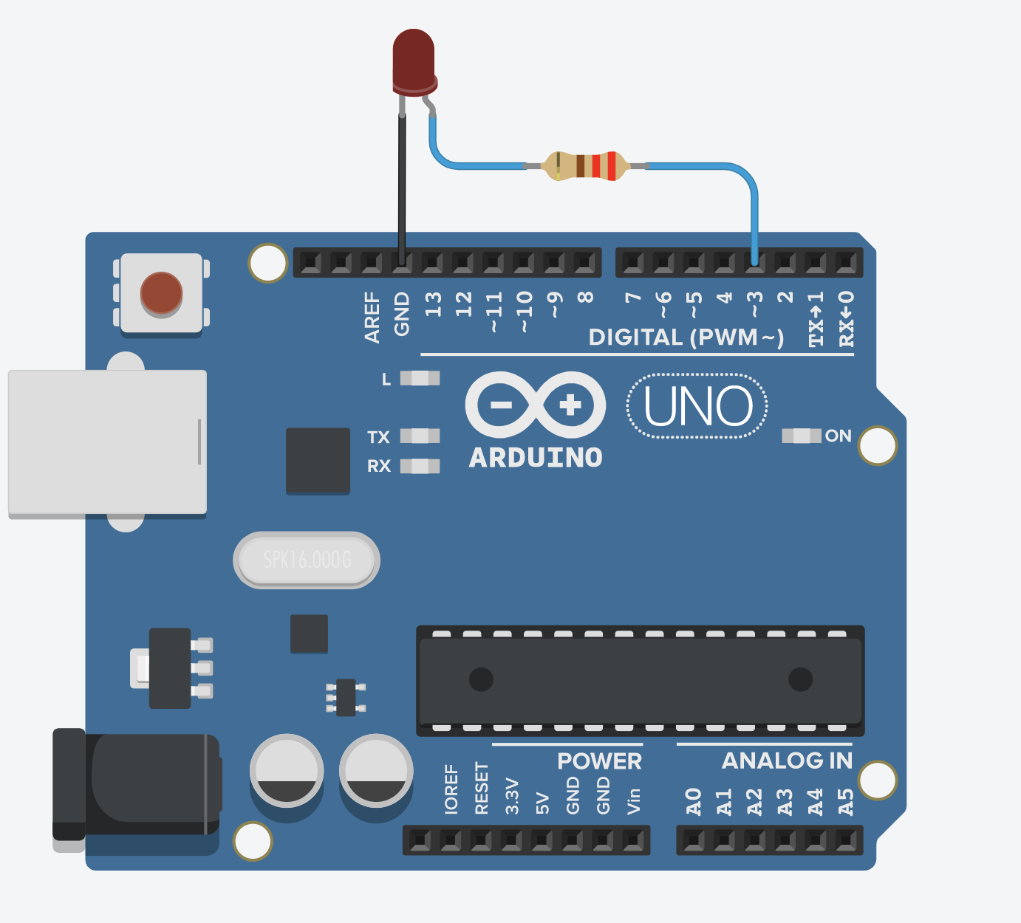
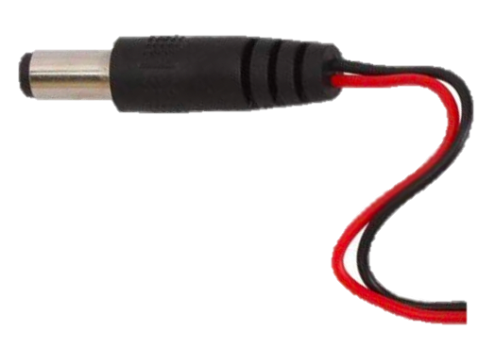
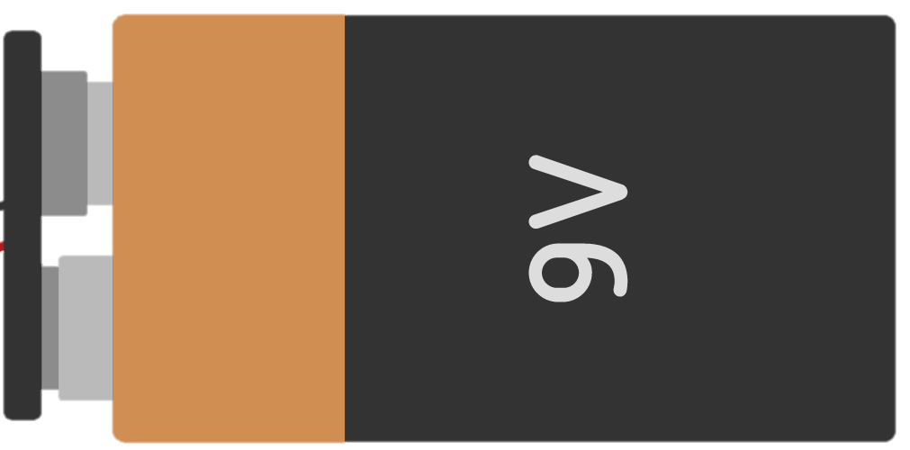
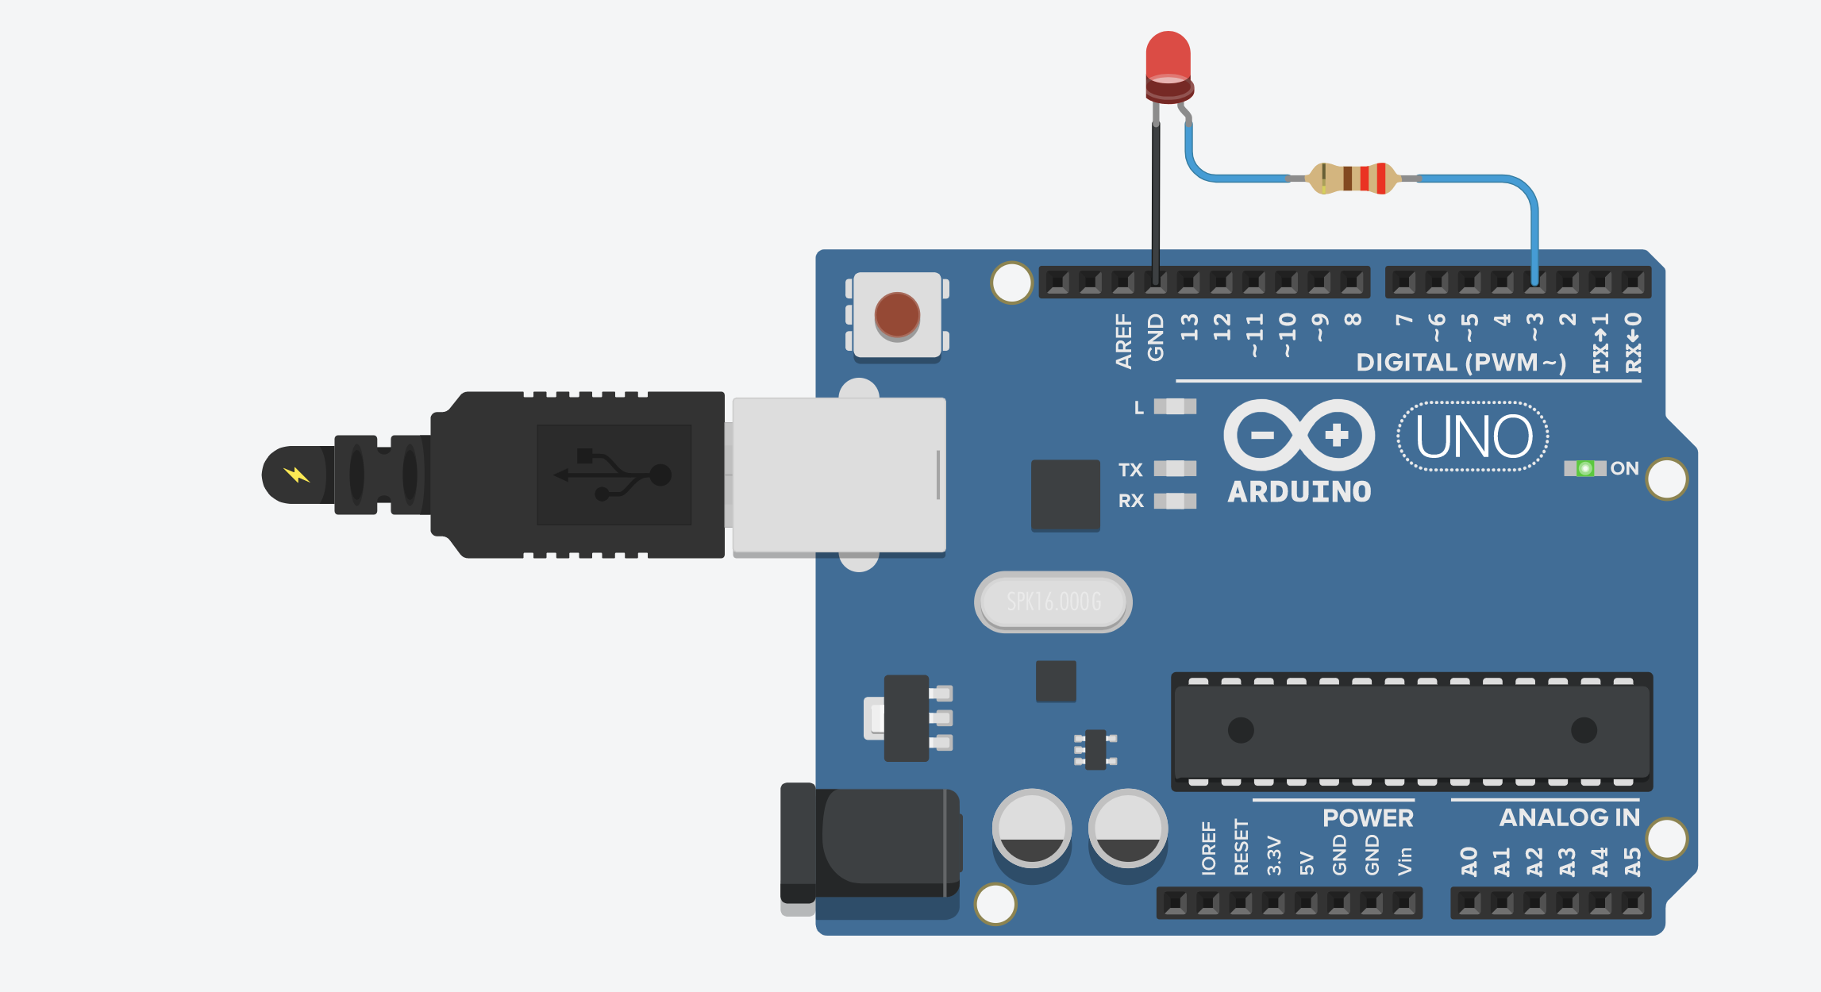
Unplugged
The Arduino is off

Slide 2
Pin 3 is HIGH (5V)
Pin 3 is set to 5V via digitalWrite(3, HIGH);
Battery plugged in
The Arduino is on
‘On’ LED illuminated
When the Arduino is on, the LED ‘On’ indicator is illuminated.

Slide 3
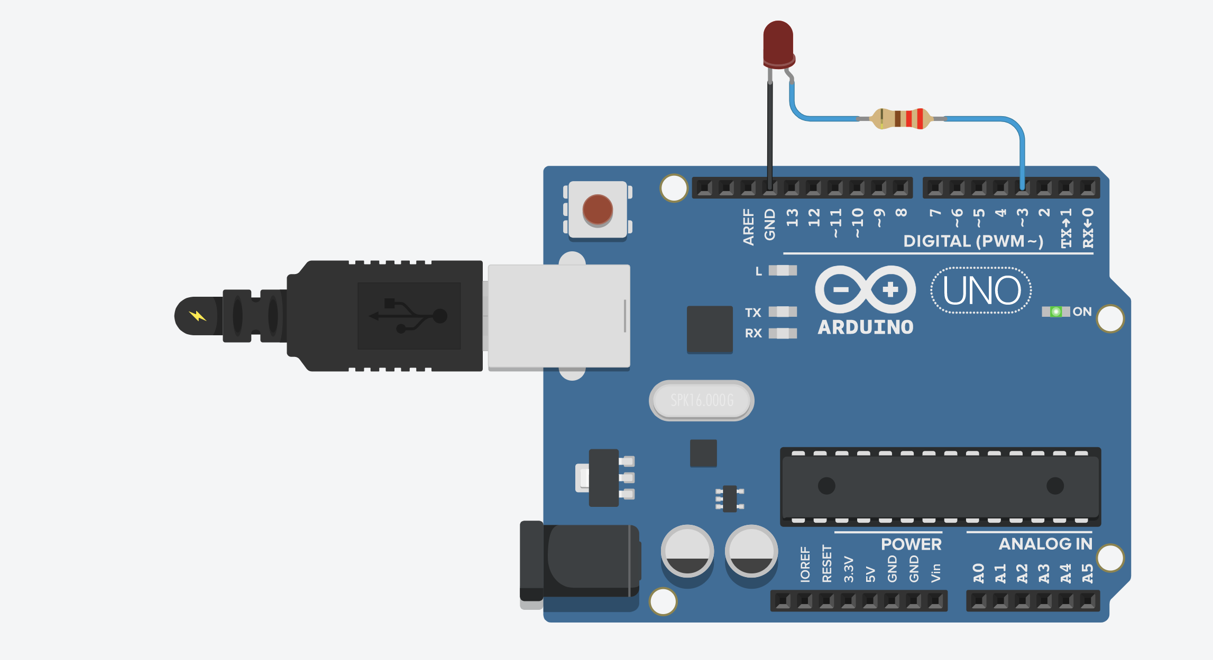
Pin 3 is LOW (0V)
Pin 3 is set to 0V via digitalWrite(3, LOW);
Battery plugged in
The Arduino is on
‘On’ LED illuminated
When the Arduino is on, the LED ‘On’ indicator is illuminated.

Slide 4
Pin 3 is HIGH (5V)
Pin 3 is set to 5V via digitalWrite(3, HIGH);
Battery plugged in
The Arduino is on
‘On’ LED illuminated
When the Arduino is on, the LED ‘On’ indicator is illuminated.

Slide 5
Pin 3 is LOW (0V)
Pin 3 is set to 0V via digitalWrite(3, LOW);
Battery plugged in
The Arduino is on
‘On’ LED illuminated
When the Arduino is on, the LED ‘On’ indicator is illuminated.

Slide 6
LED Anode Towards Pin 3
Connect the LED anode (long leg) towards Pin 3
LED Cathode to GND
Connect the LED cathode (short leg or flat side of LED casing) to GND.
220Ω

