Slide 1
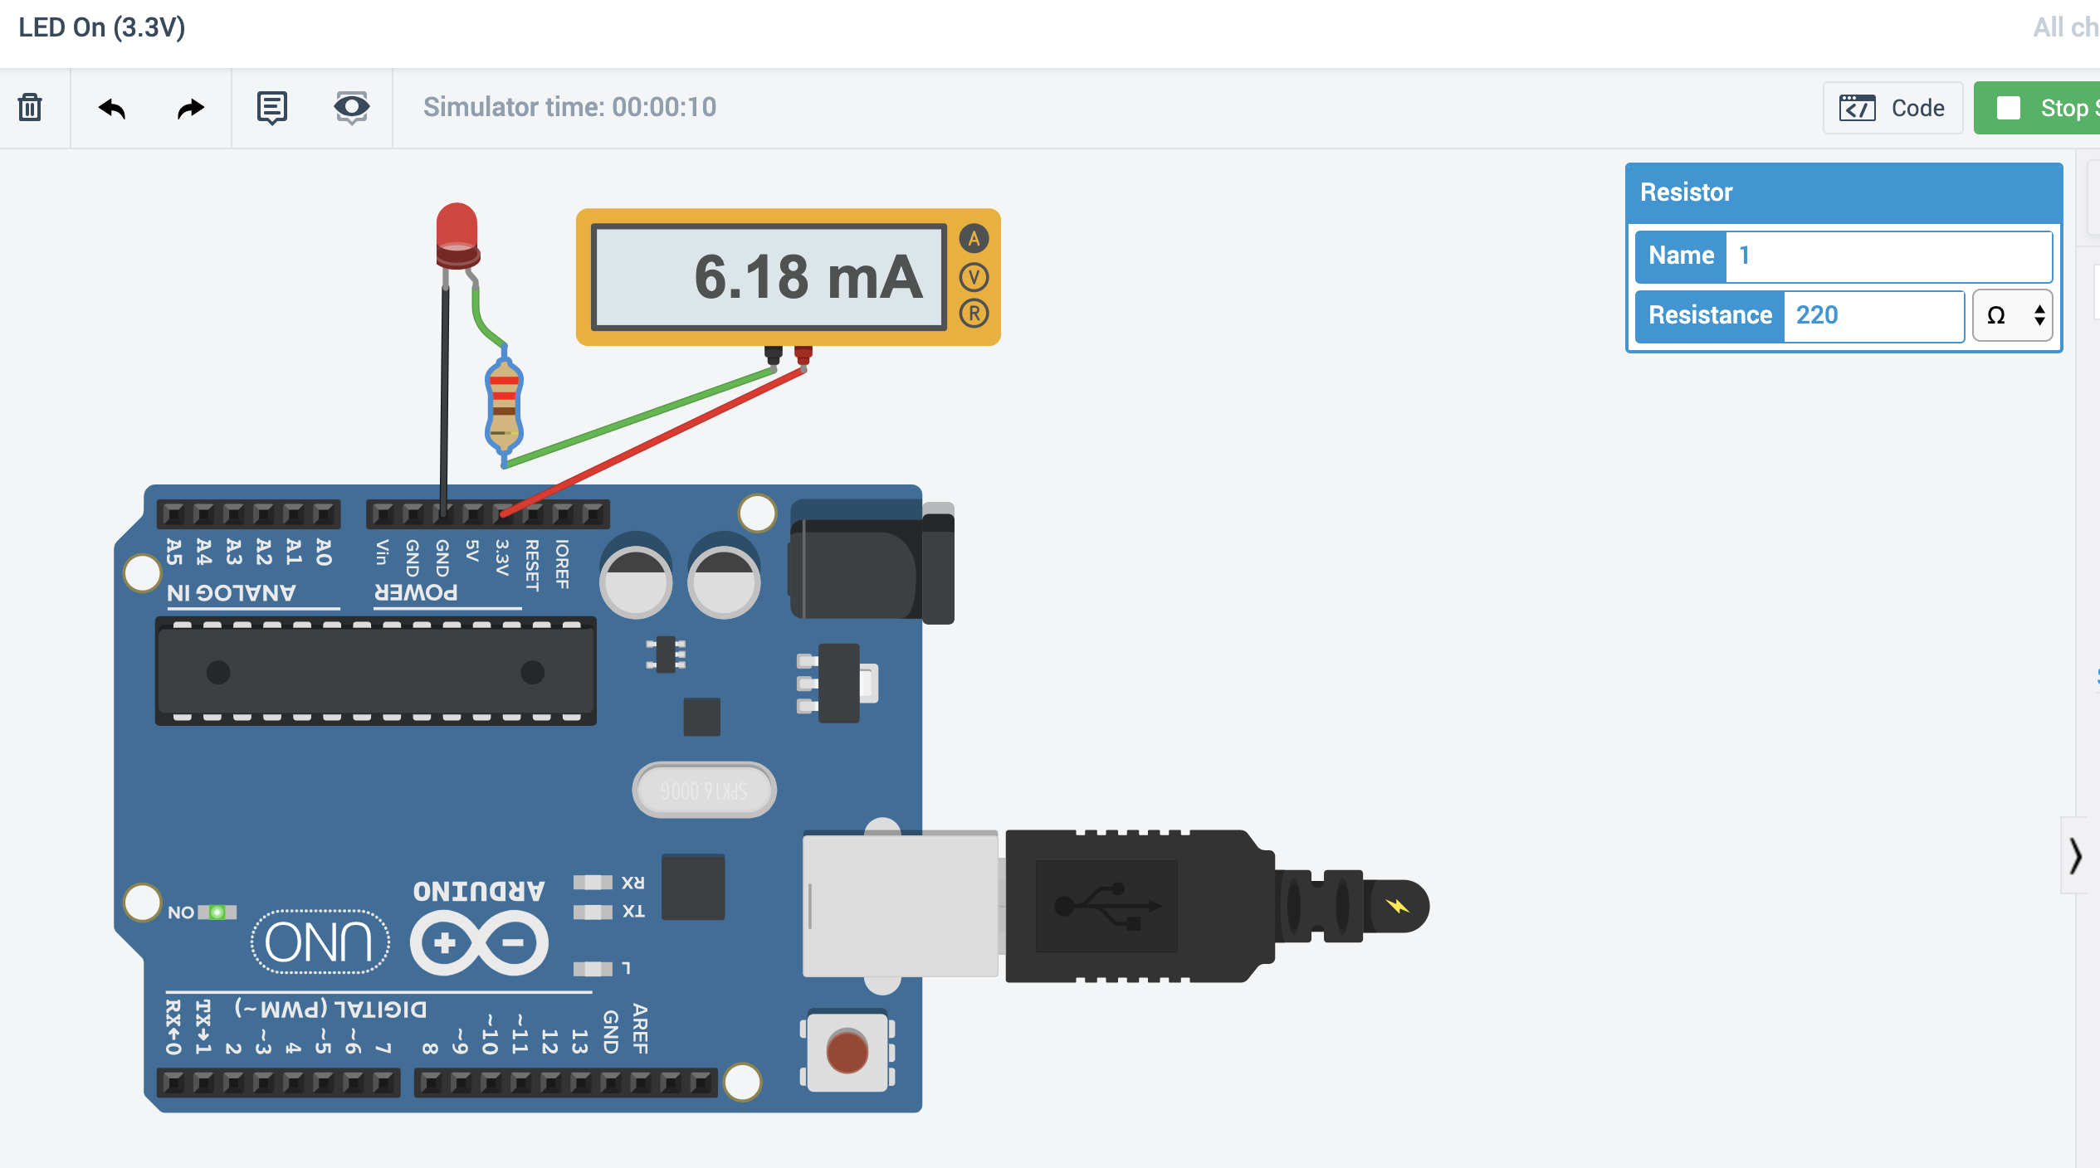
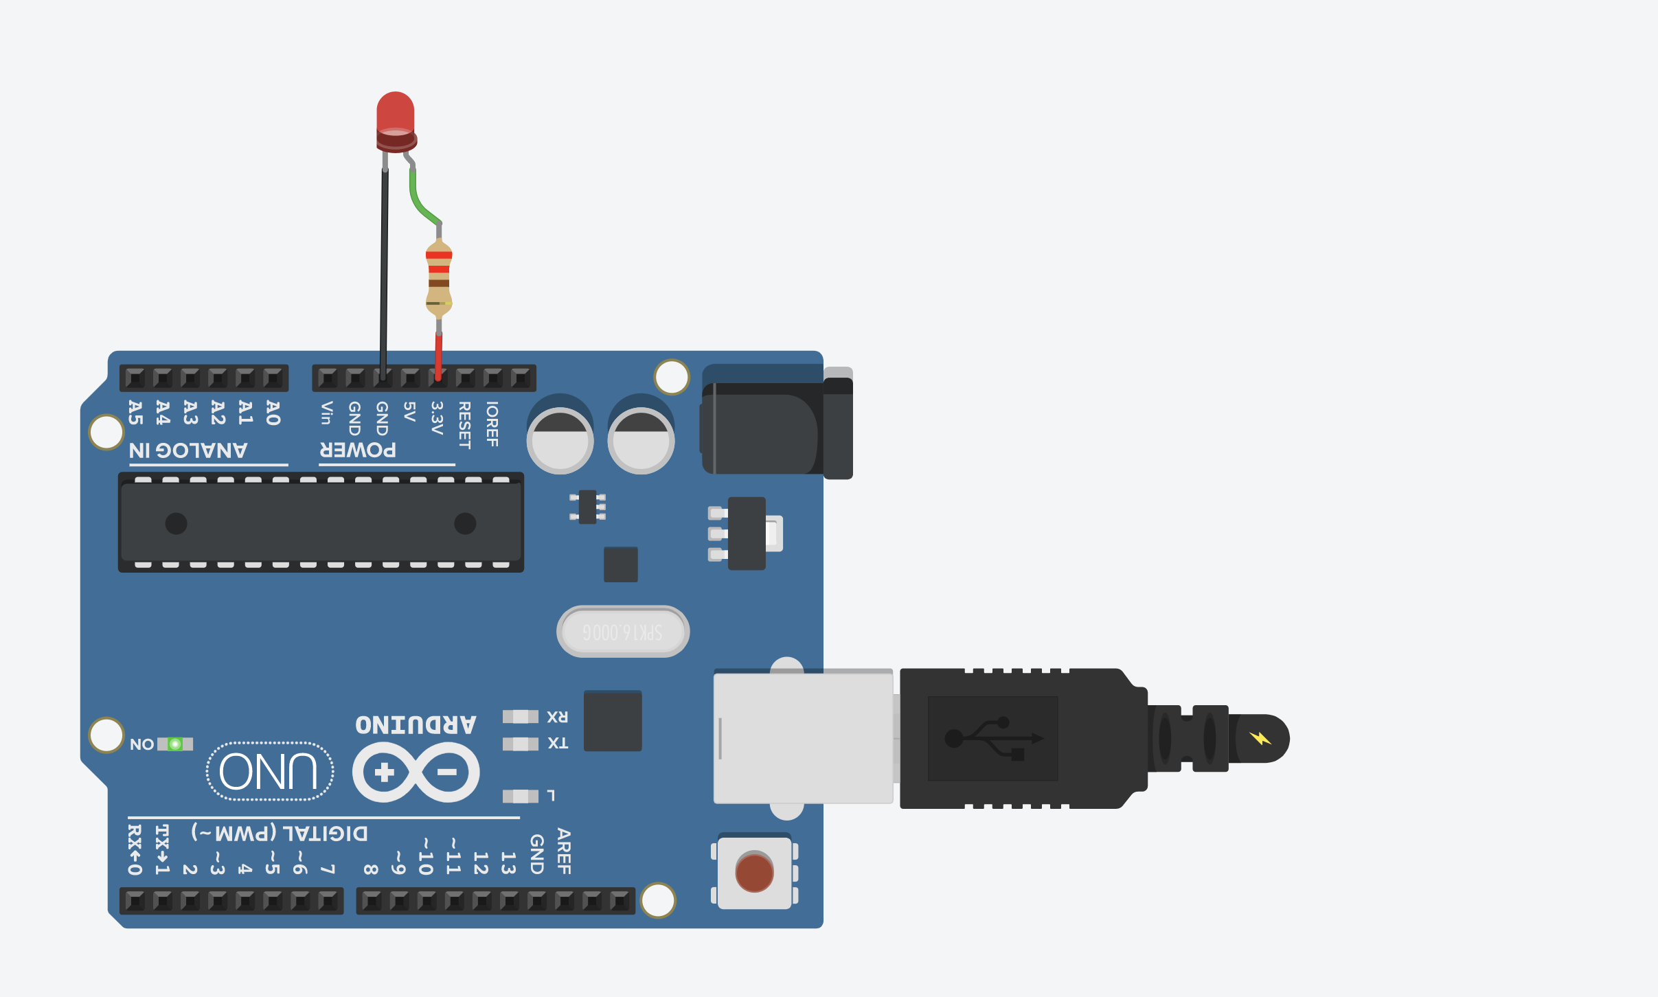



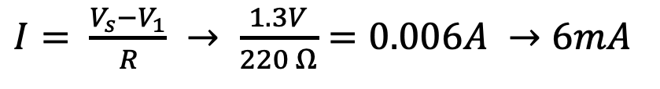
Current through LED circuit
$$V_{1}=2V$$
$$V_{2}=0V$$
$I= \frac{V_{s}−V_{1}}{R} → \frac{1.3V}{220 Ω}=0.006A →6mA$
220Ω
$$V_{s}=3.3V$$

