Slide 1
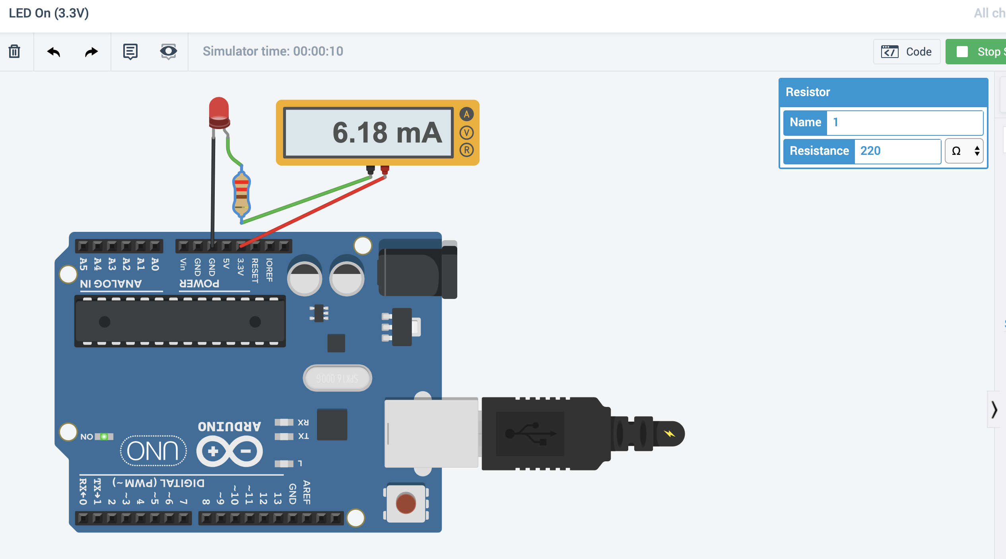
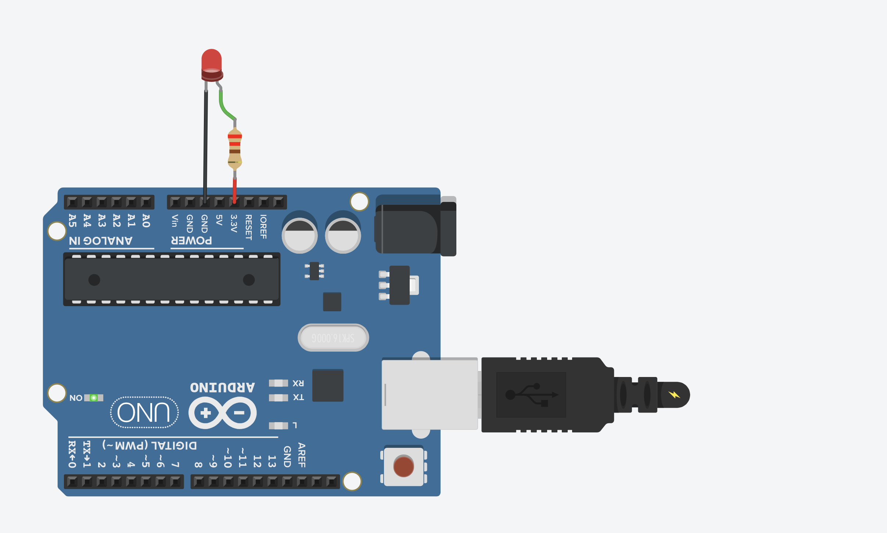
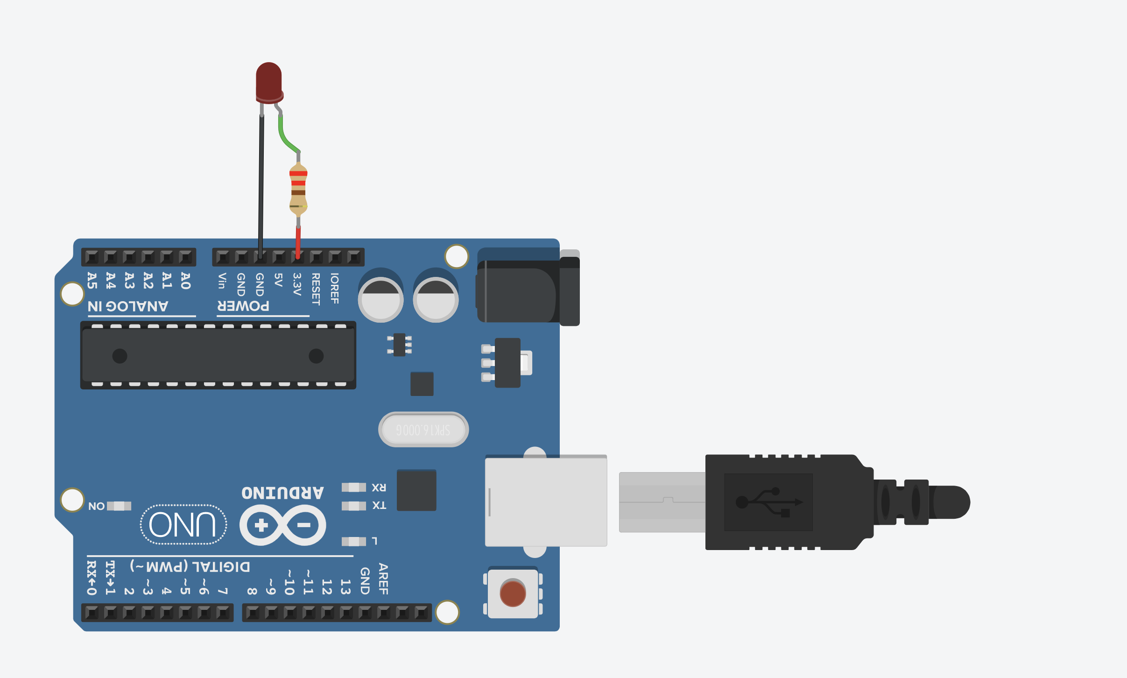
LED Anode Towards 3.3V
The LED anode (long leg) should point towards 3.3V

Slide 2
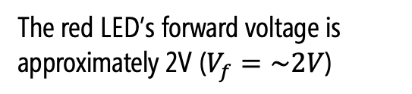



The red LED’s forward voltage is approximately 2V ($V_{f}=\sim 2V$)
$$V_{1}= ?$$
$$V_{2}=0V$$
220Ω
$$V_{s}=3.3V$$

Slide 3

Thus, V₁ is 2V
$$V_{1}=2V$$
$$V_{2}=0V$$
220Ω
$$V_{s}=3.3V$$

Slide 4
$$V_{1}=2V$$
To determine current, calculate the voltage drop over the resistor
$$V_{2}=0V$$
220Ω
$$V_{s}=3.3V$$

Slide 5
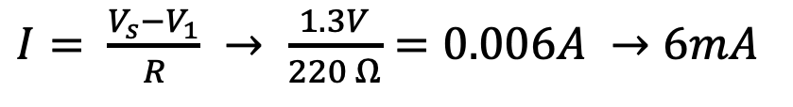
Current through LED circuit
$$V_{1}=2V$$
$$V_{2}=0V$$
$I= \frac{V_{s}−V_{1}}{R} → \frac{1.3V}{220 Ω}=0.006A →6mA$
220Ω
$$V_{s}=3.3V$$

