Slide 1
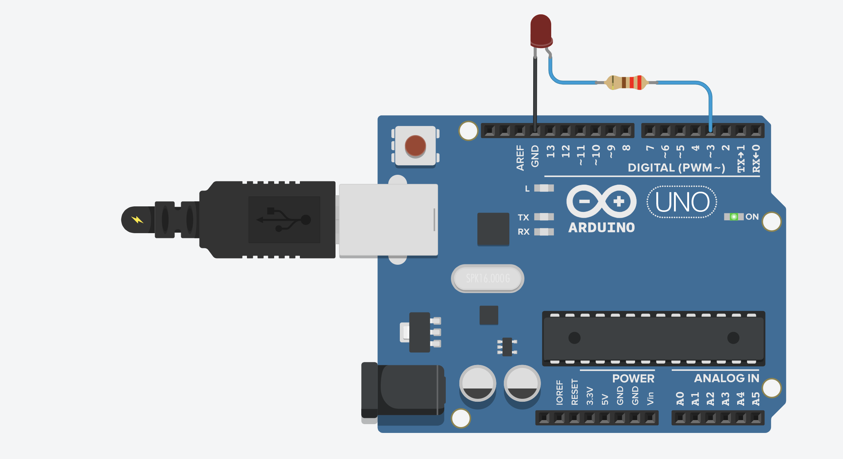
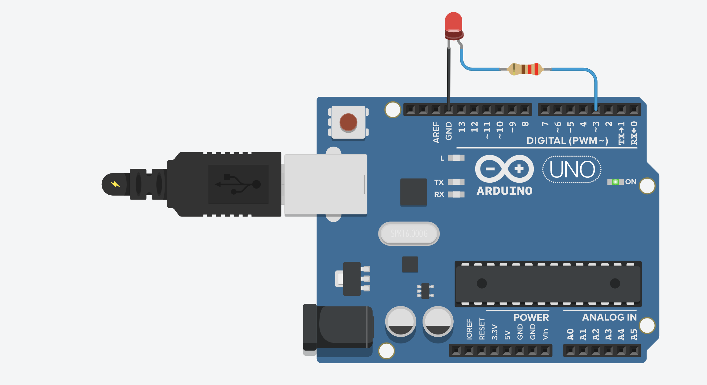
Pin 3 is HIGH (5V)
Pin 3 is set to 5V via digitalWrite(3, HIGH);
Plugged in
The Arduino is on

