Slide 1
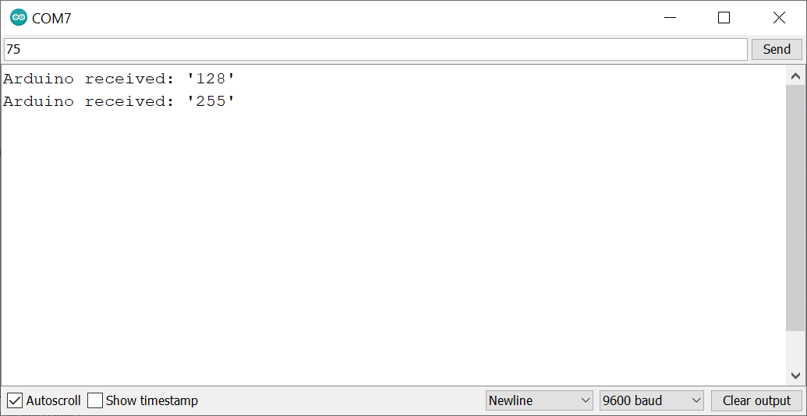
Type text to transmit here
Hit the ‘Send’ button to transmit over serial
Make sure the baud rate corresponds to the value used in Serial.begin(<baud rate>)

Slide 2
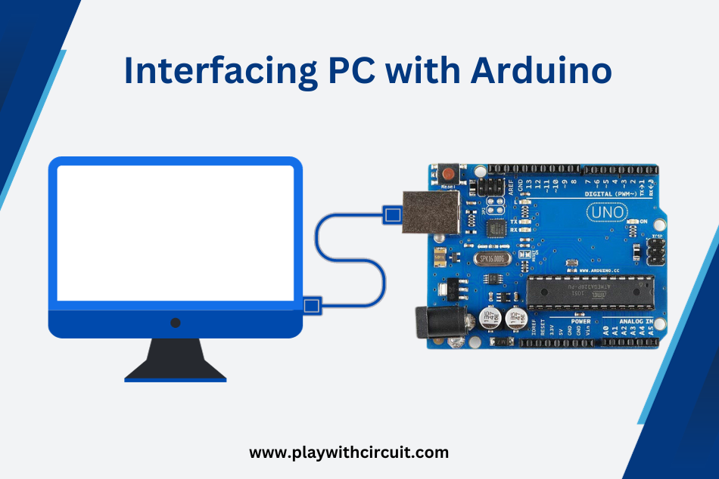
Notes:
https://playwithcircuit.com/interfacing-pc-with-arduino-uno-using-serial-communication-port/

Slide 3
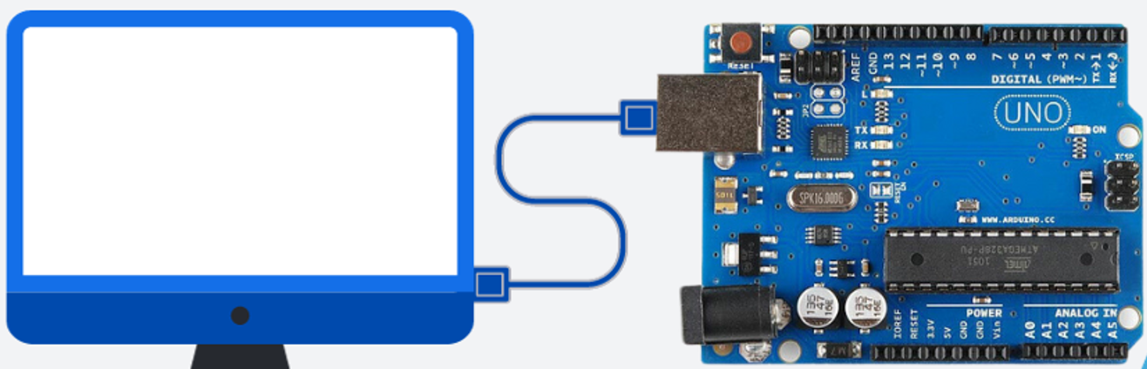

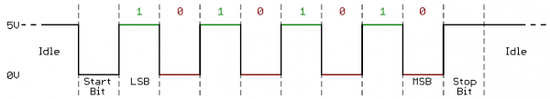

Slide 4

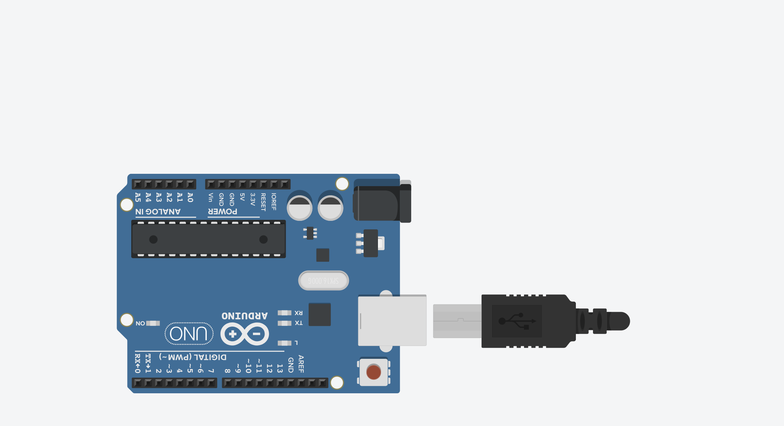
Serial.println(“Hello World”)

Slide 5
Serial.println(“Hello World”)
Hello World!

Slide 6
Serial.println(“Hello World”)
Hello World!
“Hello world” communicated via 1s & 0s (5V & GND) using the asynchronous serial protocol

