Slide 2
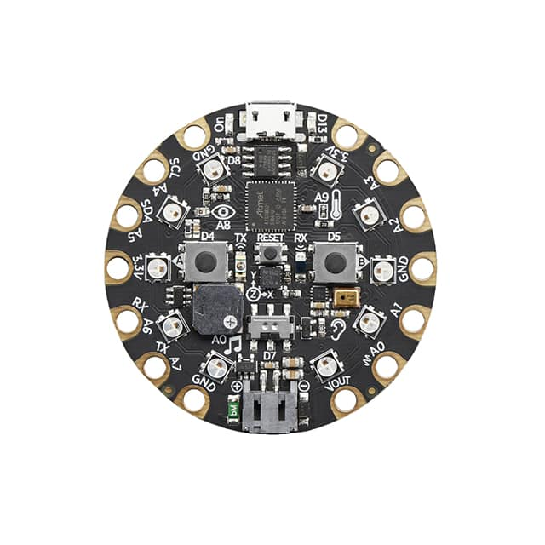
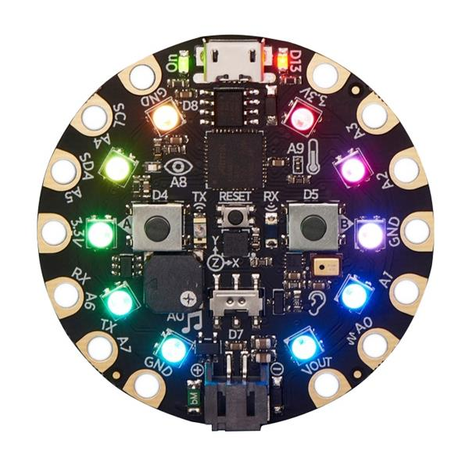
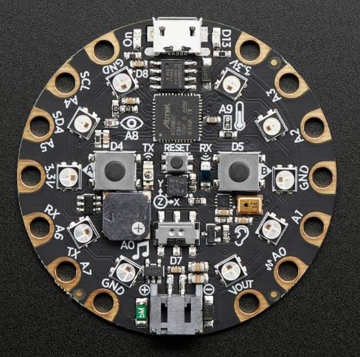

Slide 3
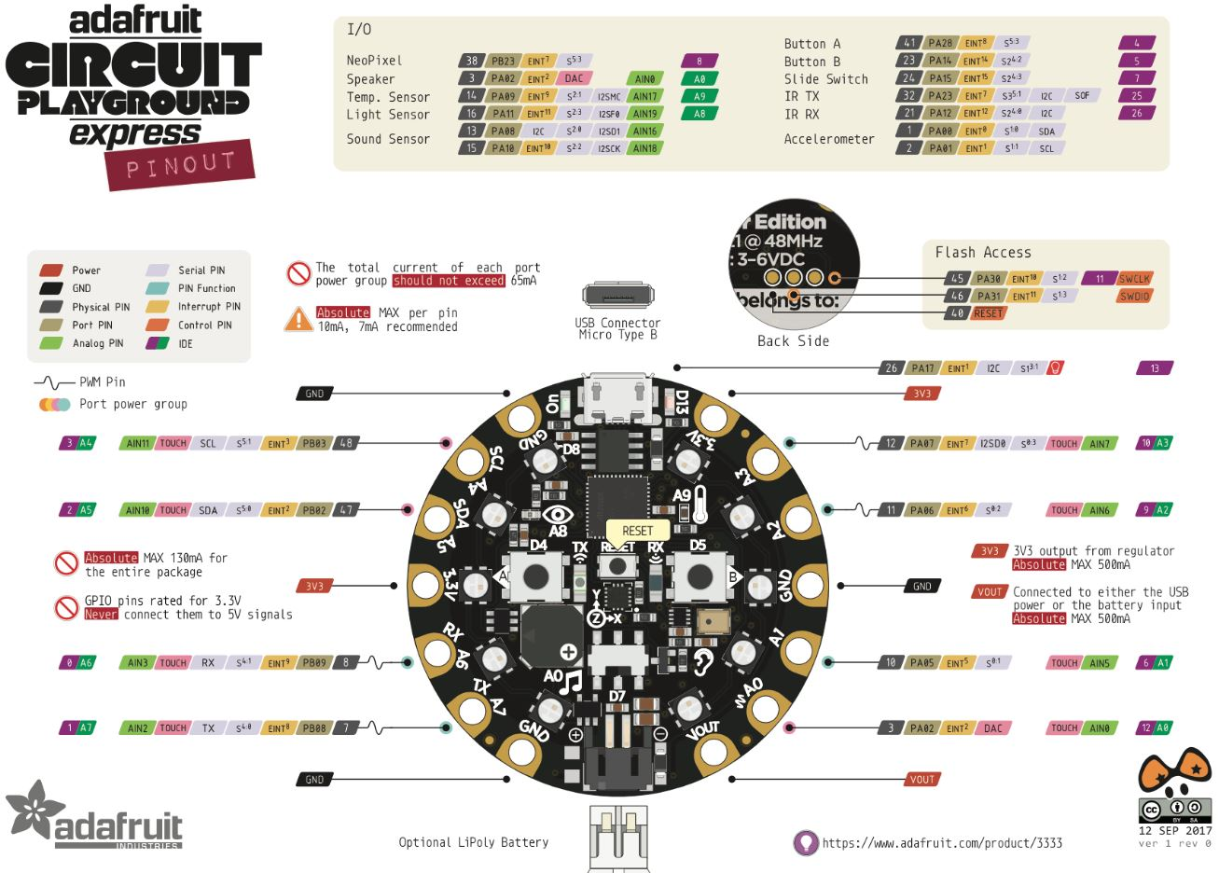
Notes:
Chart from: https://robot-r-us.com.sg/p/circuit-playground-express

Slide 4
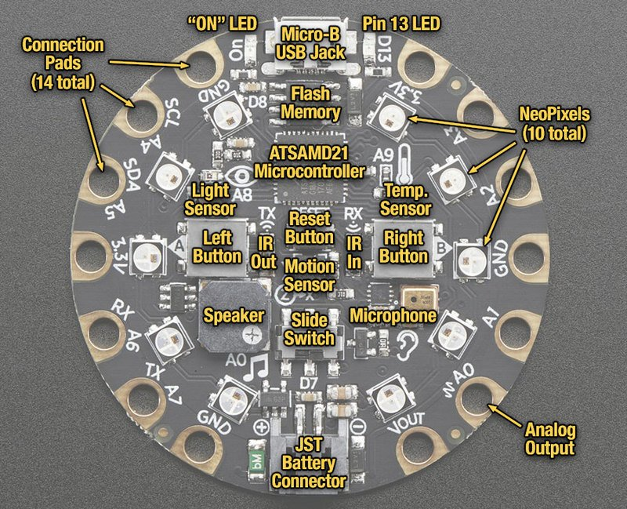
CPX Input
Temperature Sensor
Left Button
Right Button
Notes:
https://learn.adafruit.com/adafruit-circuit-playground-express/guided-tour

Slide 5
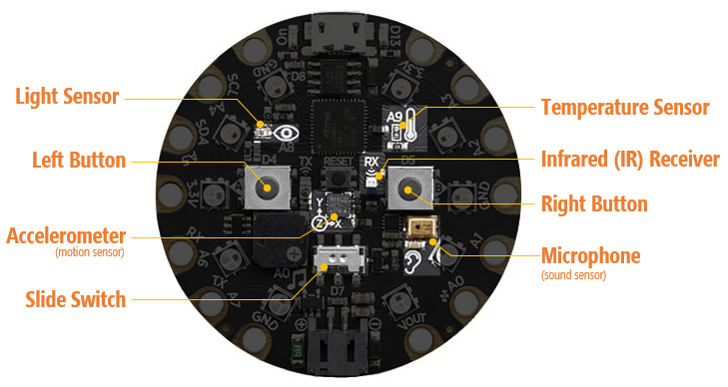
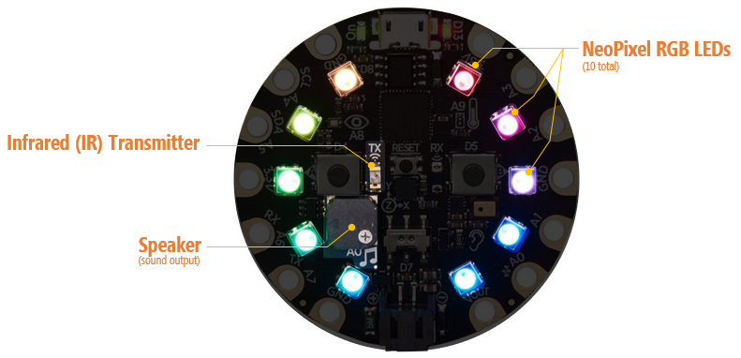
Circuit express playground hardware
CPX Board
Built-in sensors/input
Built-in output

Slide 6
Built-in CPX Input
Light Sensor
Temperature Sensor
Left Button
Infrared (IR) Receiver
Right Button
Accelerometer
(motion sensor)
Microphone
(sound sensor)
Slide Switch
Notes:
https://learn.adafruit.com/adafruit-circuit-playground-express/guided-tour

Slide 7
CPX Input
Light Sensor
Temperature Sensor
Left Button
Infrared (IR) Receiver
Right Button
Accelerometer
(motion sensor)
Microphone
(sound sensor)
Slide Switch
Notes:
https://learn.adafruit.com/adafruit-circuit-playground-express/guided-tour

Slide 8
Built-in CPX OUTPUT
NeoPixel RGB LEDs
(10 total)
Infrared (IR) Transmitter
Speaker
(sound output)
Notes:
https://learn.adafruit.com/adafruit-circuit-playground-express/guided-tour

Slide 9
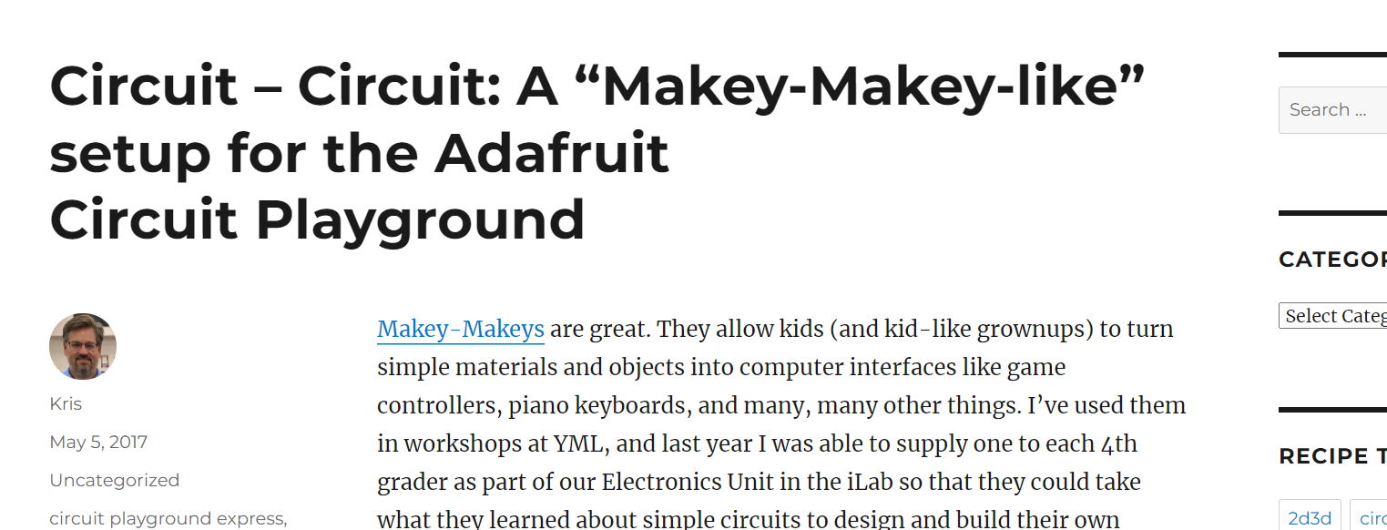
Makey Makey Activity
Notes:
https://krisswanson.blog/2017/05/05/circuit-circuit-a-makey-makey-like-setup-for-the-adafruit-circuit-playground/

