Slide 1
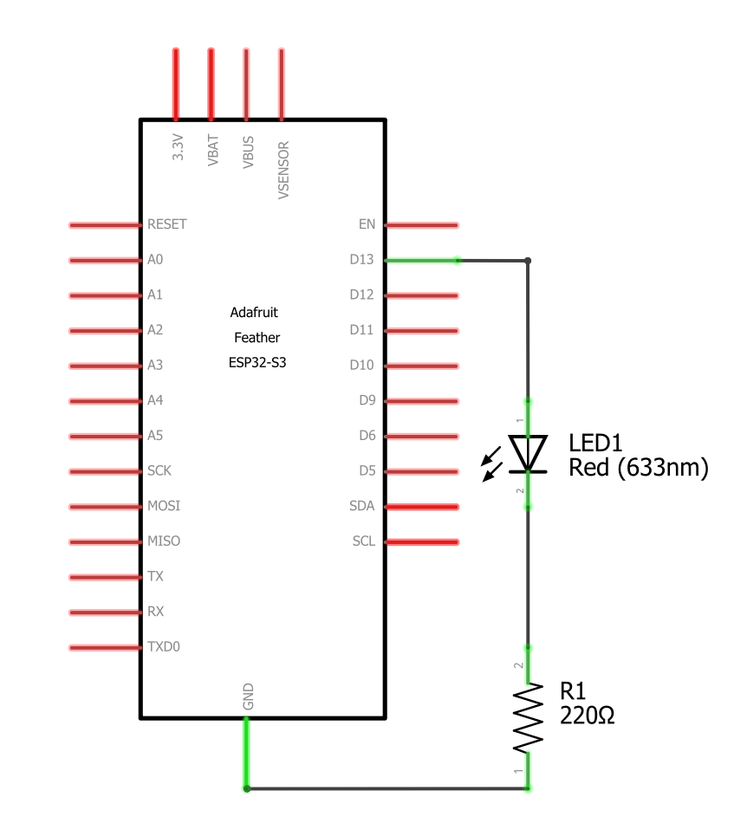
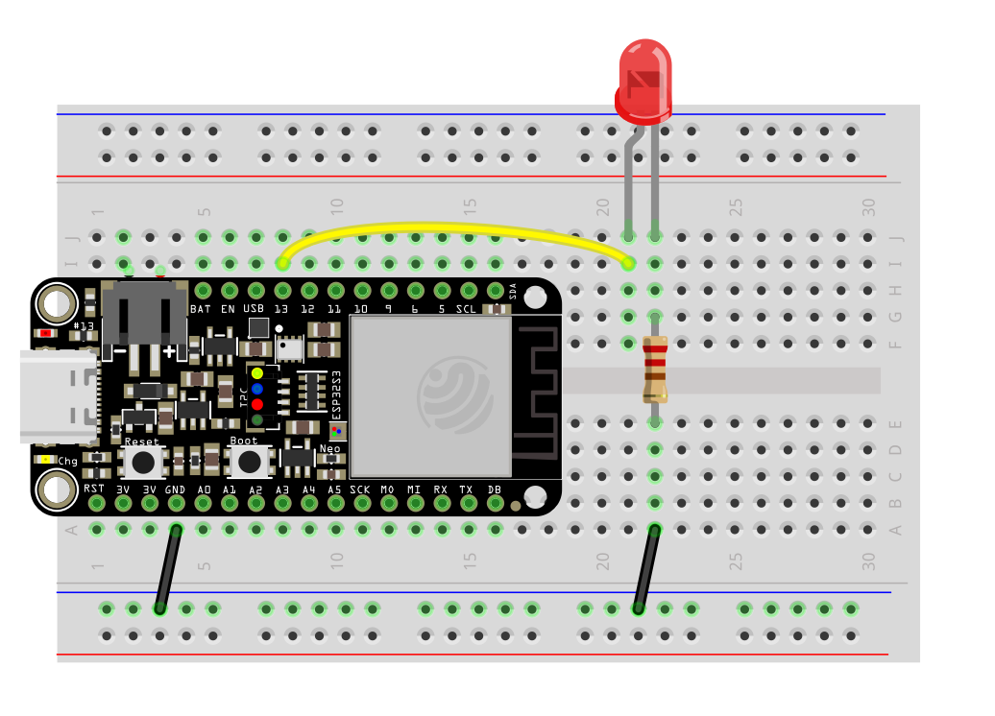
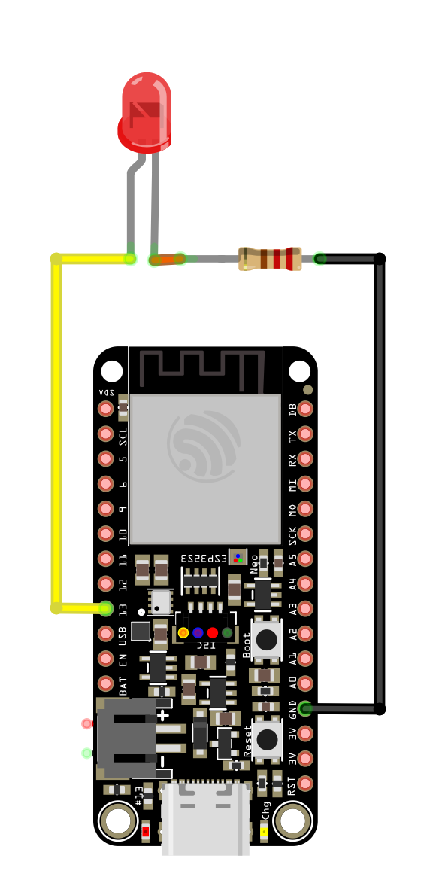
ESP32-S3 feather LED Fade Circuit Diagrams
Same diagram as blinky. Wire up LED to GPIO Pin 13 with a 220Ω current limiting resistor
No Breadboard
breadboard
Schematic

