Slide 1
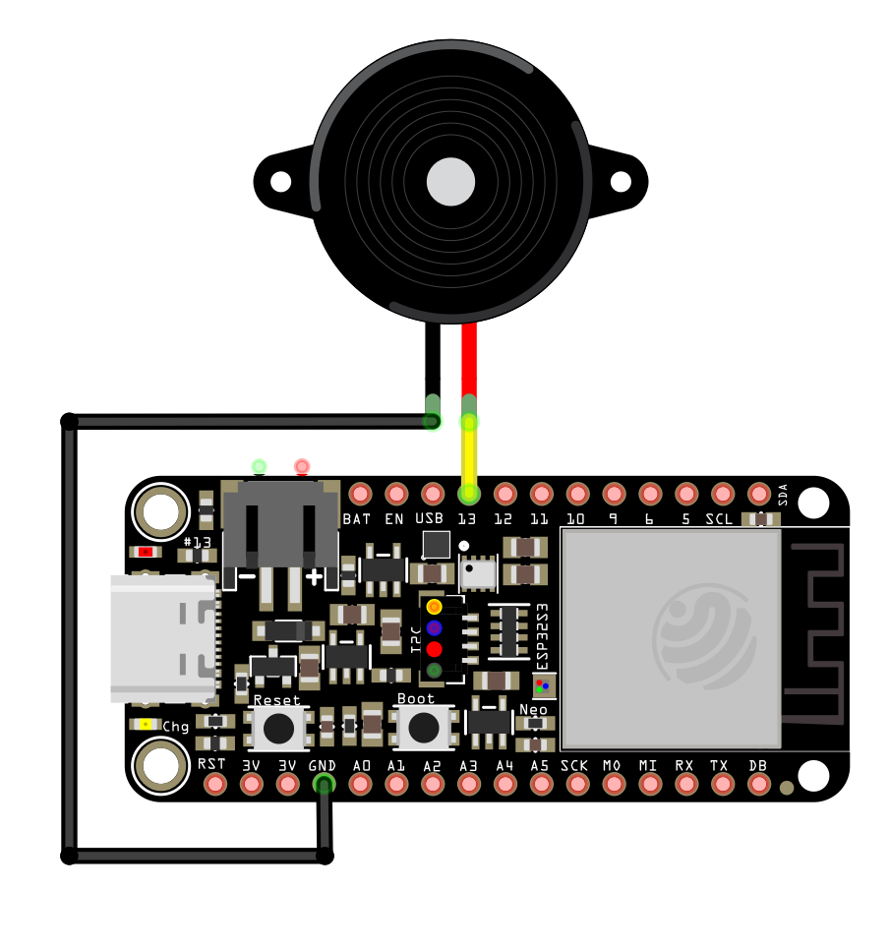
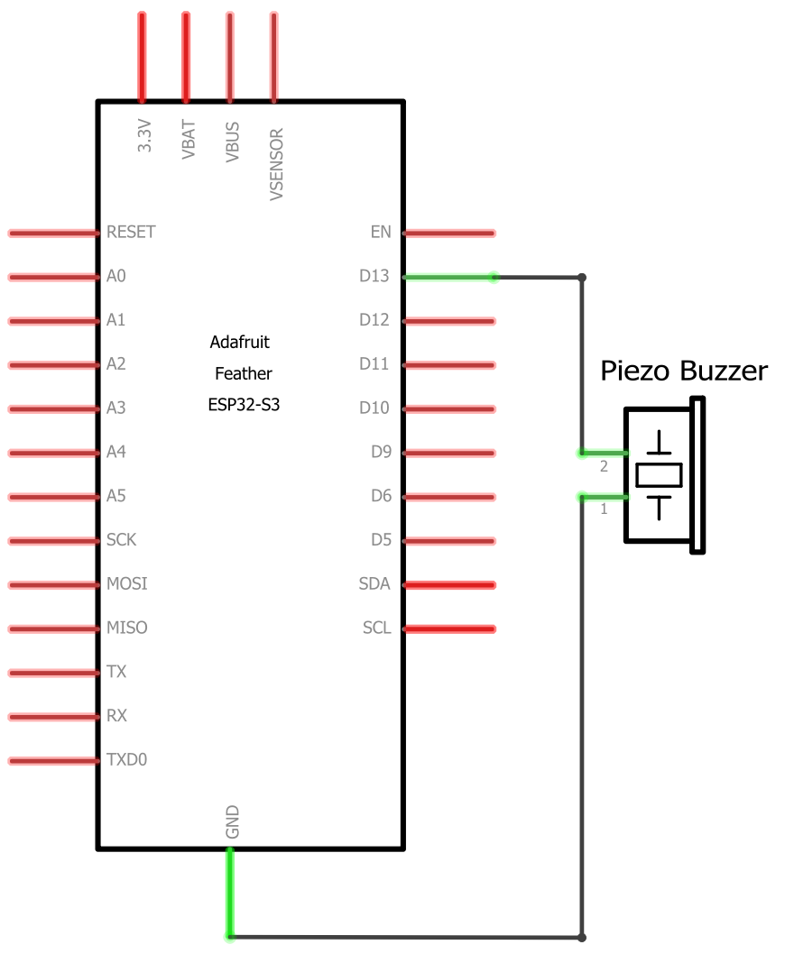
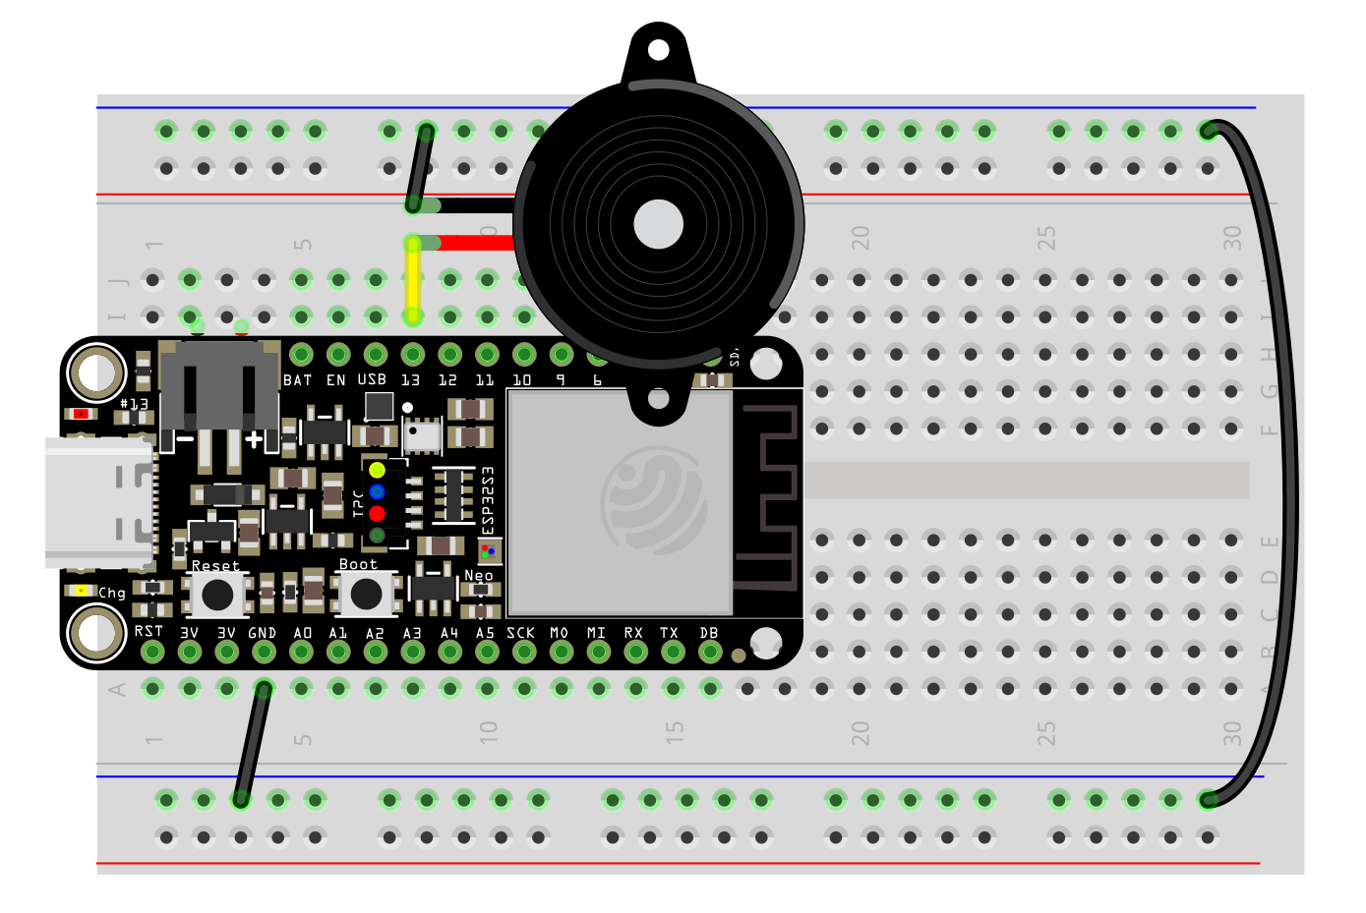
ESP32-S3 feather TONE Circuit Diagrams
Simple wiring. Wire up one leg of the piezo buzzer to GPIO13 and the other to GND.
No Breadboard
breadboard
Schematic

Slide 2
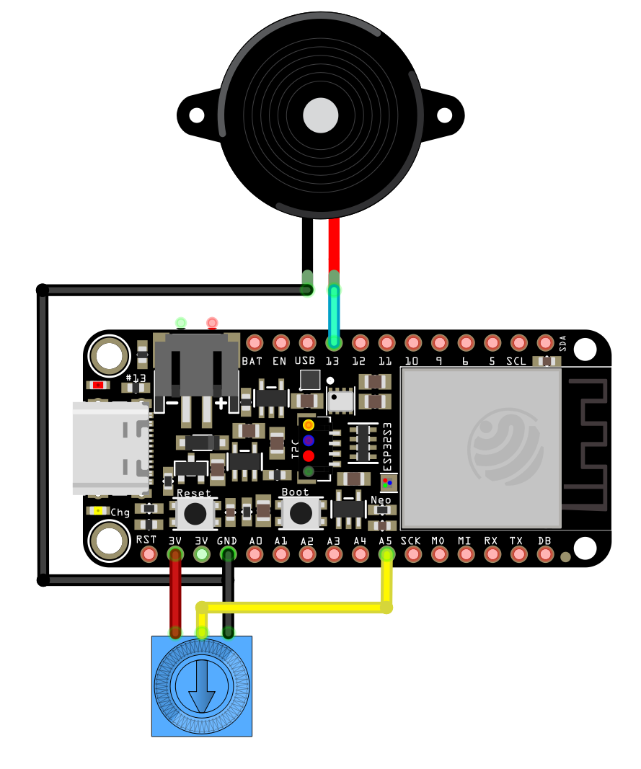
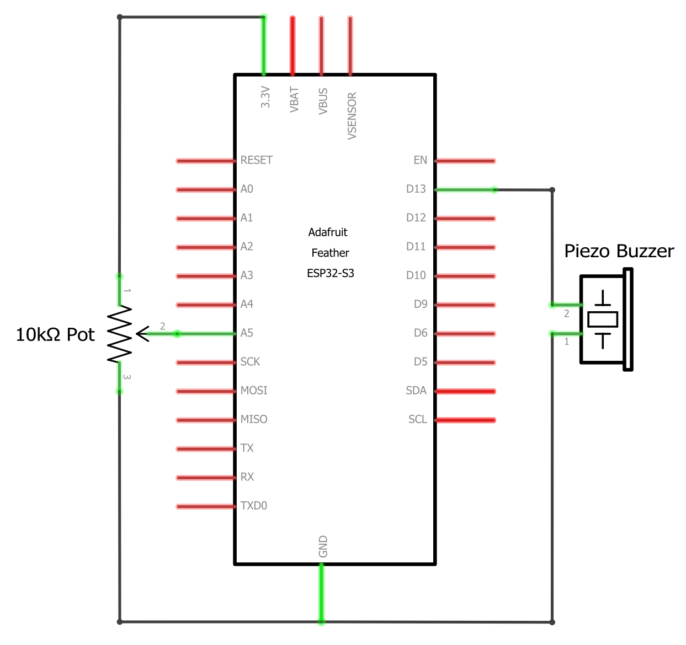
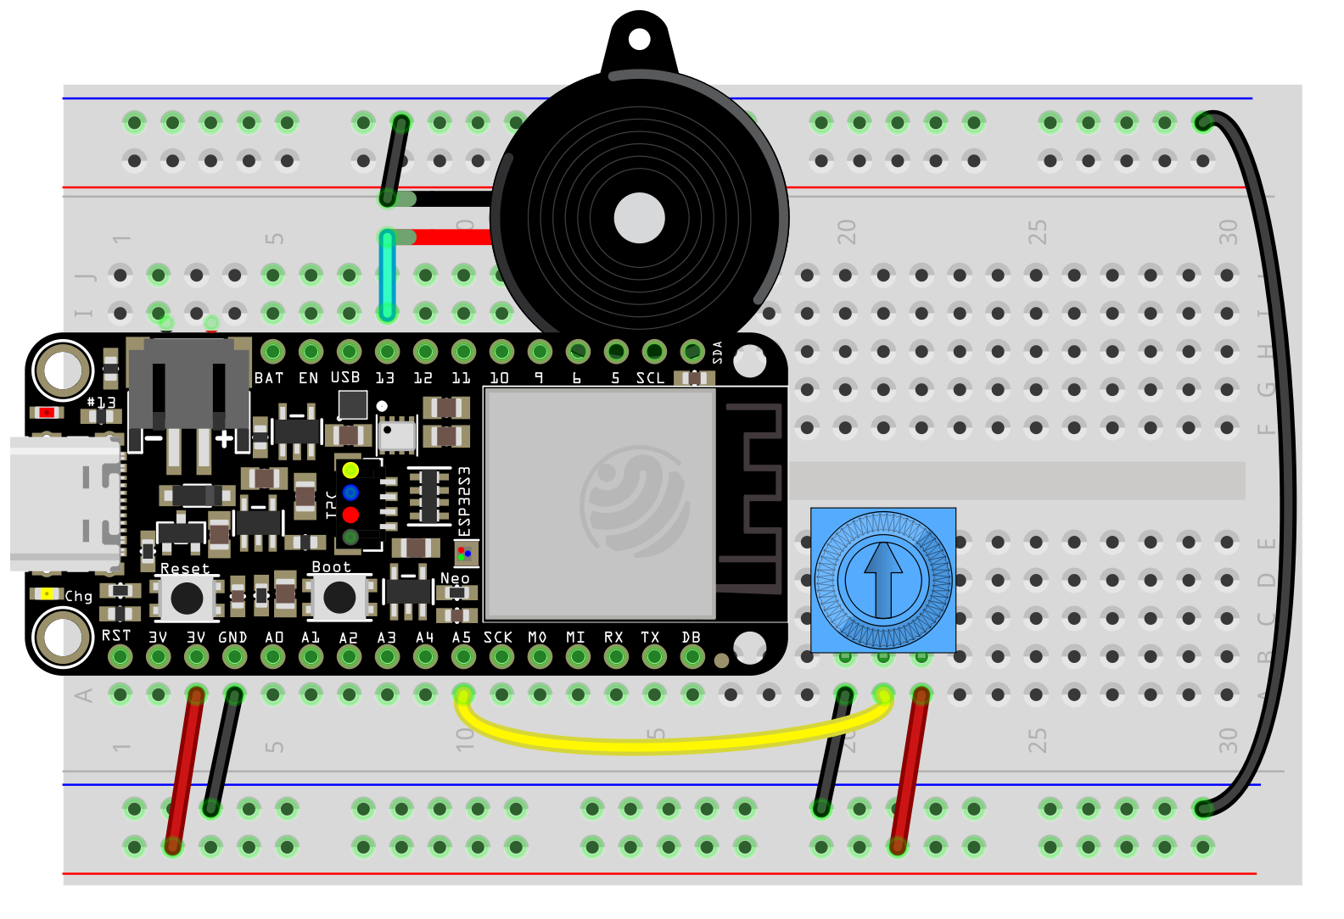
ESP32-S3 feather Pot TONE Circuit Diagrams
Wire up one leg of the piezo buzzer to GPIO13 and the other to GND. Wire the pot to A5.
No Breadboard
breadboard
Schematic

