Slide 1
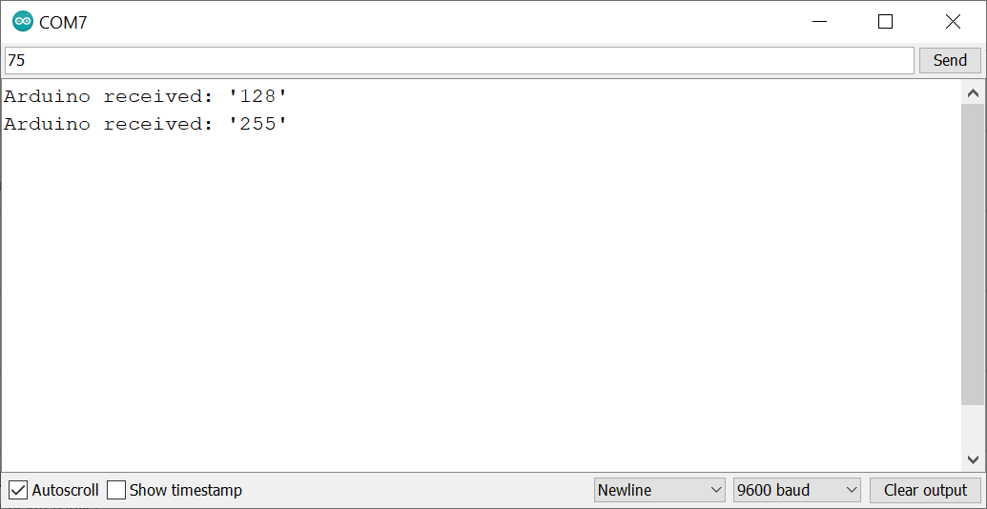
Type text to transmit here
Hit the ‘Send’ button to transmit over serial
Make sure the baud rate corresponds to the value used in Serial.begin(<baud rate>)

