Slide 1
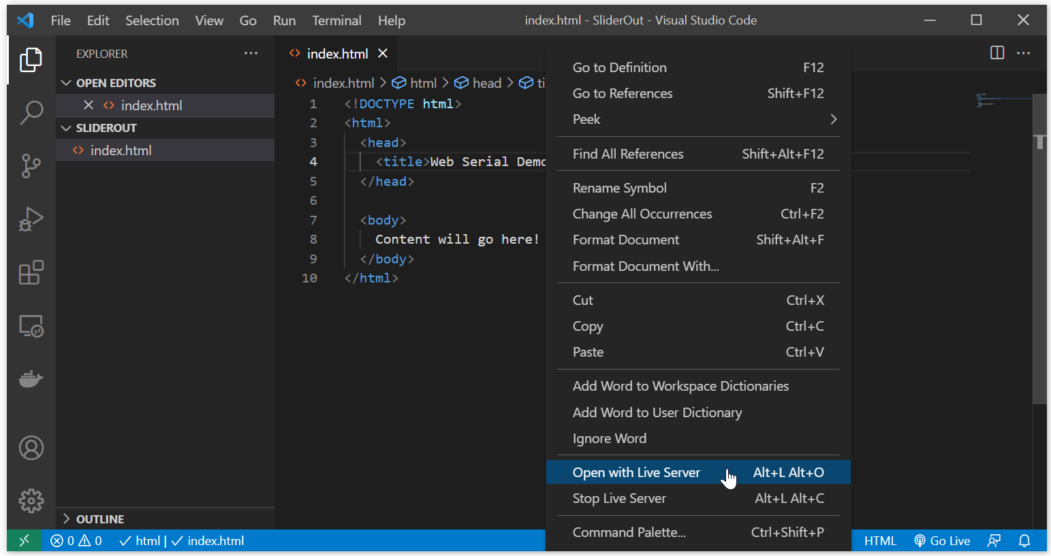
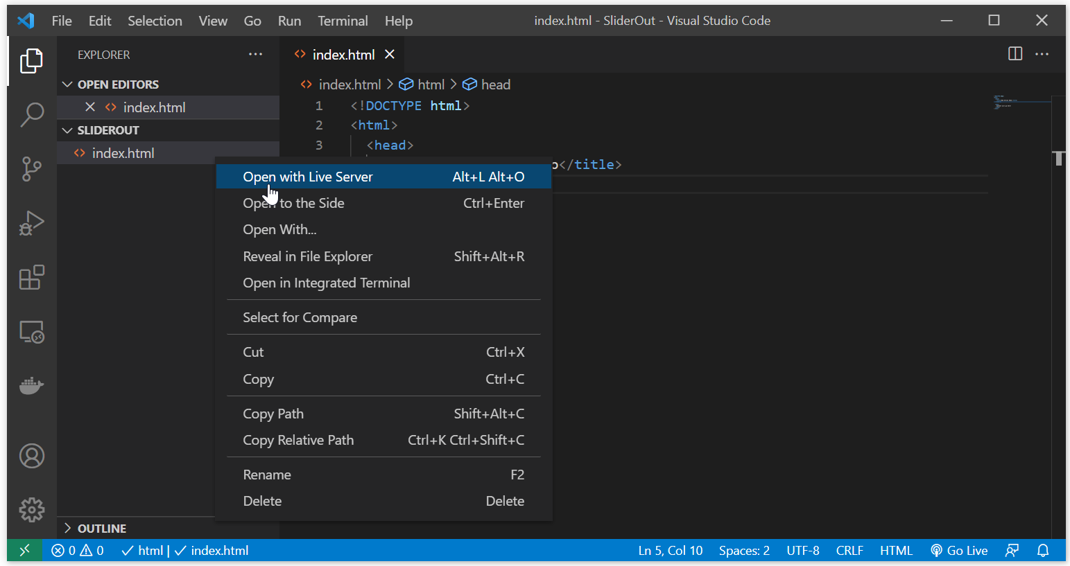

Slide 2
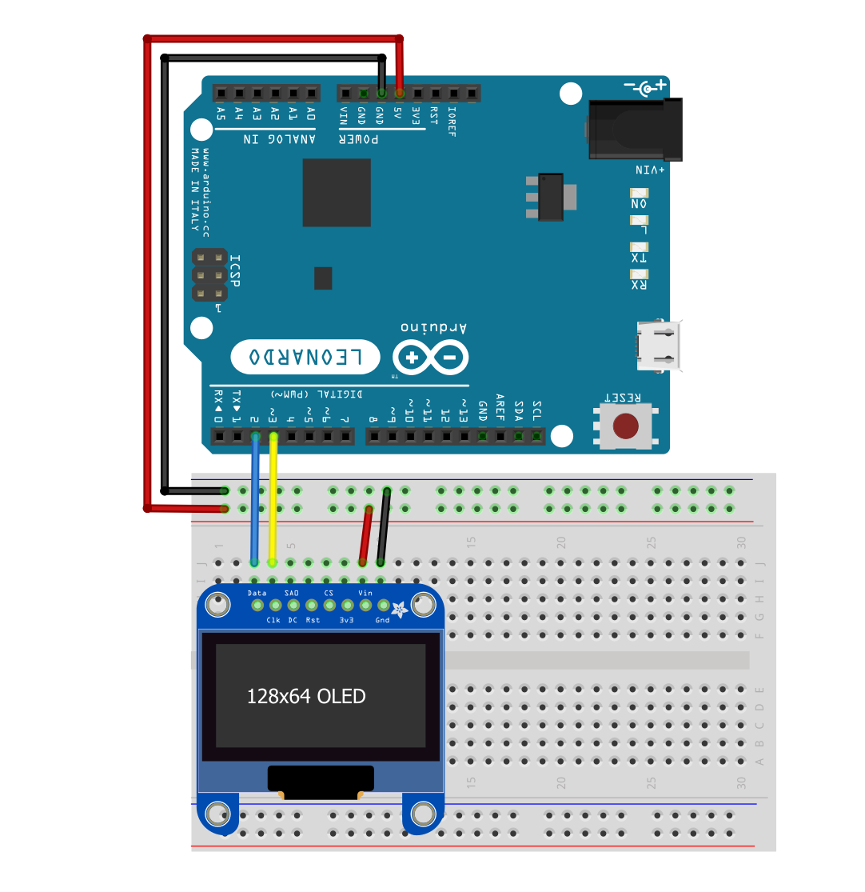
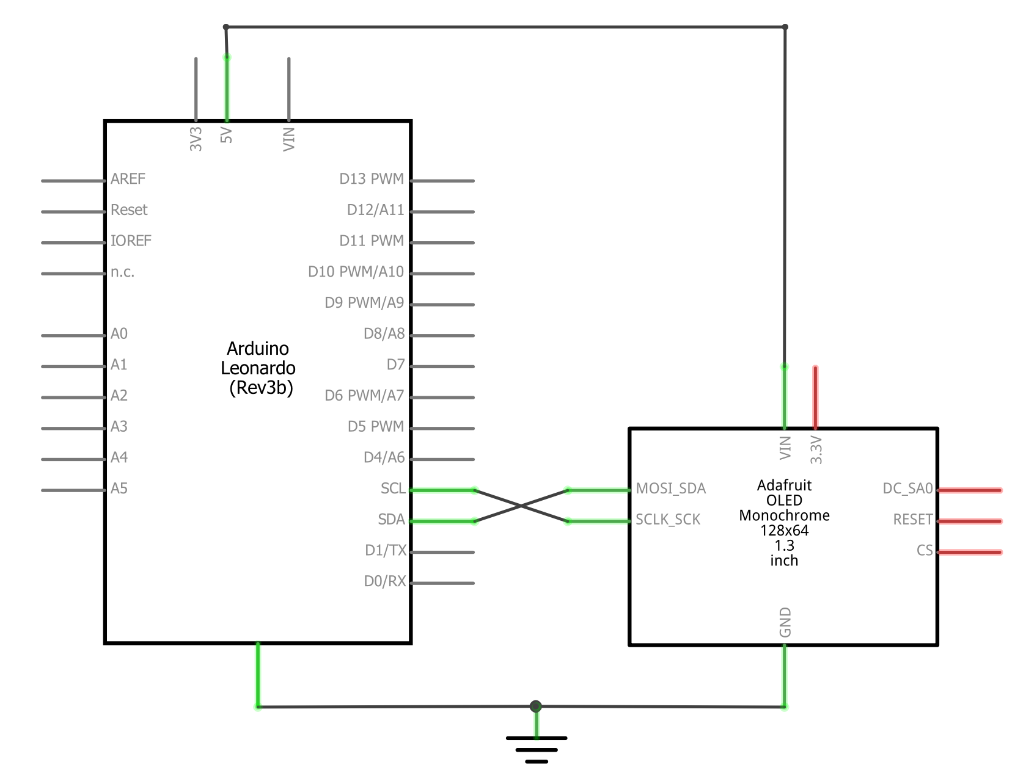

Slide 3
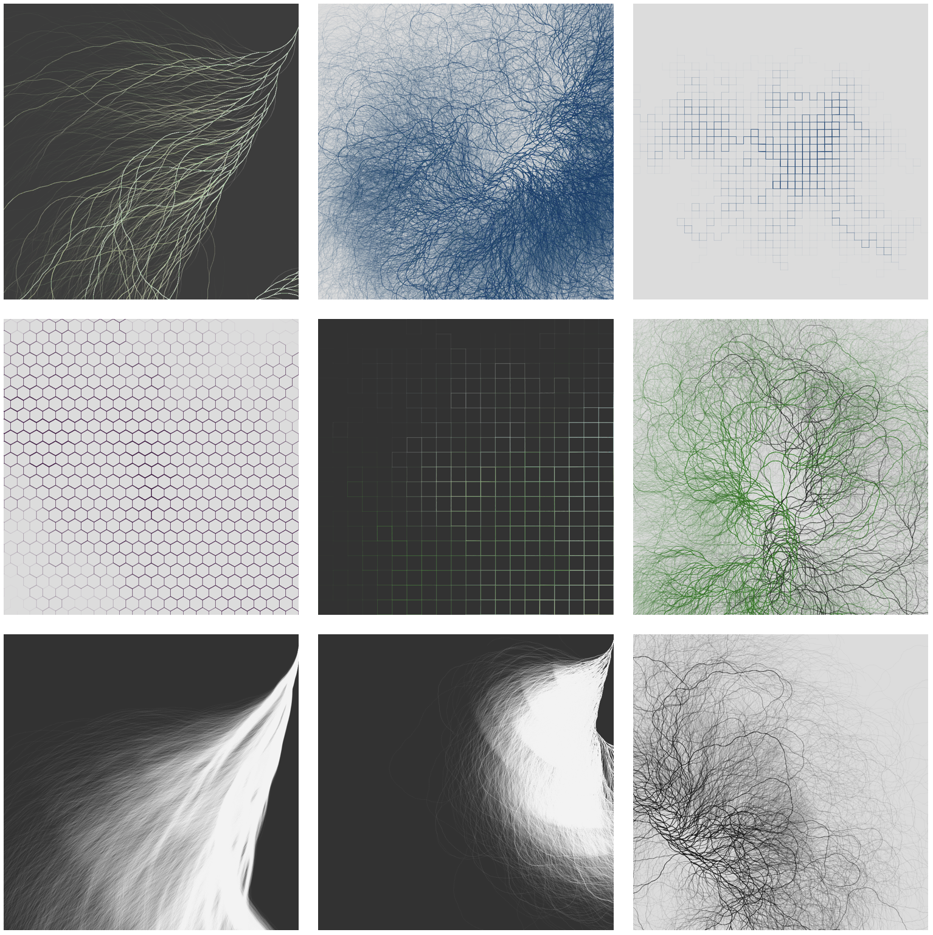
Notes:
https://www.reddit.com/r/processing/comments/dy5z5h/collatz_variations/
https://dailygenerative.art.blog/2019/11/17/reflections/

Slide 4
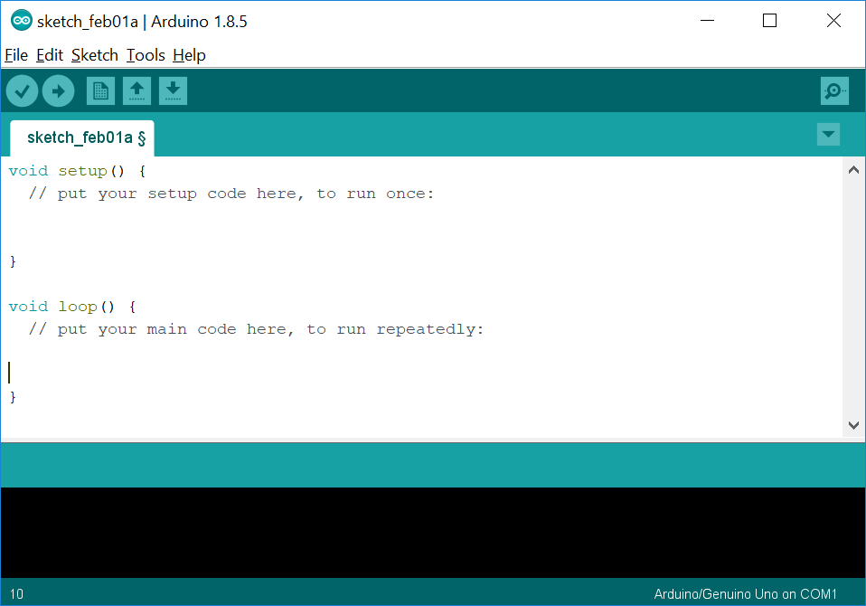
Programming Arduino!
Arduino Programming
All Arduino programs are comprised of two areas: setup and loop.
setup
Called once at the very beginning of execution. Use this for initialization
Loop
Called over and over again as fast as possible by the microcontroller. As soon as your code completes here, loop() will be called again forever

Slide 5
Programming Arduino!
Arduino Programming
All Arduino programs are comprised of two areas: setup and loop.
Does this overall structure with setup and loop look familiar?
setup
Called once at the very beginning of execution. Use this for initialization
Loop
Called over and over again as fast as possible by the microcontroller. As soon as your code completes here, loop() will be called again forever

Slide 6
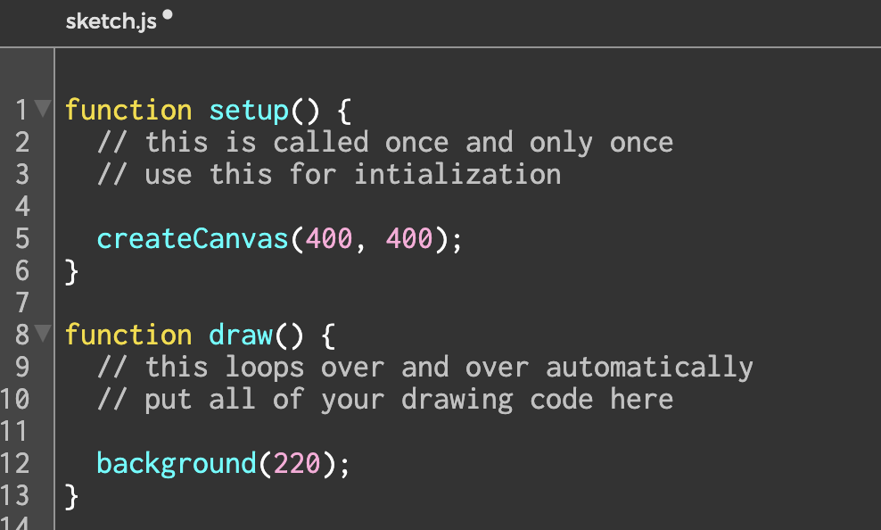
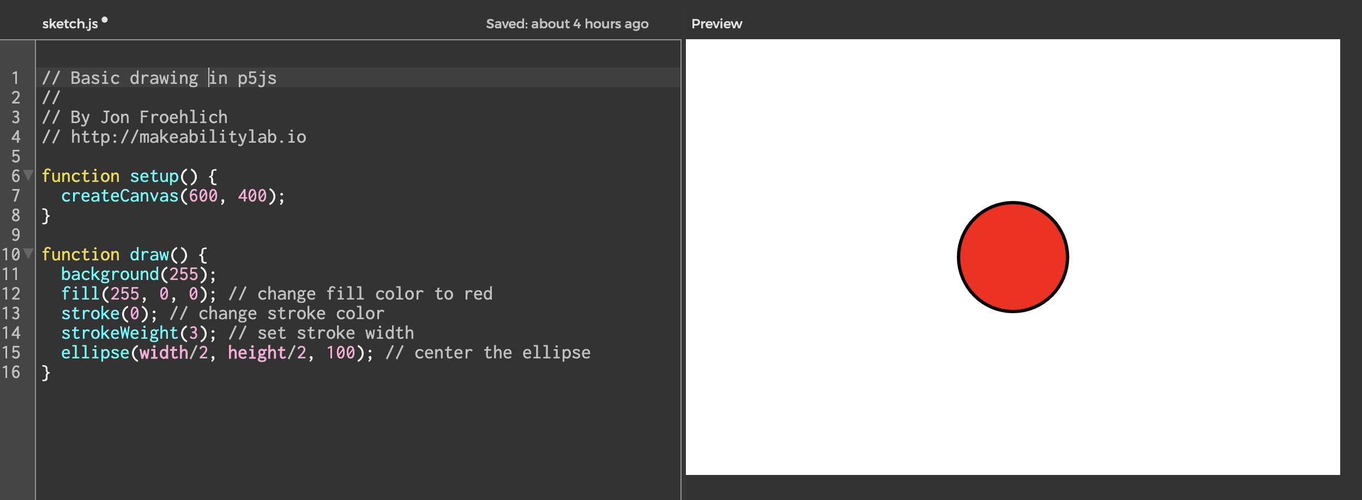
It’s the same as the Processing/p5js structure
Arduino Programming
setup
Called once at the very beginning of execution. Use this for initialization
Draw
Called over and over again at 60 frames per second. You can change the framerate.

