Slide 1
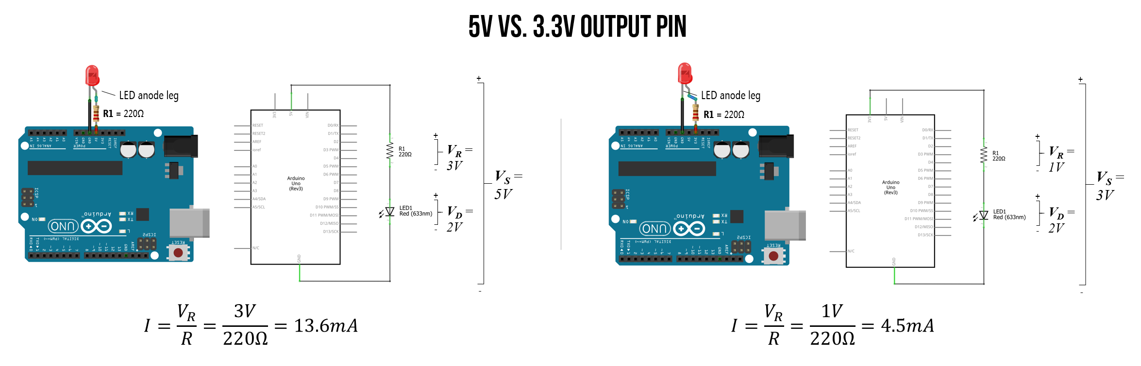
Warning: I lost the source for this and it has an error!

Slide 2
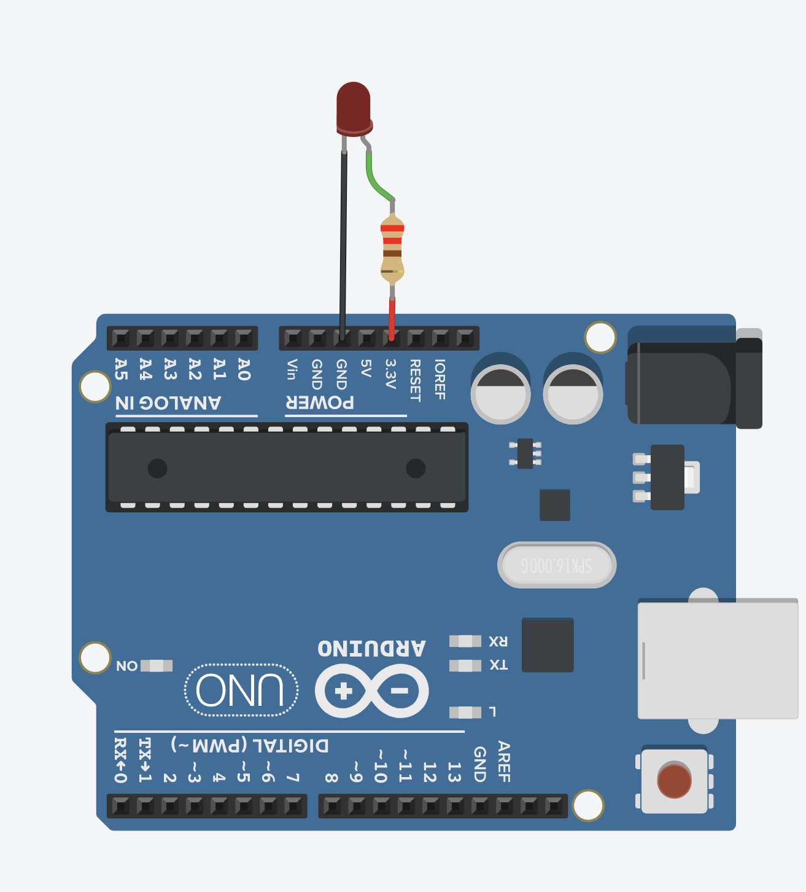
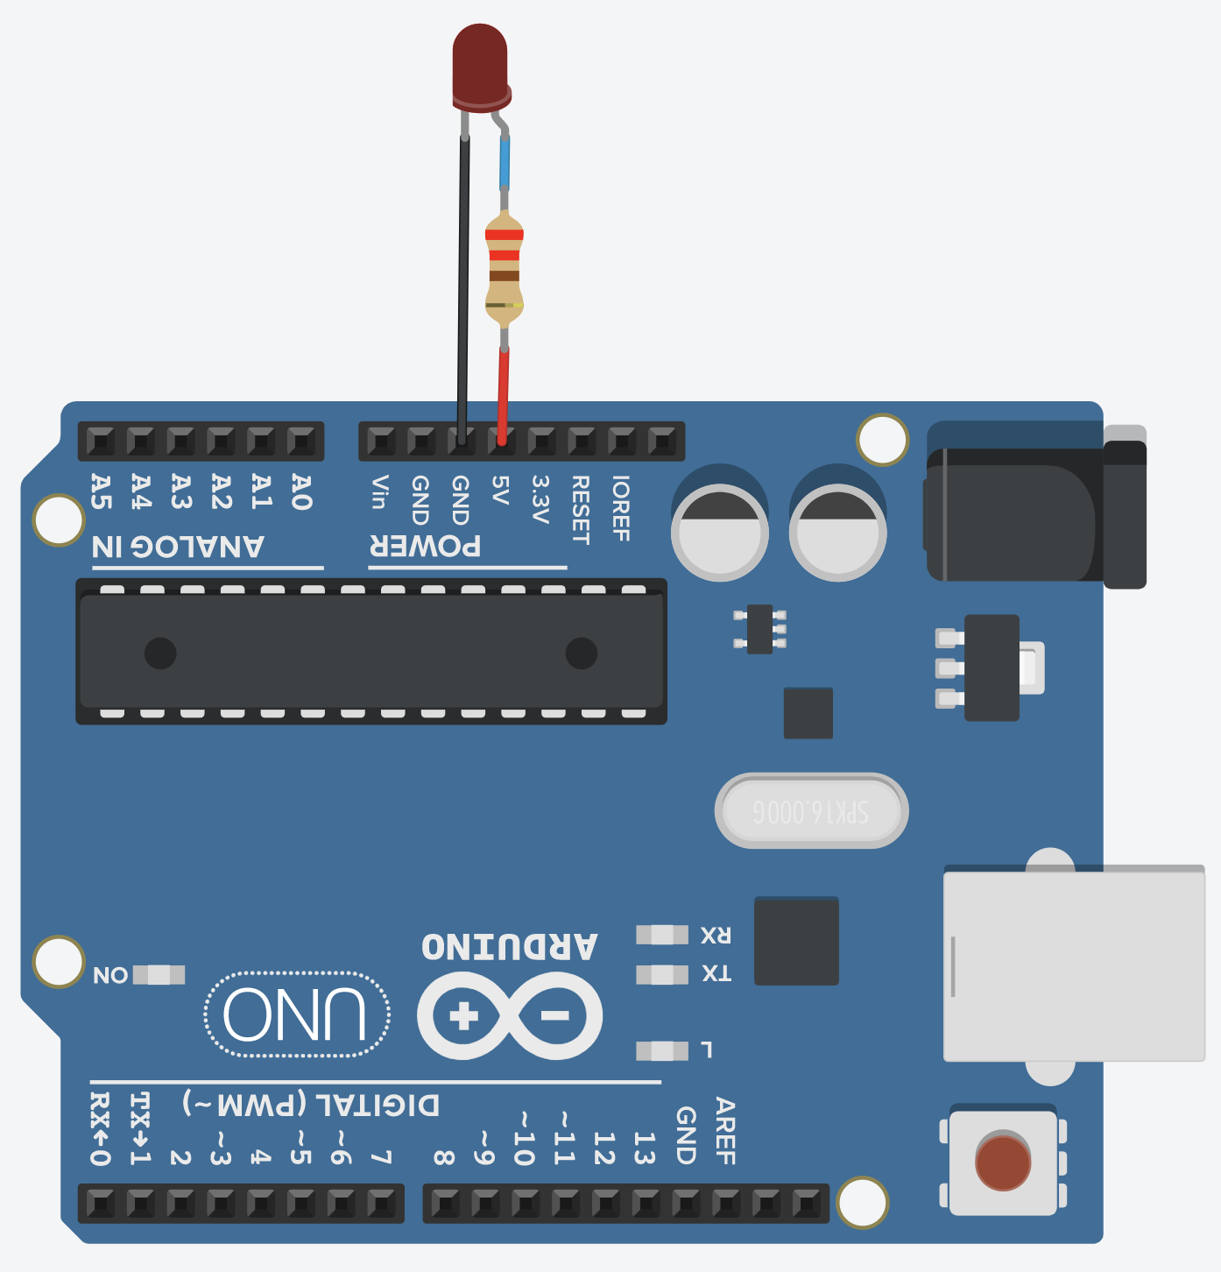
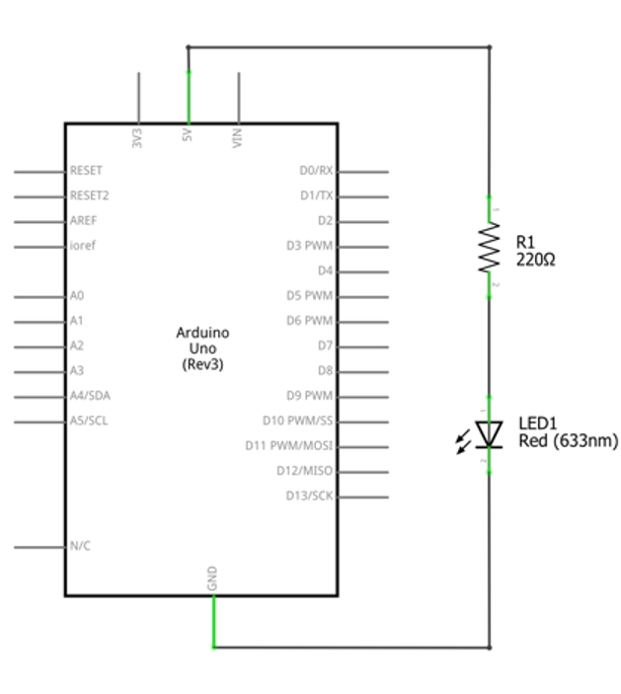
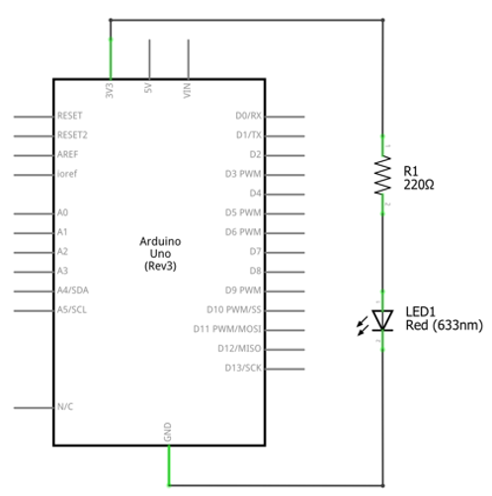



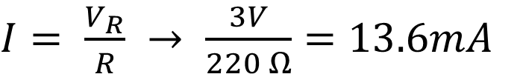

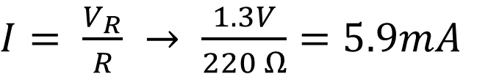

5V vs. 3.3V Output Pin
LED anode leg
LED anode leg
5V Circuit Diagram
3.3V Circuit Diagram
R1 = 220Ω
+
R1 = 220Ω
+
+
+
5V
$$V_{R}=3V$$
3.3v
$$V_{R}=1.3V$$
-
$$V_{S}=5V$$
-
$$V_{S}=3.3V$$
+
+
$$V_{D}=2V$$
$$V_{D}=2V$$
-
-
-
-
$I= \frac{V_{R}}{R} → \frac{3V}{220 Ω}=13.6mA$
$I= \frac{V_{R}}{R} → \frac{1.3V}{220 Ω}=5.9mA$

