Slide 2
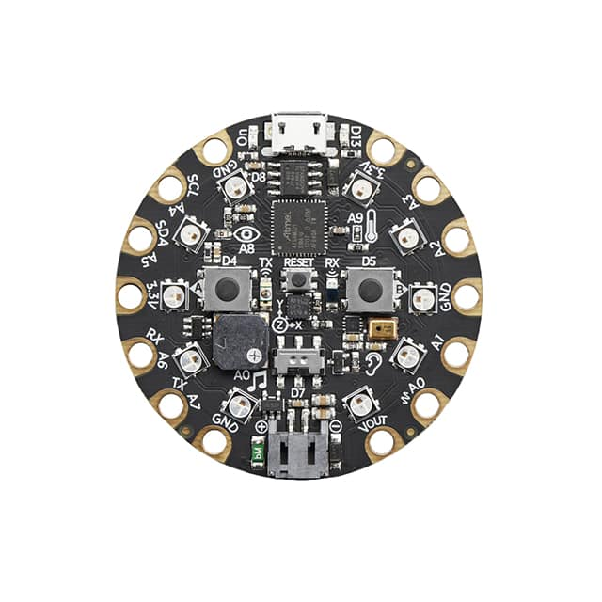
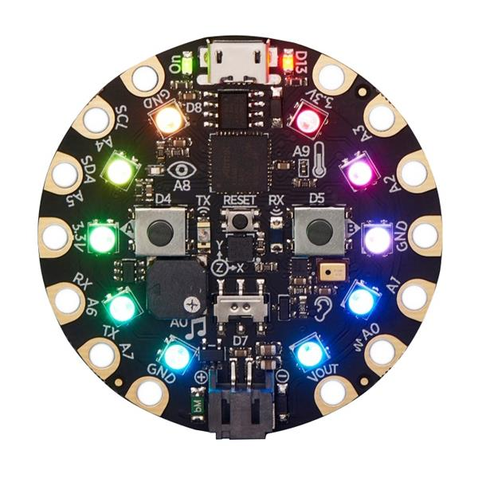
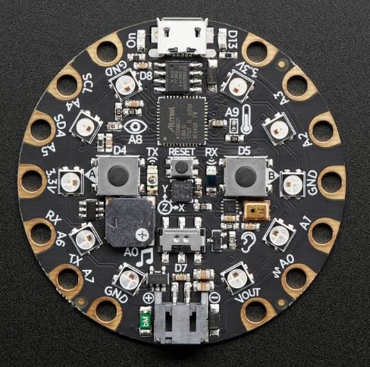

Slide 3
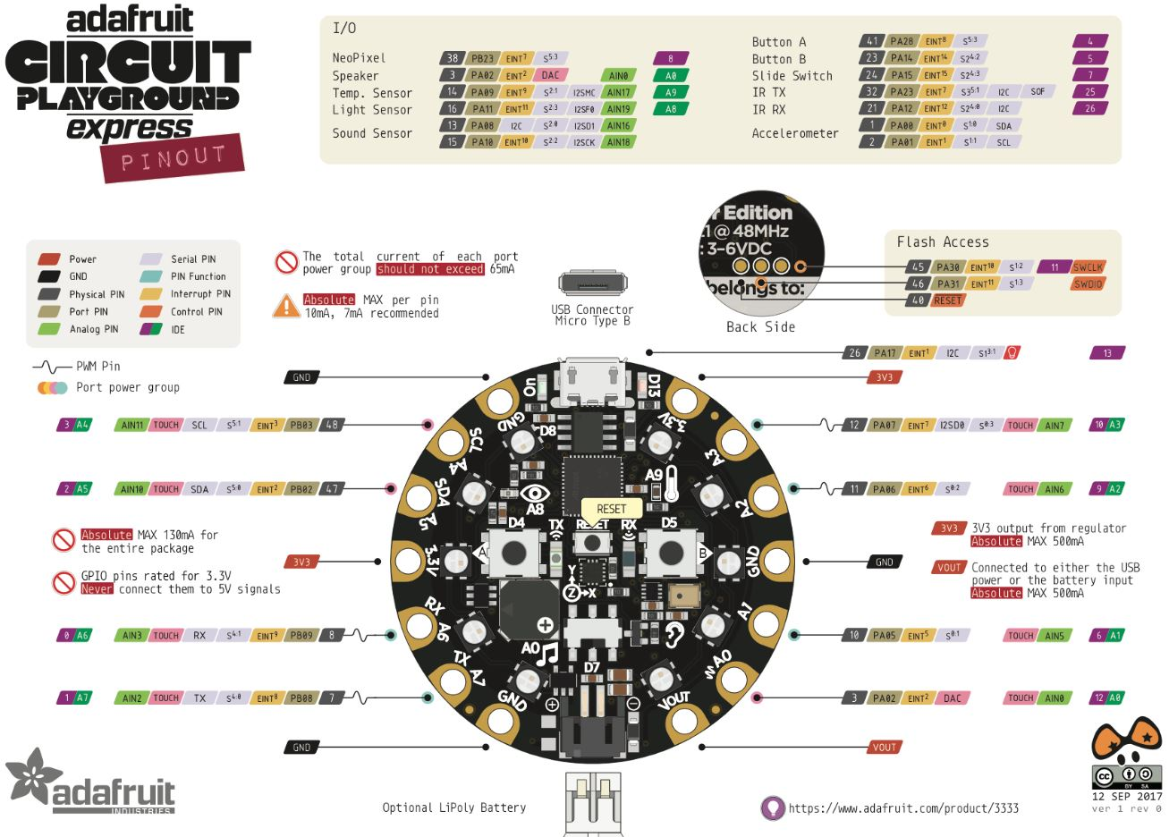
Notes:
Chart from: https://robot-r-us.com.sg/p/circuit-playground-express

Slide 4
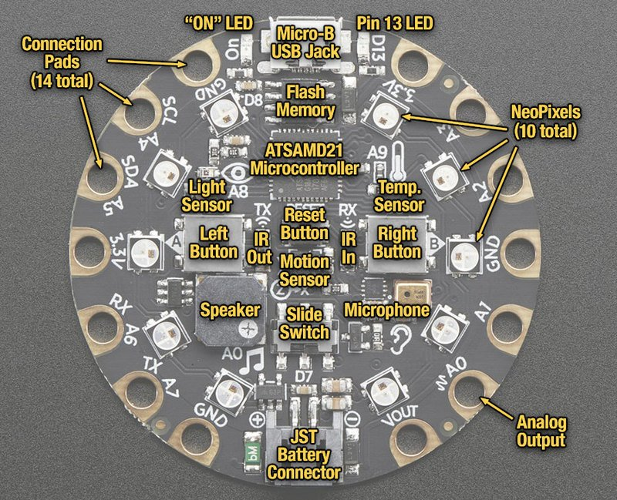
CPX Input
Temperature Sensor
Left Button
Right Button
Notes:
https://learn.adafruit.com/adafruit-circuit-playground-express/guided-tour

Slide 5
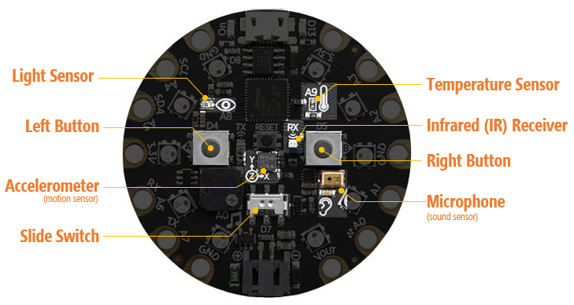
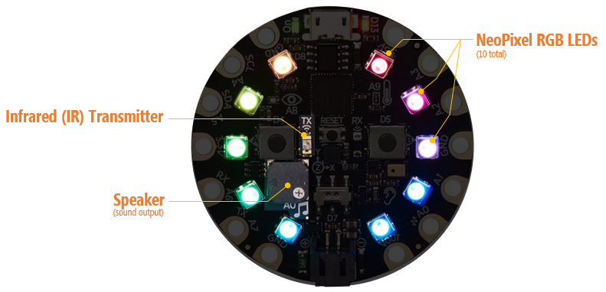
Circuit express playground hardware
CPX Board
Built-in sensors/input
Built-in output

Slide 6
Built-in CPX Input
Light Sensor
Temperature Sensor
Left Button
Infrared (IR) Receiver
Right Button
Accelerometer
(motion sensor)
Microphone
(sound sensor)
Slide Switch
Notes:
https://learn.adafruit.com/adafruit-circuit-playground-express/guided-tour

Slide 7
CPX Input
Light Sensor
Temperature Sensor
Left Button
Infrared (IR) Receiver
Right Button
Accelerometer
(motion sensor)
Microphone
(sound sensor)
Slide Switch
Notes:
https://learn.adafruit.com/adafruit-circuit-playground-express/guided-tour

Slide 8
Alligator Connection Pads
NeoPixel RGB LEDs
(10 total)
Infrared (IR) Transmitter
Speaker
(sound output)
Notes:
https://learn.adafruit.com/adafruit-circuit-playground-express/guided-tour

Slide 9
Alligator Connection Pads
NeoPixel RGB LEDs
(10 total)
Infrared (IR) Transmitter
Speaker
(sound output)
Notes:
https://learn.adafruit.com/adafruit-circuit-playground-express/guided-tour

Slide 10
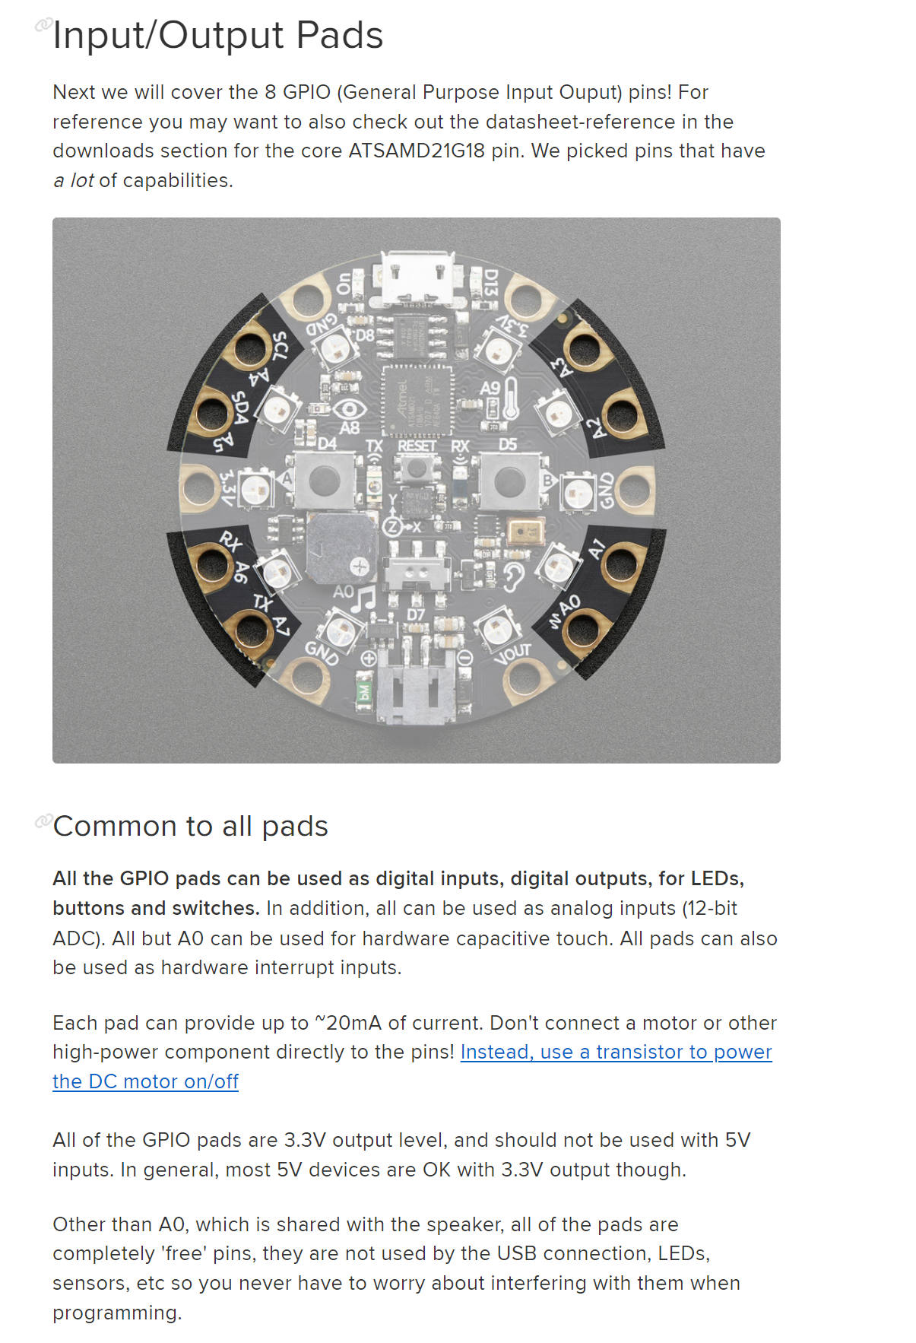
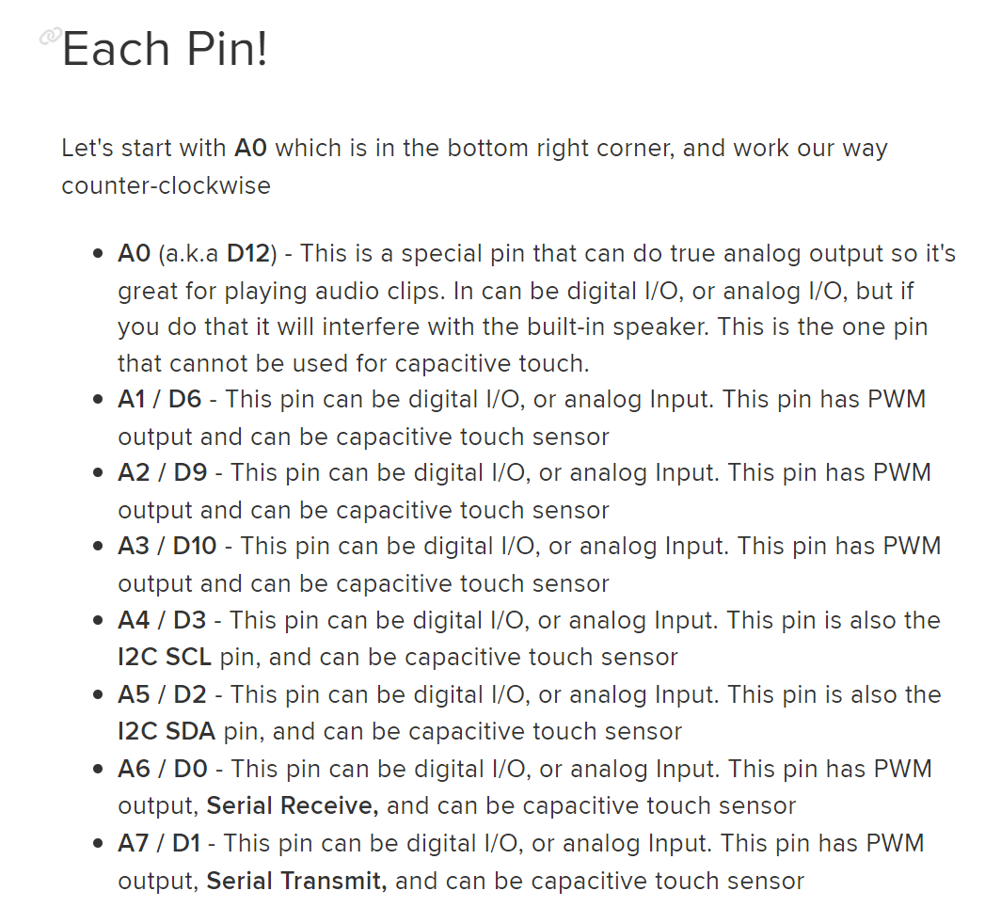
Alligator pads
Notes:
https://learn.adafruit.com/adafruit-circuit-playground-express/guided-tour

Slide 11
Notes:
https://learn.adafruit.com/adafruit-circuit-playground-express/guided-tour

Slide 12
Analog Input
In MakeCode, you can use A1-A7 as analog input, which converts a voltage to a number between 0-1023 (using a 10-bit ADC)
A4 Input Range: 0-1023
A3
Input Range: 0-1023
A5 Input Range: 0-1023
A2
Input Range: 0-1023
A6 Input Range: 0-1023
A1
Input Range: 0-1023
A7 Input Range: 0-1023
Notes:
https://learn.adafruit.com/adafruit-circuit-playground-express/guided-tour

Slide 13
14 Alligator Connection Pads
Alligator Pads
(14 total; There are different pad types, including for power, I/O, I2C)
Notes:
https://learn.adafruit.com/adafruit-circuit-playground-express/guided-tour

Slide 14
14 Alligator Connection Pads
The 14 connection pads allow you to power and connect to external components like other buttons, LEDs, etc.
GND
3.3V
A4 / D3 GPIO Pin + SCL
A3 / D10
GPIO Pin
A5 / D2 GPIO Pin
A2 / D9
GPIO Pin
3.3V
GND
A6 / D0 GPIO Pin + Serial Receive
A1 / D6
GPIO Pin
A7 / D1 GPIO Pin + Serial Transmit
A0 / D12
GPIO Pin
GND
Power Source V_{out}
Notes:
https://learn.adafruit.com/adafruit-circuit-playground-express/guided-tour

Slide 15
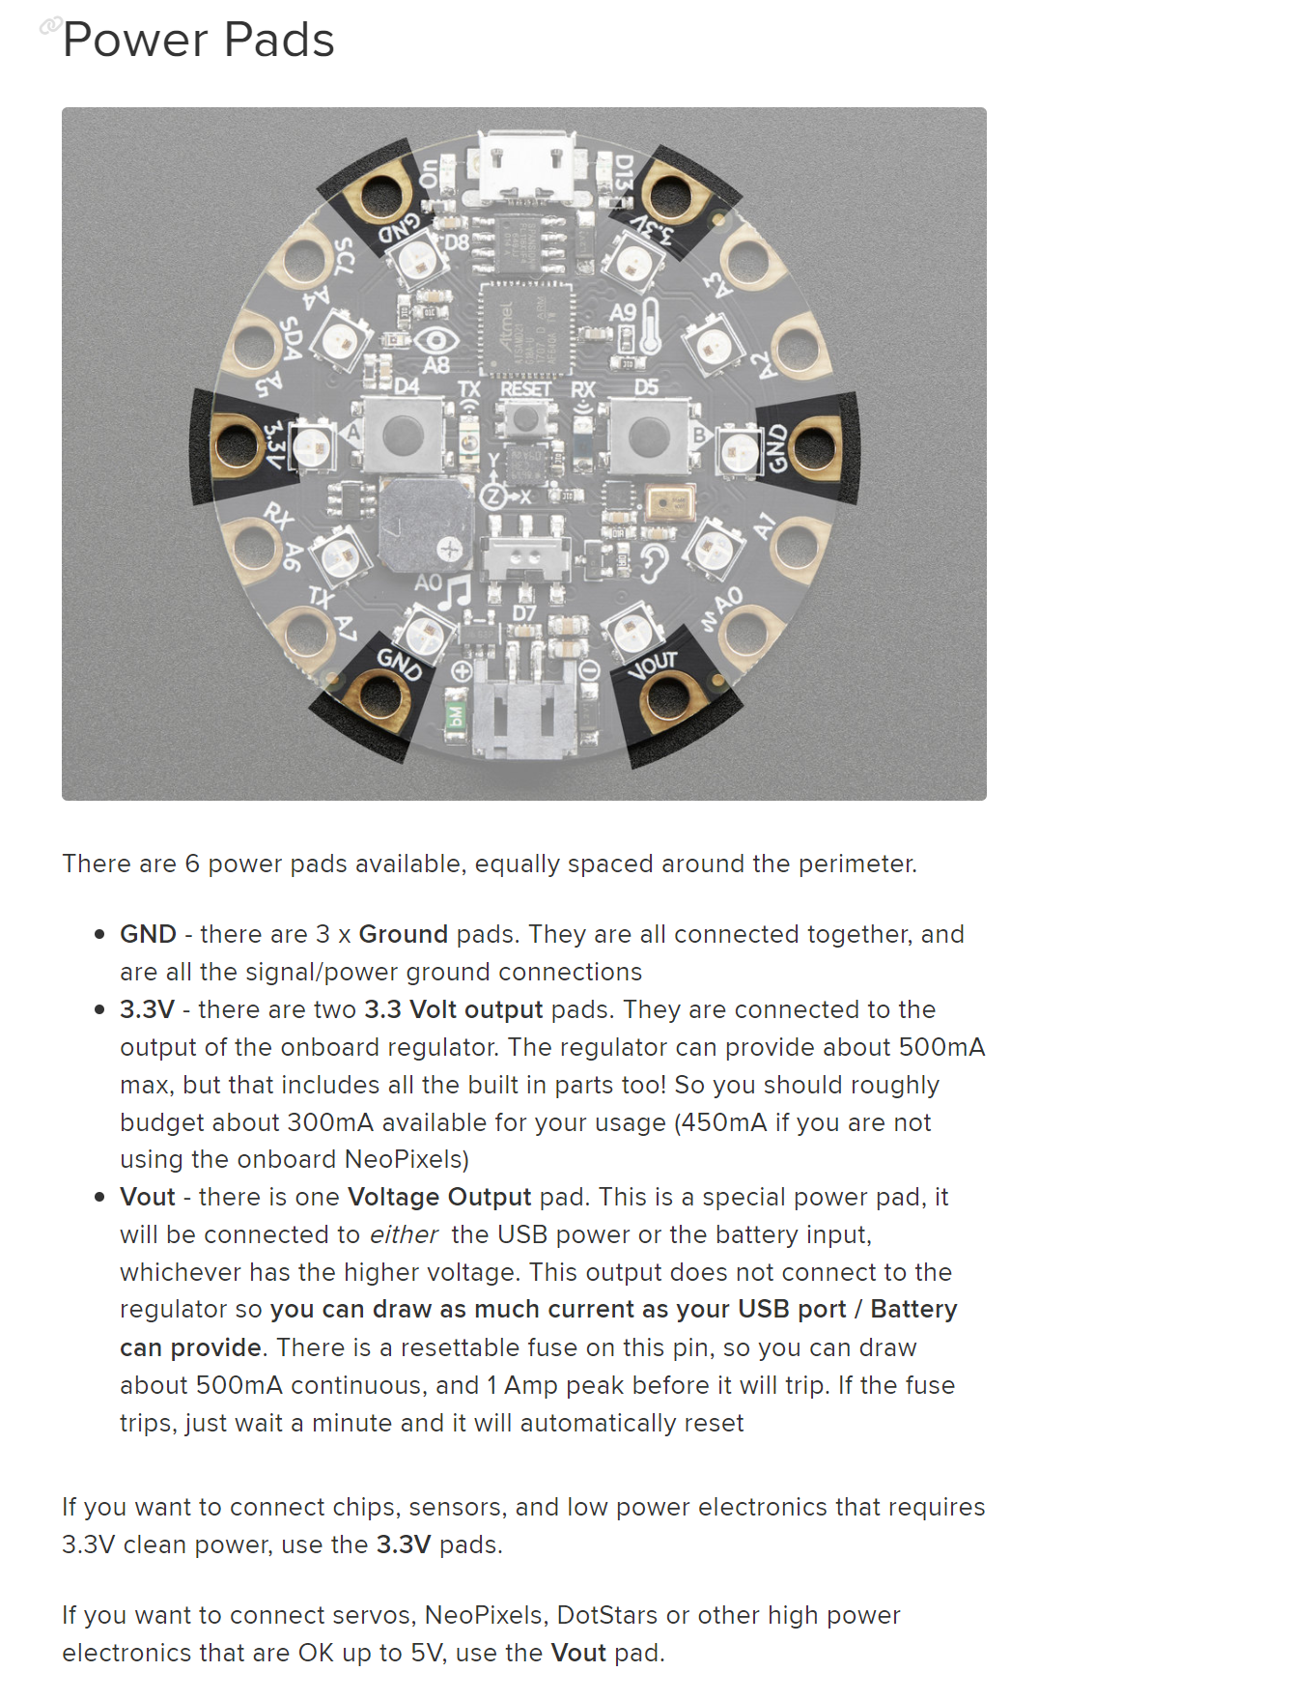
POWER Pads
GND
3.3V
3.3V
GND
GND
Power Source V_{out}
If connected to USB, will be 5V out. If connected to LiPoly battery, will be battery’s V_{out} (3.7V). If connected to both, will default to higher voltage source. You can draw 500mA continuous up to 1mA peak, so great for NeoPixels or other higher-load components.
https://learn.adafruit.com/adafruit-circuit-playground-express/pinouts
Notes:
https://learn.adafruit.com/adafruit-circuit-playground-express/guided-tour
https://learn.adafruit.com/adafruit-circuit-playground-express/pinouts

Slide 16
Input/Output pads
All I/O pads can be used as digital I/O and analog input (10-bit ADC). All but A0 can be used for capacitive touch. Each pad is 3.3V and can provide up to ~20mA of current.
A4 / D3
Digital I/O, analog in, PWM out.
Supports capacitive touch. Also, the I2C SCL pin.
A3 / D10
Digital I/O, analog in, PWM out.
Supports capacitive touch.
A5 / D2
Digital I/O, analog in, PWM out.
Supports capacitive touch. Also, the I2C SDA pin.
A2 / D9
Digital I/O, analog in, PWM out.
Supports capacitive touch.
A6 / D0
Digital I/O, analog in, PWM out.
Supports capacitive touch. Also, the Serial Receive pin.
A1 / D6
Digital I/O, analog in, PWM out.
Has PWM output. Supports capacitive touch.
A7 / D1
Digital I/O, analog in, PWM out.
Supports capacitive touch. Also, the Serial Transmit pin.
A0 / D12
Digital I/O and analog I/O. A special pin that can do true analog output so great for playing audio clips. Cannot be used for capacitive touch.
Notes:
https://learn.adafruit.com/adafruit-circuit-playground-express/guided-tour

Slide 17
Capacitive Touch Sensor Pads
A4
Supports capacitive touch.
A3
Supports capacitive touch.
A5
Supports capacitive touch
A2
Supports capacitive touch.
A6
Supports capacitive touch.
A1
Supports capacitive touch.
A7
Supports capacitive touch.
Notes:
https://learn.adafruit.com/adafruit-circuit-playground-express/guided-tour

Slide 18
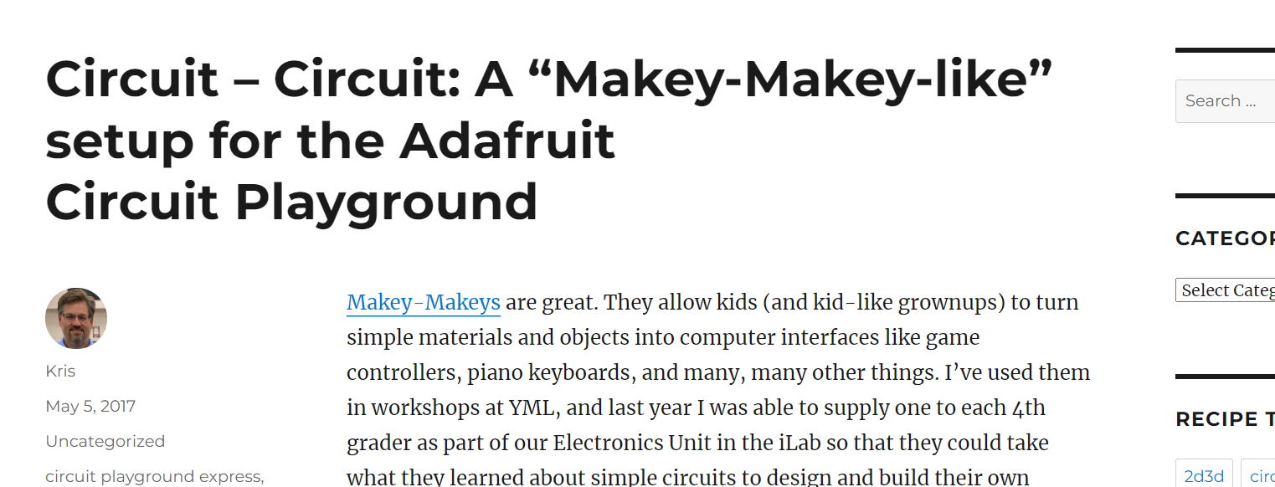
Makey Makey Activity
Notes:
https://krisswanson.blog/2017/05/05/circuit-circuit-a-makey-makey-like-setup-for-the-adafruit-circuit-playground/

