Slide 1
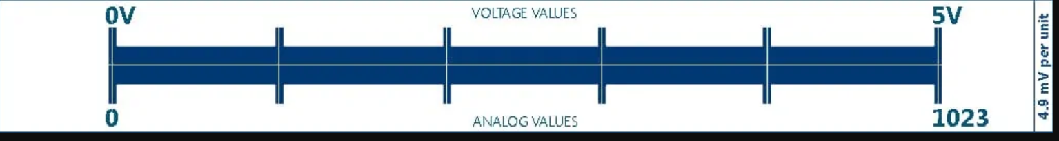
From: https://www.codrey.com/arduino-projects/arduino-get-better-analog/

Slide 2
0V
1V
2V
3V
4V
5V
Voltage Values
analog Values
0
205
409
614
818
1023

Slide 3
0V
1V
2V
3V
4V
5V
Voltage Values
analog Values
0
205
409
614
818
1023

Slide 4
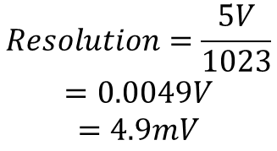
Voltage Values
0V
1V
2V
3V
4V
5V
0
205
409
614
818
1023
analog Values
$$Resolution=\frac{5V}{1023}$$
$$=0.0049V$$
$$=4.9mV$$

Slide 5
Voltage Values
0V
1V
2V
3V
4V
5V
analog Values
0
205
409
614
818
1023

