Slide 2
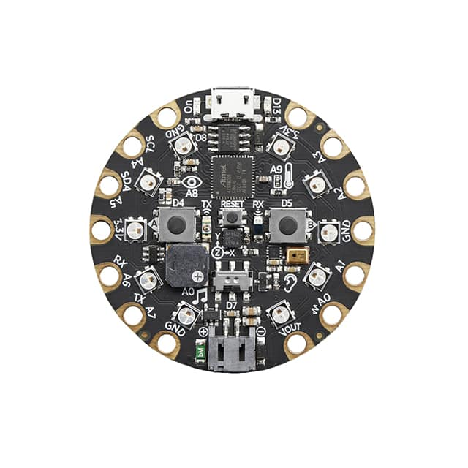
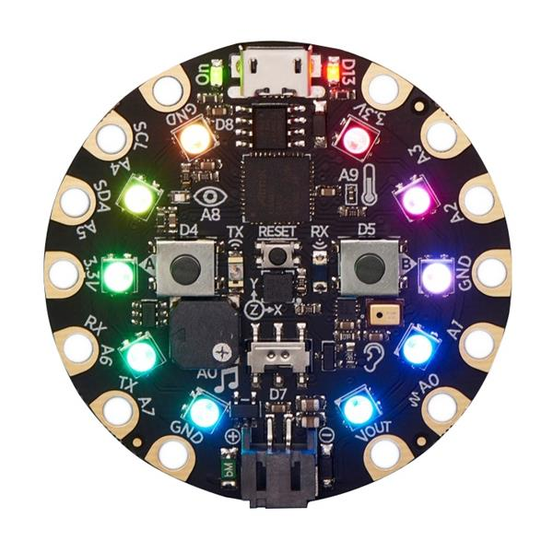
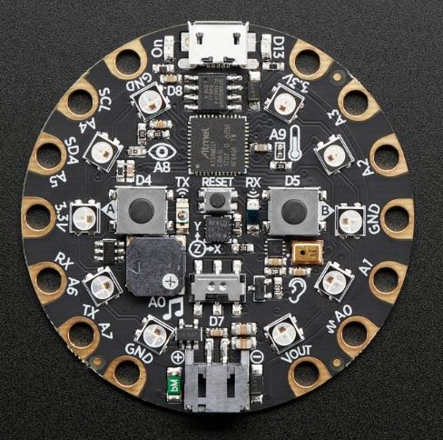

Slide 3
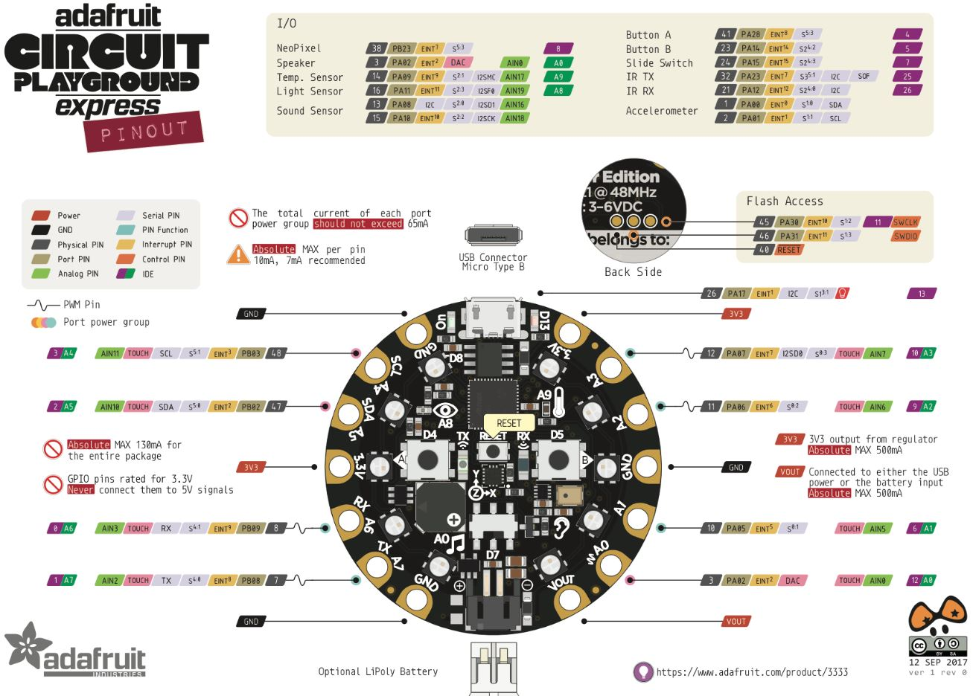
Notes:
Chart from: https://robot-r-us.com.sg/p/circuit-playground-express

Slide 4
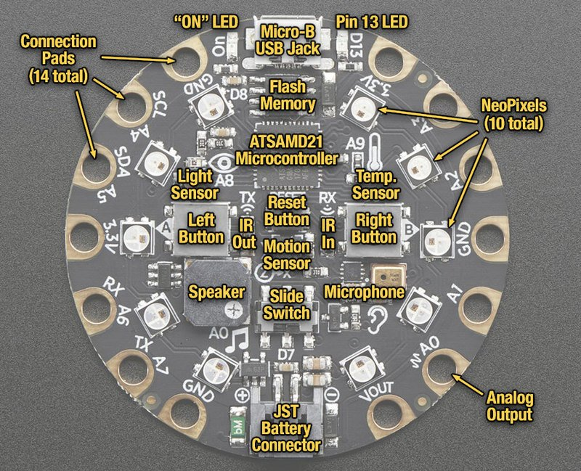
CPX Input
Temperature Sensor
Left Button
Right Button
Notes:
https://learn.adafruit.com/adafruit-circuit-playground-express/guided-tour

Slide 5
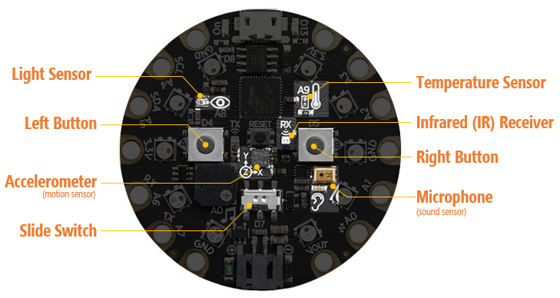
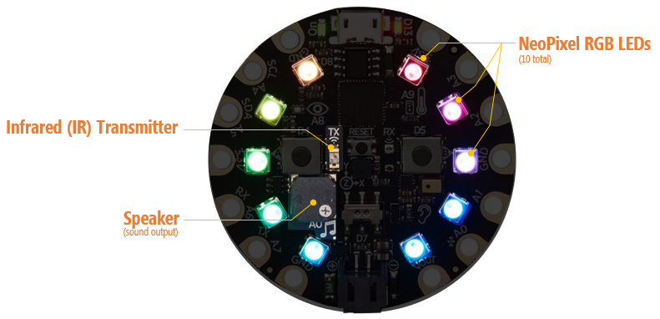
Circuit express playground hardware
CPX Board
Built-in sensors/input
Built-in output

Slide 6
Built-in CPX Input
Light Sensor
Temperature Sensor
Left Button
Infrared (IR) Receiver
Right Button
Accelerometer
(motion sensor)
Microphone
(sound sensor)
Slide Switch
Notes:
https://learn.adafruit.com/adafruit-circuit-playground-express/guided-tour

Slide 7
CPX Input
Light Sensor
Temperature Sensor
Left Button
Infrared (IR) Receiver
Right Button
Accelerometer
(motion sensor)
Microphone
(sound sensor)
Slide Switch
Notes:
https://learn.adafruit.com/adafruit-circuit-playground-express/guided-tour

Slide 8
Alligator Connection Pads
NeoPixel RGB LEDs
(10 total)
Infrared (IR) Transmitter
Speaker
(sound output)
Notes:
https://learn.adafruit.com/adafruit-circuit-playground-express/guided-tour

Slide 9
Alligator Connection Pads
NeoPixel RGB LEDs
(10 total)
Infrared (IR) Transmitter
Speaker
(sound output)
Notes:
https://learn.adafruit.com/adafruit-circuit-playground-express/guided-tour

Slide 10
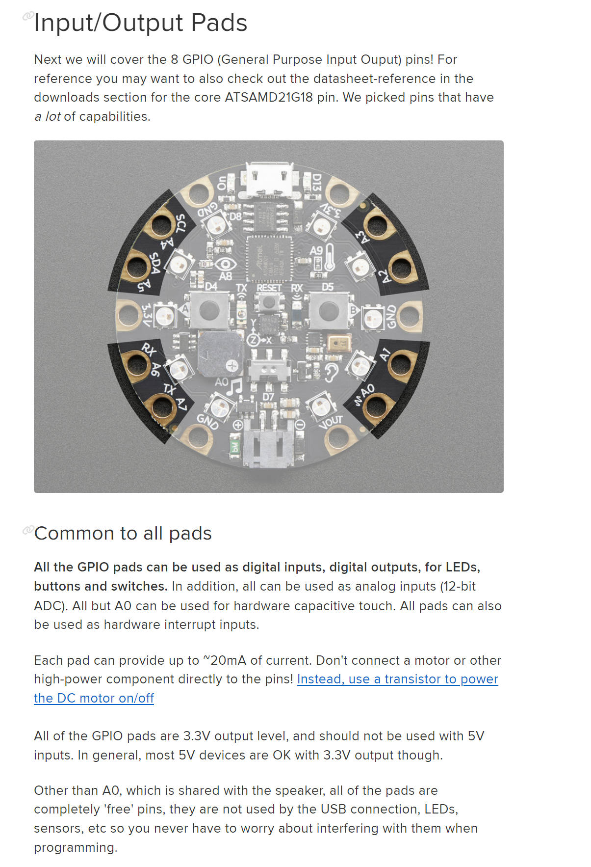
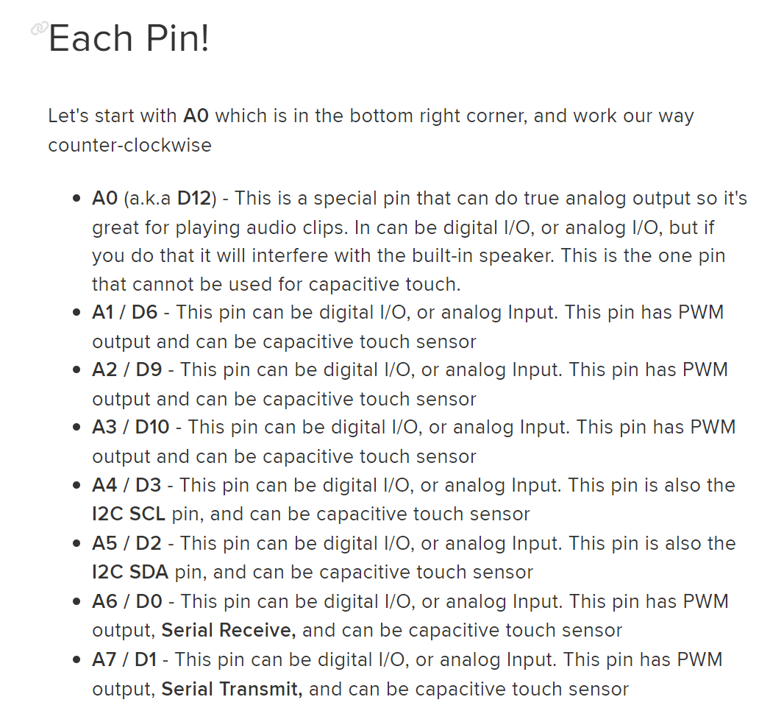
Alligator pads
Notes:
https://learn.adafruit.com/adafruit-circuit-playground-express/guided-tour

Slide 11
14 Alligator Connection Pads
Alligator Pads
(14 total; There are different pad types, including for power, I/O, I2C)
Notes:
https://learn.adafruit.com/adafruit-circuit-playground-express/guided-tour

Slide 12
14 Alligator Connection Pads
The 14 connection pads allow you to power and connect to external components like other buttons, LEDs, etc.
GND
3.3V
A4 / D3 GPIO Pin + SCL
A3 / D10
GPIO Pin
A5 / D2 GPIO Pin
A2 / D9
GPIO Pin
3.3V
GND
A6 / D0 GPIO Pin + Serial Receive
A1 / D6
GPIO Pin
A5 / D1 GPIO Pin + Serial Transmit
A0 / D12
GPIO Pin
GND
Power Source V_{out}
Notes:
https://learn.adafruit.com/adafruit-circuit-playground-express/guided-tour

Slide 13
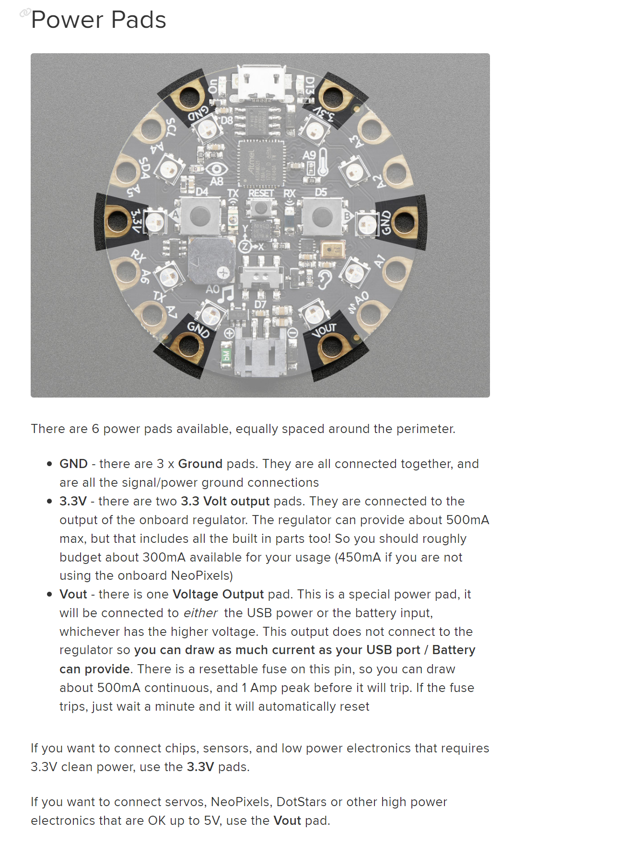
POWER Pads
GND
3.3V
3.3V
GND
GND
Power Source V_{out}
If connected to USB, will be 5V out. If connected to LiPoly battery, will be battery’s V_{out} (3.7V). If connected to both, will default to higher voltage source. You can draw 500mA continuous up to 1mA peak, so great for NeoPixels or other higher-load components.
https://learn.adafruit.com/adafruit-circuit-playground-express/pinouts
Notes:
https://learn.adafruit.com/adafruit-circuit-playground-express/guided-tour
https://learn.adafruit.com/adafruit-circuit-playground-express/pinouts

Slide 14
Input/Output pads
All I/O pads can be used as digital I/O and analog input (12-bit ADC). All but A0 can be used for capacitive touch. Each pad is 3.3V and can provide up to ~20mA of current.
A4 / D3
Digital I/O, analog in, PWM out.
Supports capacitive touch. Also, the I2C SCL pin.
A3 / D10
Digital I/O, analog in, PWM out.
Supports capacitive touch.
A5 / D2
Digital I/O, analog in, PWM out.
Supports capacitive touch. Also, the I2C SDA pin.
A2 / D9
Digital I/O, analog in, PWM out.
Supports capacitive touch.
A6 / D0
Digital I/O, analog in, PWM out.
Supports capacitive touch. Also, the Serial Receive pin.
A1 / D6
Digital I/O, analog in, PWM out.
Has PWM output. Supports capacitive touch.
A5 / D1
Digital I/O, analog in, PWM out.
Supports capacitive touch. Also, the Serial Transmit pin.
A0 / D12
Digital I/O and analog I/O. A special pin that can do true analog output so great for playing audio clips. Cannot be used for capacitive touch.
Notes:
https://learn.adafruit.com/adafruit-circuit-playground-express/guided-tour

Slide 15
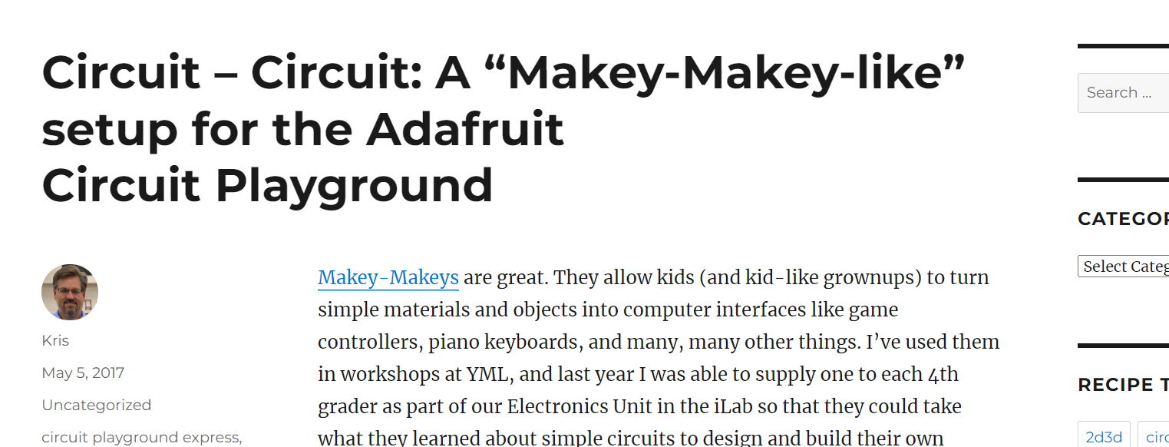
Makey Makey Activity
Notes:
https://krisswanson.blog/2017/05/05/circuit-circuit-a-makey-makey-like-setup-for-the-adafruit-circuit-playground/

