Slide 1
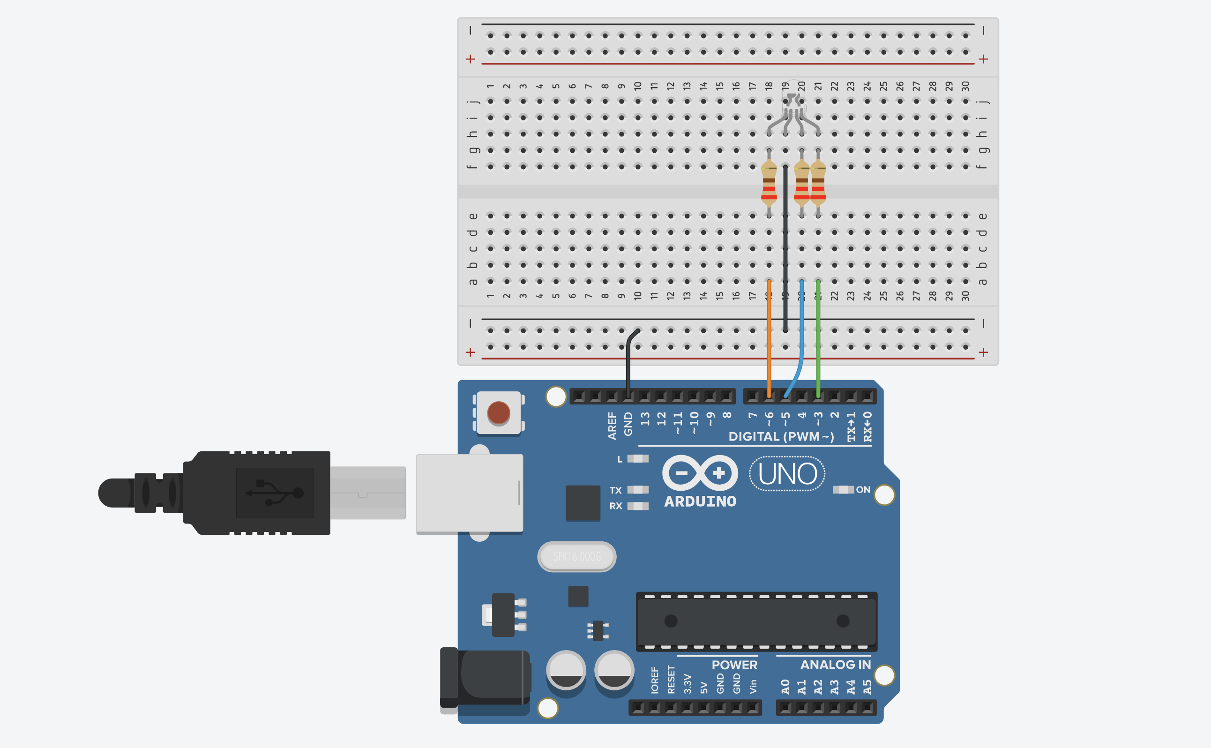
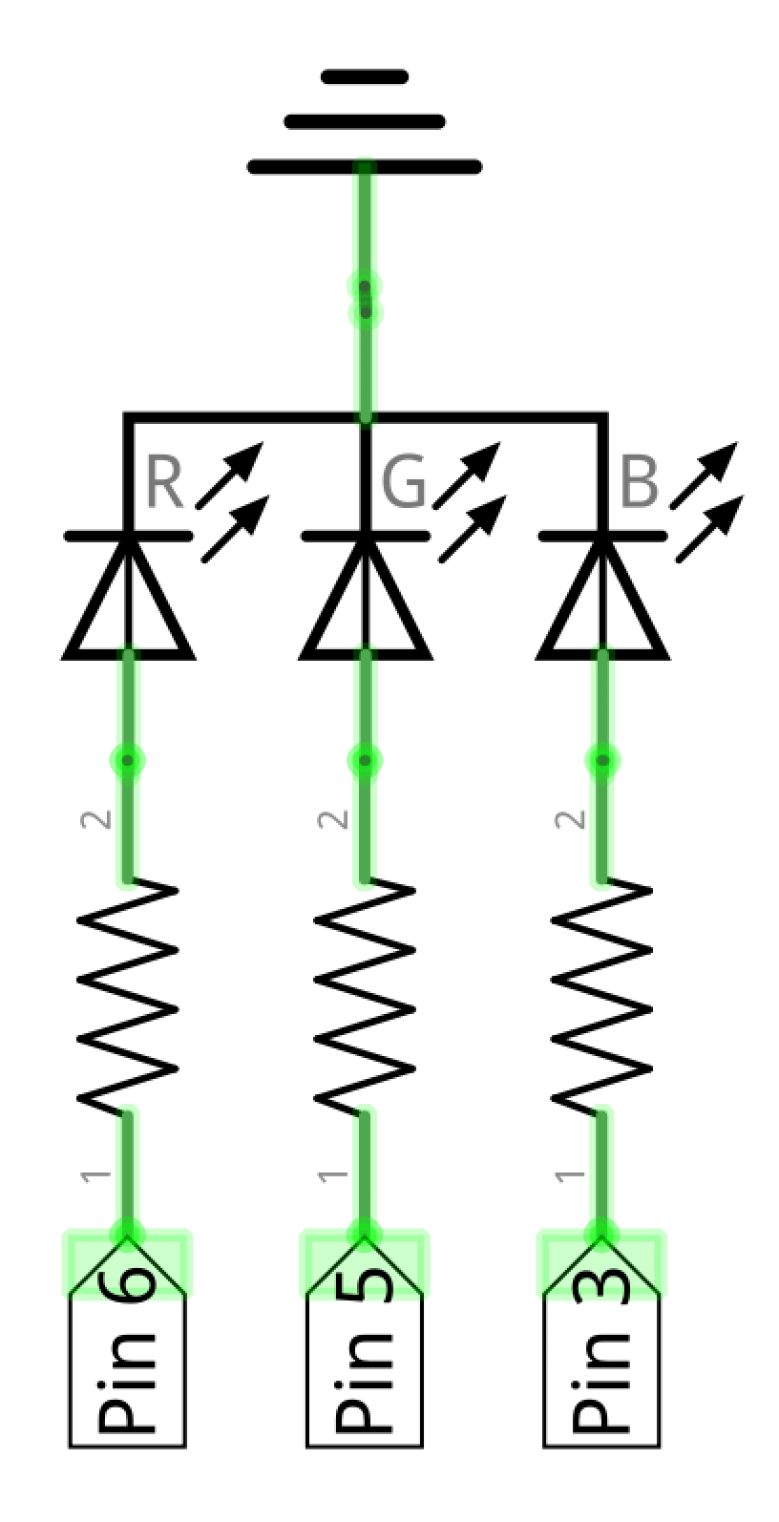

Slide 2
RGB LED: Common Cathode breadboard Circuit
GND
RGB Common Cathode
2nd leg is the cathode. Connect this leg to GND.
Current
flow
Set pins HIGH to drive current (and turn on LEDs)

Slide 3
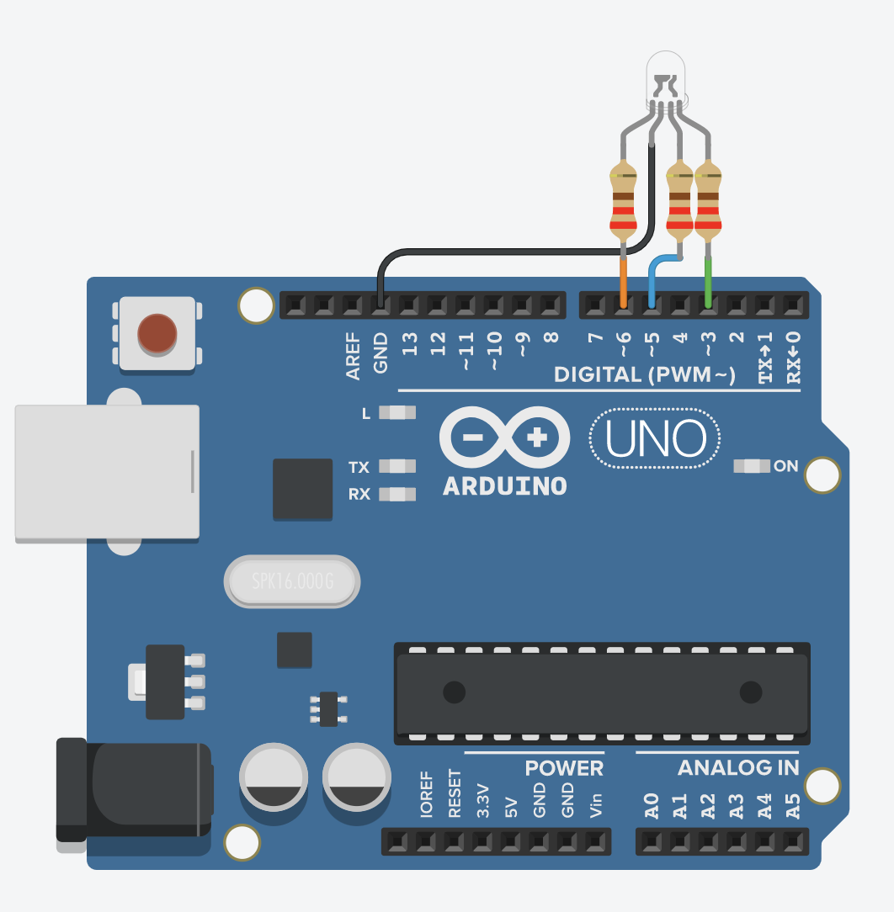
RGB LED: Common Cathode Circuit
RGB Common Cathode
2nd leg is the cathode. Connect this leg to GND.
GND
Current
flow
Set pins HIGH to drive current (and turn on LEDs)

Slide 4
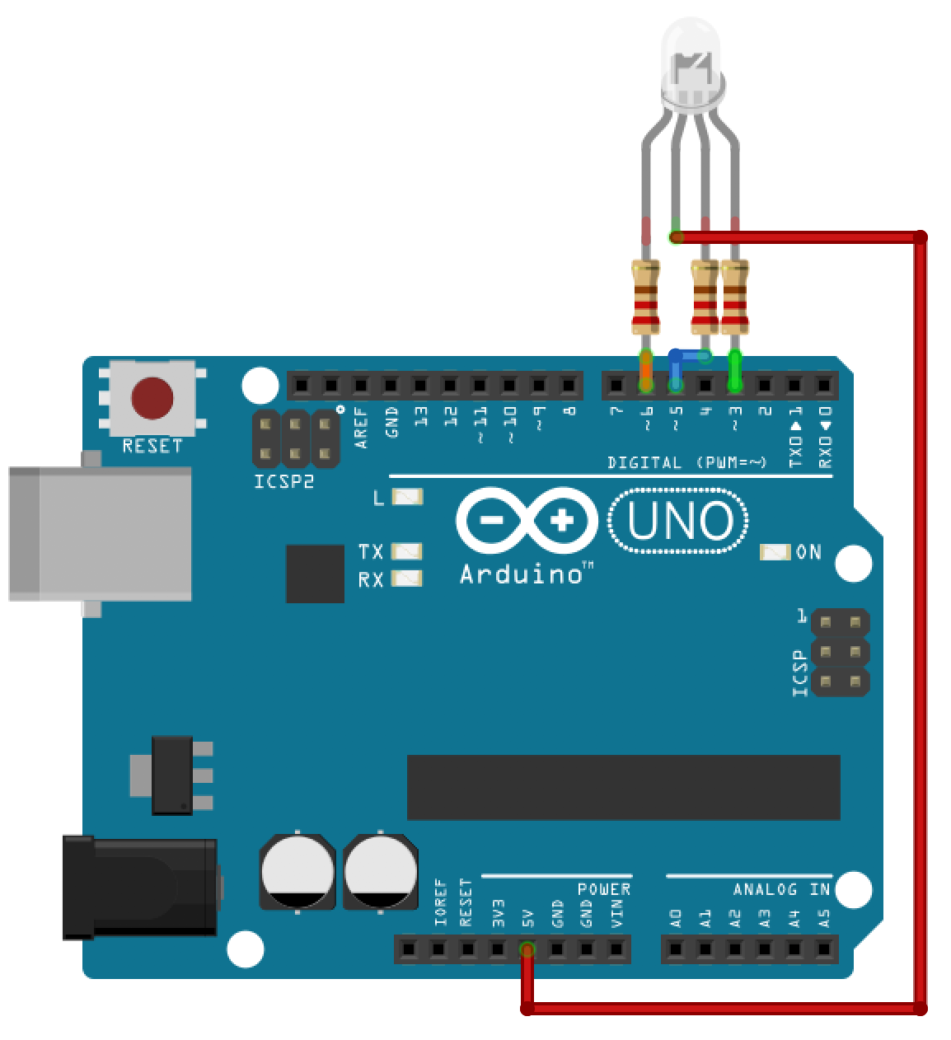
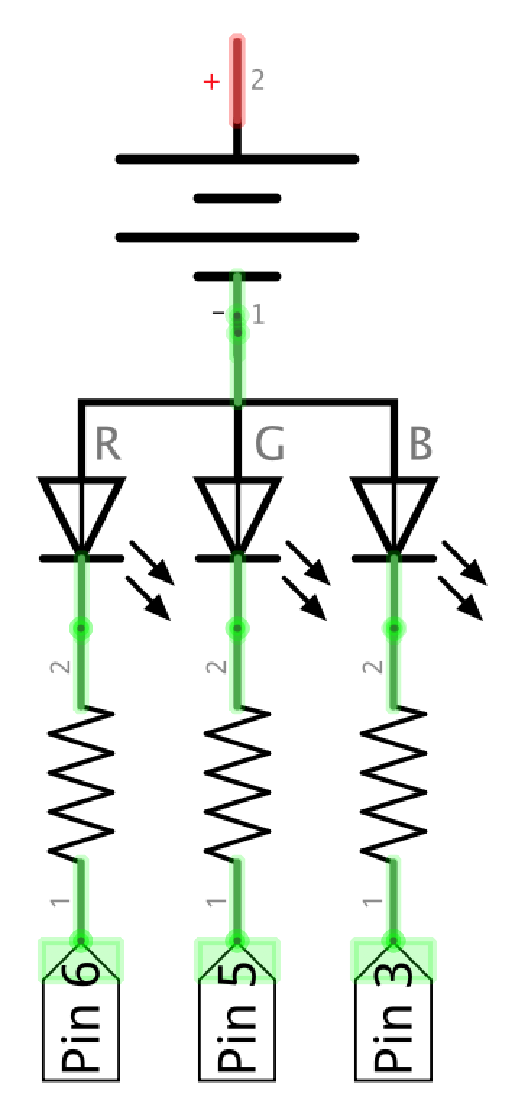
RGB LED: Common Anode Circuit
RGB Common Anode
2nd leg is the anode. Connect this leg to 5V.
5V
Current
flow
Set pins LOW to create a voltage difference and allow current flow

Slide 5
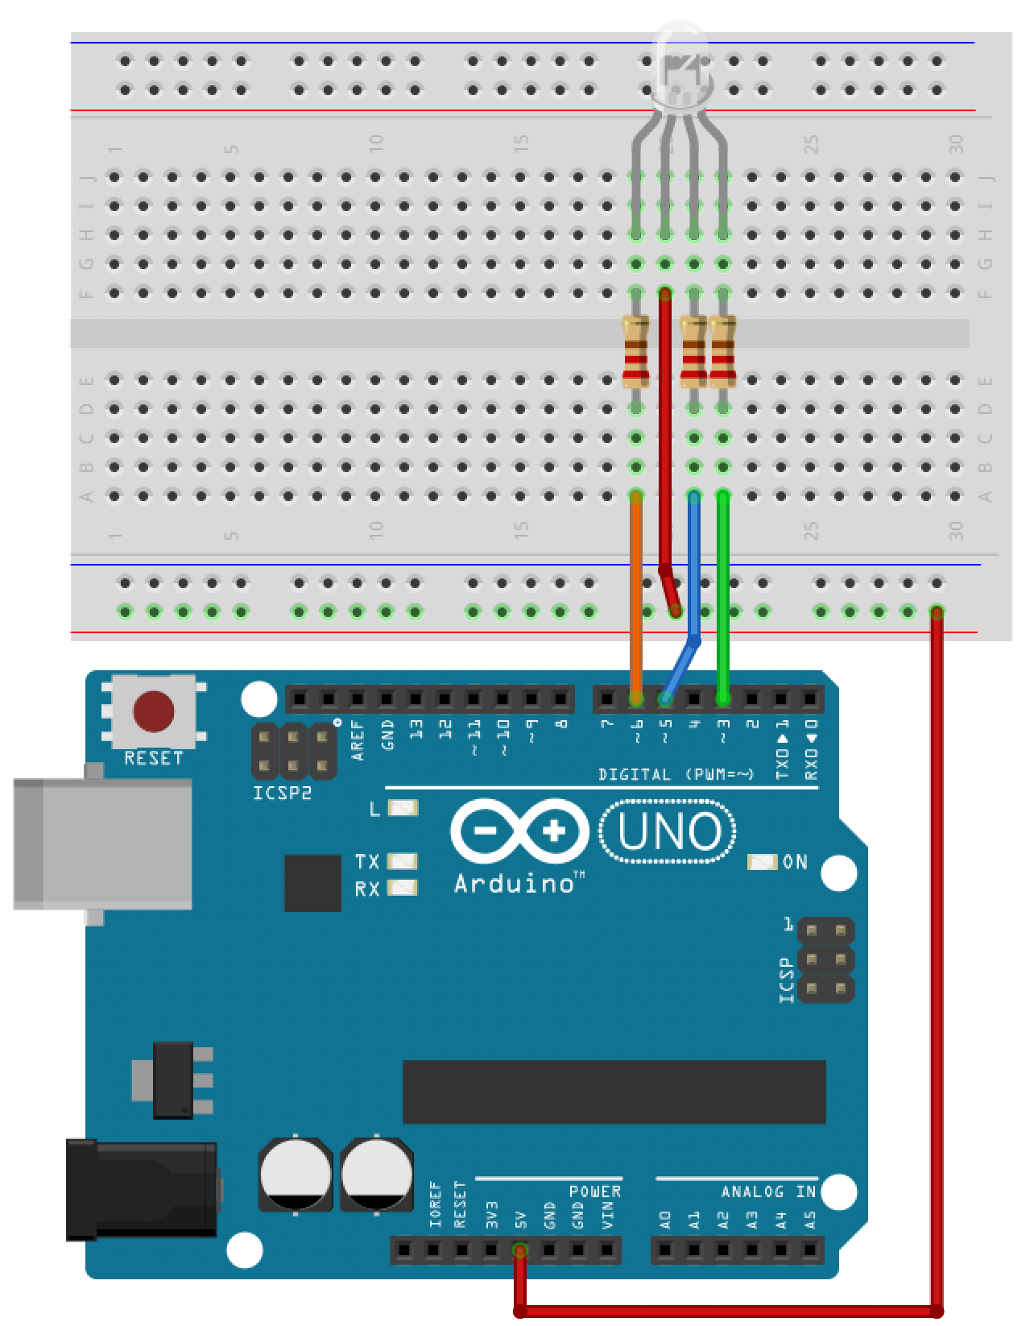
RGB LED: Common Anode breadboard Circuit
RGB Common Anode
2nd leg is the anode. Connect this leg to 5V.
5V
Current
flow
Set pins LOW to create a voltage difference and allow current flow

