Slide 1
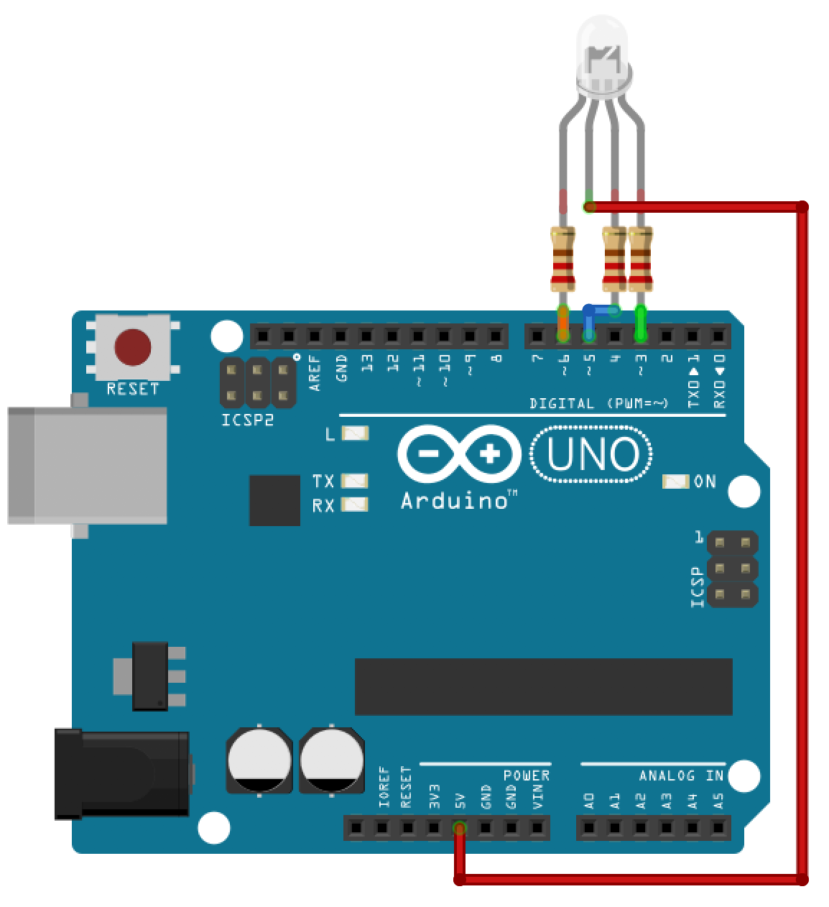

RGB LED
Common Anode
RGB LED
Common Anode
Unplugged
The Arduino is off

Slide 2
Red
digitalWrite(6, LOW); // red LED LOW
digitalWrite(5, HIGH); // blue LED HIGH
digitalWrite(3, HIGH); // green LED HIGH
RGB LED
Common Anode

Slide 3
GREEN
digitalWrite(6, HIGH); // red LED HIGH
digitalWrite(5, HIGH); // blue LED HIGH
digitalWrite(3, LOW); // green LED LOW
RGB LED
Common Anode

Slide 4
BLUE
digitalWrite(6, HIGH); // red LED HIGH
digitalWrite(5, LOW); // blue LED LOW
digitalWrite(3, HIGH); // green LED HIGH
RGB LED
Common Cathode
RGB LED
Common Anode

Slide 5
PURPLE
digitalWrite(6, LOW); // red LED LOW
digitalWrite(5, LOW); // blue LED LOW
digitalWrite(3, HIGH); // green LED HIGH
RGB LED
Common Cathode
RGB LED
Common Anode

Slide 6
Turqoise
digitalWrite(6, HIGH); // red LED HIGH
digitalWrite(5, LOW); // blue LED LOW
digitalWrite(3, LOW); // green LED LOW
RGB LED
Common Cathode
RGB LED
Common Anode

Slide 7
WHITE
digitalWrite(6, LOW); // red LED LOW
digitalWrite(5, LOW); // blue LED LOW
digitalWrite(3, LOW); // green LED LOW
RGB LED
Common Cathode
RGB LED
Common Anode

