Slide 1
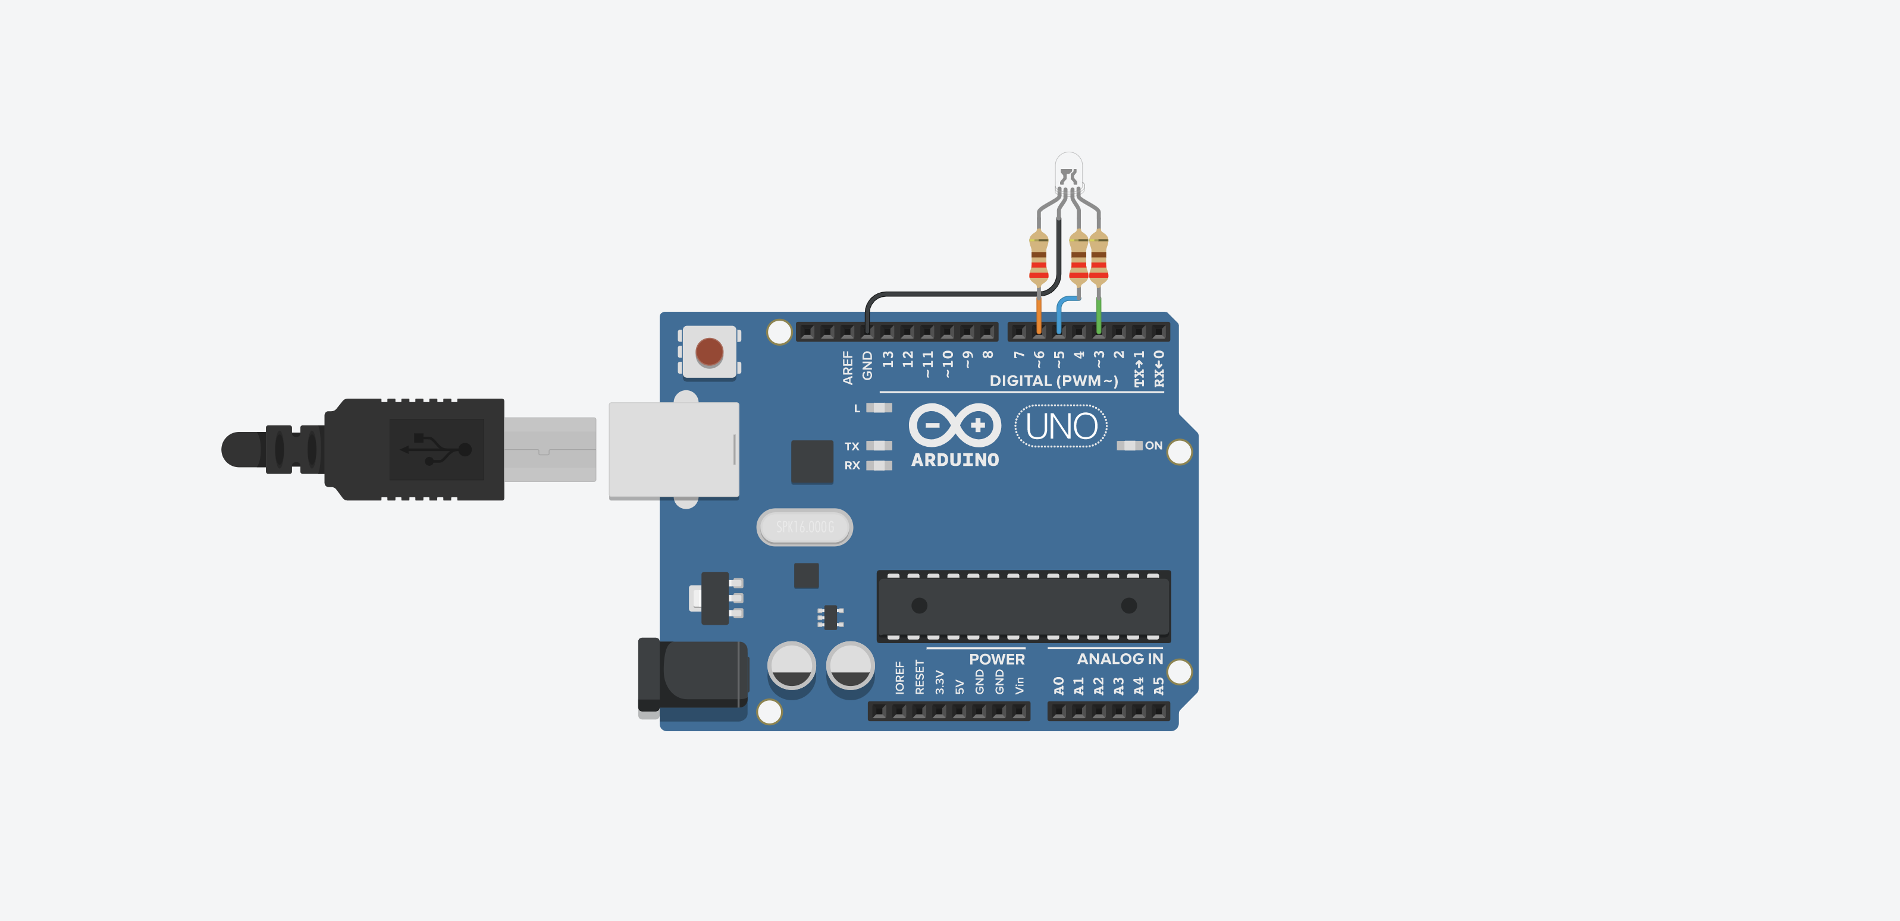
RGB LED
Common Cathode
Unplugged
The Arduino is off

Slide 2
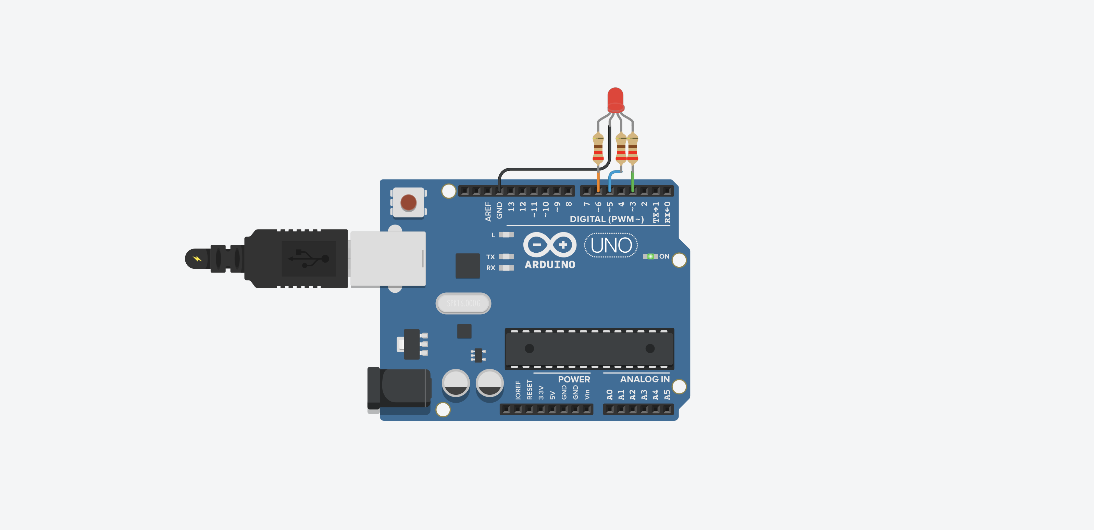
Red
digitalWrite(6, HIGH); // red LED HIGH
digitalWrite(5, LOW); // blue LED LOW
digitalWrite(3, LOW); // green LED LOW
RGB LED
Common Cathode

Slide 3

GREEN
digitalWrite(6, LOW); // red LED LOW
digitalWrite(5, LOW); // blue LED LOW
digitalWrite(3, HIGH); // green LED HIGH
RGB LED
Common Cathode

Slide 4
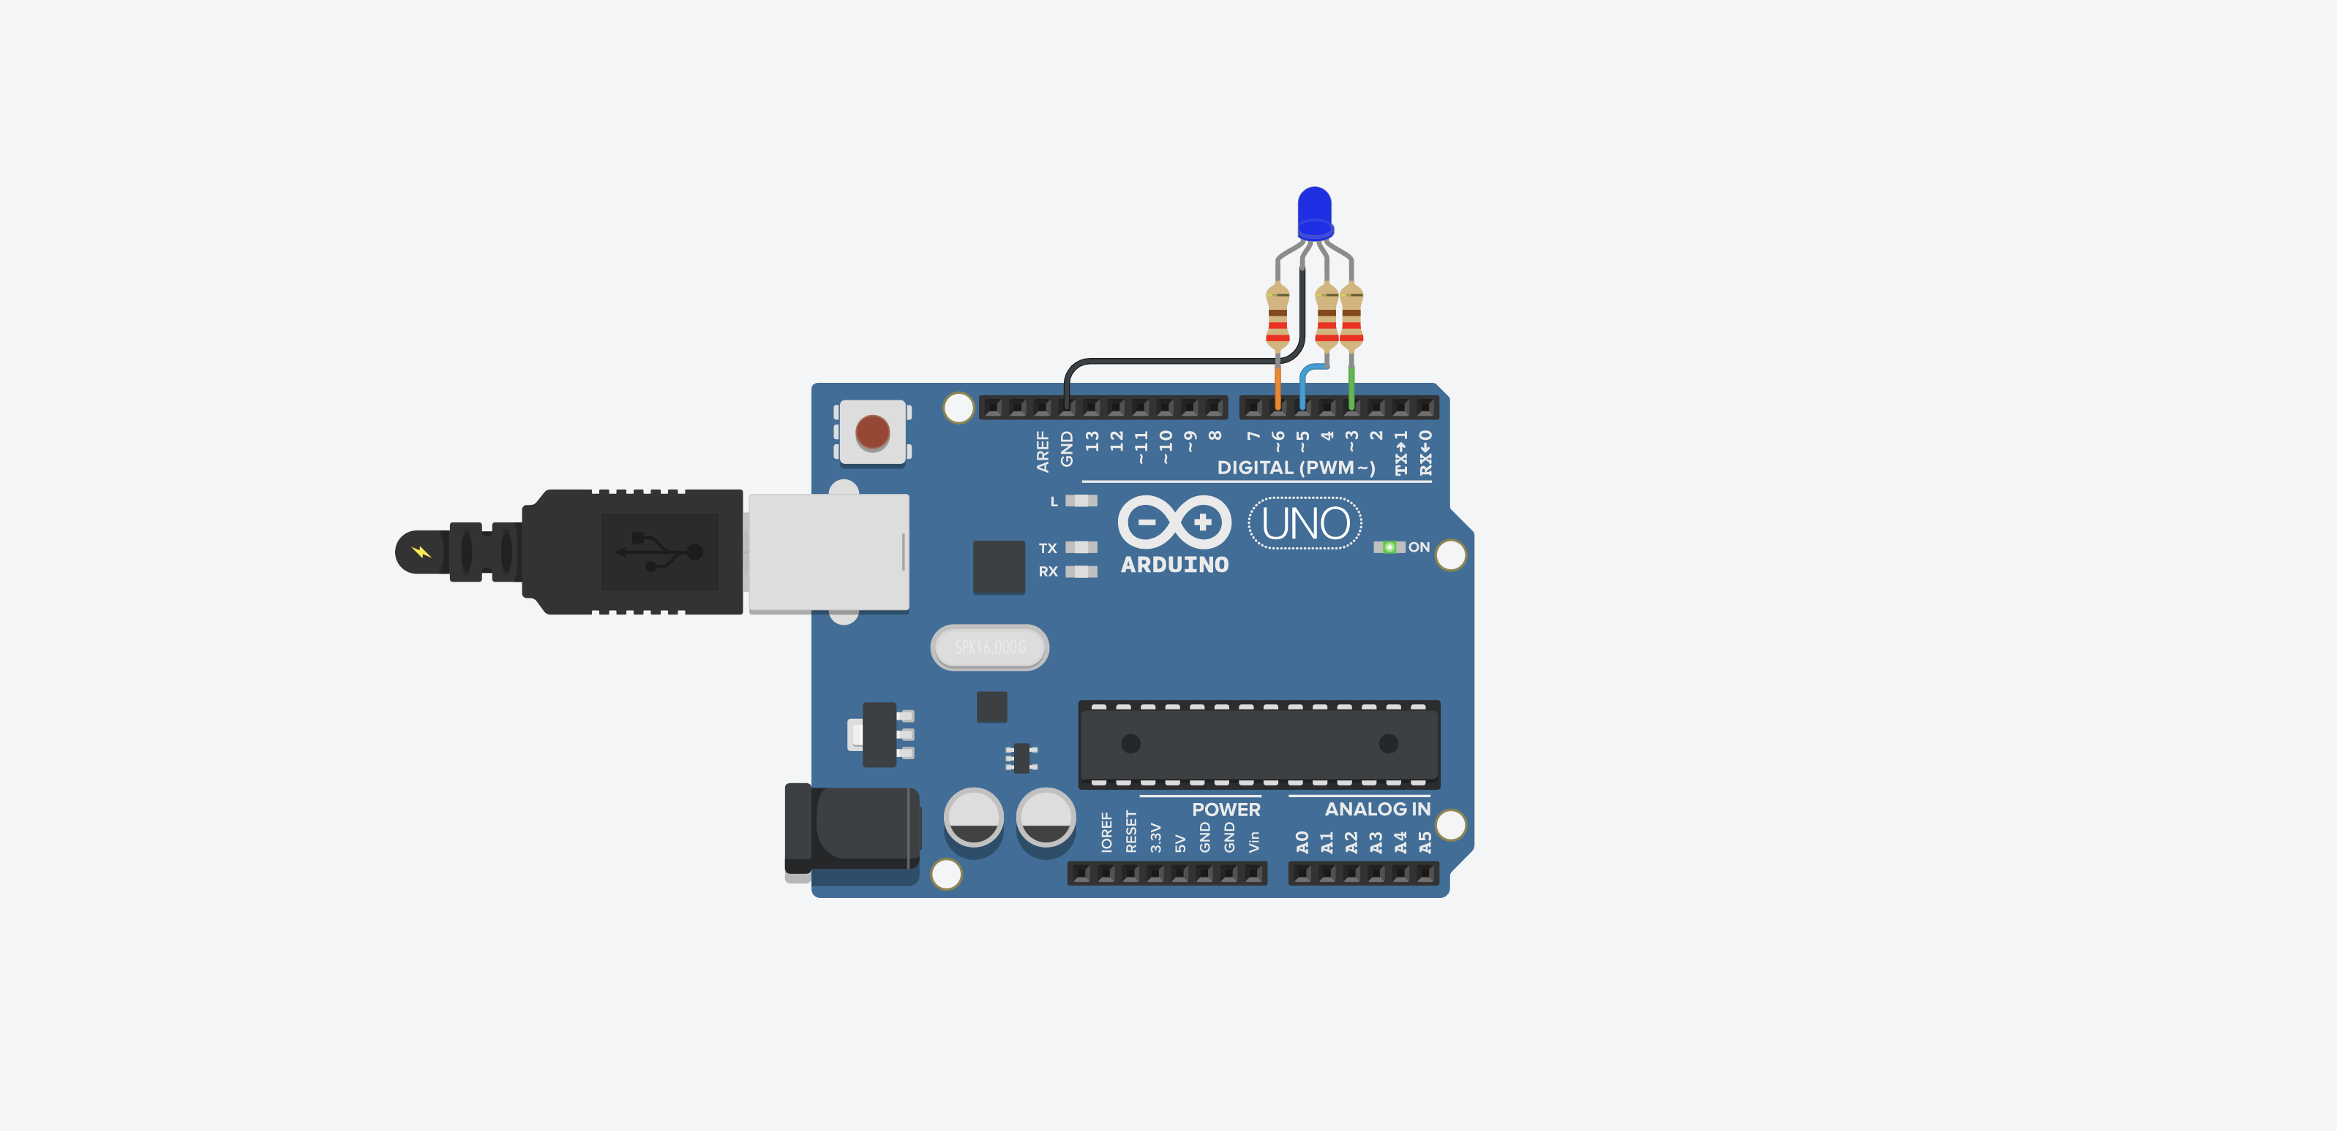
BLUE
digitalWrite(6, LOW); // red LED LOW
digitalWrite(5, HIGH); // blue LED LOW
digitalWrite(3, LOW); // green LED HIGH
RGB LED
Common Cathode

Slide 5

PURPLE
digitalWrite(6, HIGH); // red LED HIGH
digitalWrite(5, HIGH); // blue LED LOW
digitalWrite(3, LOW); // green LED HIGH
RGB LED
Common Cathode

Slide 6

TURQOISE
digitalWrite(6, LOW); // red LED LOW
digitalWrite(5, HIGH); // blue LED HIGH
digitalWrite(3, HIGH); // green LED HIGH
RGB LED
Common Cathode

Slide 7

WHITE
digitalWrite(6, HIGH); // red LED HIGH
digitalWrite(5, HIGH); // blue LED HIGH
digitalWrite(3, HIGH); // green LED HIGH
RGB LED
Common Cathode

