Slide 1
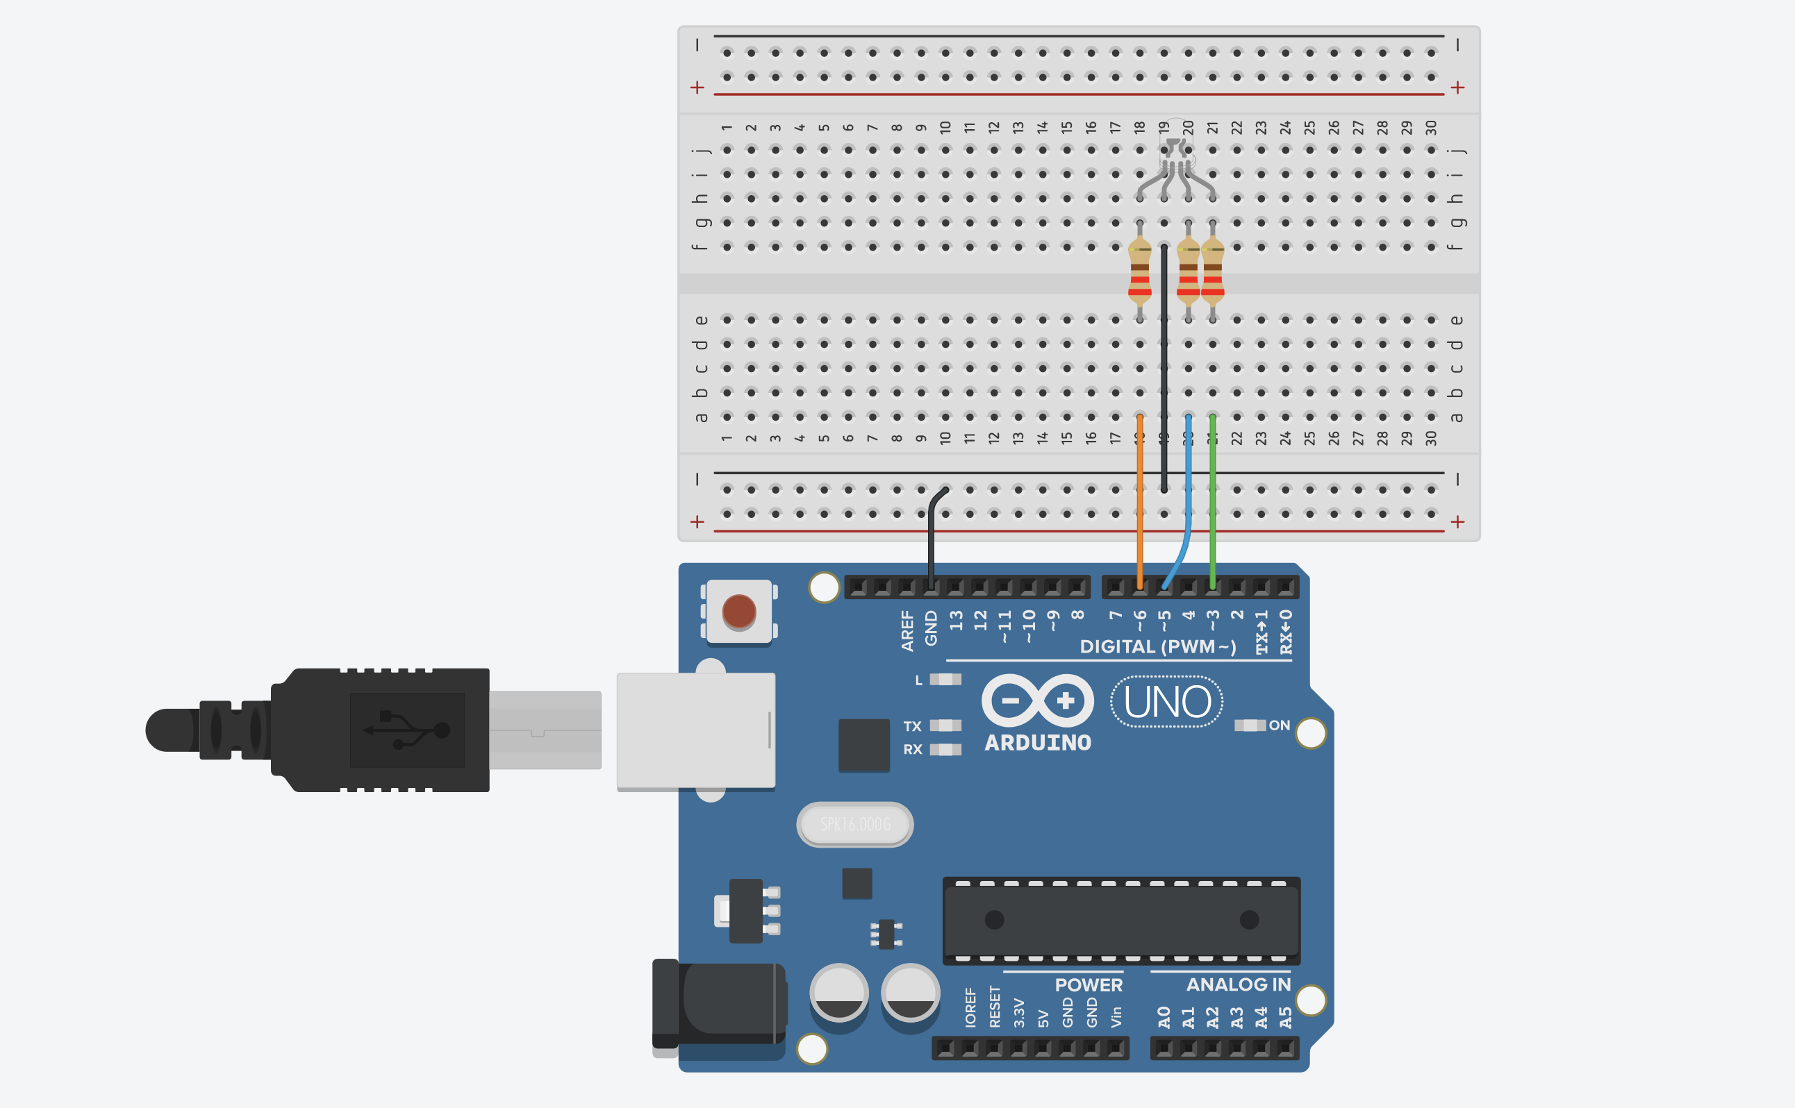
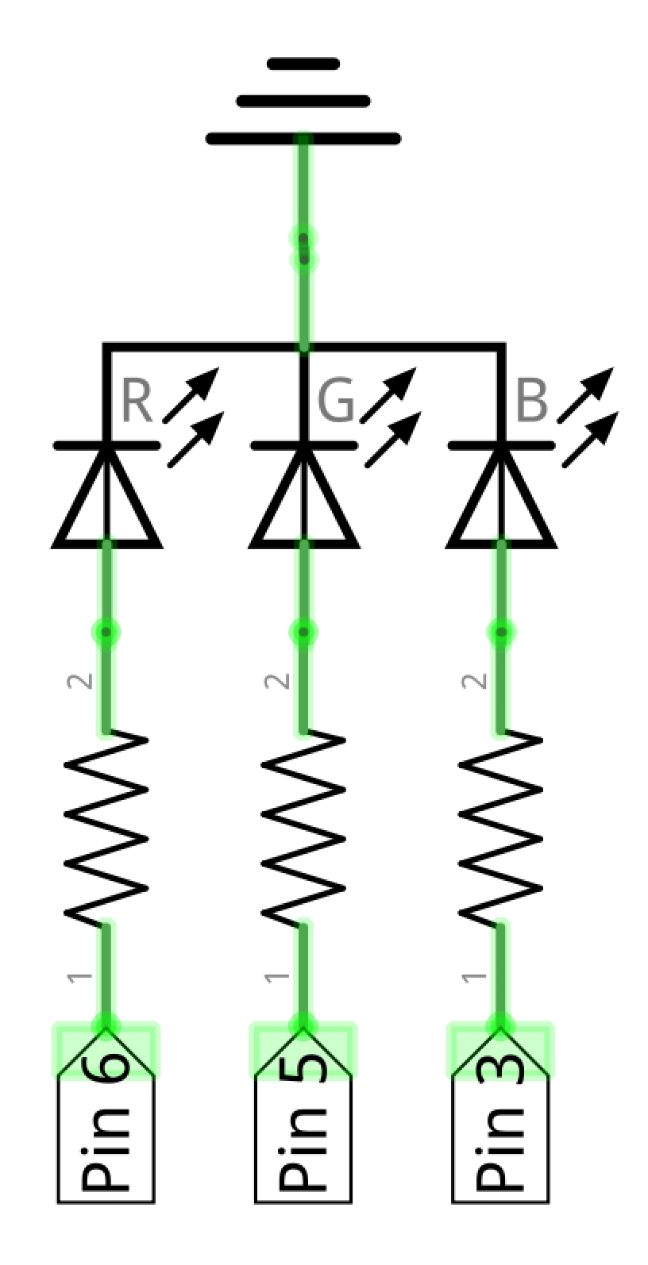

Slide 2
RGB LED: Common Cathode Circuit
GND
RGB Common Cathode
2nd leg is the cathode. Connect this leg to GND.
Current
flow
Set pins HIGH to drive current (and turn on LEDs)

Slide 3
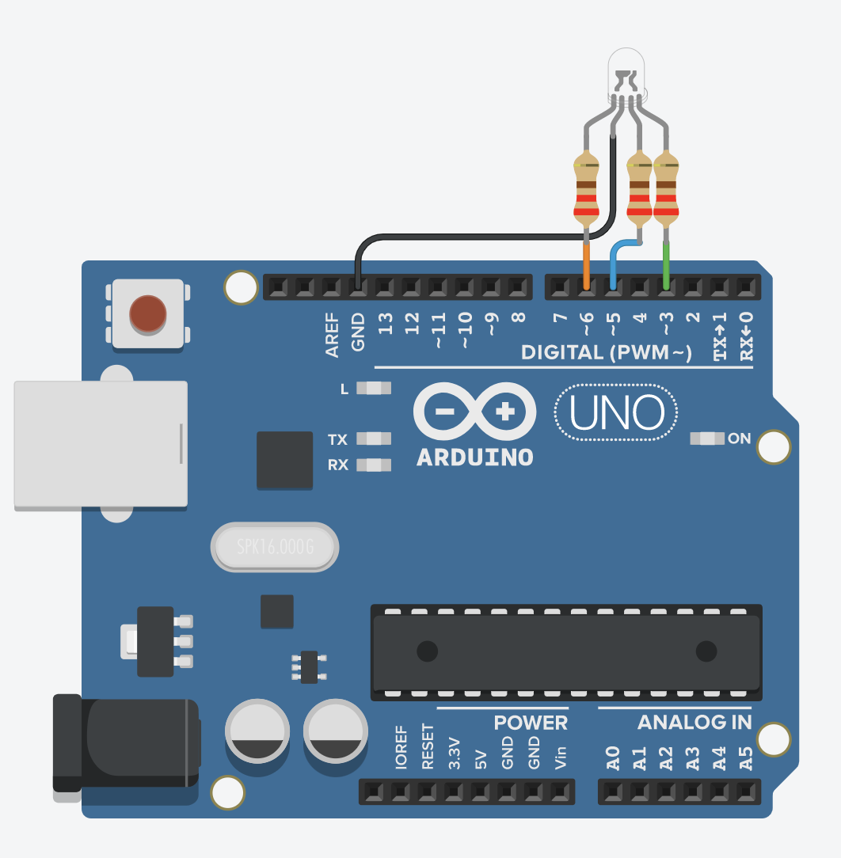
RGB LED: Common Cathode Circuit
RGB Common Cathode
2nd leg is the cathode. Connect this leg to GND.
GND
Current
flow
Set pins HIGH to drive current (and turn on LEDs)

