Slide 1
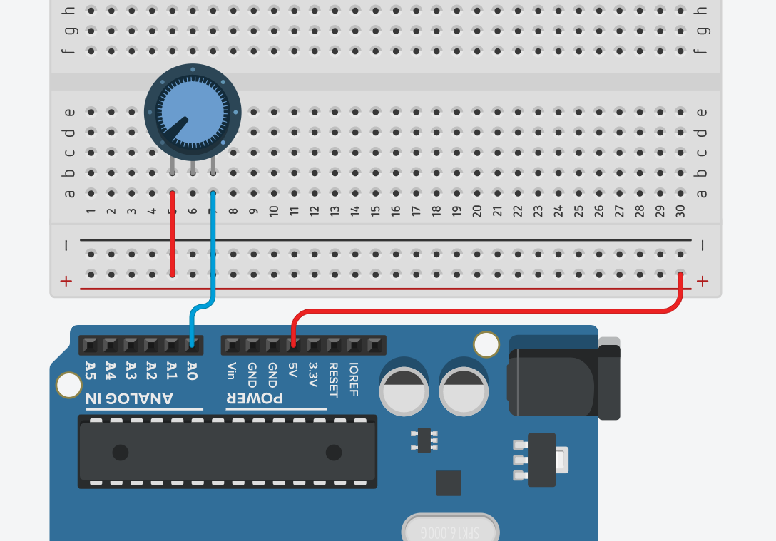
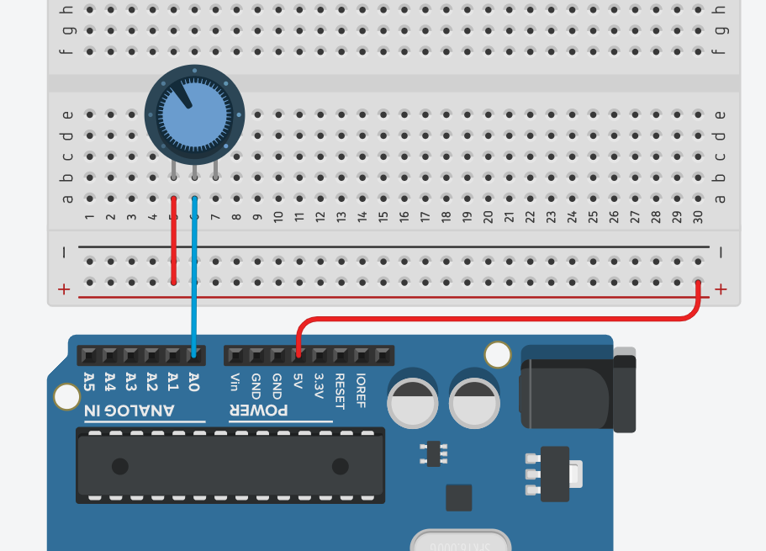
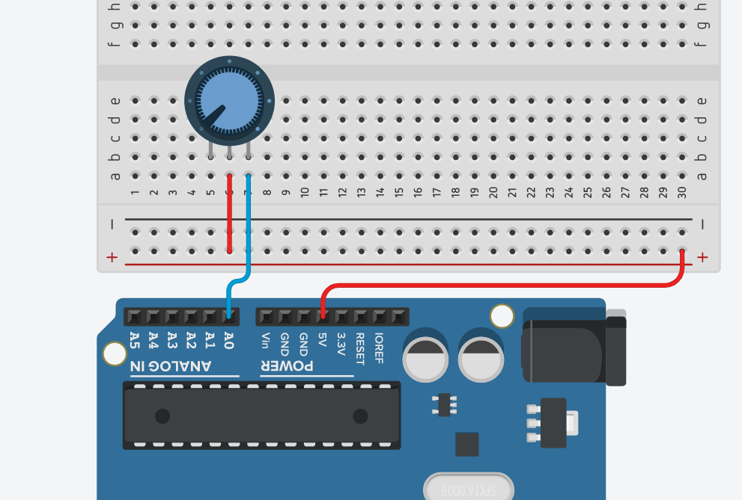
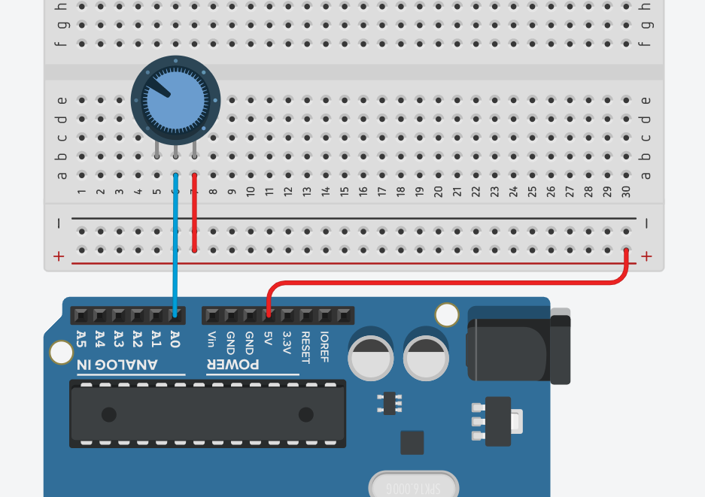
Incorrect ways of wiring a potentiometer to an Arduino
In all cases, the analog input A0 (V_{A0}) will be 5V. Can you think of why?
5V
5V
1
1
2
2
1
1
5V
Input pin A0
2
2
Input pin A0
3
3
3
3
5V
Input pin A0
Input pin A0

Slide 2
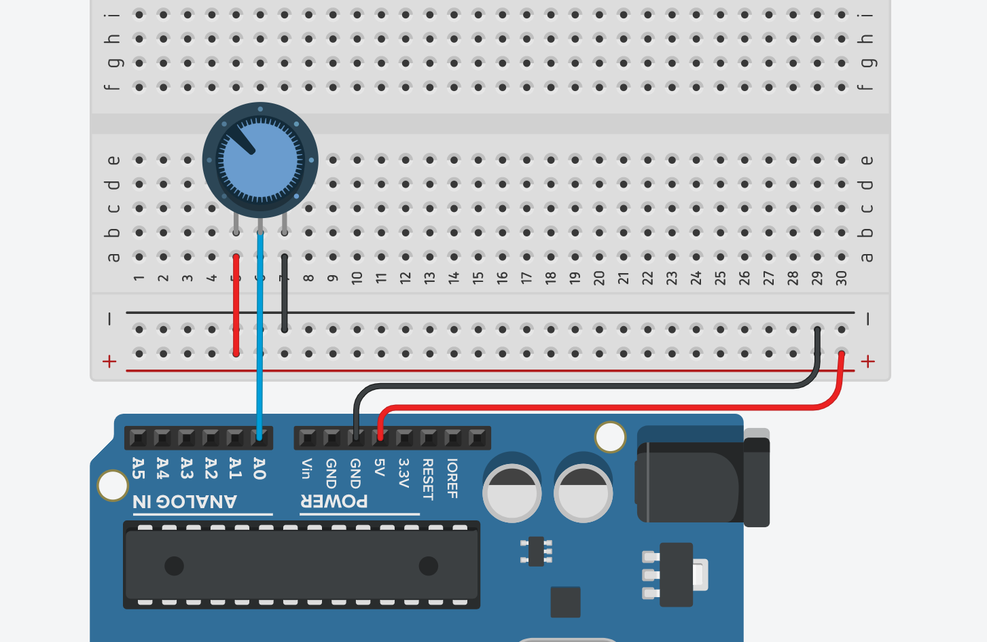
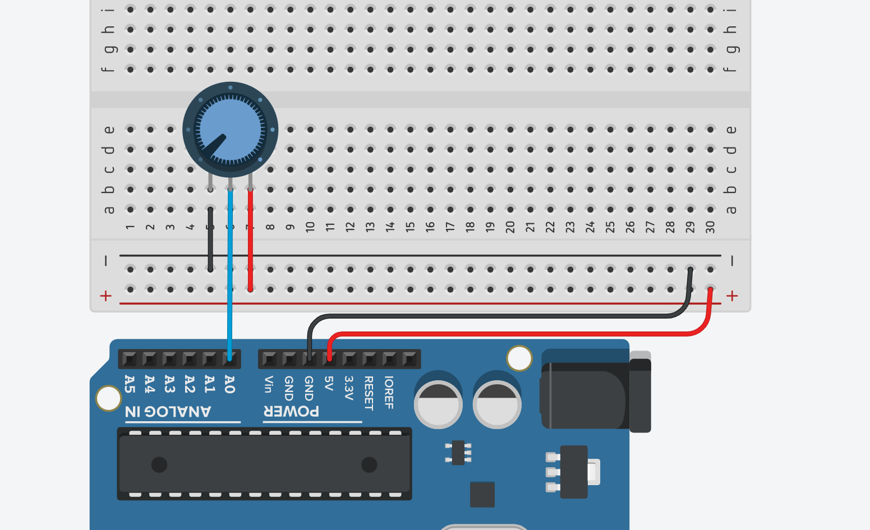
Correct ways of wiring a potentiometer to an Arduino
5V
1
GND
2
1
Input pin A0
2
Input pin A0
3
3
GND
5V

Slide 3
Correct ways of wiring a potentiometer to an Arduino
5V
1
GND
2
1
Input pin A0
2
Input pin A0
3
3
GND
5V
The analog input A0 (V_{A0}) will start at 5V and decrease to 0V as the dial moves from left to right.
The analog input A0 (V_{A0}) will start at 0V and increase to 5V as the dial moves from left to right.

Slide 4
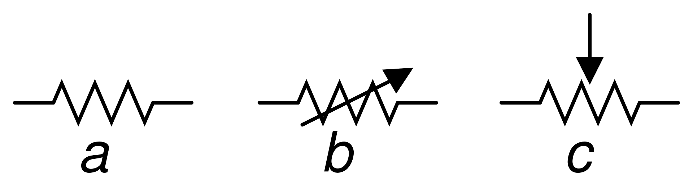
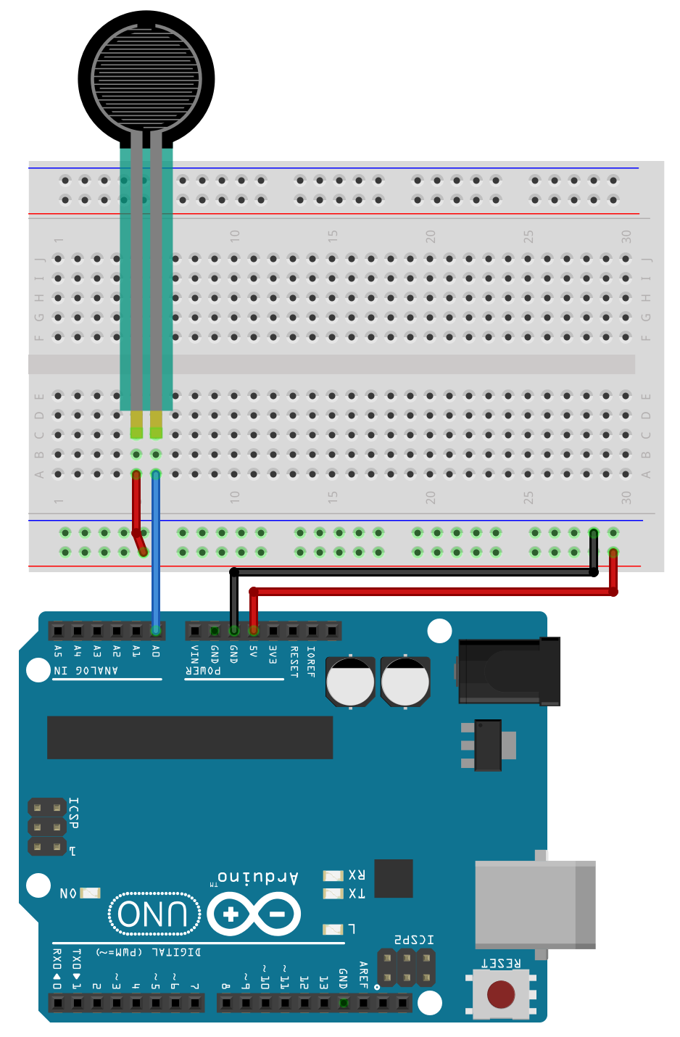
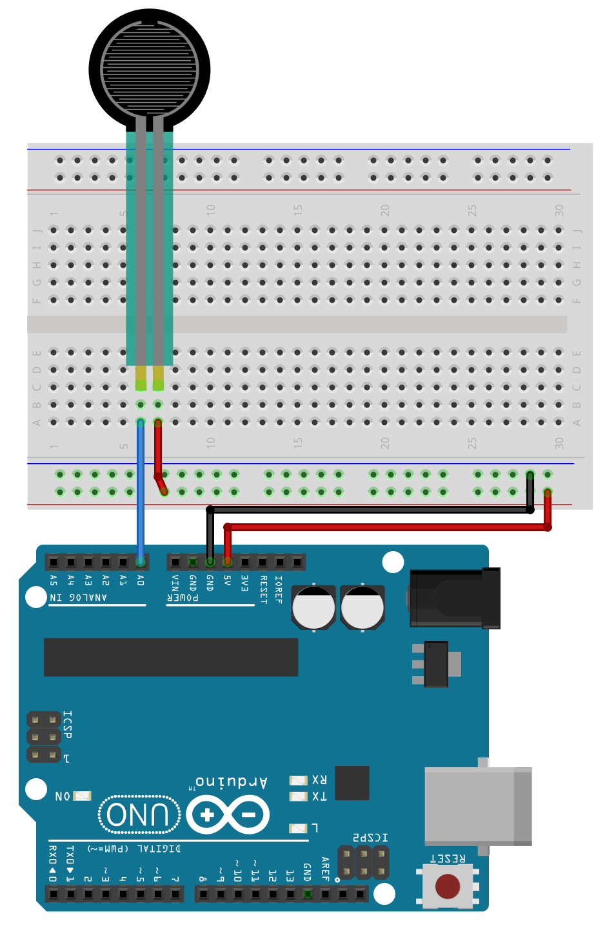
Incorrect ways of wiring a force-sensitive resistor to an Arduino
Here, the analog input A0 (V_{A0}) will vary between floating and, when the FSR is pressed, 5V.
5V
Input pin A0
Input pin A0
5V

Slide 5
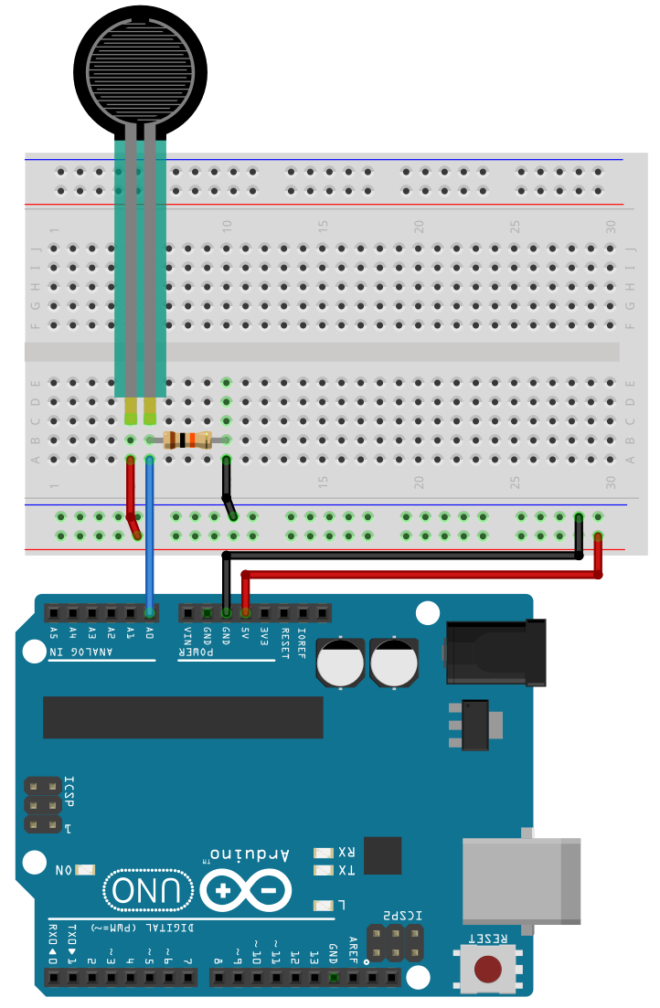
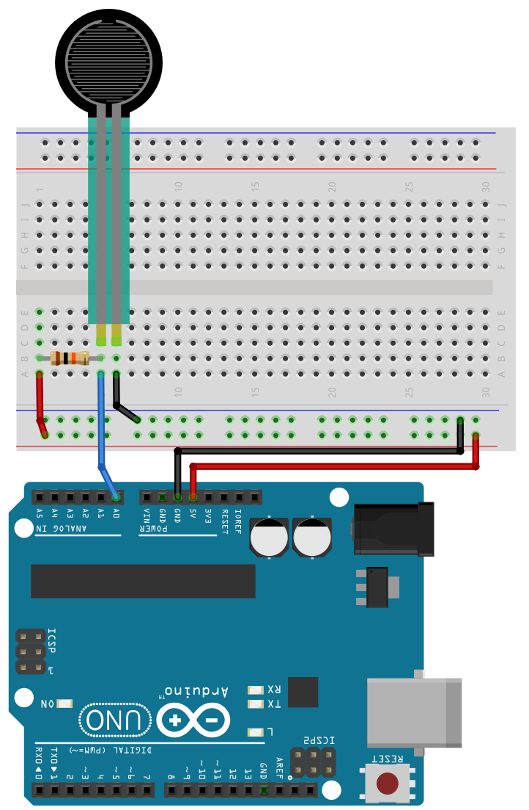


Correct ways of wiring a force-sensitive resistor to an Arduino
5V
5V
R_{fsr}
R_{x}
Input pin A0
Input pin A0
R_{y}
R_{fsr}
GND
GND
$V_{A0}=V_{in}∗\frac{R_{y}}{R_{fsr}+R_{y}}$
$V_{A0}=V_{in}∗\frac{R_{fsr}}{R_{fsr}+R_{x}}$
In this configuration, the analog input A0 (V_{A0}) will increase with increasing force and start at 0V when the FSR is not pressed.
In this configuration, the analog input A0 (V_{A0}) will decrease with increasing force and start at 5V when the FSR is not pressed.

Slide 6

5V
R_{fsr}
Input pin A0
R_{y}
GND
$V_{A0}=V_{in}∗\frac{R_{y}}{R_{fsr}+R_{y}}$

