Slide 1


Potentiometers can be hooked up in either orientation
potentiometers
Resistive material
Resistive material
Wiper
Wiper
Source: https://en.wikipedia.org/wiki/Potentiometer

Slide 2
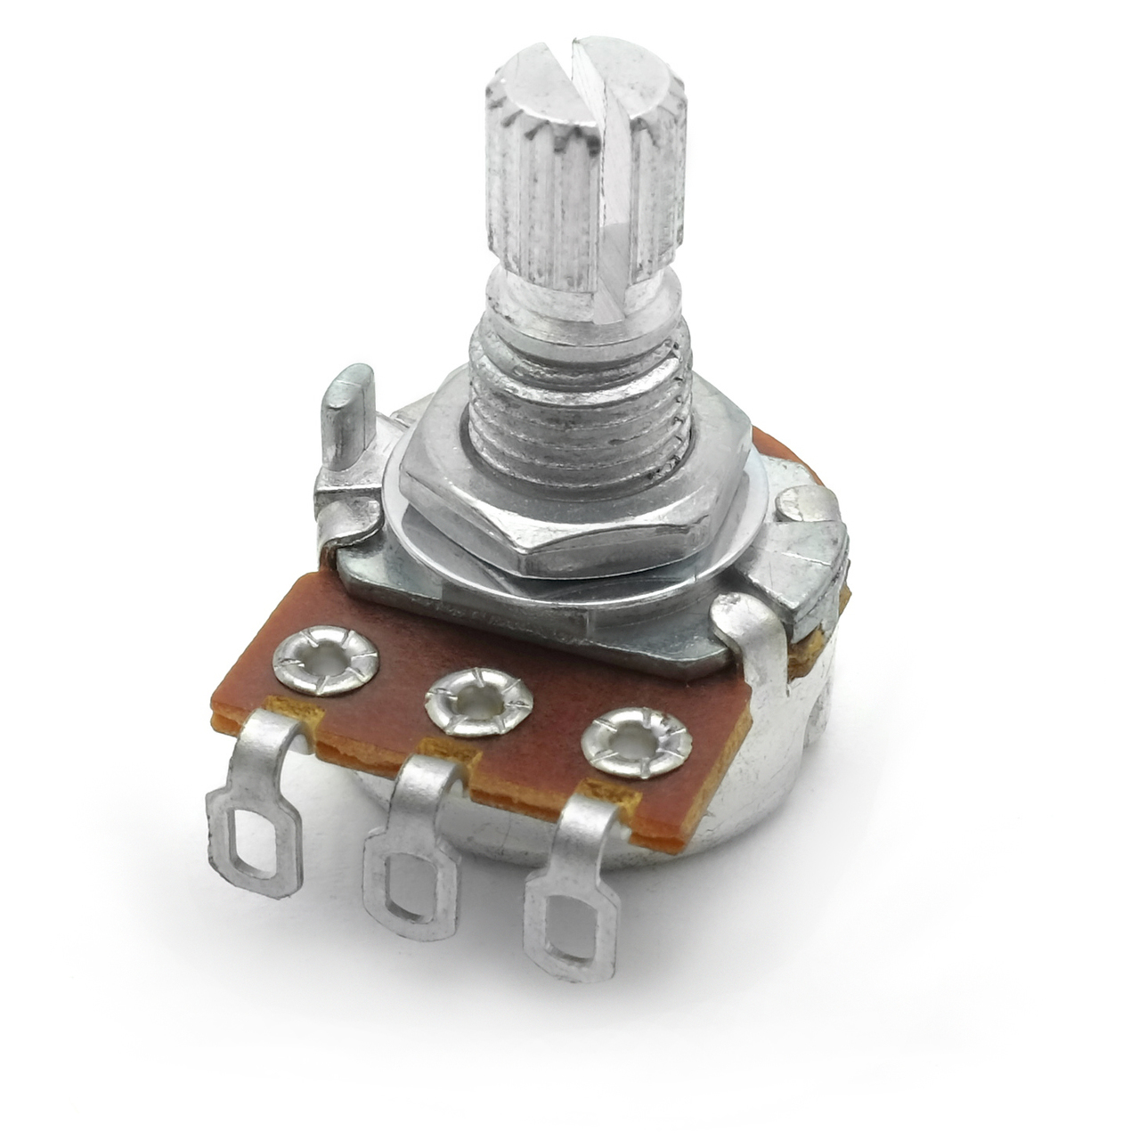
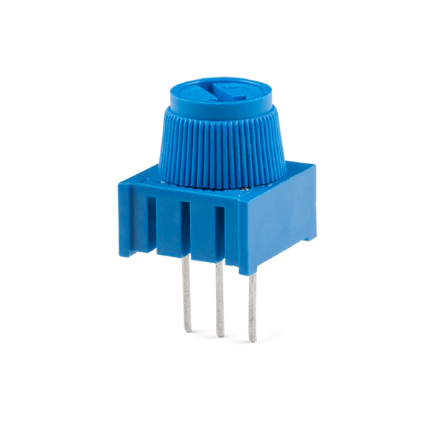
`
`

Slide 3
`
`

Slide 4
`
`

Slide 5
Resistive material
Wiper turns with dial
1
3
`
`
1
1
2
3
2
3
1
2
3
2
Wiper contact
Wiper contact
Wiper contact
Wiper contact

Slide 6
Resistive material
Wiper turns with dial
1
3
`
`
1
2
3
2
Wiper contact
Wiper contact

Slide 7
1
3
`
`
1
2
3
2
Wiper contact
Wiper contact

Slide 8
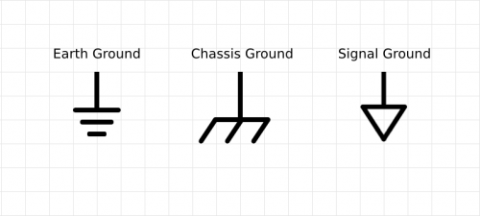
Vcc
3
Vcc
`
`
3
GND
GND
Notes:
Animation partially inspired by: https://youtu.be/fg9No42IjnM?t=114
How Potentiometer works : Linear and Rotary type Potentiometer
by EasyMechLearn

Slide 9
Resistive material
Wiper turns with dial
1
3
`
`
1
2
3
2
Wiper contact
Wiper contact
Let’s imagine that we have a 10KΩ potentiometer

Slide 10
5K
0K
2.5K
5K
7.5K
10K
2.5K
7.5K
1
3
`
`
0K
10K
1
2
3
2
Wiper contact
Wiper contact
Let’s imagine that we have a 10KΩ potentiometer

Slide 11
5K
0K
2.5K
5K
7.5K
10K
2.5K
7.5K
1
3
`
`
0K
10K
1
2
3
2
The resistance between 1 and 2 changes depending on wiper position. Let’s call this R₁₋₂.

Slide 12
5K
0K
2.5K
5K
7.5K
10K
2.5K
7.5K
1
3
`
`
0K
10K
1
2
3
2
The wiper also changes the resistance between 2 and 3. Let’s call this R₂₋₃.

Slide 13
5K
0K
2.5K
5K
7.5K
10K
2.5K
7.5K
1
3
`
`
0K
10K
1
2
3
2
However, the resistance (R₁₋₃) between 1 and 3 is always 10KΩ regardless of wiper position

Slide 14
5K
0K
2.5K
5K
7.5K
10K
2.5K
7.5K
1
3
`
`
0K
10K
1
2
3
2
In fact, R₁₋₃ always equals R₁₋₂ + R₂₋₃

Slide 15
5K
0K
2.5K
5K
7.5K
10K
2.5K
7.5K
1
3
`
`
0K
10K
1
2
3
2
Wiper contact
Wiper contact
R₁₋₂=0Ω R₂₋₃=10KΩ

Slide 16
5K
0K
2.5K
5K
7.5K
10K
2.5K
7.5K
1
3
`
`
0K
10K
1
2
3
2
Wiper contact
Wiper contact
R₁₋₂=2.5KΩ R₂₋₃=7.5KΩ

Slide 17
5K
0K
2.5K
5K
7.5K
10K
2.5K
7.5K
1
3
`
`
0K
10K
1
2
3
2
Wiper contact
Wiper contact
R₁₋₂=7.1KΩ R₂₋₃=2.9KΩ

Slide 18
5K
0K
2.5K
5K
7.5K
10K
2.5K
7.5K
1
3
`
`
0K
10K
1
2
3
2
Wiper contact
Wiper contact
R₁₋₂=10KΩ R₂₋₃=0KΩ

Slide 19
5K
5V
0K
2.5K
5K
7.5K
10K
2.5K
7.5K
3
5V
`
`
0K
10K
3
GND
GND

