Slide 1
Circuit Schematics: Common Electronic Symbols
+
-
Voltage source
Current source
Battery
Resistive light (lamp)
Resistor
Switch
Diode
LED
(light-emitting diode)

Slide 2
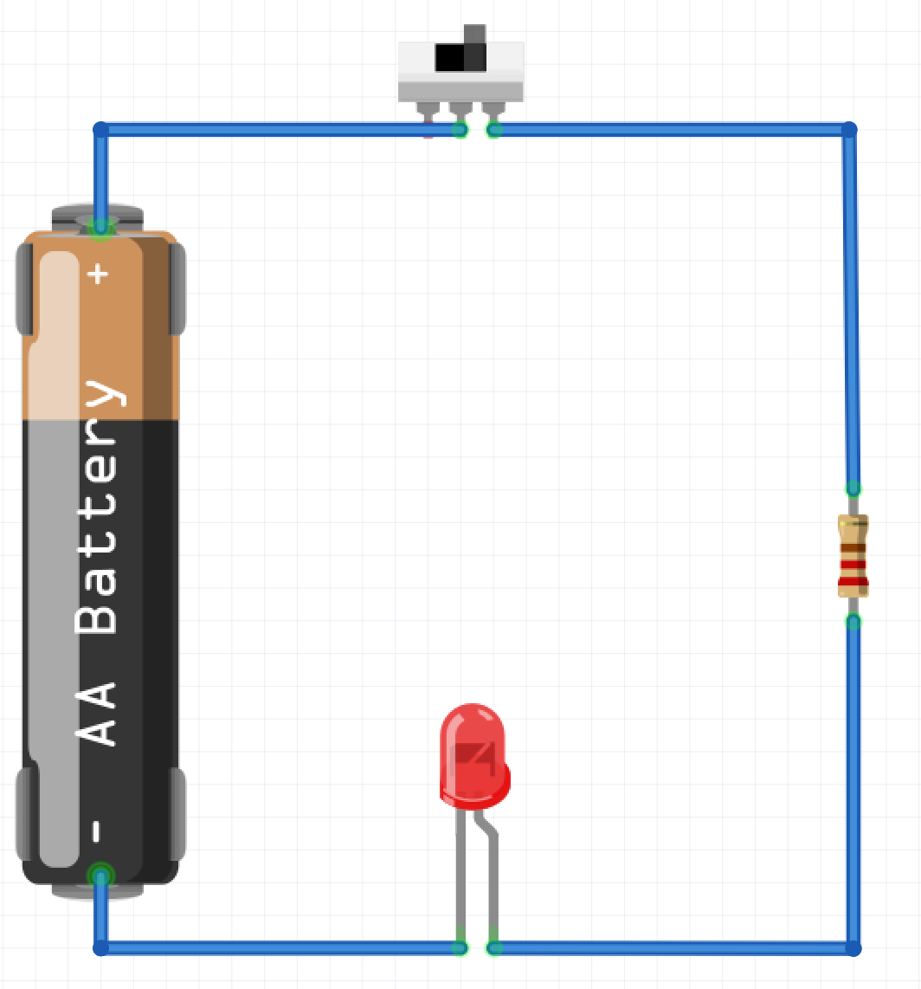
Open Switch
5V
Battery
Resistor
0V
LED

Slide 3
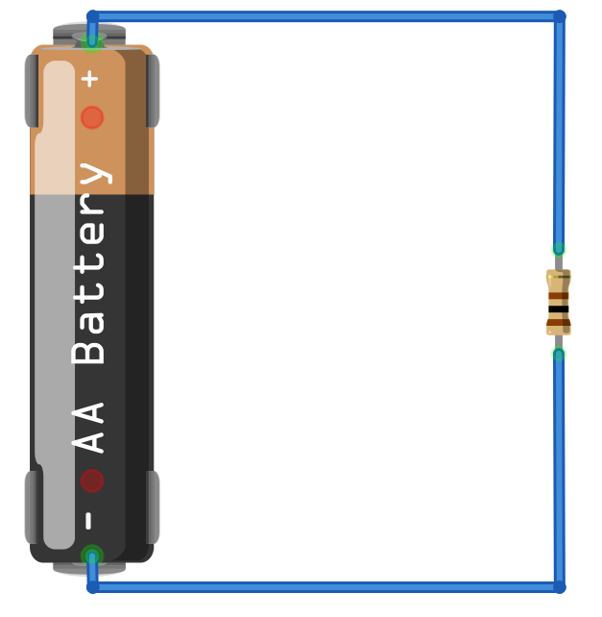
Realistic Diagram vs. Circuit Schematic
+
1.5V
Battery
Resistor
R =100Ω
Battery
Resistor
R =100Ω
-

Slide 4
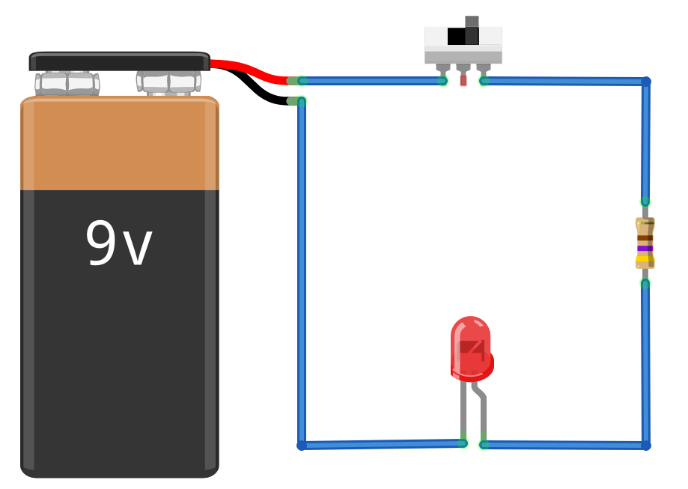
Switch
Switch
9V
+
Resistor
R = 470Ω
Battery
Resistor
R = 470Ω
-
LED
(light-emitting diode)
LED
(light-emitting diode)

Slide 5

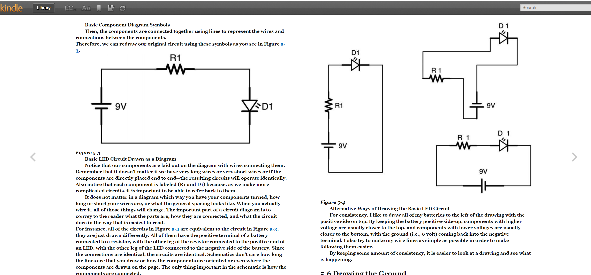

Slide 6
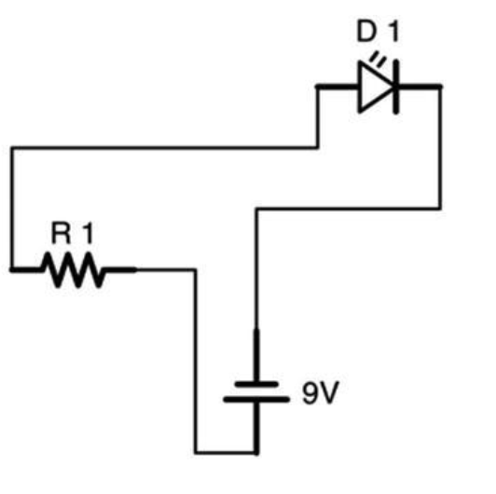
+
R1
9V
-
L1
Five equivalent circuit schematics for the basic LED Circuit
L1
R1
R1
+
+
R1
+
+
L1
9V
R1
9V
9V
-
-
R1
+
9V
-
L1
-
9V
-
L1
L1

Slide 7
Equivalent circuits
A
B
A
B
C
D
C
D
Notes:
https://web.stanford.edu/class/archive/engr/engr40m.1178/slides/lecture01.pdf

Slide 8
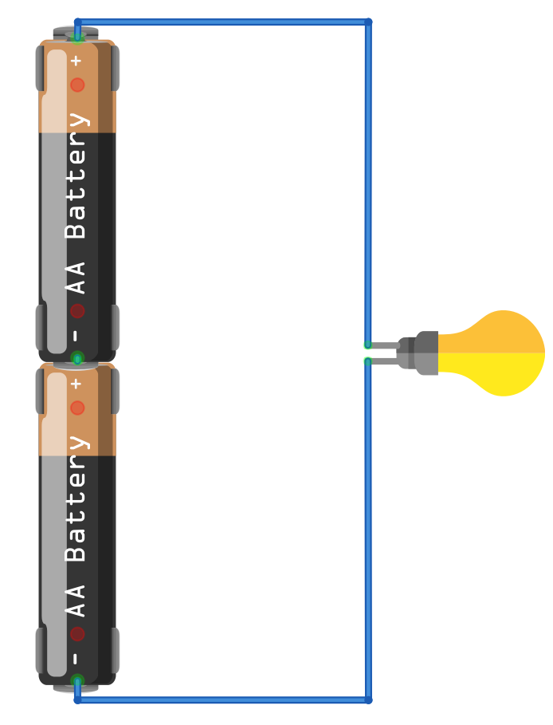
3V
3V
+
1.5V
Battery
Resistive light (lamp)
Resistive light (lamp)
-
0V

Slide 9
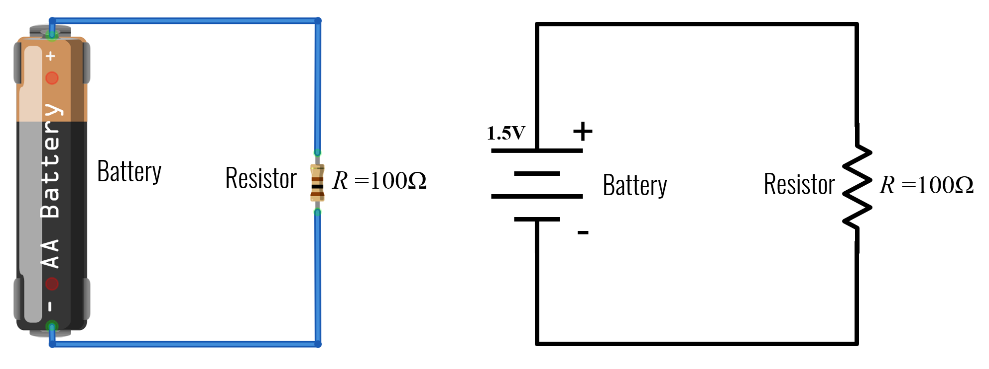
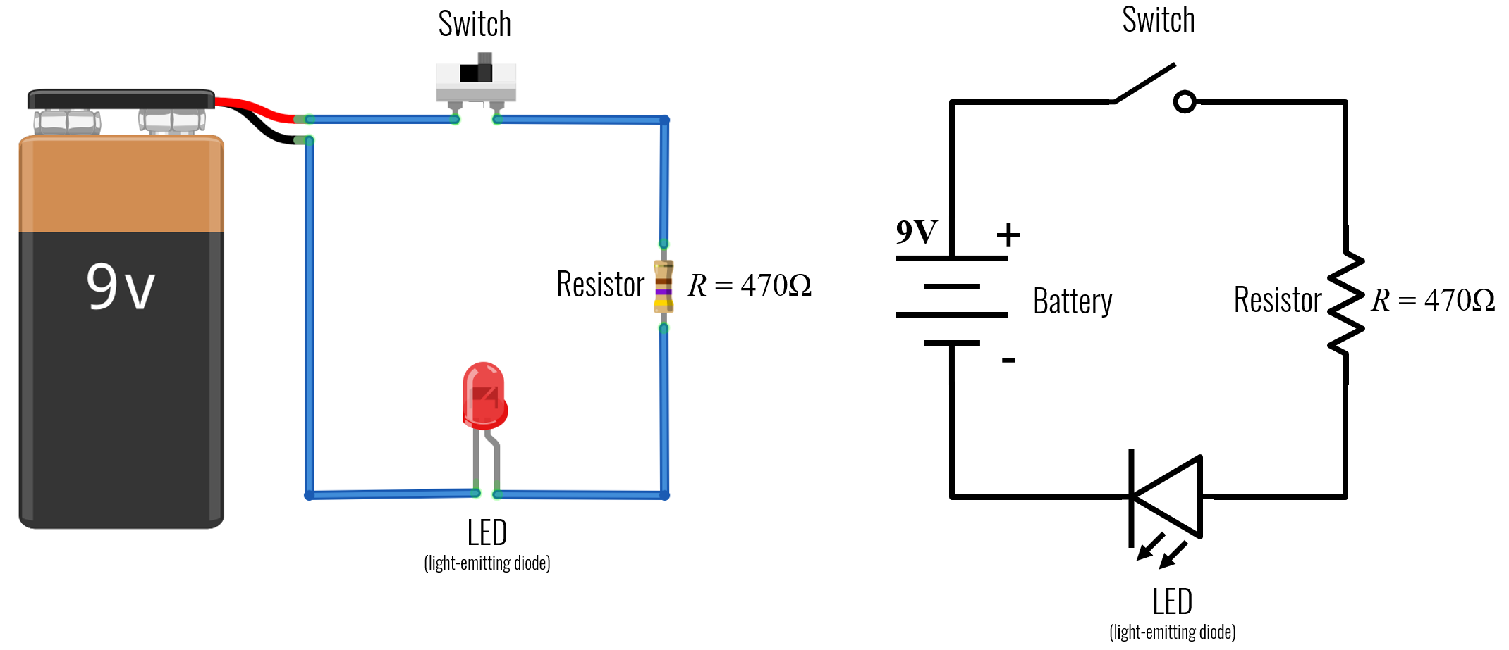
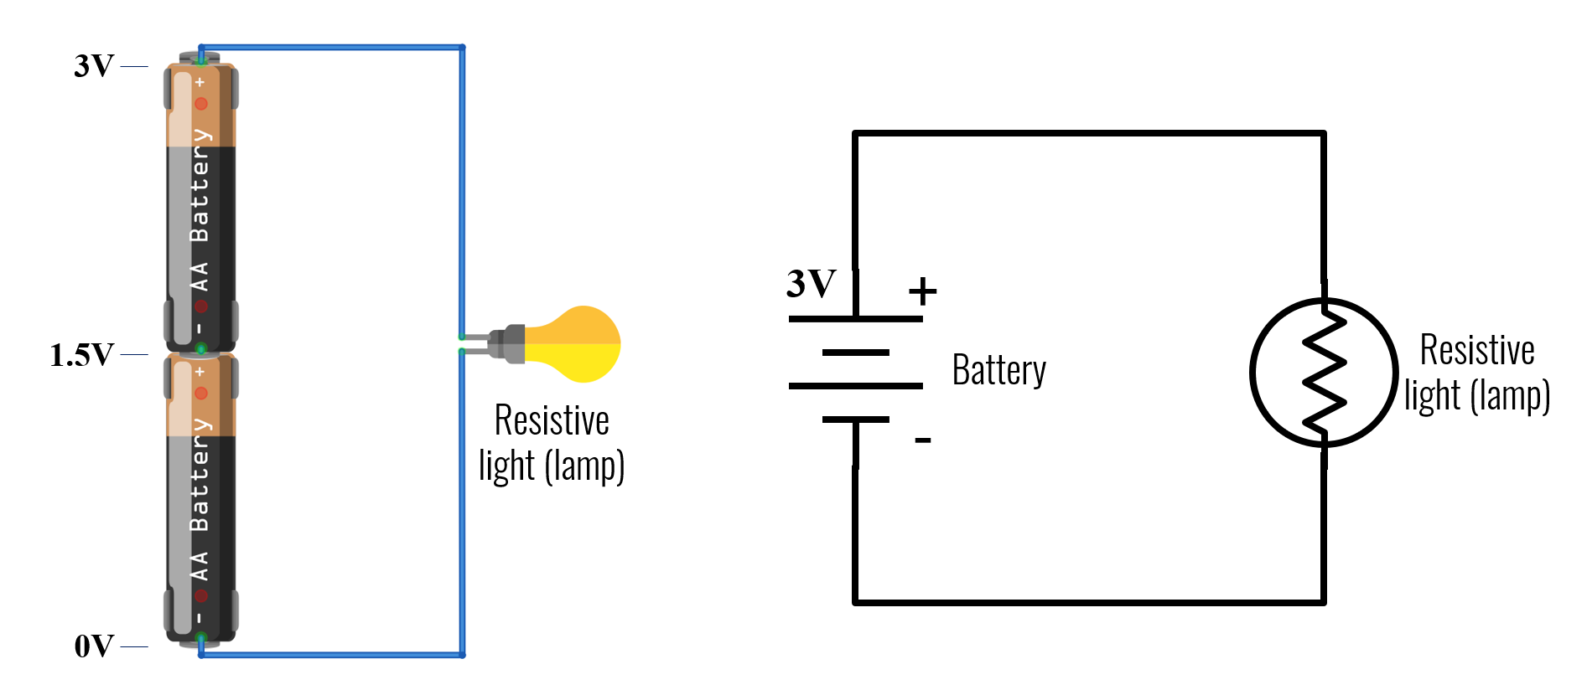
Realistic Diagram vs. Circuit Schematic

Slide 10
Pictorial Diagram vs. Circuit Schematic

Slide 11
Pictorial Diagram vs. Circuit Schematic
+
1.5V
Battery
Resistor
R =100Ω
Battery
Resistor
R =100Ω
-

Slide 12
Additional Pictorial Diagram vs. Circuit Schematic examples

Slide 13
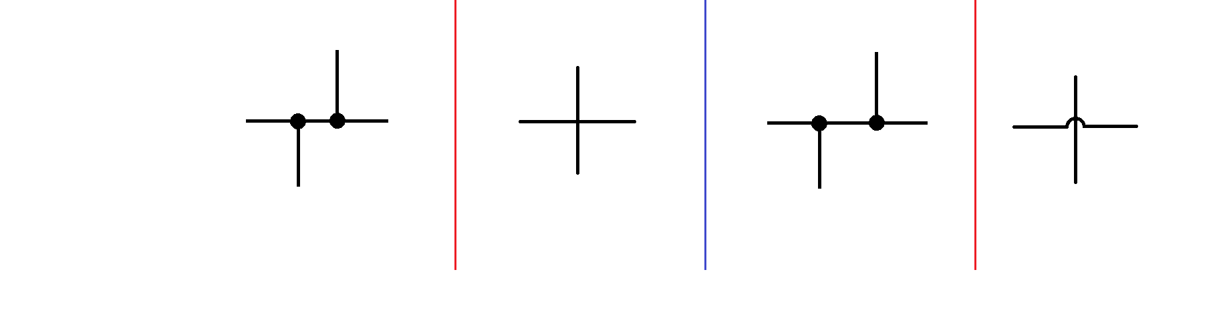
Differentiating Connected vs. Crossing Wires
Connected
Connected
Connected
(But using dot is preferred)
Connected
(Dot reduces ambiguity)
Not connected
Not connected
https://en.wikipedia.org/wiki/Circuit_diagram

Slide 14
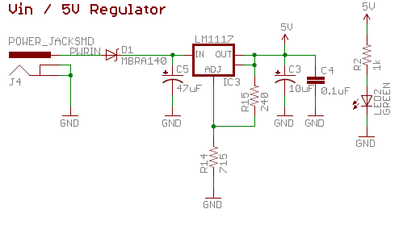
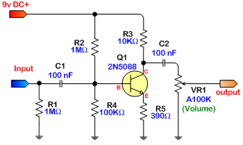
https://learn.sparkfun.com/tutorials/how-to-read-a-schematic/all
http://beavisaudio.com/techpages/SchematicToReality/

Slide 15
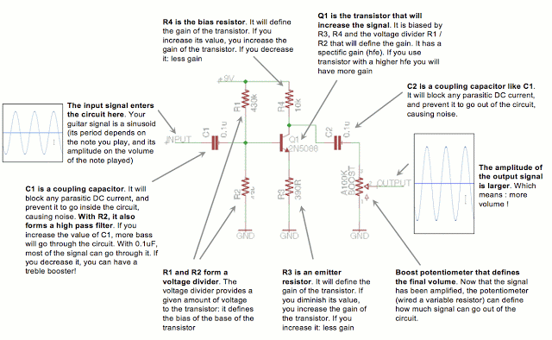
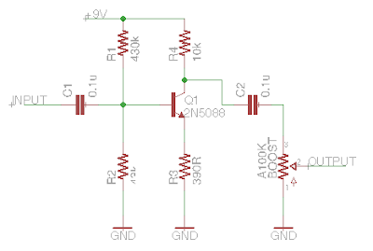
https://www.coda-effects.com/p/lpb1-circuit-analysis.html
Notes:
https://www.coda-effects.com/p/lpb1-circuit-analysis.html

Slide 16
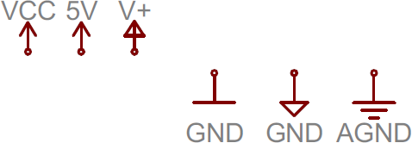
Voltage source and ground nodes
Vcc
5V
V+
GND
GND
GND
Notes:
https://learn.sparkfun.com/tutorials/how-to-read-a-schematic/all

Slide 17
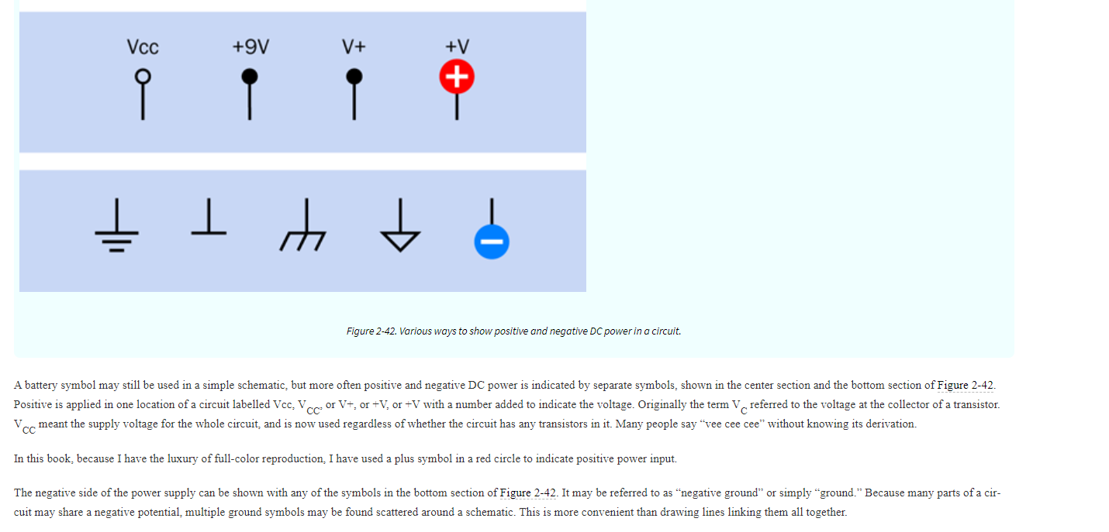
Notes:
https://learning.oreilly.com/library/view/make-electronics-2nd/9781680450255/ch02.html#SECTION_TWO

Slide 18
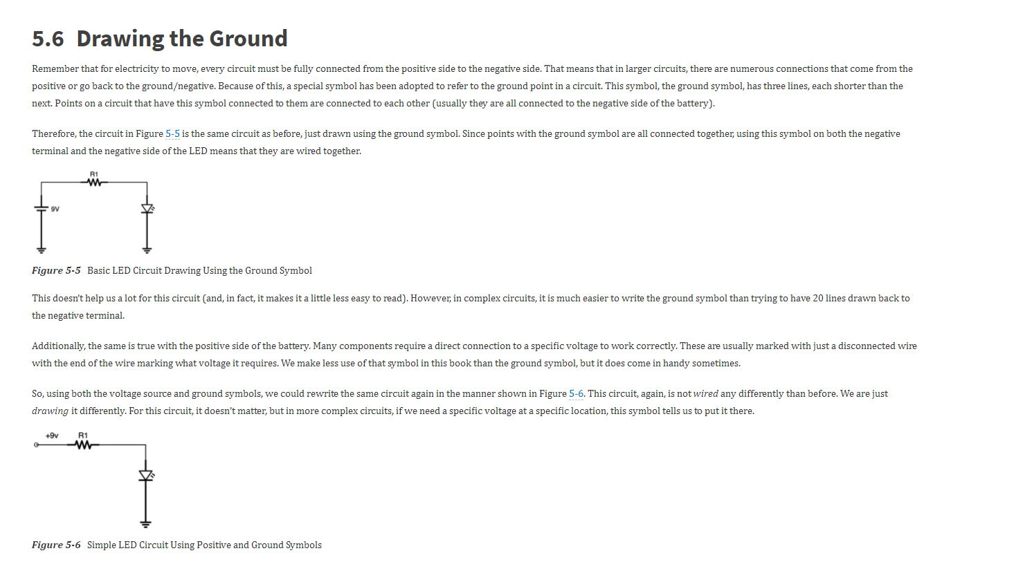
Notes:
https://learning.oreilly.com/library/view/electronics-for-beginners/9781484259795/html/488495_1_En_5_Chapter.xhtml

Slide 19
Equivalent circuits but increasingly simple diagrams
9V
9V
+
R1
+
R1
+
R1
9V
9V
R1
-
-
-
LED1
LED1
LED1
LED1
GND
GND
GND
GND

Slide 20
