Slide 1
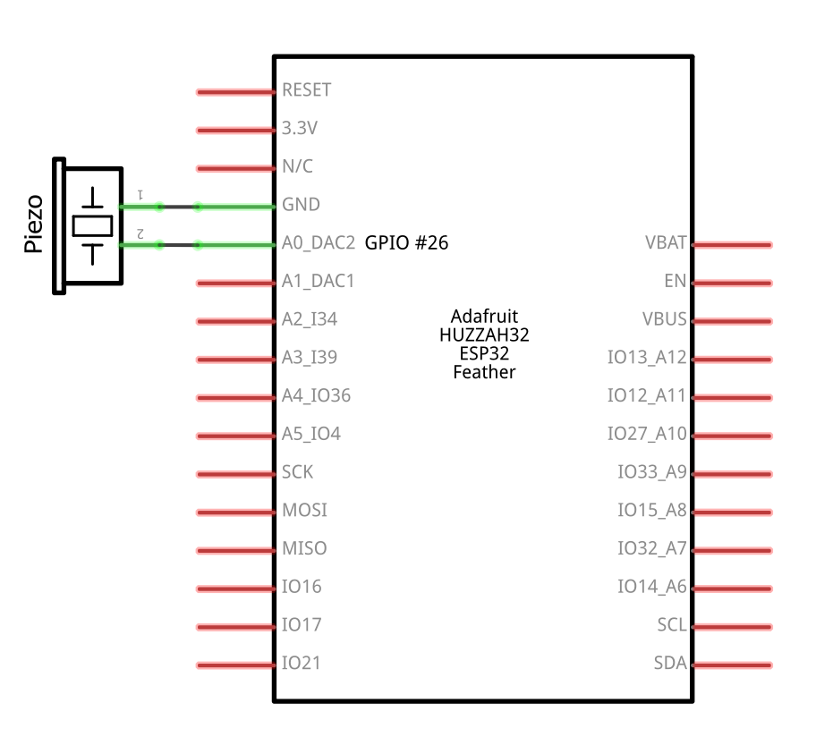
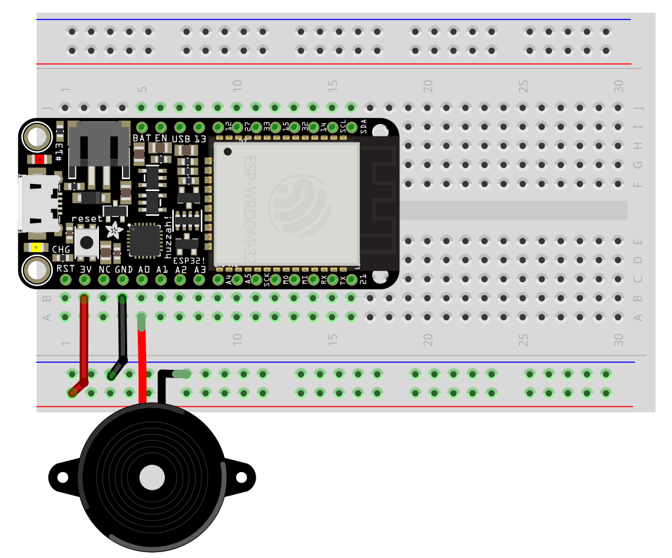
These piezobuzzers have no polarity, so you can swap legs between the GPIO pin and GND.

