Slide 1
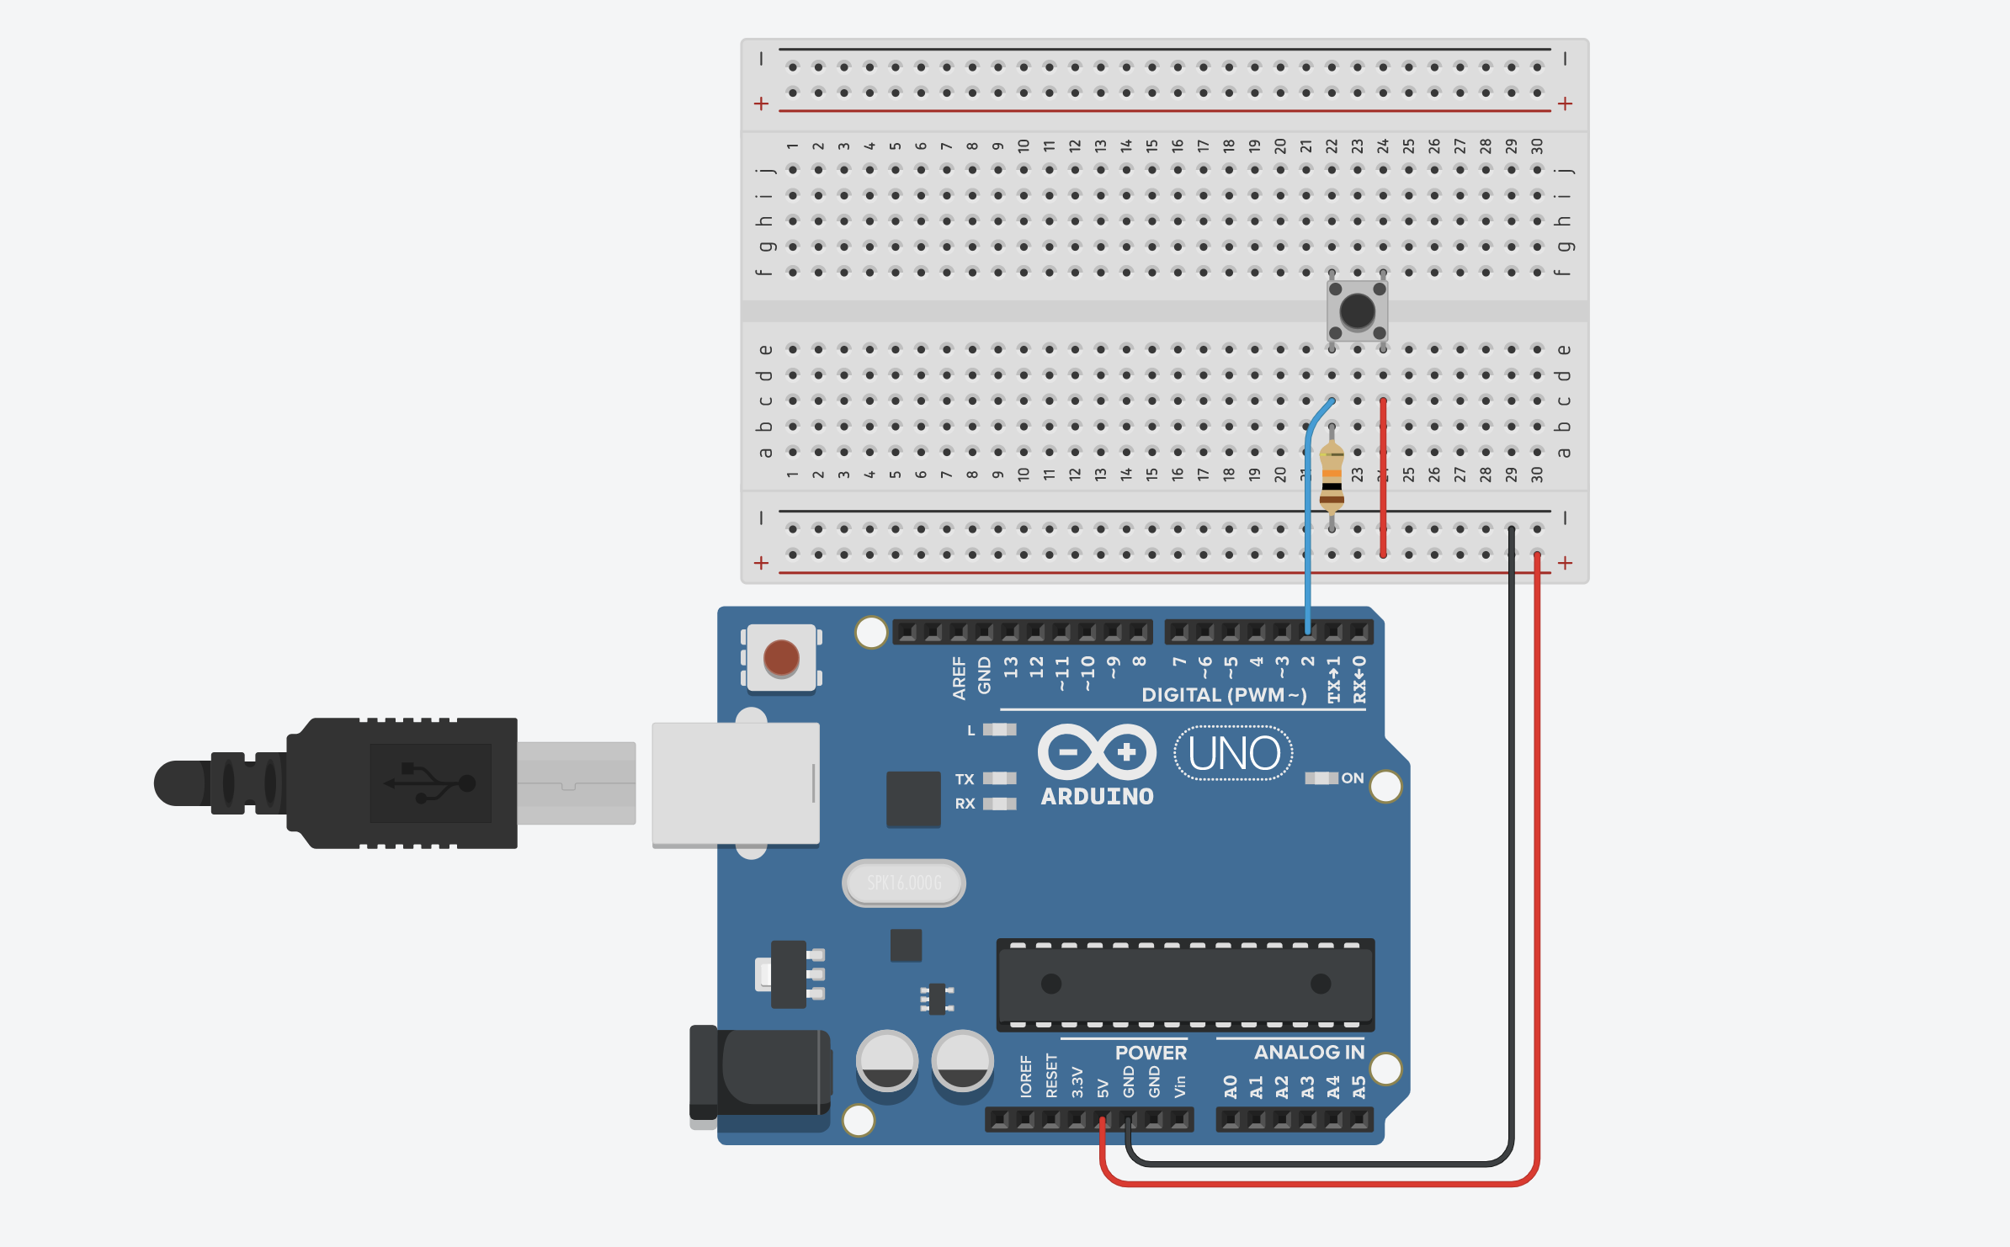

Slide 2

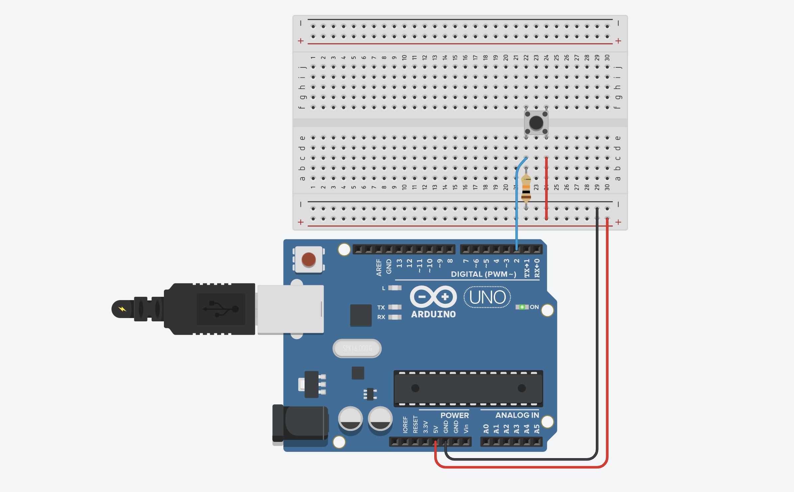
Notes:
Finger by https://thenounproject.com/search/?q=finger&i=1159676

Slide 3

Button pressed!

Slide 4
Button pressed!

