Slide 1

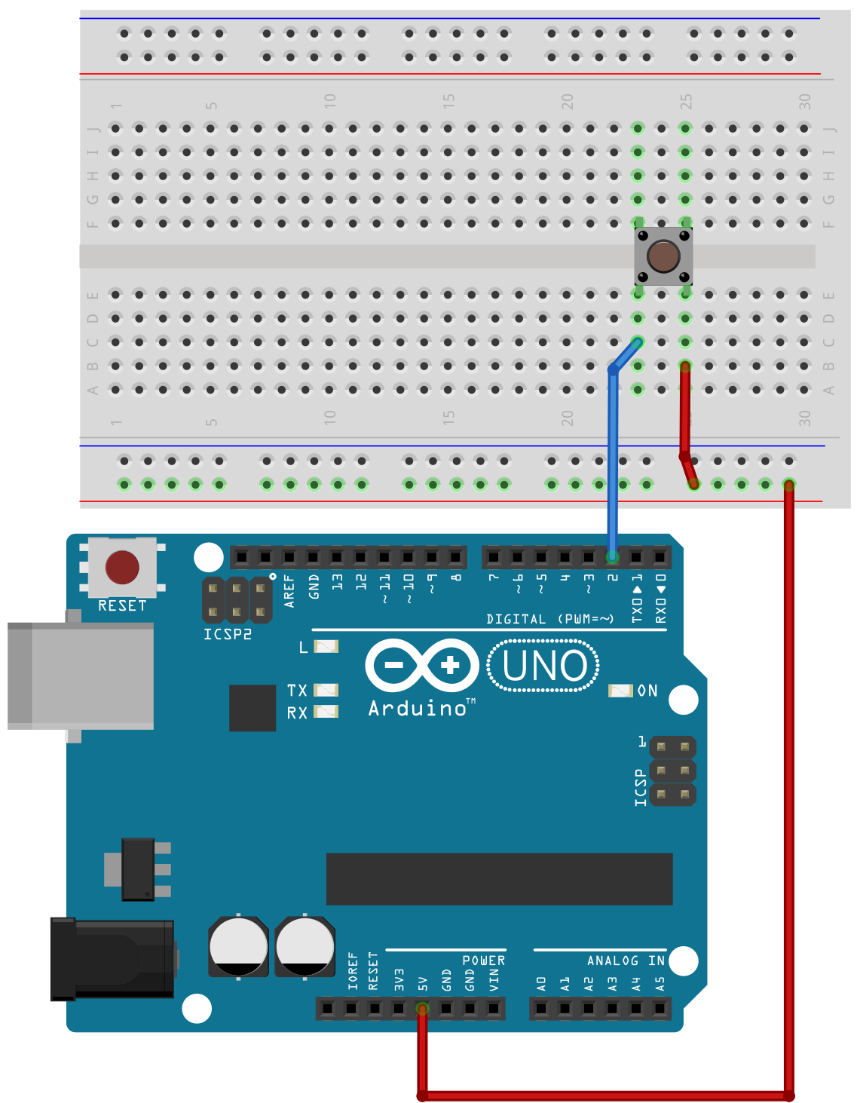
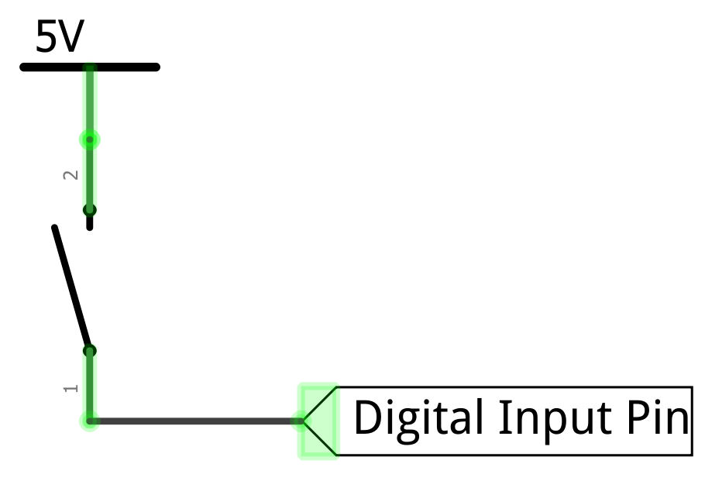
This is our initial attempt at hooking up a switch to a microcontroller
Open

Slide 2
What happens when we press the button?
Open

Slide 3
Button pressed!
The input pin becomes 5V
Closed

Slide 4
Button pressed!
The input pin becomes 5V
digitalRead(2)returns HIGH
Closed

Slide 5
Button not pressed!
But what does the input pin read when the button is not pressed?
Open

Slide 6
Button not pressed!
But what does the input pin read when the button is not pressed?
The pin can oscillate between HIGH and LOW. This is called a floating pin!
Open

Slide 7
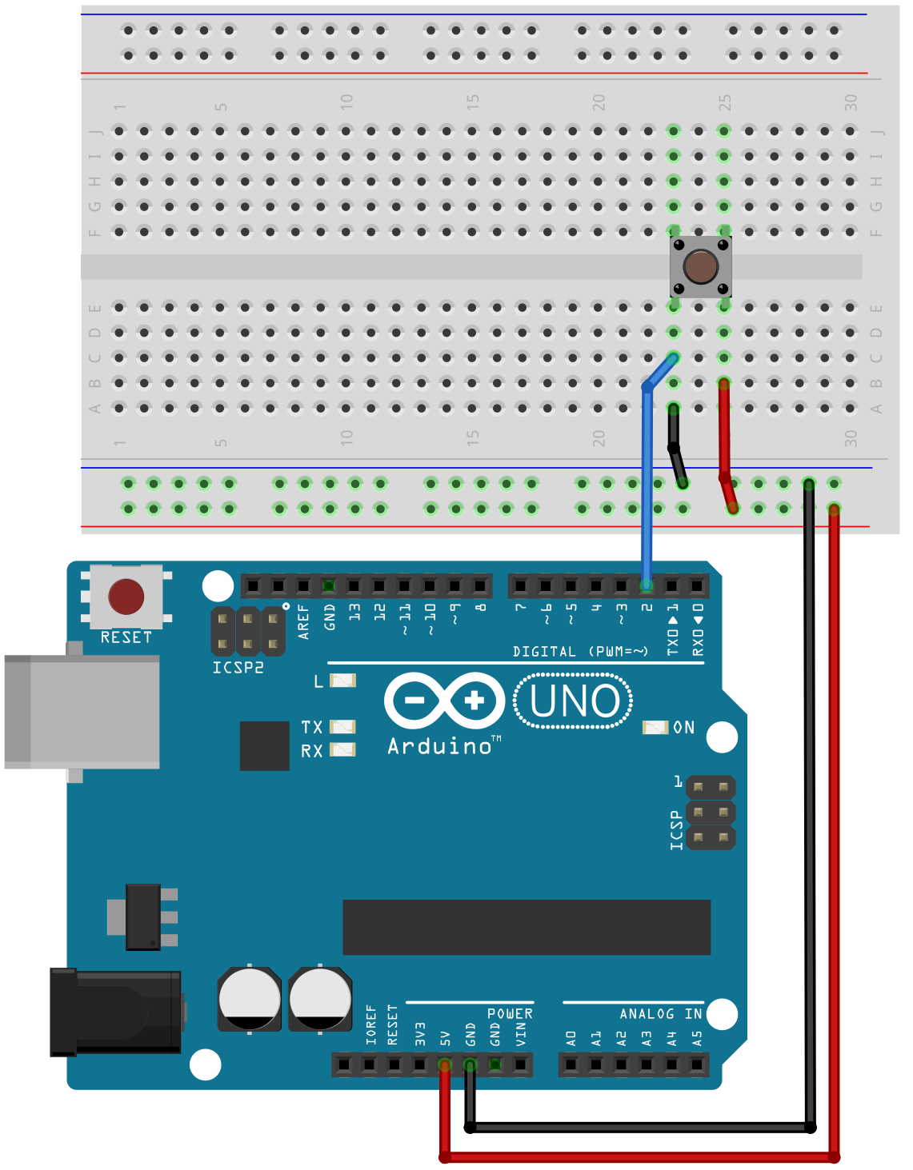
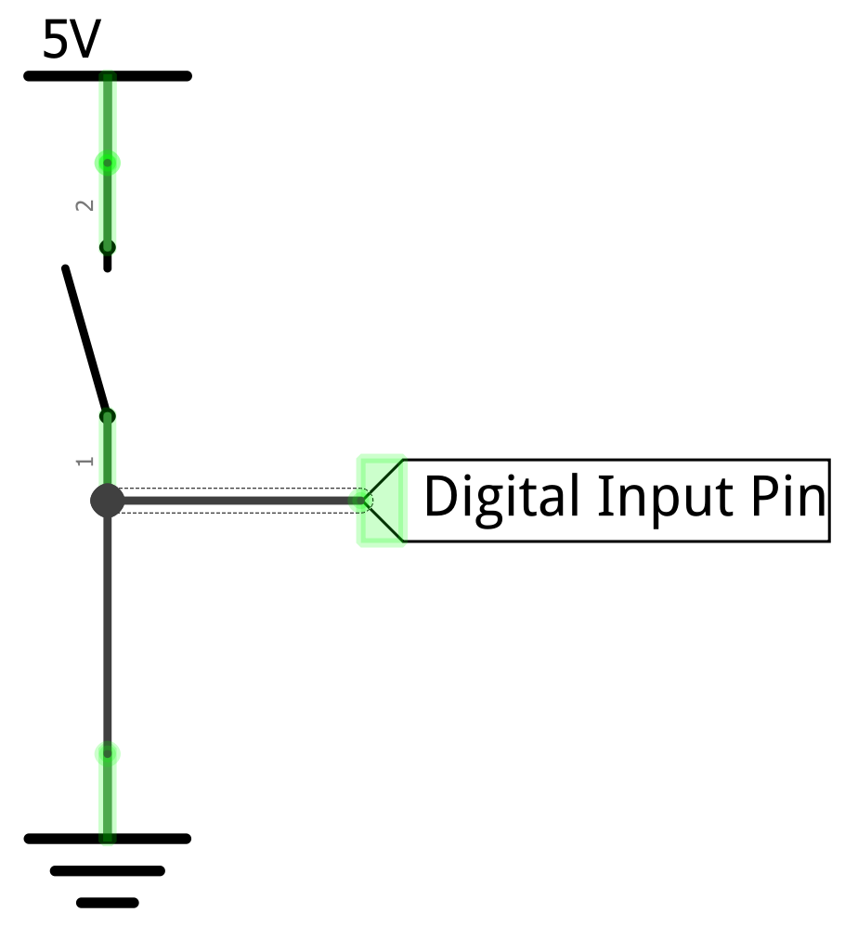
To solve the floating pin problem, you might think to add a GND connection
Open

Slide 8
To solve the floating pin problem, you might think to add a GND connection
Added GND wire
Open
Add GND here

Slide 9
To solve the floating pin problem, you might think to add a GND connection
Button not pressed!
Open
Now, with the switch open, the input pin is 0V rather than floating
So, digitalRead(2)returns LOW

Slide 10
Now, with the switch open, the input pin is 0V rather than floating
Button not pressed!
Open

Slide 11
Now, with the switch open, the input pin is 0V rather than floating
So, digitalRead(2)returns LOW
Button not pressed!
Open

Slide 12
However… now what happens when we press the button?
Button not pressed!
Open

Slide 13

A short circuit!
This can damage our microcontroller
Button pressed!
Closed

Slide 14
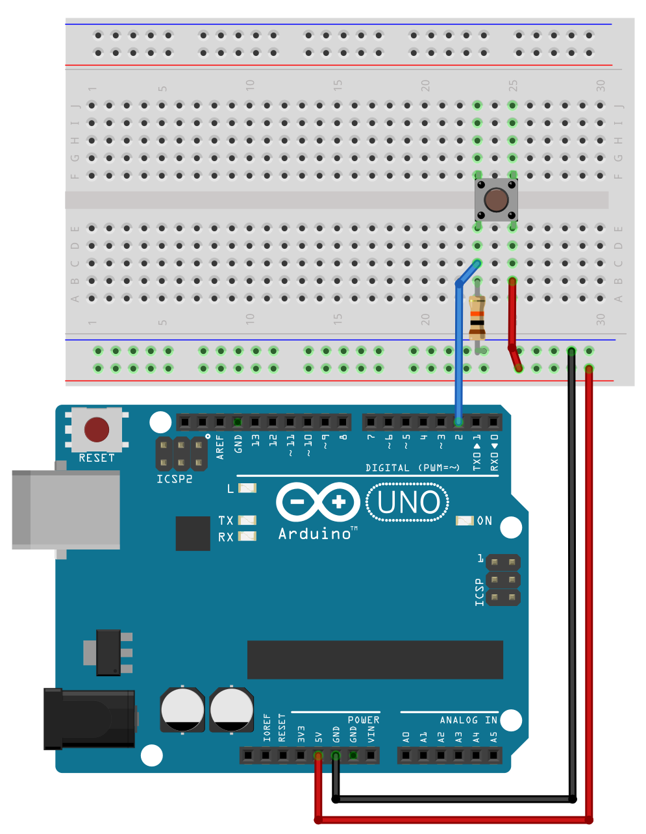
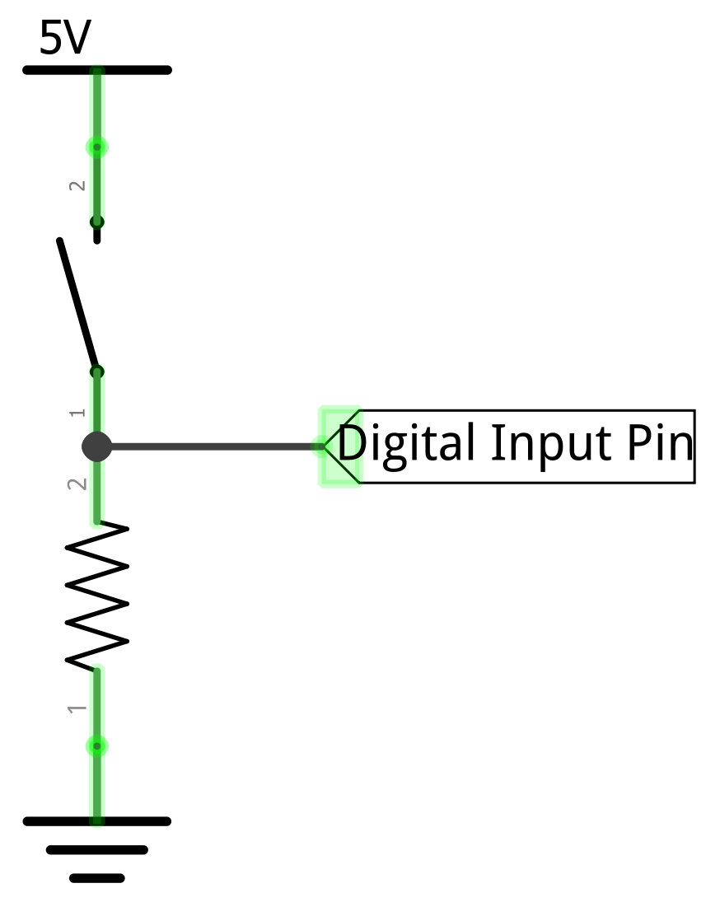
To avoid this short circuit condition and still prevent floating pins, we add what’s called a pull-down resistor

Slide 15
To avoid this short circuit condition and still prevent floating pins, we add what’s called a pull-down resistor
Added pull-down resistor
This resistor “pulls down” the digital input pin to GND when the switch is open

Slide 16
Now, with the switch open, the input pin is pulled down to 0V
Button not pressed!
Open

Slide 17
Now, with the switch open, the input pin is pulled down to 0V
So, digitalRead(2)returns LOW
Button not pressed!
Open

Slide 18
And when switch closes, the input pin becomes 5V, and the pull-down resistor prevents a short circuit
So, digitalRead(2)returns HIGH
Button pressed!
Closed

