Slide 1
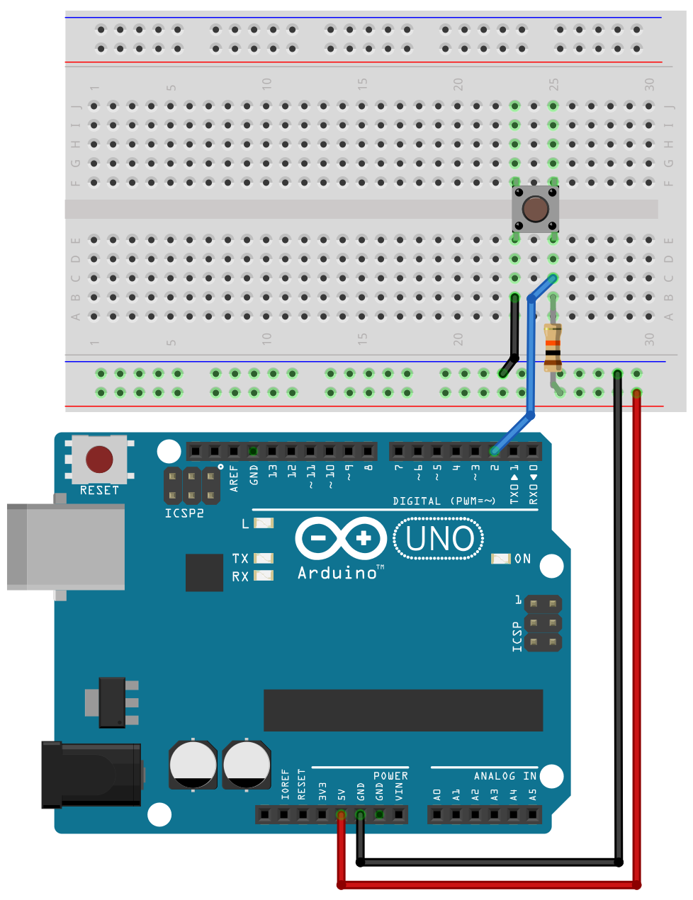
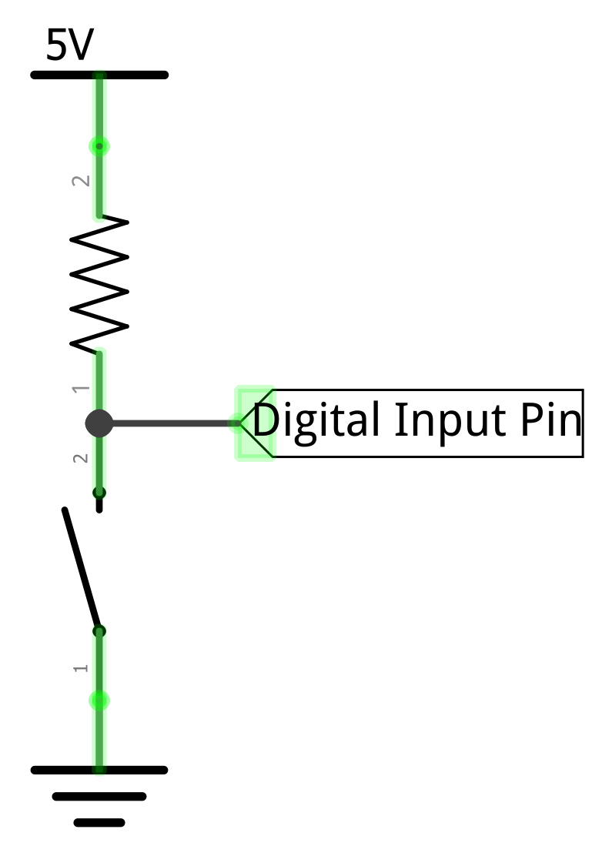
With the switch open, the input pin is pulled up to 5V
Open

Slide 2

With the switch open, the input pin is pulled up to 5V
So, digitalRead(2)returns HIGH
Open

Slide 3
With the switch open, the input pin is pulled up to 5V
So, digitalRead(2)returns HIGH
Button not pressed!
Open

Slide 4
And when switch closes, the input pin becomes 0V, and the pull-up resistor prevents a short circuit
So, digitalRead(2)returns LOW
Button pressed!
Closed
Yes, this is counterintuitive. With a pull-up resistor configuration, the input pin goes LOW when the button is pressed.

