Slide 1
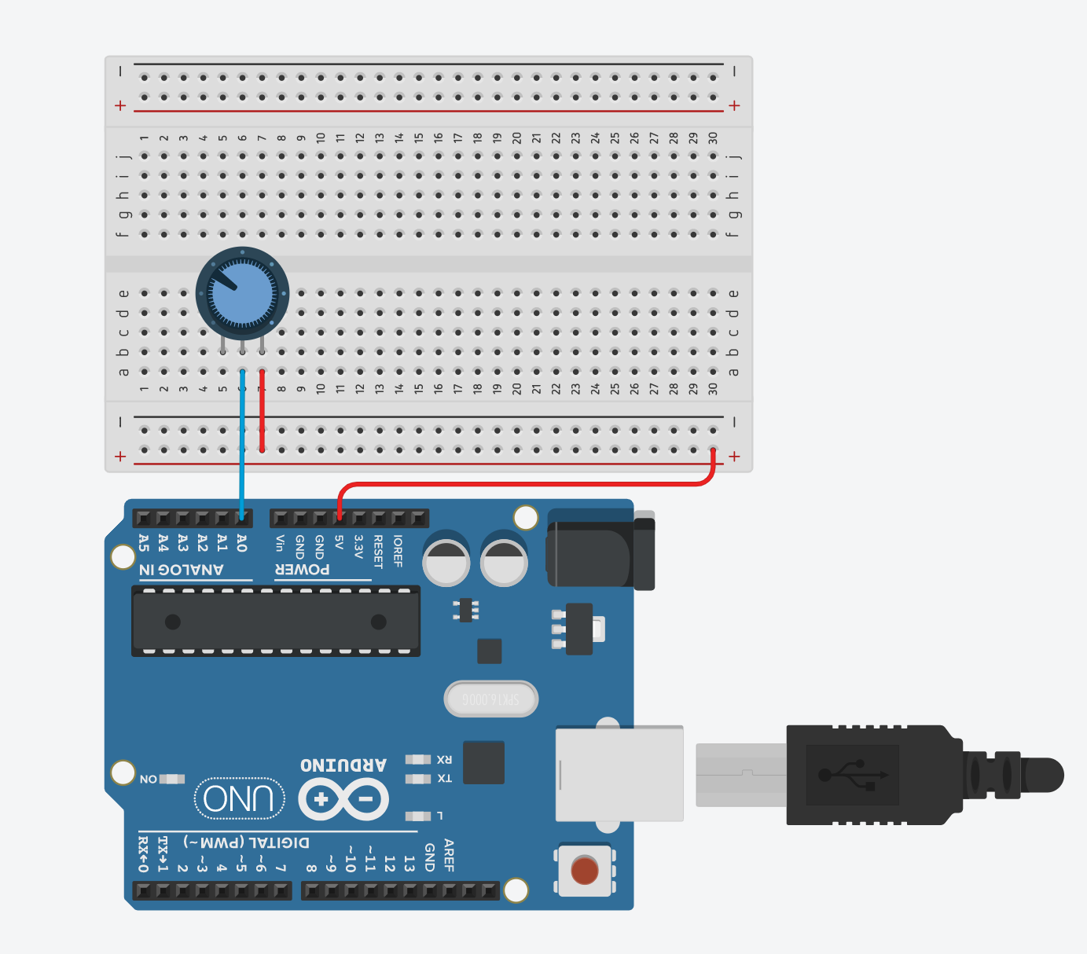
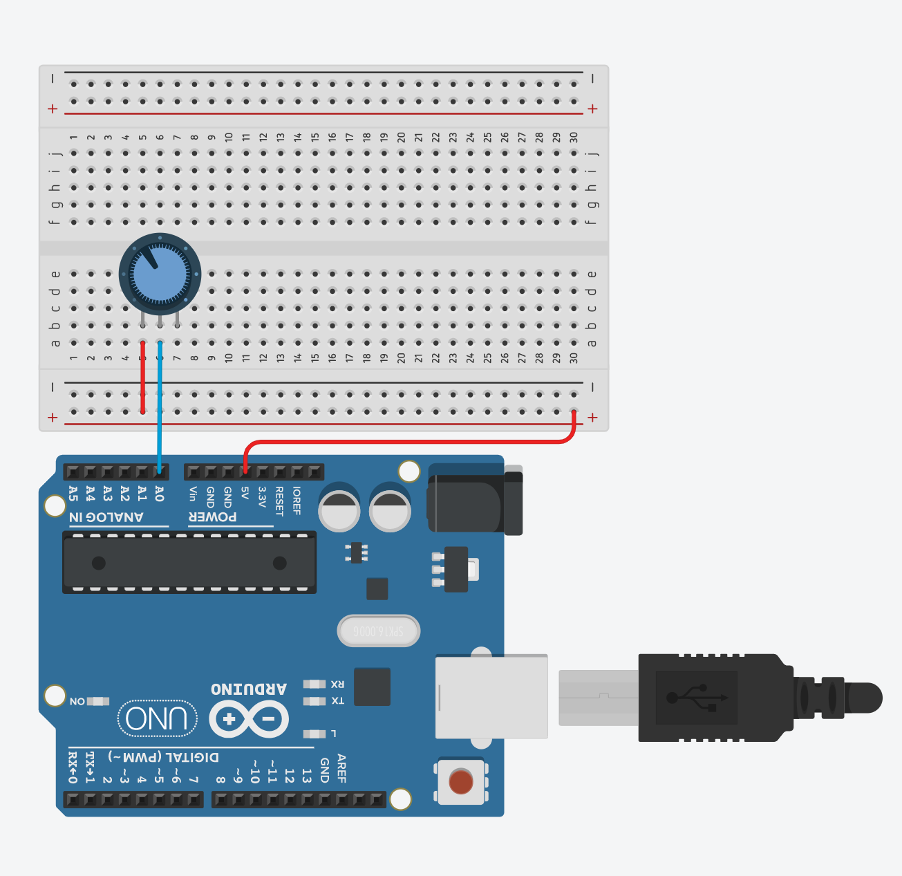
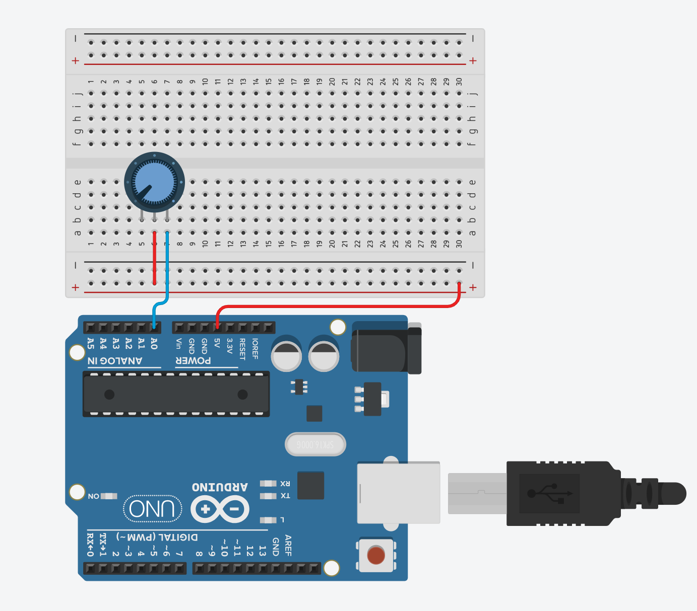
Incorrect ways of wiring a potentiometer to an Arduino

Slide 2
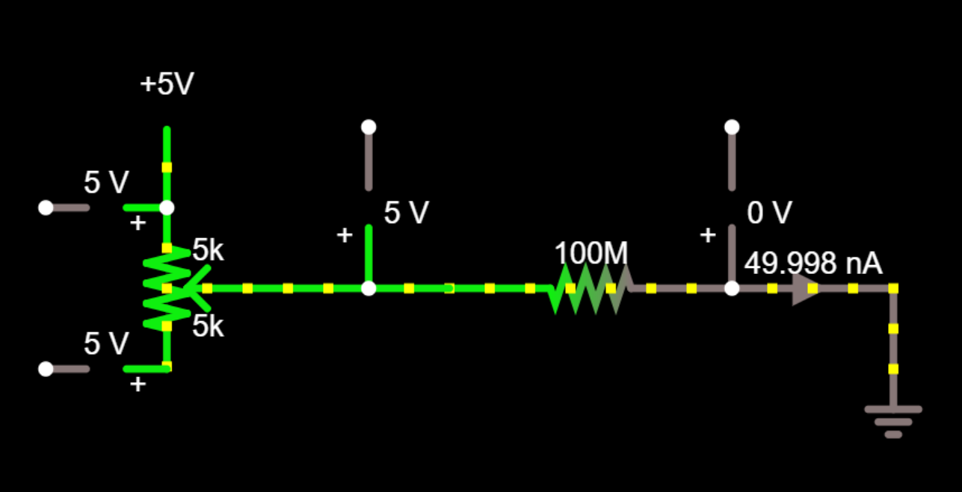

Incorrect ways of wiring a potentiometer to an Arduino
5V
1
2
Input pin A0
3
GND

Slide 3
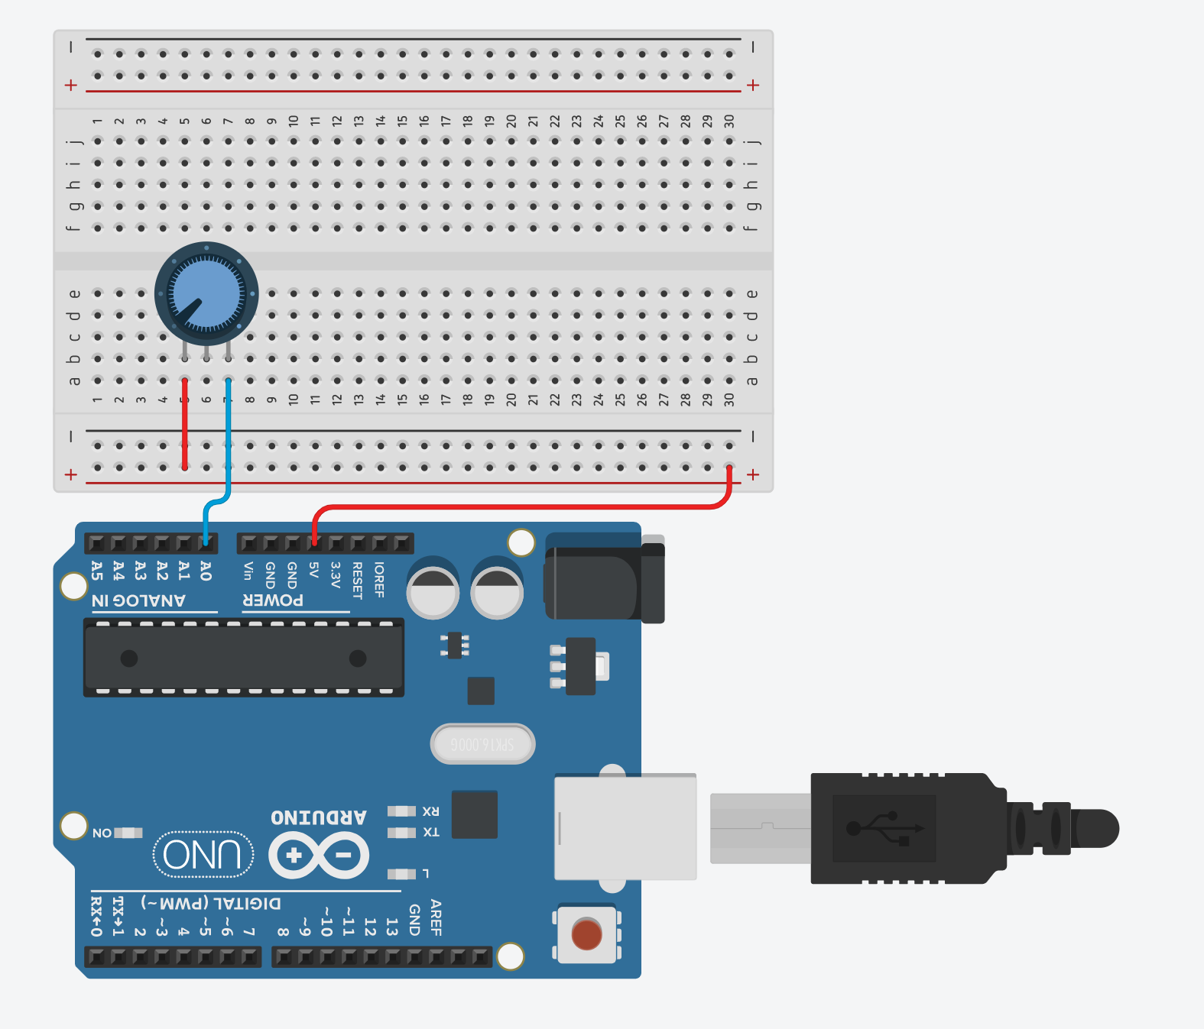
Incorrect ways of wiring a potentiometer to an Arduino
5V
1
1
1
2
5V
2
Input pin A0
2
Input pin A0
3
3
3
5V
Input pin A0

Slide 4
Incorrect ways of wiring a potentiometer to an Arduino
In all cases, the analog input A0 (V_{A0}) will be 5V. Can you think of why?
5V
5V
1
1
2
5V
2
1
1
Input pin A0
2
2
Input pin A0
3
3
3
3
5V
Input pin A0
Input pin A0

Slide 5
Incorrect ways of wiring a potentiometer to an Arduino
In all cases, the analog input A0 (V_{A0}) will be 5V. Can you think of why?
5V
5V
1
1
2
2
1
1
5V
Input pin A0
2
2
3
Input pin A0
3
3
3
5V
Input pin A0
Input pin A0

Slide 6
Incorrect ways of wiring a potentiometer to an Arduino
In all cases, the analog input A0 (V_{A0}) will be 5V. Can you think of why?
5V
5V
1
1
2
2
1
1
5V
Input pin A0
2
2
Input pin A0
3
3
3
3
5V
Input pin A0
Input pin A0

