Slide 1
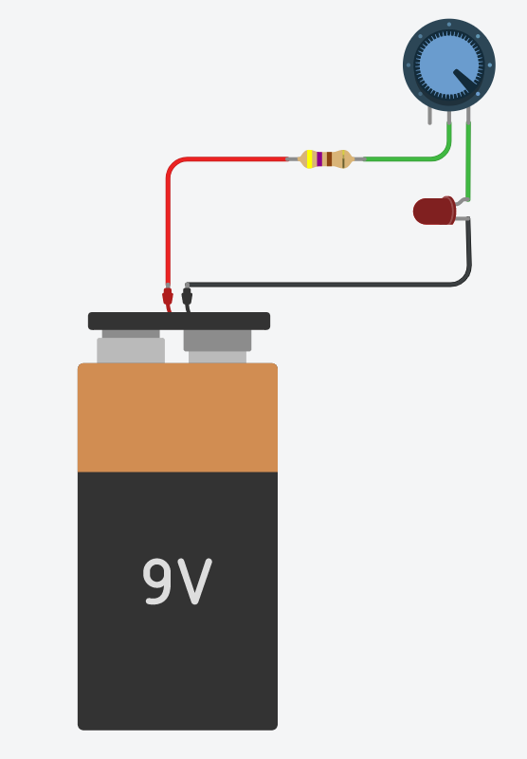
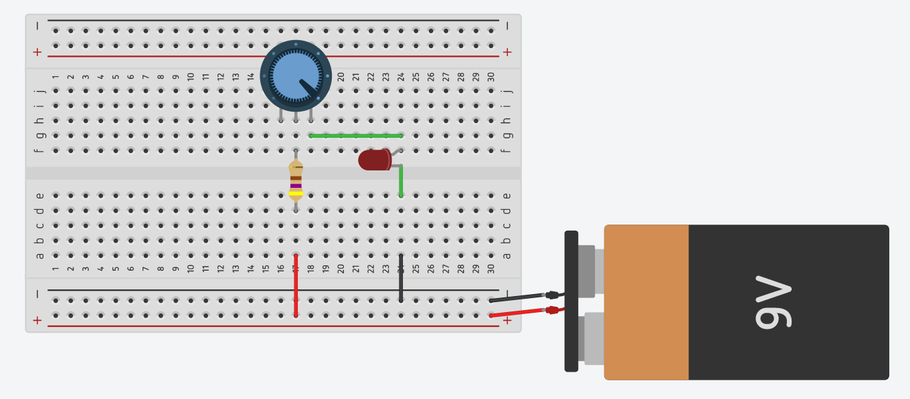
10KΩ
470Ω
10KΩ
470Ω

Slide 2
10KΩ
470Ω

Slide 3
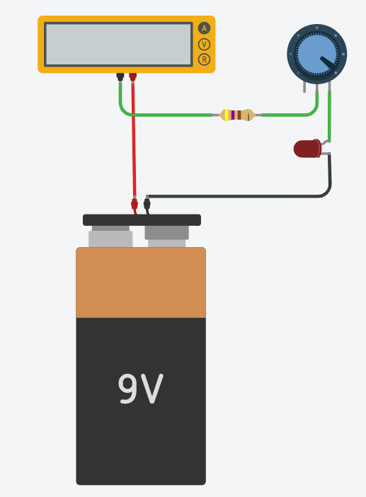
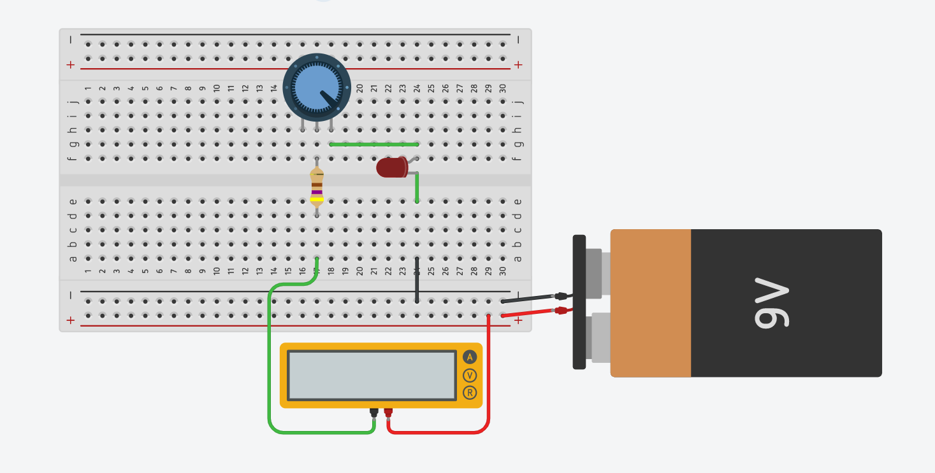
10KΩ
470Ω
10KΩ
470Ω
Make sure to switch the mode to ammeter

Slide 4
10KΩ
470Ω
Make sure to switch the mode to ammeter

Slide 5
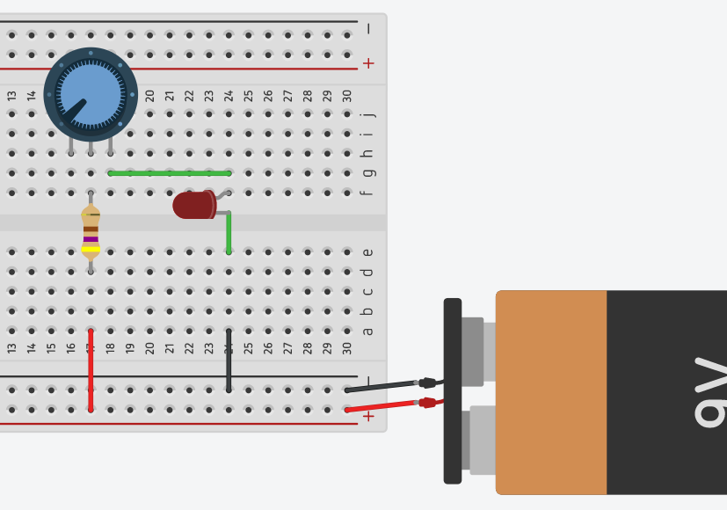
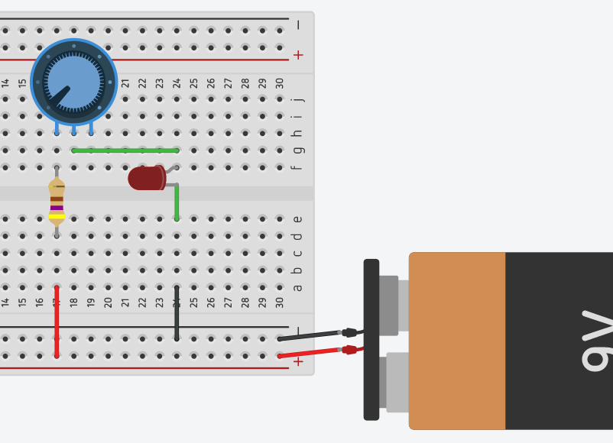
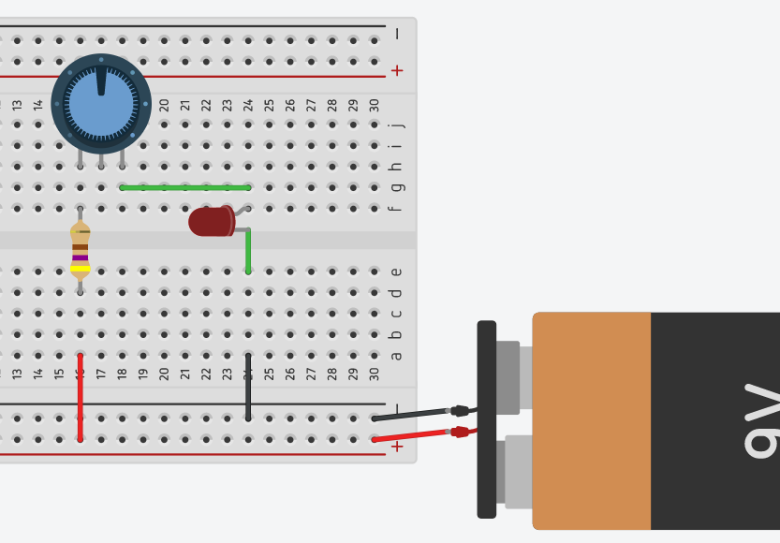
Legs 2 and 3 connected
Legs 1 and 2 connected
Legs 1 and 3 connected

Slide 6
