Slide 1
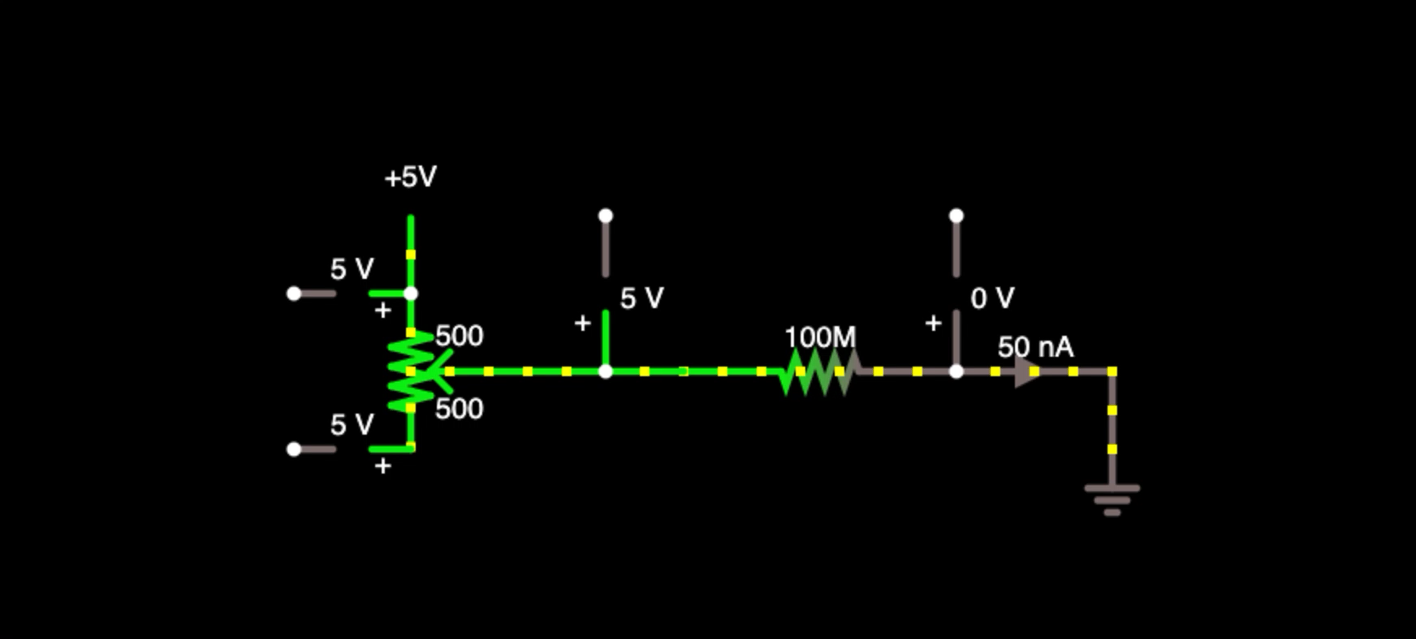
Outside microcontroller
Inside microcontroller
No current flows into MCU input pins
No voltage difference across potentiometer. Thus, no current.
Pin A0

