Slide 1
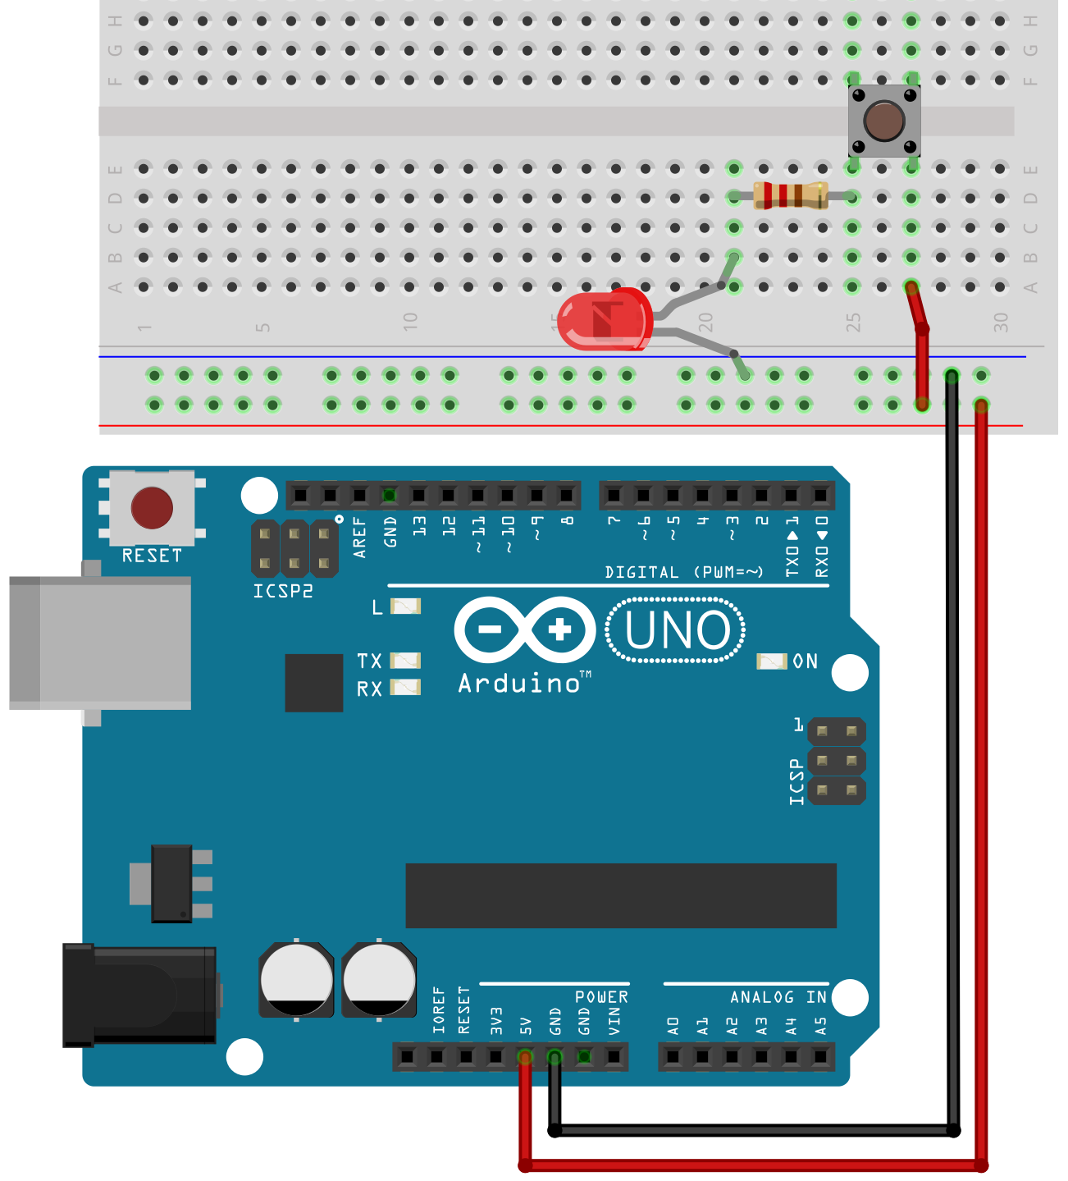
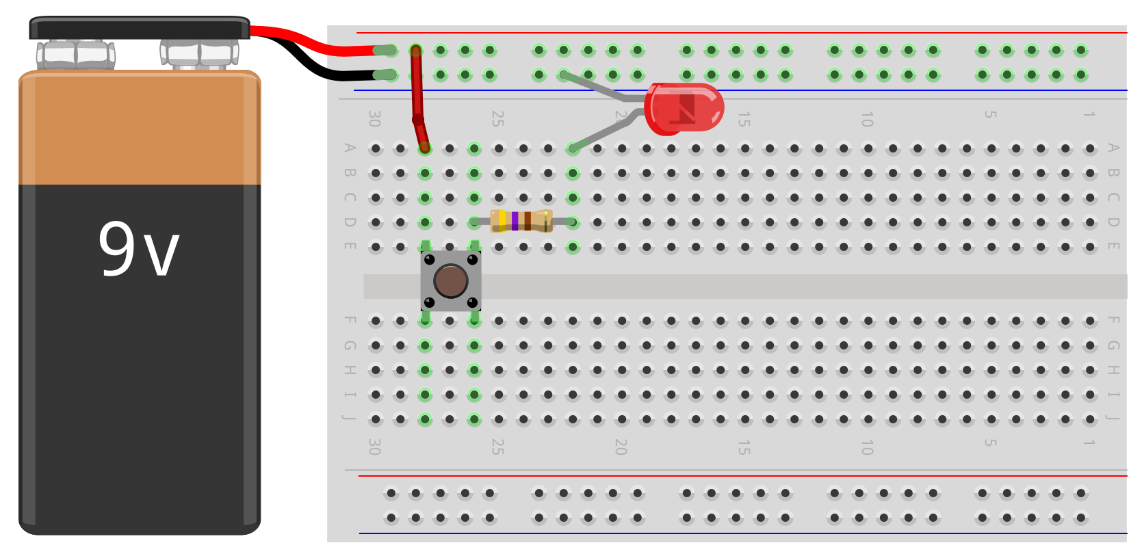

Slide 2


Slide 3
Button pressed!
Button pressed!

Slide 4
Button pressed!
Button pressed!

